Slide 1




Polynomial Régression Kernel Principal Components Analysis
Présenté par: Encadre par :
RAKIB Soukaina Pr MAHMOUDI

Slide 2
Plan
Polynomial Régression :
Introduction
Polynomial Regression Uses
Features of Polynomial Regression
Procedure to Apply Polynomial Regression
Kernel Principal Components Analysis :
Introduction
How PCA Work
Data Representation
Calculation of PCA
Objective of PCA

Slide 3
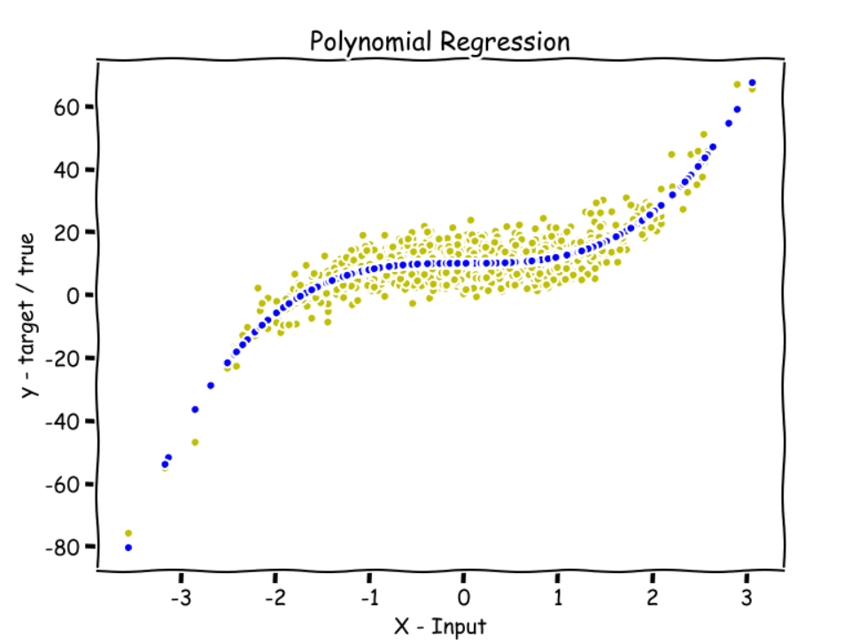
Polynomial Régression

Slide 4
Introduction to Polynomial Regression
Regression is defined as the method to find the relationship between the independent and dependent variables to predict the outcome.
The first polynomial regression model was used in 1815 by Gergonne.
It is used to find the best fit line using the regression line for predicting the outcomes. There are many types of regression techniques; polynomial regression is one of them.
The equation of the polynomial regression having an nth degree can be written as:
Y= b0+a1x+a2x^2+a3x^3+…. anx^n

Slide 5
Polynomial Regression Uses
It is used in many experimental procedures to produce the outcome using this equation.
It provides a great defined relationship between the independent and dependent variables.
It is used to study the isotopes of the sediments.
It is used to study the rise of different diseases within any population.
It is used to study the generation of any synthesis.

Slide 6
Features of Polynomial Regression
It is a type of nonlinear regression method which tells us the relationship between the independent and dependent variable when the dependent variable is related to the independent variable of the nth degree.
The best fit line is decided by the degree of the polynomial regression equation.
The model derived from the polynomial regression is affected by the outliers so it is always better to treat outliers before applying the algorithm to the dataset.
Polynomialfeature () function converts into a feature of matrix depending on the degree of the equation.
The nature of the curve can be studied or visualized by using a simple scatter plot which will give you a better idea about the linearity relationship between the variables and decide accordingly.

Slide 7
Procedure to Apply Polynomial Regression
Step 1: Import the respective dataset to any platform (R or Python) and install the required packages required for applying the model.
Step 2: Divide the dataset into training and testing sets so that we can apply the algorithm to the training data set and test it using the testing data set.
Step 3: Apply Exploratory Data Analysis methods to study the background of the data like mean, median, mode, first quartile, second quartile, etc.
Step 4: Apply the linear regression algorithm to the dataset and study the model.
Step 5: Apply the Polynomial regression algorithm to the dataset and study the model to compare the results either RMSE or R square between linear regression and polynomial regression.
Step 6: Visualize and predict both the results of linear and polynomial regression and identify which model predicts the dataset with better results.

Slide 8
Polynomial Regression is used in many organizations when they identify a nonlinear relationship between the independent and dependent variables. It is one of the difficult regression techniques as compared to other regression methods, so having in-depth knowledge about the approach and algorithm will help you to achieve better results

Slide 9
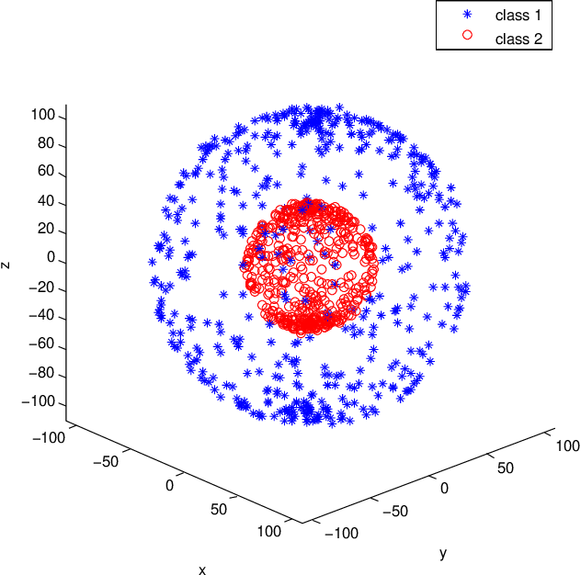
Kernel Principal Components Analysis (PCA)

Slide 10
Introduction
Principal component analysis (PCA) is a statistical technique that is useful for compression and extract useful information from multivariate data sets.
The purpose is to reduce the dimensionality of a data set (sample) by finding a new set of variables (Uncorrelated), smaller than the original set of variables (Correlated), without much loss of information and still retains most of the sample's information.

Slide 11
How PCA Work
PCA concerned with explaining the variance-covariance of a set of variables (Multi-variant)
x1 , x2 , x3 ,…, xp
Through a few linear combinations of these variables
a1x1 + a2x2 + a3x3 + … + ap xp
To capture the variability of original dataset (Covariance Matrix)

Slide 12
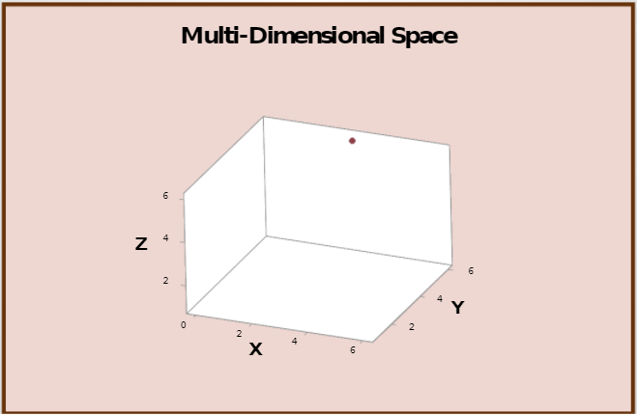
Data Representation
Data represented as a cloud of n points in a multidimensional space with an axis for each of the p variables.

Slide 13

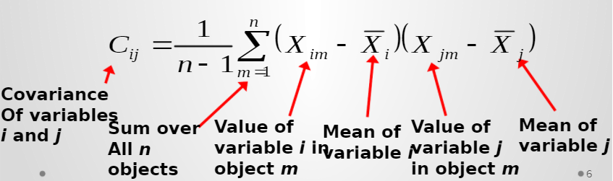
Calculation of PCA
The variance of each variable is the average squared deviation of its n values around the mean of that variable.
degree to which the variables are linearly correlated is represented by their covariance’s.

Slide 14
Objective of PCA
objective of PCA is to rigidly rotate the axes of this p-dimensional space to new positions (principal axes) that have the following properties:
ordered such that principal axis 1 has the highest variance, axis 2 has the next highest variance, .... , and axis p has the lowest variance
covariance among each pair of the principal axes is zero (the principal axes are uncorrelated).

