Slide 1
ADDRESSING THE CURSE OF DIMENSIONALITY TO fMRI: A PRINCIPAL COMPONENT ANALYSIS APPROACH
Soukhin Das
Mangun Lab
PSC205A – 06/02/2020

Slide 2
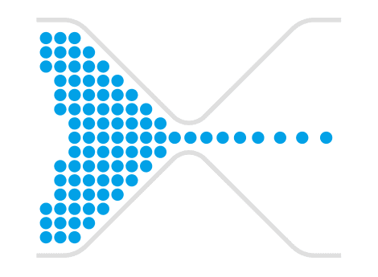
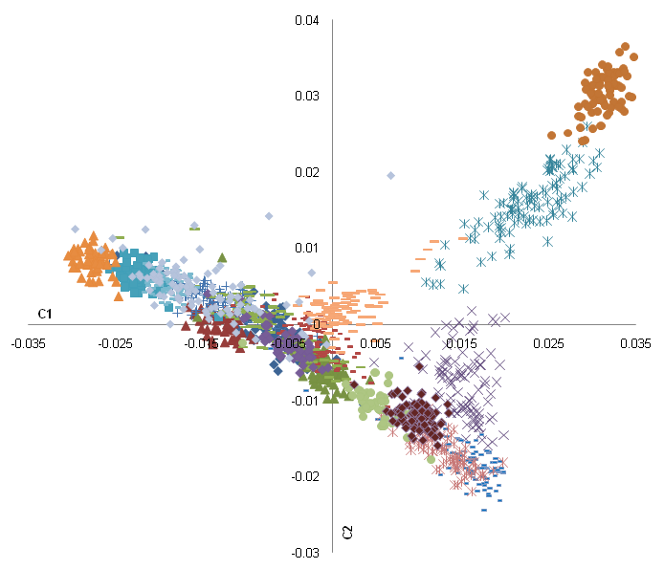
The Curse of Dimensionality
Size of fMRI data
(>1,000,000 voxels)
MVPA
Principal Component Analysis
High Dimensional Feature Space
Weak activation due to noise
Time Complexity
Lower Dimensional Feature Space
Feature
Selection
Retain Important Information
Faster Computation
SVM
3 fold Cross Validation
Classification
fMRI Data
PCA
SVM
3 fold Cross Validation
Classification

Slide 3

fMRI Paradigm
3 Runs per participant
TR: 1.5s
Voxels: 232022
TRs per run = 310

Slide 4
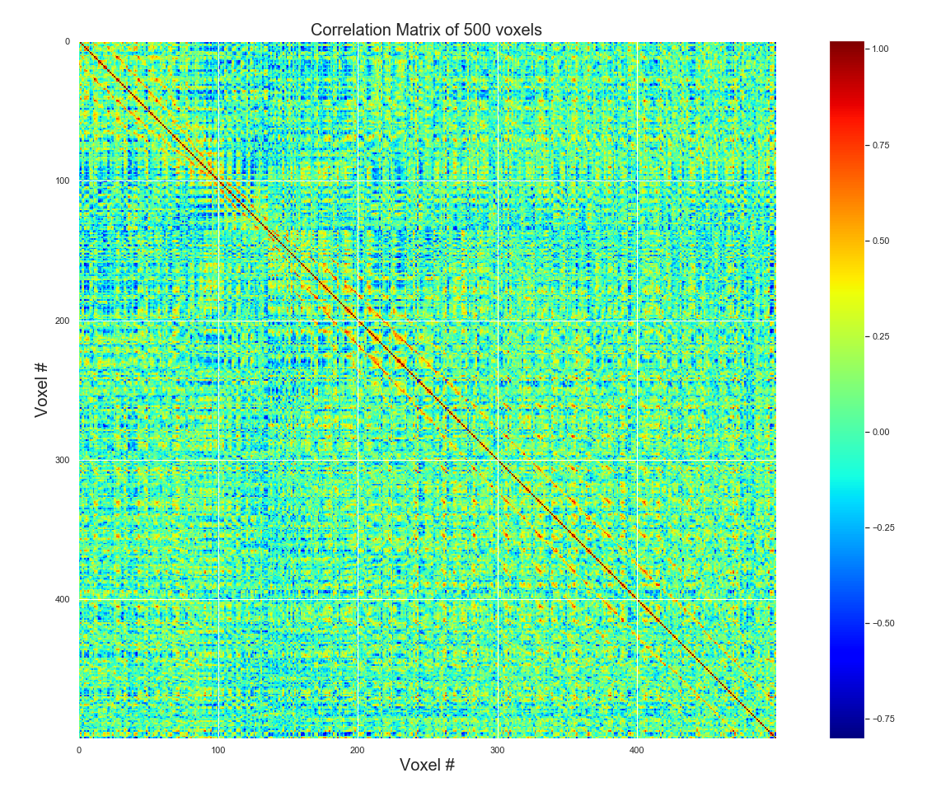
PCA Analysis

Slide 5
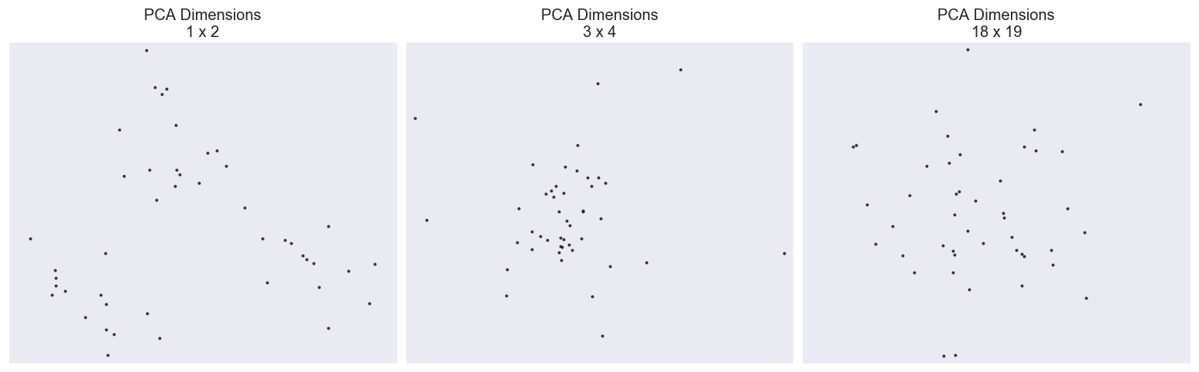
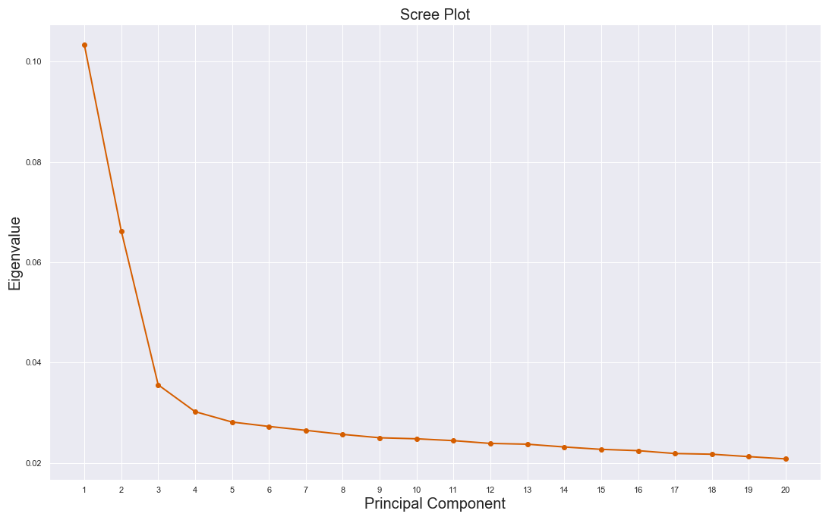
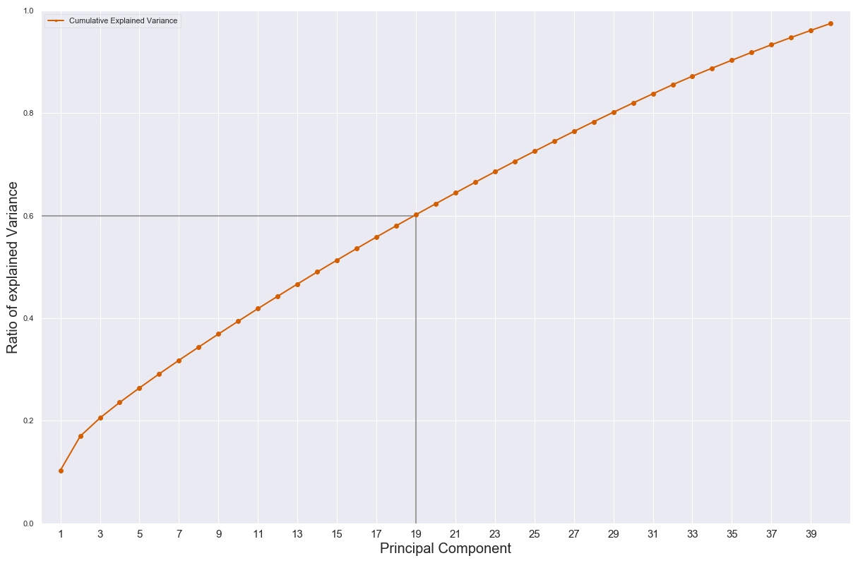
PCA Analysis
Fig. 2
Fig. 3- Scree Plot
Fig. 4- Cumulative Explained Variance

Slide 6
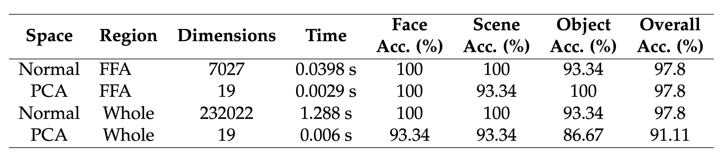
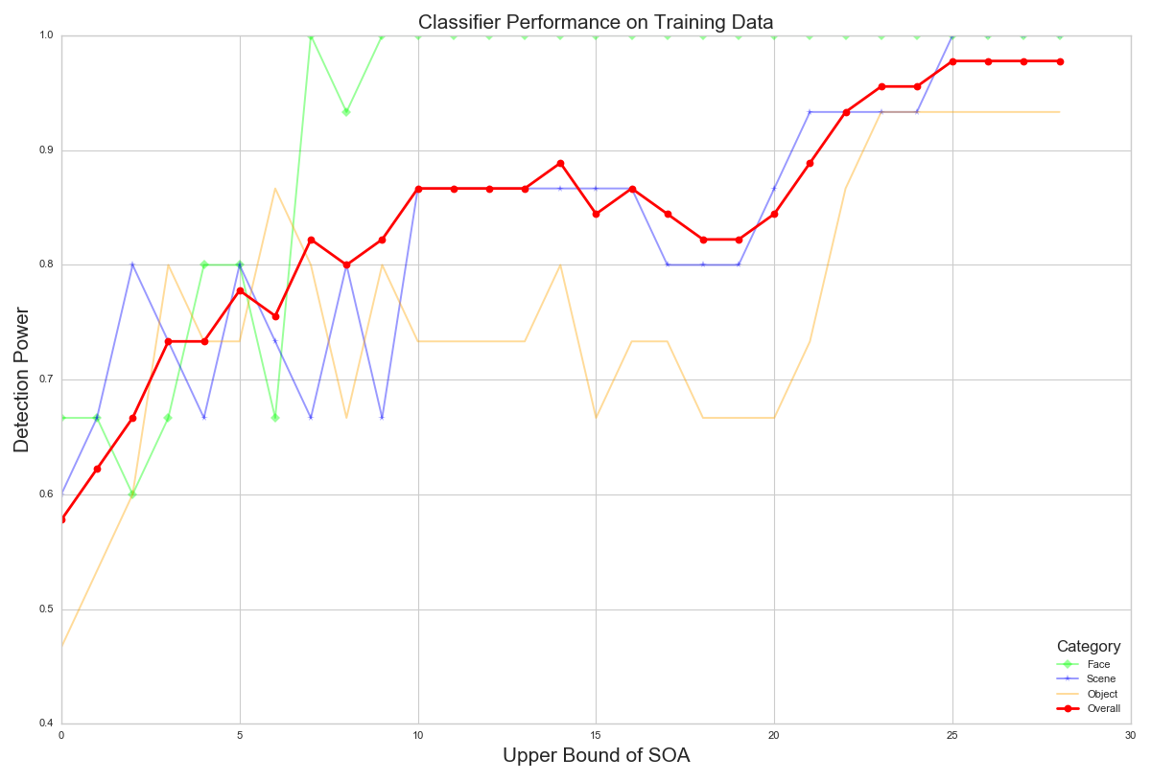
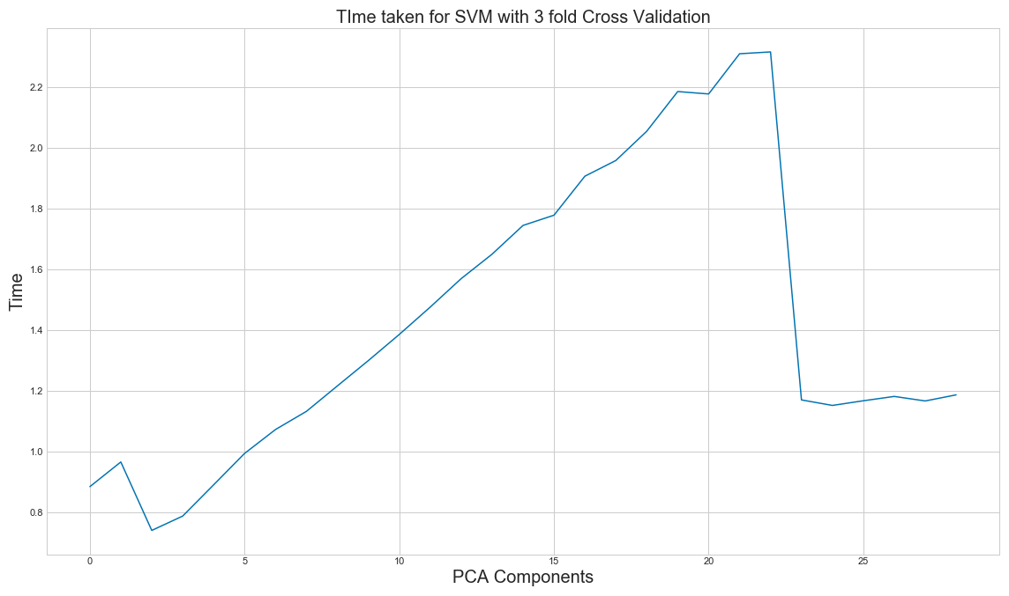
SVM Results
13.72x
~430x
Fig. 5- Classifier Performance
Fig. 5- PCA Dimensions vs Processing Time

Slide 7
Conclusion
With very little accuracy drop, SVM performed significantly faster in a ROI as well as over the entire brain.
The classifier converged to acceptable accuracies with only 19 components which explain ~60% of the data.
PCA can be reliably used in conjunction to different MVPA techniques for feature extraction, reducing the burden on the classifiers, and significantly boost the processing time.
THANK YOU!

