Slide 1

Transportation equity conceptualizations and standards:
Findings from a scoping review
Anastasia Soukhov (McMaster University)
Ignacio Tiznado-Aitken (University of Toronto Scarborough)
Matthew Palm (University of Toronto Scarborough)
Steven Farber (University of Toronto Scarborough)
Antonio Páez (McMaster University)
Notes:
A scoping review
We are from MJ, a group of experts in this matter. Looking to come away with recommendations to practioners.

Slide 2

Our questions to the literature:
Dimensions and conceptualizations
Who and what?
Which theories or normative principles?
Applications: Policy and practice
What exists, what is absent?
How?
What are thresholds?
Standards: measures and indicators
Protocol!
Notes:
What are the equity dimensions (e.g., types of population groups, opportunities, network conditions)
Who and what is the focus?
How has equity been conceptualized (e.g., a type of distributive justice, spatial equity, rights to the city, vertical or horizontal equity)
Which theories or normative principles are used?
What are the standards (e.g., max. travel distance, min. number of opportunities, min. accessibility score)
What is present? What is not?
What thresholds are used to determine what is equitable and what is not? By which measures?
The goal: what can we recommend to our planning and community partners? What has the academic literature done, what is missing?
Why academic literature? Indexed and centralized. They also have a better understanding of policy and local practice than the literature.

Slide 3
The search query
(TS= (( "transport*" OR "travel" or "paratransit" or "microtransit" or "micro-transit" or "transit" OR "bus" OR "buses" OR “e-bus” or "e-buses" OR "busing" OR "streetcar*" OR "subway*" OR "tram" or "trams" or "tramway" or "public transport*" OR "rail*" OR "train" or "trains" or "bik*" Or "biking" OR “bike-shar*" OR “bike shar*” OR “cycling" OR "bicyclist*" OR "bicycling" OR “*scooter*” or "pedestrian*" OR "walk*" OR "active transport*" OR "active travel" or "ride-shar*" OR "ride shar*" OR "ride-hail*" OR "car" OR "cars" OR "car-shar*" Or "car shar*" OR "taxi*" or “*motori*ed” ))) AND (TS=(( "MCA" or "CBA" or "wider impact*" or "mobility" or "accessibility" or "access" or "affordab*" or "user fees" or "user-fees" or "poverty" or "activity participation" or "quality of service" or "level of service" or "service frequency" or "congestion" or "crowding" or "safety" or "collisions" or "accidents" or "crashes" or "vulnerable road user*" or "*policing" or "*policed" or "externalit*" or "pollution" or "air quality" or "emissions" or "energy consumption" or "fuel consumption" ))) AND (TS=(( "justice*" or “fairness” or “fair” or “ethic*” or "equit*" OR "inequit*" OR "equalit*" OR "inequalit*" OR "equal" OR "unequal" OR "disparit*" OR "relian*" or “*dependent” OR "social inclusion" OR “social exclusion” or "capabilit*" or "marginali*" or "barrier*" OR "disadvantage*" or “needs-based” or "dissonance" OR "wellbeing" or "well*being" or "transport poverty" or "social assessment" or "equity assessment" or "universal design" or “captive” or "deprived" ))) AND ( TS = (( "standard*" OR "threshold*" or "indicator*" or "criteria" or "criterion" or "guideline*" or "guidance*" or "score*" or "equ* ind*" or "pricing strateg*" or "priorit*")))
1992 to (Mar) 2022; English; Doc type: Articles, Early Access, Book Chapters
TRANSPORT MODE AND TRANSPORT MEASURE AND JUSTICE/EQUITY AND STANDARDS
Protocol!
Notes:
- Transport terms – relate to urban land transportation systems (roads+trains) + measurement terms + Justice related terms (equity) + standard terms.
- searched: the full WoS collection along with TTR and a few other social science specific databases.

Slide 4
Step 1 – Title and abstract screening
Step 2 – Full-paper screening
Step 3 – Data-extraction
Measure of transport equity dimensions?
No
EXCLUDED
What? (Dimension i.e., mobility/accessibility, traffic-related pollution, traffic safety, or health)
When? and Where? (urban/rural, city, continent, temporal scope)
Who?(population group, mode type, activity/opportunity type, transport network status)
Yes
Provides a standard?
Yes
Engages with equity conceptualization?
Yes
INCLUDED
How? (i.e., max. travel distance, max. time distance, etc.)
How? (i.e., social exclusion, transport poverty, spatial equity, etc.)
No
No
EXCLUDED
EXCLUDED
Notes:
So what did our search look like? Briefly these are the steps. 1. Is there an equity transport dimension? Yes? Include!. Step 2. Is there an equity standard AND conceptualization potentially? Yes? Then Include! If it doesn’t have both. Exclude. Step 3. Fill in all this information --- the equity dimensions (What, who where, how), the equity standards and conceptualization (what) .
This was a massive effort. Almost 7000 papers entered step 1. That was the intention – very broad, across all disciplines. We are now left with 166 papers with very detailed data extraction templates (step 3).
Step 0: ~40 hours to refine question + consult + query, retain records. Team
Step 1: 70 hours – 25% is training - RAs + PhDs
Step 2: 200 hours – 30% is training – RAs + PhDs
Step 3: 160 hours – post-docs and PhDs
Step now: Still counting. Team
Hours it took: Almost 500 hours of labour, RAs, PhD students, post-docs and team from step 0 to Step 3. Impressive effort.

Slide 5
Step 1 – Title and abstract screening
Step 2 – Full-paper screening
Step 3 – Data-extraction
Includes transport equity dimension(s)?
No
EXCLUDED
What? (Dimension i.e., mobility/accessibility, traffic-related pollution, traffic safety, or health)
When? and Where? (urban/rural, city, continent, temporal scope)
Who?(population group, mode type, activity/opportunity type, transport network status)
Yes
Provides a standard?
Yes
Engages with equity conceptualization?
Yes
INCLUDED
How? (i.e., max. travel distance, max. time distance, etc.)
How? (i.e., social exclusion, transport poverty, spatial equity, etc.)
No
No
EXCLUDED
EXCLUDED
Notes:
So what did our search look like? Briefly these are the steps. 1. Is there an equity transport dimension? Yes? Include!. Step 2. Is there an equity standard AND conceptualization potentially? Yes? Then Include! If it doesn’t have both. Exclude. Step 3. Fill in all this information --- the equity dimensions (What, who where, how), the equity standards and conceptualization (what) .
This was a massive effort. Almost 7000 papers entered step 1. That was the intention – very broad, across all disciplines. We are now left with 166 papers with very detailed data extraction templates (step 3).
Step 0: ~40 hours to refine question + consult + query, retain records. Team
Step 1: 70 hours – 25% is training - RAs + PhDs
Step 2: 200 hours – 30% is training – RAs + PhDs
Step 3: 160 hours – post-docs and PhDs
Step now: Still counting. Team
Hours it took: Almost 500 hours of labour, RAs, PhD students, post-docs and team from step 0 to Step 3. Impressive effort.

Slide 6
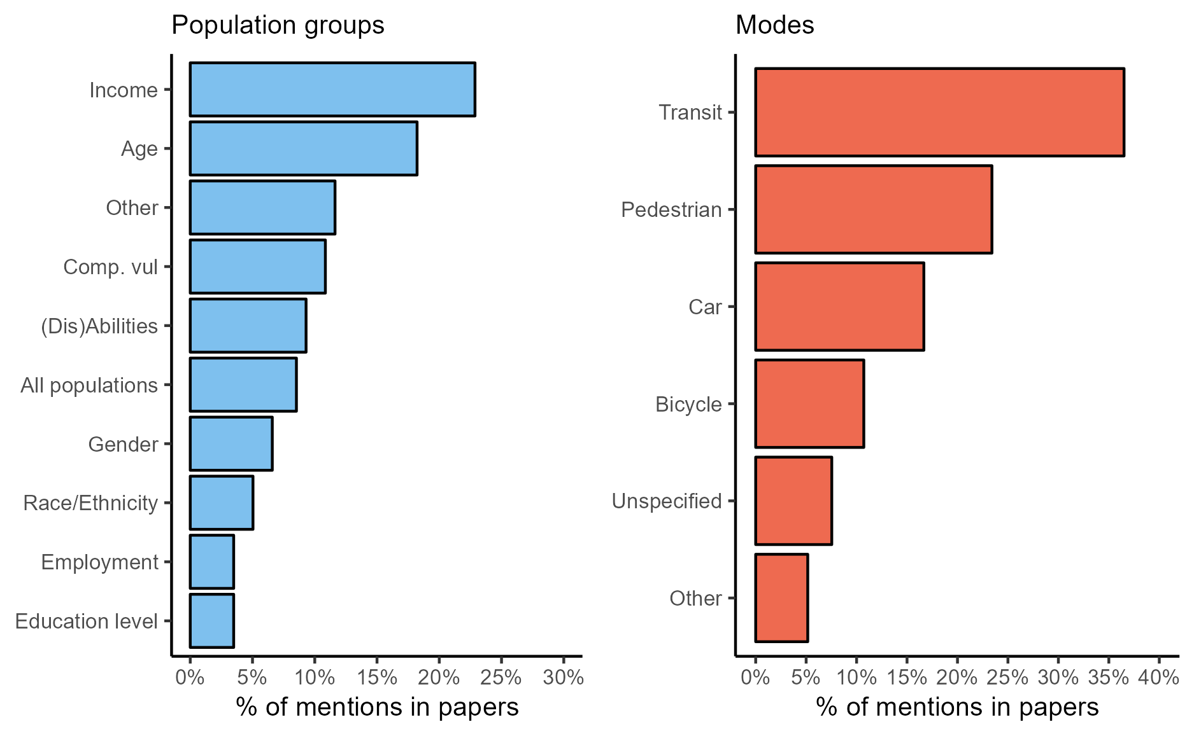
Findings: population groups and modes
Notes:
Population group: (who does the literature study???)
Majority of papers have a focus on income, particularly low income -> high income if for comparison. We know income and age are significant determinates of inequities
Age is also significant, particularly children and older aged people
Composite vulnerability almost always includes income and age (in addition to other SES)
But what’s missing? Indigenous is missing – Canada context.
Mode: (what modes is the literature interested in??)
Majority of papers have a focus on transit mode
Transit as almost always present in multi-modal comparisons
Pedestrian is often complimented with bicycle
Car is infrequently the only mode studied – it is used as comparison, e.g. versus transit accessibility, quantifying resulting externalities for other modes (road safety, air pollution) for active modes

Slide 7
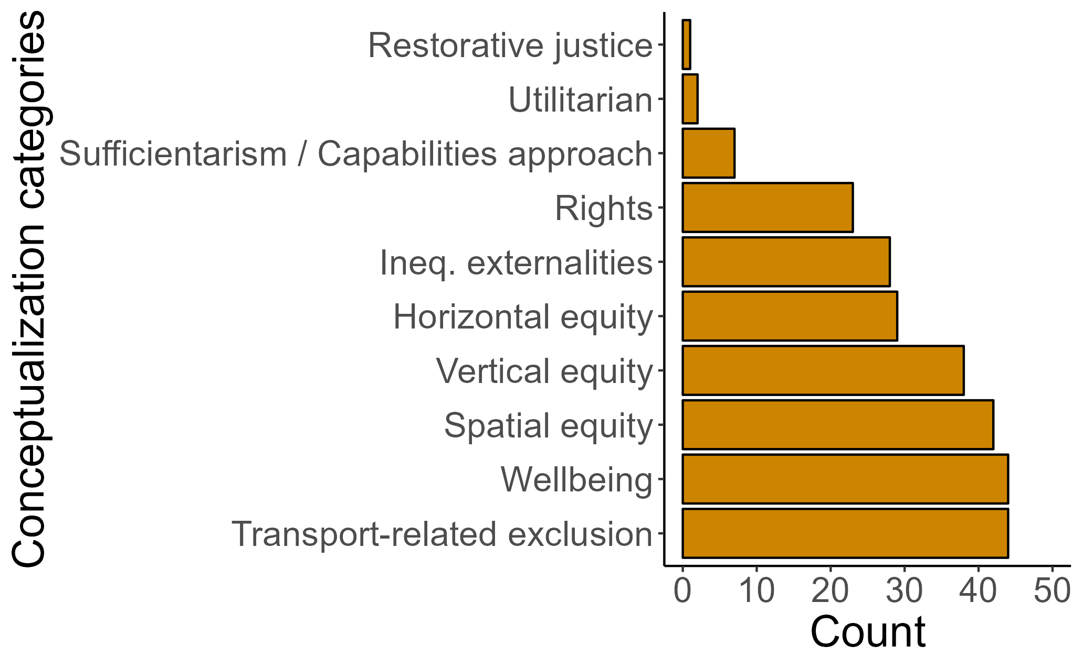
Findings: Equity conceptualizations
Restorative justice – e.g., repairing harm
Utilitarian – e.g., maximizing benefits overall
Sufficientarism/Capabilities – e.g., what is ‘sufficient’ based on individual capabilities
Rights – e.g., fundamental rights to access
Inequitable externalities – e.g., resulting externalities should be equitable
Horizontal/vertical /spatial equity – e.g., equal across the population, prioritization of disadvantaged groups, and equal/prioritized across space, respectively.
Wellbeing – e.g., livability, quality of life, subjective wellbeing.
Transport-related exclusions – e.g., focus on how lacking transport access results in social exclusions.
Notes:
Most common – TRSE, wellbeing, H/V/S equity.
On the least common – we see the emerging concepts. Utilitarian is not population/
For transport-related exclusions: includes t \ransport disadvantage, Transport poverty, accessibility poverty, Transport or related affordability, Transport-related social exclusion, time poverty

Slide 8
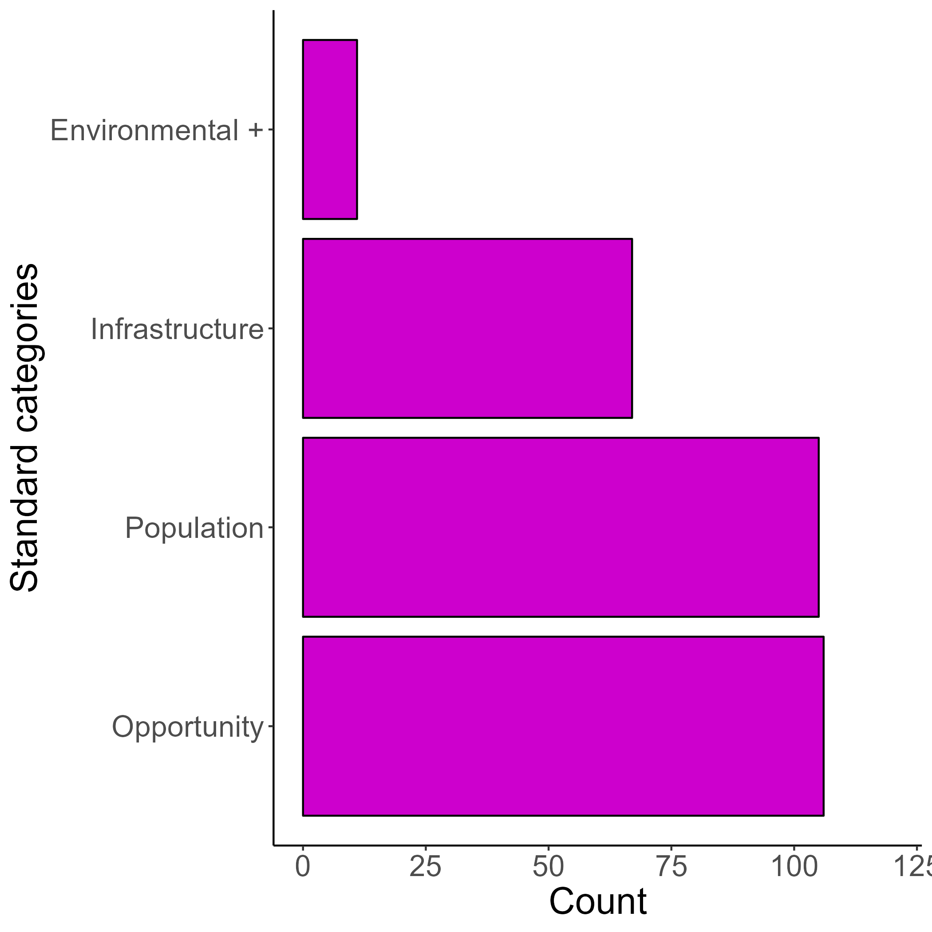
Findings: Equity standards
Environment + – e.g., noise, air, pollution criteria
Infrastructure – e.g., level of service, universal design standards
Population – e.g., transport-related affordability level, perceived equitable trip
Opportunity
Opportunity demand vs. supply – e.g., ratio value
Opportunity accessibility threshold – e.g., an access indicator value
Travel impedance – e.g. 300m to bus stop
Notes:
Explain each type of standard. This is a count of each instance, often papers have multiple.
Opportunity – specifically, travel impedance, is the most common standard present on it’s own. E.g. paper says 300 m to a bus stop is an ‘equitable’ trip. Nothing about it’s population, environmental standards, and/or other ‘opportunity’ standard categories.
Population-based is second most common solo standard.
E.g. physical activity levels per week, a certain sufficient minimum energy requirement being met, a vulnerable population group should be using a fare subsidy more than average
Ultimately though, most papers use multiple types of standards
E.g. Opportunity; Population = 300 m to some destination, for the 100% of the vulnerable population (e.g., low-income groups)

Slide 9
(Alderton et al., 2019) What is the meaning of urban liveability for a city in a low-to-middle-income country? Contextualising liveability for Bangkok, Thailand
Establishes short-, medium-, and long-term goals for the city in collaboration with technical leaders within the municipal government. Standards inspired by the Sustainable Development Goals (SDGs) and other international planning documents
Equity conceptualization: Wellbeing
Equity standards:
Infrastructure | Opportunity | Population | Environment+
- | % of residents living < 400 m of public open space, a large park (> 1.5 ha), local park % of residents living < 400 m of a local bus stop and living < 800 m of train station % of residents living < 400 m of community centre | - | Canal water quality - dissolved oxygen content of ≥2.0 mL/L
Notes:
Includes many more indicators – not thresholds (i.e., number of schools per child population ((hort term), percentage of people living and working in the same district (med-term), ratio of work to leisure (long-term), etc.) this is for the purpose of tracking.

Slide 10
(Carrier et al. 2014) The application of three methods to measure the statistical association between different social groups and the concentration of air pollutants in Montreal: A case of environmental equity
Montreal, Canada.
Measures residential location to near-road way air pollution (NOx, CO, PM2.5 and NO2)
Equity conceptualization: inequitable externalities and spatial equity
Equity standards:
Infrastructure | Opportunity | Population | Environment+
Major roadways should be 200 m or more away from residential locations | - | - | NO2 should not exceed 40 μg/m⁻³ (WHO Guideline)
Notes:
In the discussion/conclusion, its discussed that overall low-income areas are disproportionally impacted by above average air pollution levels. While their high levels are higher than average, they are much lower than the WHO exceedance air pollution guidance. However - this paper states that this is _still_ not fair. It can assumed that 'fair' would be relatively equal air pollution exposure across the full population.

Slide 11
(Rivas et al. 2018) How Affordable Is Transportation in Latin America and the Caribbean?
Montevideo (Uruguay), Santiago (Chile), Lima (Peru), Panama (Panama), Ciduad de Mexico (Mexico), Nassau (Bahamas), Tegucipalpa (Honduras), Ascuncion (Paraguay), Brasilia (Brazil), San Jose (Costa Rica), La Paz (Mexico), Managua (Nicaragua).
Analysis household expenditure on urban transportation based on income group.
Equity conceptualization: affordability and vertical equity (especially the most economically vulnerable)
Equity standard:
Infrastructure | Opportunity | Population | Environment+
- | - | The financial burden of a basket of transportation trips (60 trip fares) should not exceed 10 percent of household monthly income. | -
Notes:
This is a conference paper (technical note)

Slide 12
Next steps
Synthesizing findings by conceptualizations and standards.
Tables of commonly used equity standards and related measures.
Formulating equity conceptualization processes – with you!
Protocol!
Notes:
Clear: modes, population groups – easier
Mesy: standards and concepts are a bit messier and we’re figuring out how to best summarize.
Explain each type of standard
. This is a count of each instance, often papers have multiple.
Opportunity – specifically, travel impedance, is the most common standard present on it’s own. E.g. paper says 300 m to a bus stop is an ‘equitable’ trip. Nothing about it’s population, environmental standards, and/or other ‘opportunity’ standard categories.
Population-based is second most common solo standard.
E.g. physical activity levels per week, a certain sufficient minimum energy requirement being met, a vulnerable population group should be using a fare subsidy more than average
Ultimately though, most papers use multiple types of standards
E.g. Opportunity; Population = 300 m to some destination, for the 100% of the vulnerable population (e.g., low-income groups)

Slide 13
Questions?
Transportation equity conceptualizations and standards:
Findings from a scoping review
Protocol!
Anastasia Soukhov (McMaster University)
Ignacio Tiznado-Aitken (University of Toronto Scarborough)
Matthew Palm (University of Toronto Scarborough)
Steven Farber (University of Toronto Scarborough)
Antonio Páez (McMaster University)
Notes:
Why academic literature? Indexed and centralized. It’s a first step; easier to search; and will tell us which policies and planning objectives are being discussed in literature.

Slide 14
Step 1 – Title and abstract screening
Step 2 – Full-paper screening
Step 3 – Data-extraction
Includes an object of justice (“What?”)?
No
EXCLUDED
What? (accessibility, mobility, activity participation, etc.)
Who? (Population group, possibly mode)
Where? (City, Country, relevant sphere, i.e., transportation)
How? (Standard/equity measure/relevant theory and concepts)
Yes
Provides a standard?
Yes
Engages with concepts and theories of equity?
Yes
INCLUDED
How? (i.e., max. travel distance, max. time distance, etc.)
How? (i.e., TRSE, transport poverty, spatial equity, justice theories (numerous), etc.)
No
No
EXCLUDED
EXCLUDED
Notes:
So what did our search look like? Briefly these are the steps. 1. Is there an equity transport dimension? Yes? Include!. Step 2. Is there an equity standard AND conceptualization potentially? Yes? Then Include! If it doesn’t have both. Exclude. Step 3. Fill in all this information --- the equity dimensions (What, who where, how), the equity standards and conceptualization (what) .
This was a massive effort. Almost 7000 papers entered step 1. That was the intention – very broad, across all disciplines. We are now left with 166 papers with very detailed data extraction templates (step 3).
Step 0: ~40 hours to refine question + consult + query, retain records. Team
Step 1: 70 hours – 25% is training - RAs + PhDs
Step 2: 200 hours – 30% is training – RAs + PhDs
Step 3: 160 hours – post-docs and PhDs
Step now: Still counting. Team
Hours it took: Almost 500 hours of labour, RAs, PhD students, post-docs and team from step 0 to Step 3. Impressive effort.

Slide 15
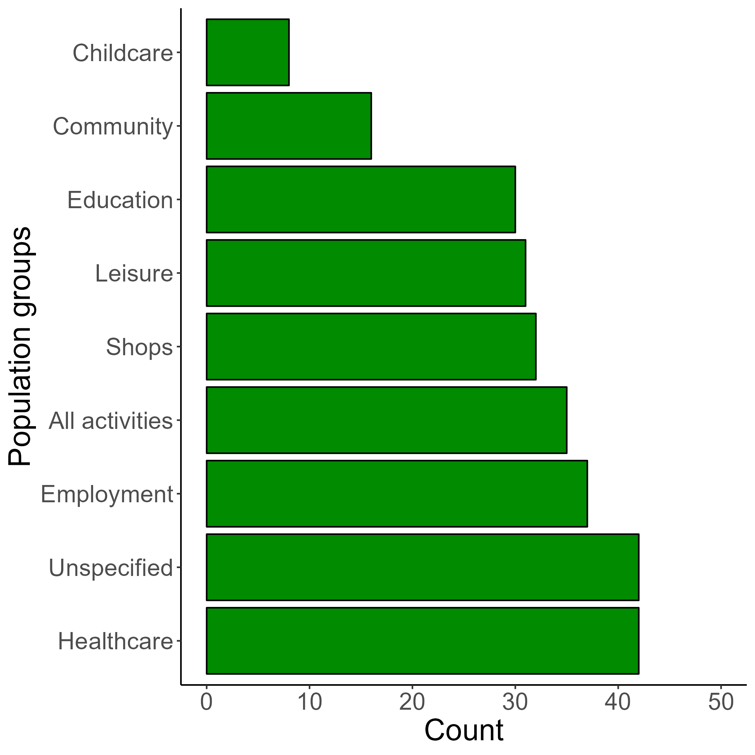
Findings: Opportunities of interest
Notes:
Employment, Healthcare – location of work, public health planning, a significant source of data
All activities – subjective, enough for ‘sufficient’ quality of life, visiting friends and family
*Unspecified: the destination is not the focus.
Employment, Healthcare, and Education destinations that are conceptualized across Income groups and Age groups most commonly
What makes a safe (equitable) trip to school for children on bike?
What is equitable travel distance and availability to health care facilities for older aged people?
Most are observed journeys -- conventional travel survey data sources
All activities (composite destinations) are most frequently of interest for (Dis)Abilities and Gender
Capabilities, what can and do you want to access
Some are observed journeys, some are where they may want to go
Smaller data sources – synthesizing the gaps in the planned system
What don’t we study? What are the sources of data and what are the motivations or a few significant categories?
POI databases, gramma’s house is not there
Within ‘community’ are organizations, government services, visiting friends/family – very broad. But still not significantly represented.
Childcare, typically daycare or facilities – domestic work, mobilities of care, not here.
Leisure destinations (e.g., green space, parks, recreation) are less studied in this context.
Some categories are missing all together – mobilities of care. Issue of data availability, subjective!

Slide 16
Findings: Equity standards categorization
Environment + – e.g., noise, air, pollution criteria
Infrastructure – e.g., level of service, universal design standards
Population – e.g., transport-related affordability level, perceived equitable trip
Opportunity
Opportunity demand vs. supply – e.g., ratio value
Opportunity accessibility threshold – e.g., an access indicator value
Travel impedance – e.g. 300m to bus stop
Notes:
Explain each type of standard. This is a count of each instance, often papers have multiple.
Opportunity – specifically, travel impedance, is the most common standard present on it’s own. E.g. paper says 300 m to a bus stop is an ‘equitable’ trip. Nothing about it’s population, environmental standards, and/or other ‘opportunity’ standard categories.
Population-based is second most common solo standard.
E.g. physical activity levels per week, a certain sufficient minimum energy requirement being met, a vulnerable population group should be using a fare subsidy more than average
Ultimately though, most papers use multiple types of standards
E.g. Opportunity; Population = 300 m to some destination, for the 100% of the vulnerable population (e.g., low-income groups)

Slide 17
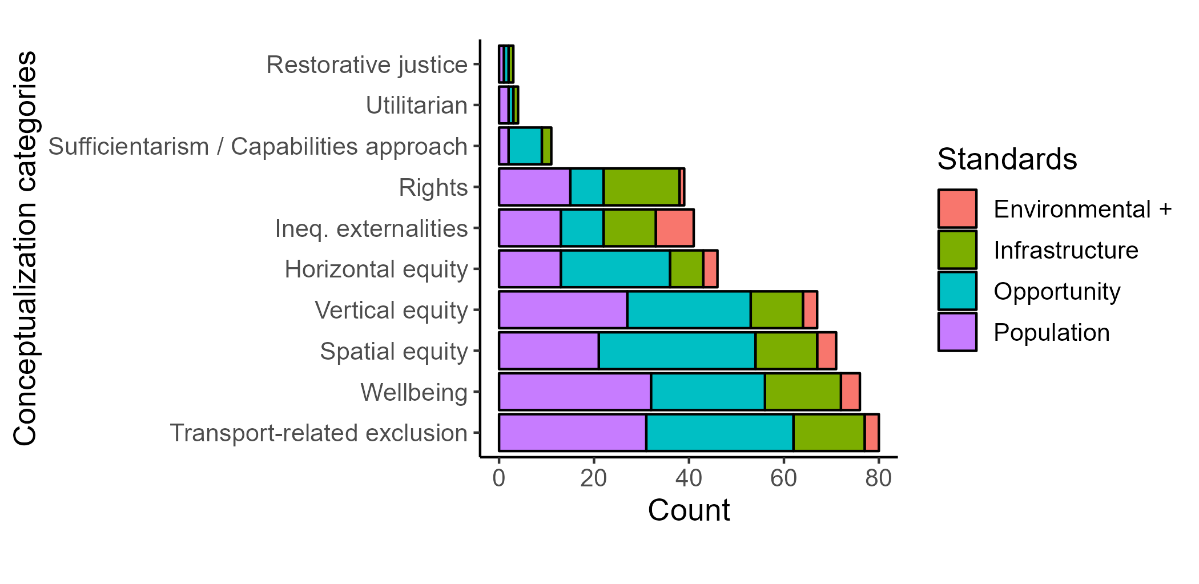
Findings: Equity conceptualizations and associated standards
Notes:
What is in the literature
Horizontal/Vertical equity – e.g., equal transport benefit throughout
Concerns equity within the population, - so many standards proposed are opportunity based (e.g., 300 m to bus stops or an accessibility score). Not as often a certain population-based standard (e.g., opportunity standard for a certain % of the population)
Institutionalized equity tests
Rights – e.g., everyone deserves access
Disproportionally represented with universal design, levels of service type standards – less levels of opportunities (or related travel impedance) standards.
What isn’t in the literature:
Utilitarian – not very represented, often cost-benefit. Researchers know to not use it in the equity literature – it’s already institutionalized
Sufficientarism – e.g., minimum sufficient transport benefit
Opportunity-based, plenty, but population-based standards are missing. Meaning population-based standards are coded under Wellbeing. Wellbeing is not sufficient though.
hard to define what is a sufficient minimum.
RJ – hard to define, too new and harder to infer.

Slide 18

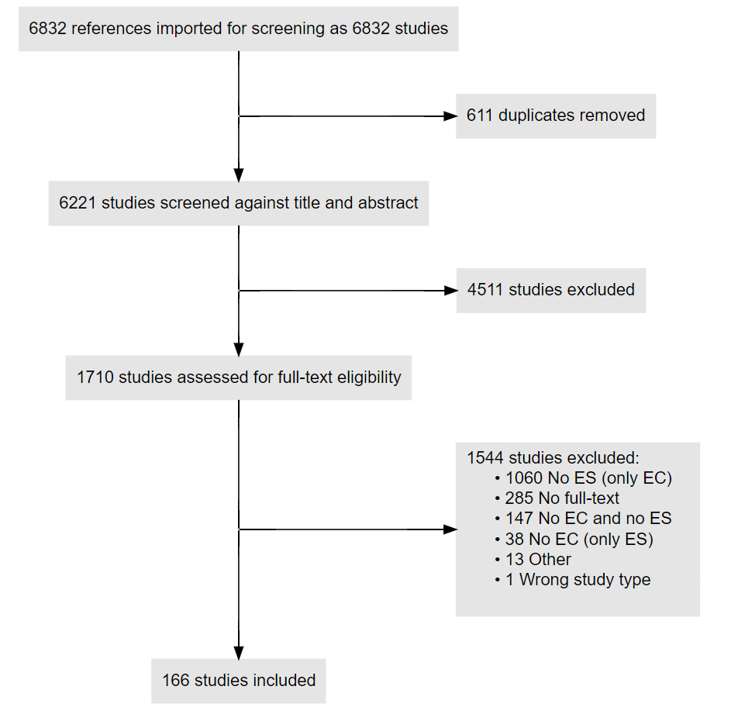
The search results
Feedback?
Email us!
Pre-print!
Notes:
Confidence in our direction
Why academic literature? Indexed and centralized. It’s a first step; easier to search; and will tell us which policies and planning objectives are being discussed in literature.
-------
Dianin et al. Implications of Autonomous Vehicles for Accessibility and Transport Equity: A Framework Based on Literature. 2021
A framework for AVs impact on accessibility and equity (“morally proper distribution of transport benefits and costs over members of society”)
Accessibility polarization (increase in accessibility in central areas), accessibility sprawl (increase in suburban and rural areas), exacerbation of social accessibility inequities (market driven) and alleviation of social accessibility inequities (more balanced accessibility for all groups)
Guo et al. A systematic overview of transportation equity in terms of accessibility, traffic emissions, and safety outcomes: From conventional to emerging technologies (2020)
Contributes a summary of equity analysis methods (population measurement -> cost/benefit -> inequity measurement) and identifies gaps (trade-offs and interactions among equity measures for different outcome types, modal types, spatial resolutions, and operational characteristic)
Smith et al. Systematic literature review of built environment effects on physical activity and active transport - an update and new findings on health equity. 2017
Review 27 articles and find: Improving walkability, quality of parks and playgrounds, and active transport infrastructure is likely to generate positive impacts on activity in children and adults. Potentially, the benefits are inequitably distributed but require further investigation.
Neutens et al. Accessibility, equity and health care: review and research directions for transport geographers. (2015)
Discussion of different accessibility methods applied: min travel time, PPR, gravity, FCA, expansion, KDE, method and identifies limitations
Author calls for future metrics work to be “person-based and temporally integrated”. Equity measures (Gini, Utilitarian social welfare function)
Thomoploulos et al. Incorporating equity as part of the wider impacts in transport infrastructure assessment: an application of the SUMINI approach. 2012
Reviews Cost-benefit analysis and Multi-criteria analysis methods. Proposes a new MCA which considers transport infrastructure + accessibility + land use planning in a unified framework.
Ravi. Et all. Outdoor spaces and buildings, transportation, and environmental justice: A qualitative interpretive meta-synthesis of two age-friendly domains (2021)
The three areas of EJ (i.e., distributional justice, procedural justice, and recognition) provide a helpful framework to guide the systematic documentation and evaluation of age-friendly community efforts. Interprofessional collaborations are needed to address transportation equity and inclusion better.
Hosford et al. The effects of road pricing on transportation and health equity: a scoping review. 2021
Limited articles available (only 12 reviewed). Most evaluate work trips; more research needed on non-work trips
Road, Area, and Cordon pricing are beneficial overall but there may be some degree of inequities in distribution of benefits and burdens
There have also been context-specific contributions which also don’t capture our scope:
Zhang et al. Literature review on urban transport equity in transitional China: From empirical studies to universal knowledge. 2021
Calls for a shift in research to focus on (in a China context): evaluating and tracking accessibility distribution, unpacking neoliberal globalization forces, and emerging social trends (e.g., information technology revolution and the aging society)
Doran et al. The Pursuit of Cycling Equity: A Review of Canadian Transport Plans. (2021)
Four key themes on how they can and (a limited few) currently address equity in projects: socio-spatial network analysis (accessibility/distribution of faculties) ; consideration of equity in projects and priorities (equity MCA); equity-oriented funding mechanisms; inclusive design and safety.
Academic literature reveals six subject areas: Disadvantaged Groups; Design, Safety, and Security; Political and Economic Forces; Racial Profiling and Harassment; (In)adequacies in Planning Tools; and The Planning Process and Procedural Equity
Researchers must focus on understanding the political‐economic forces impacting decision‐making; planners and people’s perceptions of equity
Venter et al. The equity impacts of bus rapid transit: A review of the evidence and implications for sustainable transport. (2018)
Global south – Africa, Asia and Latin America
Vertical equity assessment; BRT does offer significant benefits to low-income groups but are often skewed towards medium-income users (insufficient spatial coverage and inappropriate fare policies). -> issues with distribution of burdens/benefits
Better integration with other transit, paratransit, and nonmotorized transport services, and housing sector is needed to materialize greater pro-poor out comes.
Karner and Niemeier. Civil rights guidance and equity analysis methods for regional transportation plans: a critical review of literature and practice. 2013
regional transportation plan equity is analyzed to comply with Title VI of the 1964 Civil Rights Act.
They find that recommendations are extensive but generally lack specificity and are rarely enforceable
Need for context-specific a priori indicators which take into account transportation investment benefits
Vecchio et al. Transport and equity in Latin America: a critical review of socially oriented accessibility assessments. 2020
Proposes a theoretical framework, highlights how a growing but still limited body of work has examined transport and equity in Latin America and provide research gaps

Slide 19
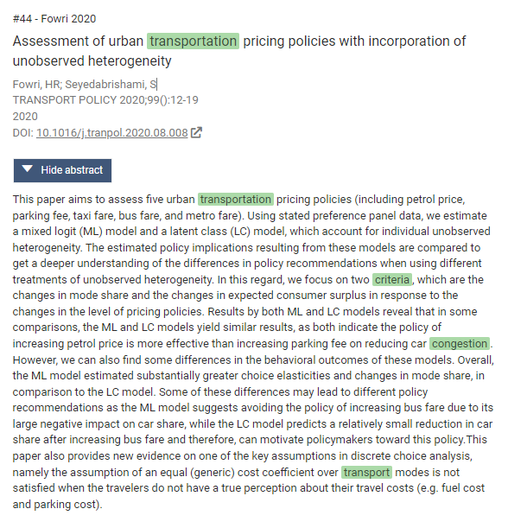
Example: paper 1
Feedback?
Email us!
Step 1 – Exclude
No conceptualization is apparent
Maybe a standard but unlikely - flagged for review because of the term ‘criteria’ and ‘equal’
Pre-print!
Notes:
Why academic literature? Indexed and centralized. It’s a first step; easier to search; and will tell us which policies and planning objectives are being discussed in literature.

Slide 20
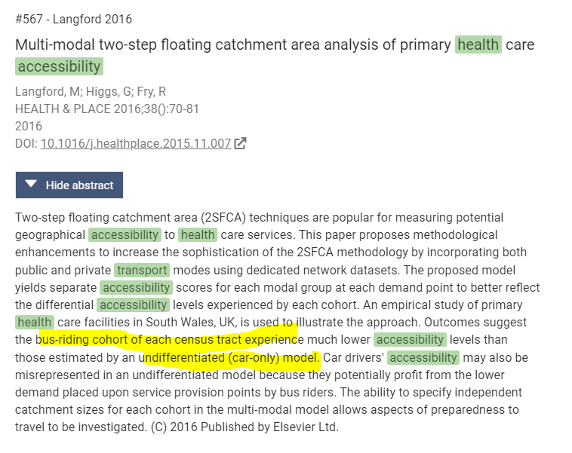
Example: paper 2
Feedback?
Email us!
Step 1 – Include
Maybe a conceptualization - related to health equity
Maybe a standard (i.e., accessibility level which bus-riding cohort should reach )
Step 2 – Exclude
No equity standard
Pre-print!
Notes:
Why academic literature? Indexed and centralized. It’s a first step; easier to search; and will tell us which policies and planning objectives are being discussed in literature.

Slide 21

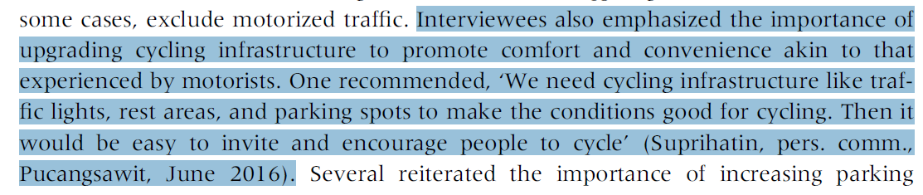
Example: paper 3
Feedback?
Email us!
Step 1 – Include
Maybe a conceptualization
Maybe a standard
Step 2 – Include
Concept: modal and gender equity
Standard: perceived equity (in safety) - qualitative
Pre-print!
Notes:
Why academic literature? Indexed and centralized. It’s a first step; easier to search; and will tell us which policies and planning objectives are being discussed in literature.

Slide 22
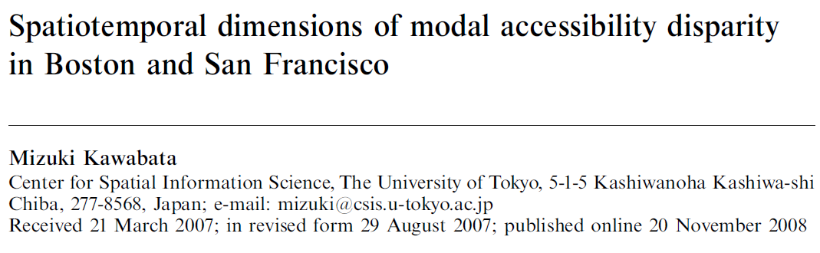
Example: paper 4
Feedback?
Email us!
Step 1 – Include
Maybe a conceptualization
Maybe a standard
Step 2 – Include
Concept: modal equity.
Standard: max. relative modal accessibility disparity threshold. Inferred.
Pre-print!
Notes:
Why academic literature? Indexed and centralized. It’s a first step; easier to search; and will tell us which policies and planning objectives are being discussed in literature.

Slide 23
Summary of work
Feedback?
Email us!
March – April 2022 Step 1 – Title/abstract screen all papers in Covidence RAs screened 6832 papers from WoS – Core and TRID Criteria: if an equity dimension is discussed – include. 15 seconds per record, each record needs 2 votes Resolved conflicting records | 608 duplicates removed 6224 screened (2 votes each) 72% excluded (4511 studies)
April – August 2022 Step 2 – Full-text review of all “Yes” papers Criteria: if an equity standard AND equity conceptualization is discussed – include RAs 3-10 mins per article Resolved conflicting records | 288 records removed (no full-texts) 1425 full-text papers (2 votes each) 66% excluded
10% COMPLETE Stage 3 – Data extraction using customized template in Covidence Anastasia, Ignacio, Matt, Mahdis filling in missing concepts in data extraction | 485 full-text papers for data extraction
Pre-print!
Notes:
Why academic literature? Indexed and centralized. It’s a first step; easier to search; and will tell us which policies and planning objectives are being discussed in literature.

Slide 24
The work of training RAs
Feedback?
Email us!
“what is a standard!” and “what is a concept!”
Step 1 training – more-or-less straight-forward
~25% of time was training (66.5 hrs total for the step)
Step 2 training – more challenging; tricky as standards and concepts sometimes are inferred.
~31% of time was training (208 hrs total for the step)
Resolving conflicts in RAs
Pre-print!
Notes:
Why academic literature? Indexed and centralized. It’s a first step; easier to search; and will tell us which policies and planning objectives are being discussed in literature.

Slide 25
Timeline of the review’s progress
Feedback?
Email us!
 | Many weeks | 3 weeks | 3 weeks | 3 weeks | 3 weeks
 | Sept (2021) – Sept 19 | Sept 19 – Oct 9 | Oct 10 – Oct 30 | Oct 31 – Nov 20 | Nov 21 - Dec 11
Conceptualization, literature querying, and Steps 1 and 2
Step 3 – data extraction |  |  |  | Estimate: assuming 15 mins per record and 485 records = 121 ‘expert-hours’ total
Data analysis |  |  |  |  | Estimate
First draft
Pre-print!
Notes:
Why academic literature? Indexed and centralized. It’s a first step; easier to search; and will tell us which policies and planning objectives are being discussed in literature.

Slide 26
The data extraction template
Feedback?
Email us!
Record details and study setting → common cities/regions which are studied, data sources
Record study rationale → research goal, question and/or topic
Equity research methodology → data and data and methods for equity analysis, how do they measure equity?
Equity dimensions → which are the equity-seeking groups? Which characteristics are used for the analysis?
Equity standard → What and how?
Equity conceptualization → How?
Main outcomes/findings of study → Equity and policy recommendations?
Protocol!
Notes:
What are the equity dimensions (e.g., types of population groups, opportunities, transport modes, network conditions)
What are the standards (e.g., max. travel distance, min. number of opportunities, min. accessibility score)
How has equity been conceptualized (e.g., a type of distributive justice, spatial equity, rights to the city, vertical or horizontal equity)

Slide 27
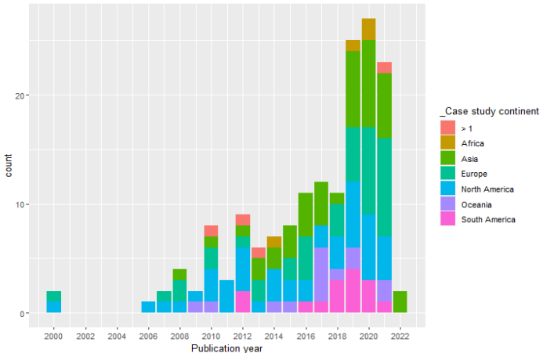
Findings: Years and case study geography
Ends Mar 2022.
Recent interest in Europe and Asia
Disproportionally studied in developed countries (these topics have high data needs)
Notes:
NOTE: include stats on the bottom, and text no on slide

Slide 28
Findings: Some interesting destinations vs. population groups
Employment, Healthcare, and Education destinations that are conceptualized across Income groups and Age groups most commonly
What makes a safe (equitable) trip to school for children on bike?
What is equitable travel distance and availability to health care facilities for older aged people?
What is a fair commute-to-work trip length for low-income populations?
Most are observed journeys
Conventional travel survey data sources – can be operationalized in existing applied planning practice
All activities (composite destinations) are most frequently of interest for (Dis)Abilities and Gender
Capabilities, what can and do you want to access
Some are observed journeys, some are where they may want to go
Smaller data sources – synthesizing the gaps in the planned system
Leisure destinations (e.g., green space, parks, recreation) are less studied in this context.
Data availability?
Subjective.
Some categories are missing all together – mobilities of care

Slide 29
Interesting initial findings – rejected papers
Feedback?
Email us!
A lot of disparity analysis – not as many standards. Yes, it is unequal, but where do we set a standard? What is too much inequity?
Evaluation of scenarios using indexes and comparing … but no goals!
Using inequities to prioritize … but no goals!
Using fancy methods… but no goals!
Papers that interview planners/policy makers – they are engaging with goals that academia are not really picking up
Public engagement, coordination and collaboration among decision-making entities
Pre-print!
Notes:
An example: paper: An assessment of the correlation between urban green space supply and socio‑economic disparities of Tehran districts—Iran
is all inequity in urban green space per capita unequitable? Unclear they just measure disparity, that’s it!
scenarios by calculating an environmental index and a social (including justice) index and comparing; but there is no min or max. that should be reached.
Ex. paper: Equity-Advancing Practices at Public Transit Agencies in the United States

Slide 30
Interesting initial findings – extracted papers
Feedback?
Email us!
Difficult to define standards.
Terms like ‘equity standard, threshold, ratio’ are not explicitly present.
Where explicit standards exist, mixed results are found.
They are not always justified by robust or well-grounded conceptualizations.
Accessibility is not the only standard methodology.
Qualitative surveys/interviews, big data, mixed-methods.
Pre-print!
Notes:
Ex. WHO Declaration of Alma-Ata: access to primary health care as a basic human right.

Slide 31
Interesting initial findings – extracted papers
Feedback?
Email us!
Health geography has standards – why?
Health care is conceptualized as a human right. None such declarations for other opportunities.
Disaster-oriented studies often discuss transport equity – why?
We think it is because they experienced disaster and (recognized) the visible suffering of particular groups so they have policy guidelines!
Papers mentioning climate change targets – again, policy guidelines
Decision/policy-makers have normatively and collectively recognized this as a disaster/injustice.
Pre-print!
Notes:
Ex. WHO Declaration of Alma-Ata: access to primary health care as a basic human right.

Slide 32
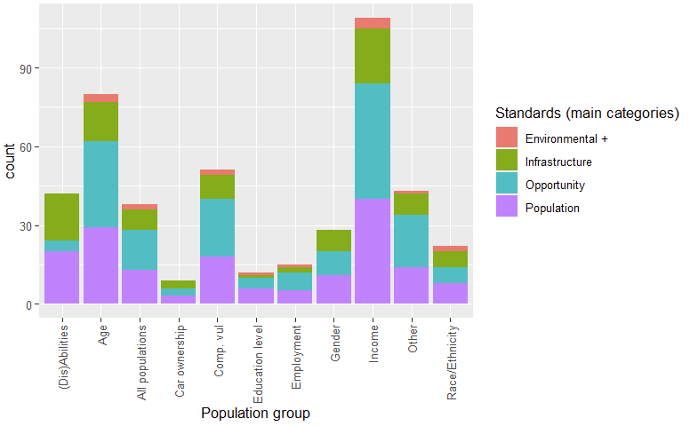
Equity standards and POPULATION GROUP
(not super interesting, can be explained through the equity standards x concept cross tab)

Slide 33
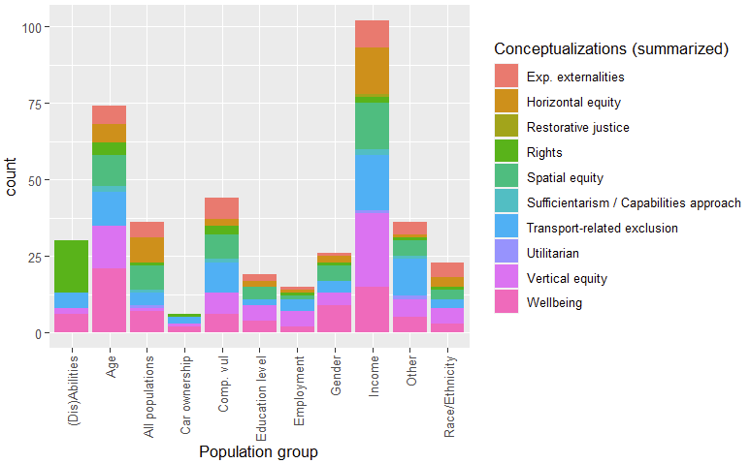
Equity conceptualizations and POPULATION GROUP
(Dis)Ability – mostly Rights! No Spatial equity
(Dis)Ability access is no where near average access, so can’t even begin to conceptual it around spatial equity perhaps
Age – disproportionally wellbeing. Aging = healthcare = long life
All populations – those papers throw in all SES and most conceptualize Spatial equity/Wellbeing. Interestingly, not general “Rights”. Literature sees rights as group-specific.
Composite vulnerable populations, similar to all population but with more Transport-related exclusion
Race/Ethnicity – disproportionally externalities (EJ)

Slide 34
Preliminary synthesis of equity standards’ (tables?)
Opportunity-based standards
Travel impedance
Travel distance, time, (and sometimes cost) to destination, beyond which it is unequitable.
Source: national and local policy guidelines, transport literature.
Opportunity accessibility thresholds
Often relative, equity group vs. total population. Or the top quantile of some composite measure (in this case, the equity standard will implicitly always renew, always a new goal)
Sometimes a minimum
Opportunity demand vs. supply
Accounting for population demand for an opportunity and the supply of the opportunity – concepts relating to spatial mismatch framed as equity.

Slide 35
Preliminary synthesis of equity standards’ (tables?)
Environmental thresholds: noise, air, pollution criteria's
WHO guidelines
Population characteristic threshold
WHO guidelines on physical activity
Equity legislation, transport benefit of equity group vs. non-equity group
Medical recommendation on access to hospital for specific conditions
Infrastructure/related-service criteria
Min quality of infrastructure, level of service…

