Slide 1
Interview Trainer Agent
CAPSTONE PROJECT
Presented By:
1. SUMAN MONDAL_B. P. Poddar Institute of Management and Technology_Information Technology

Slide 2
OUTLINE
Problem Statement (Should not include solution)
Proposed System/Solution
System Development Approach (Technology Used)
Algorithm & Deployment
Result (Output Image)
Conclusion
Future Scope
References

Slide 3
Problem Statement
Current job aspirants struggle to prepare efficiently for interviews due to lack of personalized guidance and access to role-specific questions. Interview preparation often lacks soft skill assessments and real-time improvement feedback, especially tailored to job title, experience, and industry expectations.
The goal is to make a agent that prepares users for job interviews by generating tailored question sets and preparation strategies based on their profile name, experience level, and job role, which supports both technical and soft skill assessment, ensuring a comprehensive interview prep experience which builds user confidence, sharpens responses, and increases success rates in competitive hiring environments.

Slide 4
Proposed Solution
The proposed system aims to address the challenge of personalized and role-specific interview preparation. Many candidates lack access to tailored technical and soft skill questions relevant to their job roles. This system leverages IBM Watsonx's foundation models and Retrieval-Augmented Generation (RAG) to simulate mock interviews and provide intelligent mentorship. The solution will consist of the following components:
Data Collection
Gather predefined interview questions and answers from open-source job preparation platforms (e.g., GeeksforGeeks, Zety, InterviewBit).
Collect both technical and soft skill Q&A across different job roles and experience levels.
Organize the data into structured PDF format for ingestion into Watsonx knowledge tools.
Data Preprocessing
Curate and clean the Q&A dataset to ensure relevance, clarity, and quality.
Group questions based on experience (fresher, mid-level) and job role (e.g., web developer, software engineer).
Convert the dataset into searchable formats (PDF, CSV) optimized for RAG input.
Foundation Model & RAG Integration
Use IBM Watsonx.ai with foundation models such as granite-3-3-8b-instruct or llama-3-2-11b-virsion-instruct
Enable RAG (Retrieval-Augmented Generation) to retrieve relevant Q&A from the uploaded documents.
Use prompt chaining to fetch answers, feedback, and improvement tips based on the user input.
Agent Interaction & Deployment
Build the agent using LangGraph and ReAct architecture in Watsonx’s Agent Lab.
Configure the agent to respond with a friendly tone as an interview mentor (EURI).
Allow user input via chat, guiding the system to generate dynamic questions, model answers, and soft skill evaluations.
Evaluation
Evaluate agent performance based on relevance and quality of generated questions and answers.
Continuously test using varied prompts for different roles to ensure flexibility and accuracy.
Improve the dataset and prompts based on trial feedback to maintain high-quality output.

Slide 5
System Approach
Platform: IBM Watsonx.ai studio(Lite Plan)
Runtime environment: watsonx.ai Runtime
Storage: Cloud Object Storage
Framework & Architecture: LangGraph & ReAct
Model: granite-3-3-8b-instruct / llama-3-2-11b-virsion-instruct
Method: RAG (with custom PDF/Q&A ingestion)
Resources Tools:
Google search
DuckDuckGo search
Wikipedia search
Document search - Sample-q&a-for-training
Tech:
File upload support for role-based Q&A datasets
Prompt-based question generation
Custom agent built in Agentic Lab

Slide 6
Algorithm & Deployment
Foundation Create:
Create a sandbox project into the watsonx.ai studio.
Storage: Add storage configuration by adding Cloud Object Storage.
Service: Add associate service watsonx.ai runtime for runtime environment.
Model Selection The agent uses foundation models available in IBM Watsonx.ai. Specifically, it supports:
granite-3-3-8b-instruct – for general-purpose reasoning and response generation
llama-3-2-11b-virsion-instruct – lightweight, instruction-tuned model ideal for prompt-based Q&A
These models were chosen for their accuracy, support for prompt tuning, and availability in IBM Watsonx Lite plan.
Training Process:
The agent does not require fine-tuning or traditional model training. Instead, it leverages Retrieval-Augmented Generation (RAG) for dynamic retrieval of Q&A pairs based on prompt context.
Instruct the model how to act and what parameter shouls asked from users and then greeting’s.
The custom Q&A PDF is ingested via Watsonx Agentic Lab’s “Tool” feature
Prompt-chaining logic is defined via LangGraph and ReAct principles
Model automatically retrieves and ranks relevant answers from document data and also from the research tools(e.g. Google search ,DuckDuckGo search ,Wikipedia search)

Slide 7
Algorithm & Deployment
Data Input:
Structured Prompt: Users enter name, experience level ,job role, or paste their resume along with the number of questions and answers. Example prompt:
“SUMAN MONDAL,Fresher’s,Software Engineer “ “Generate mock interview questions for a fresher web developer.”
Document Upload (RAG-based): A curated PDF containing predefined Q&A is uploaded to the Watsonx agent, acting as a knowledge source.
Prediction & Reasoning Process:
When a prompt is submitted, the model uses RAG + foundation model inference
Questions, answers, and feedback are generated in real-time
Model provides improvement suggestions, follow-up questions, and soft skill feedback
Deployment:
Save the model that you created.
Create a deployment space and deploy it.

Slide 8
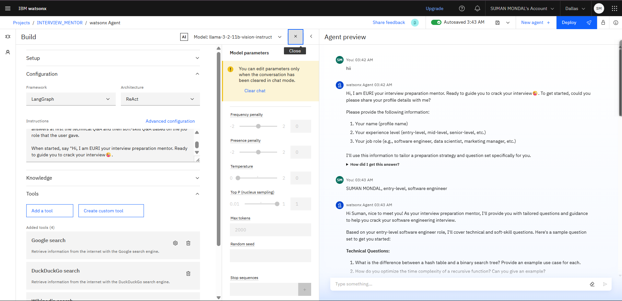
Result

Slide 9
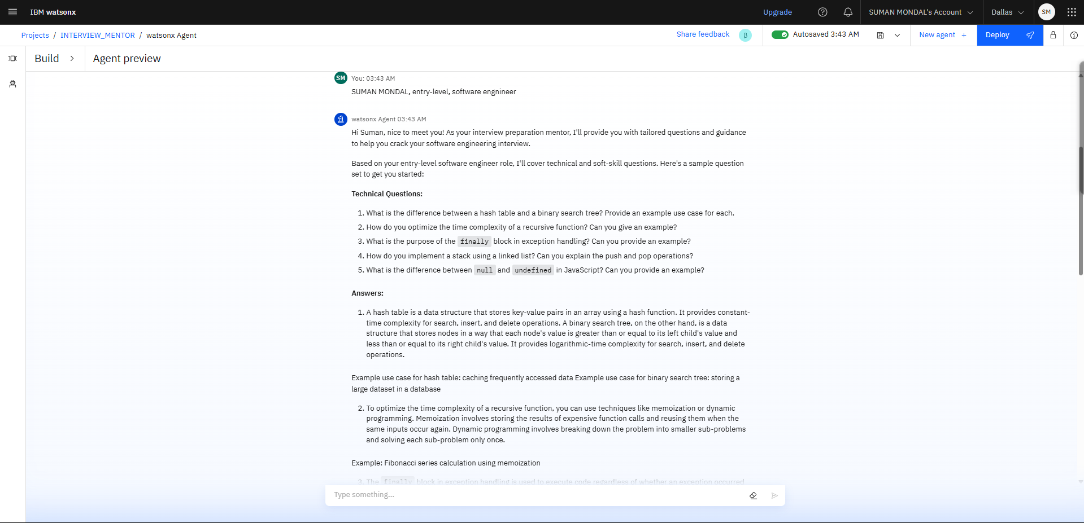
Result

Slide 10
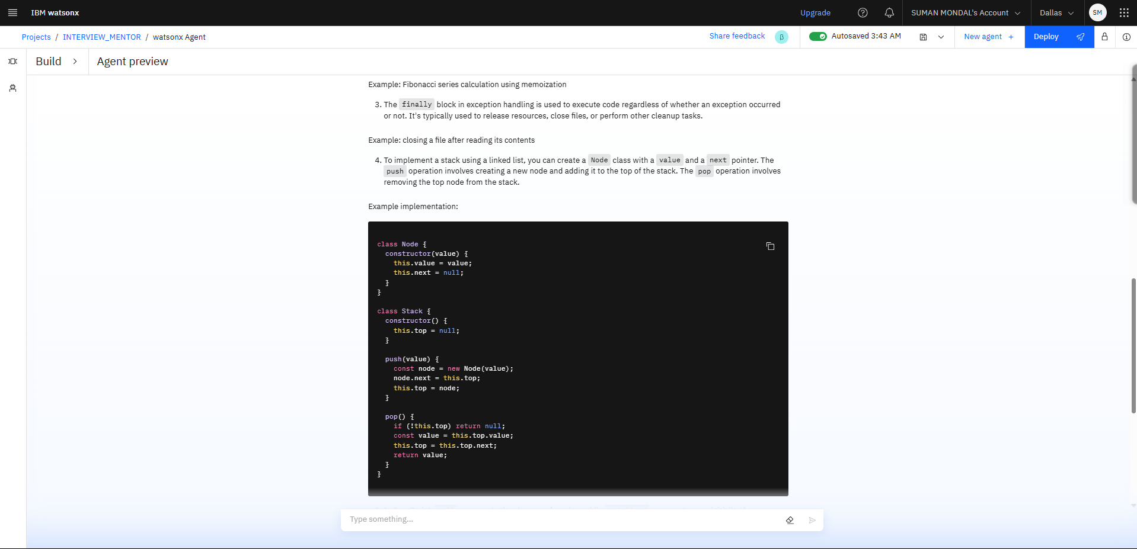
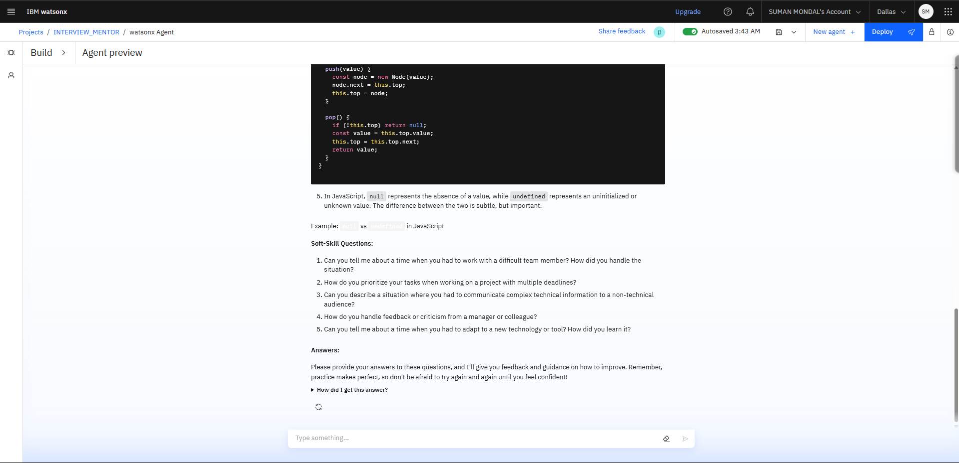
Result

Slide 11
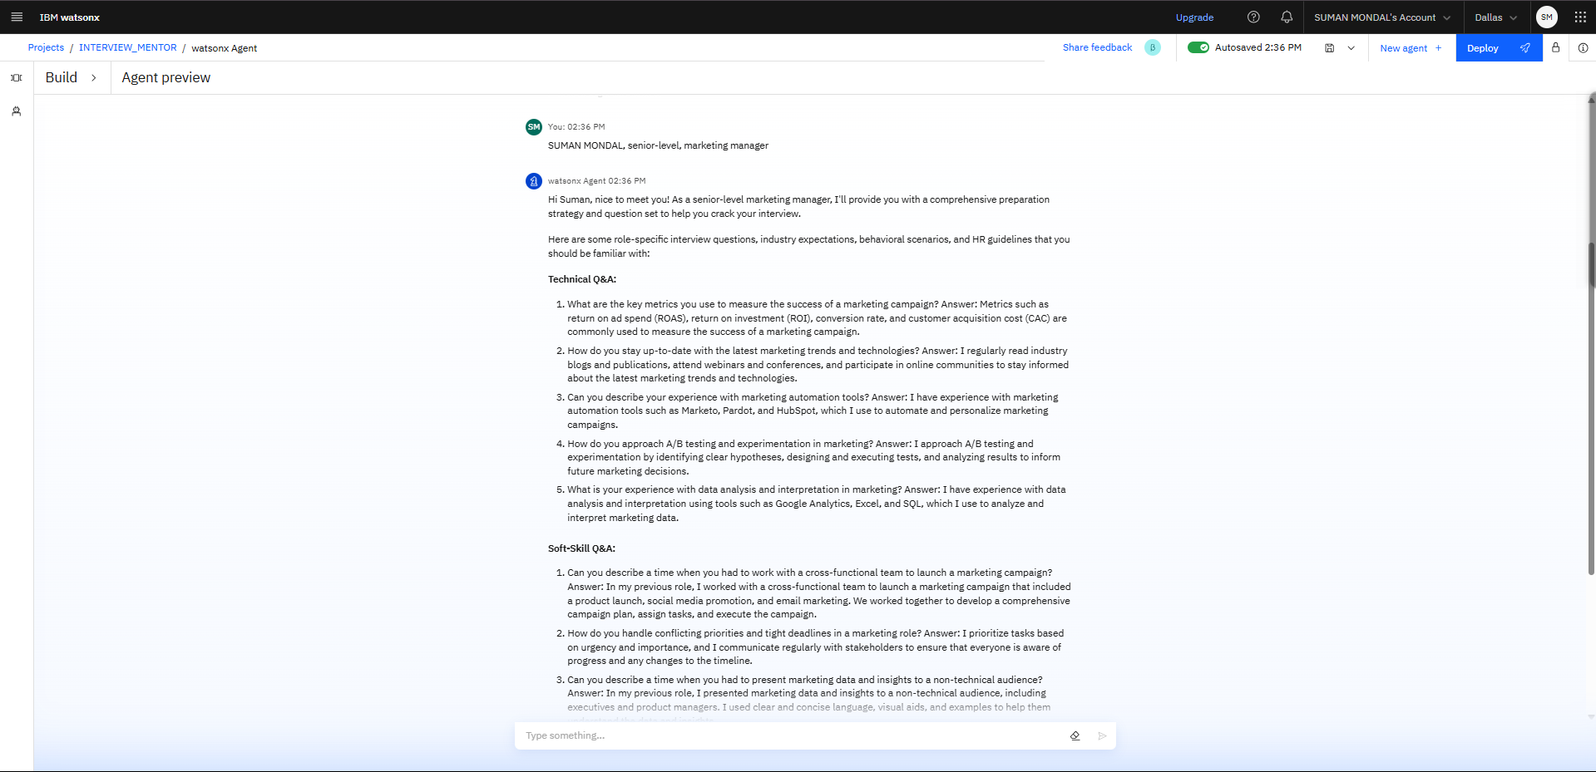
Result

Slide 12
Conclusion
The Interview Trainer Agent provides scalable, intelligent, and customized interview preparation. It supports learners and job seekers with role-specific resources, confidence-building responses, and continuous learning strategies . This AI-driven assistant supports both technical and soft skill assessment, ensuring a comprehensive interview prep experience ,sharpens responses, and increases success rates in competitive hiring environments.

Slide 13
Future scope
This AI driven model have huge potential in future by augmenting several tech strategy's like:
Add voice-based mock interviews
Expand to more job roles and experience levels
Integrate resume parsing for automatic role detection
Add analytics dashboard to track readiness level

Slide 14
References
IBM Watsonx Documentation
GeeksforGeeks, InterviewBit
indeed, Zety (soft skills Q&A)
IBM RAG Lab & Model Guide
Sample Q&A sheet
IBM Certificates

Slide 15
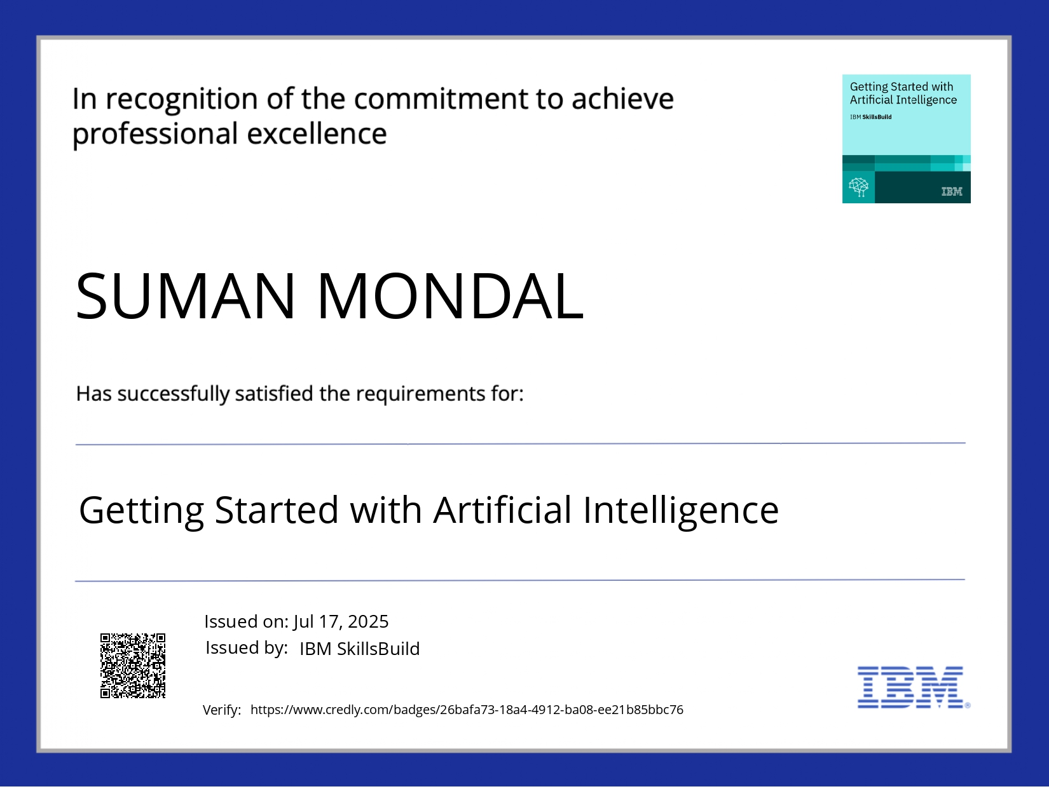
IBM Certifications
Screenshot/ credly certificate( getting started with AI)

Slide 16
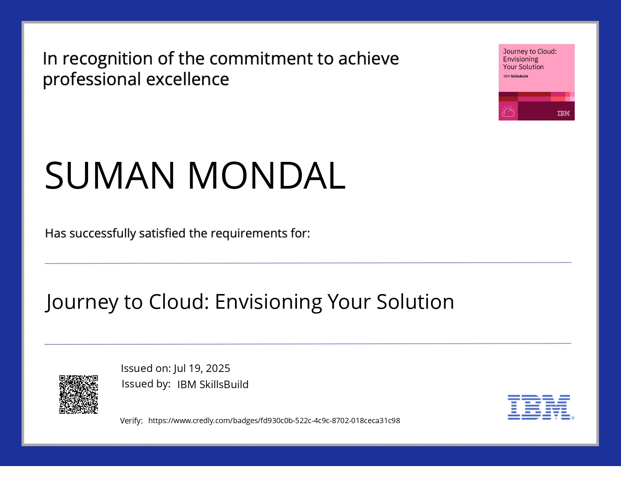
IBM Certifications
Screenshot/ credly certificate( Journey to Cloud)

Slide 17
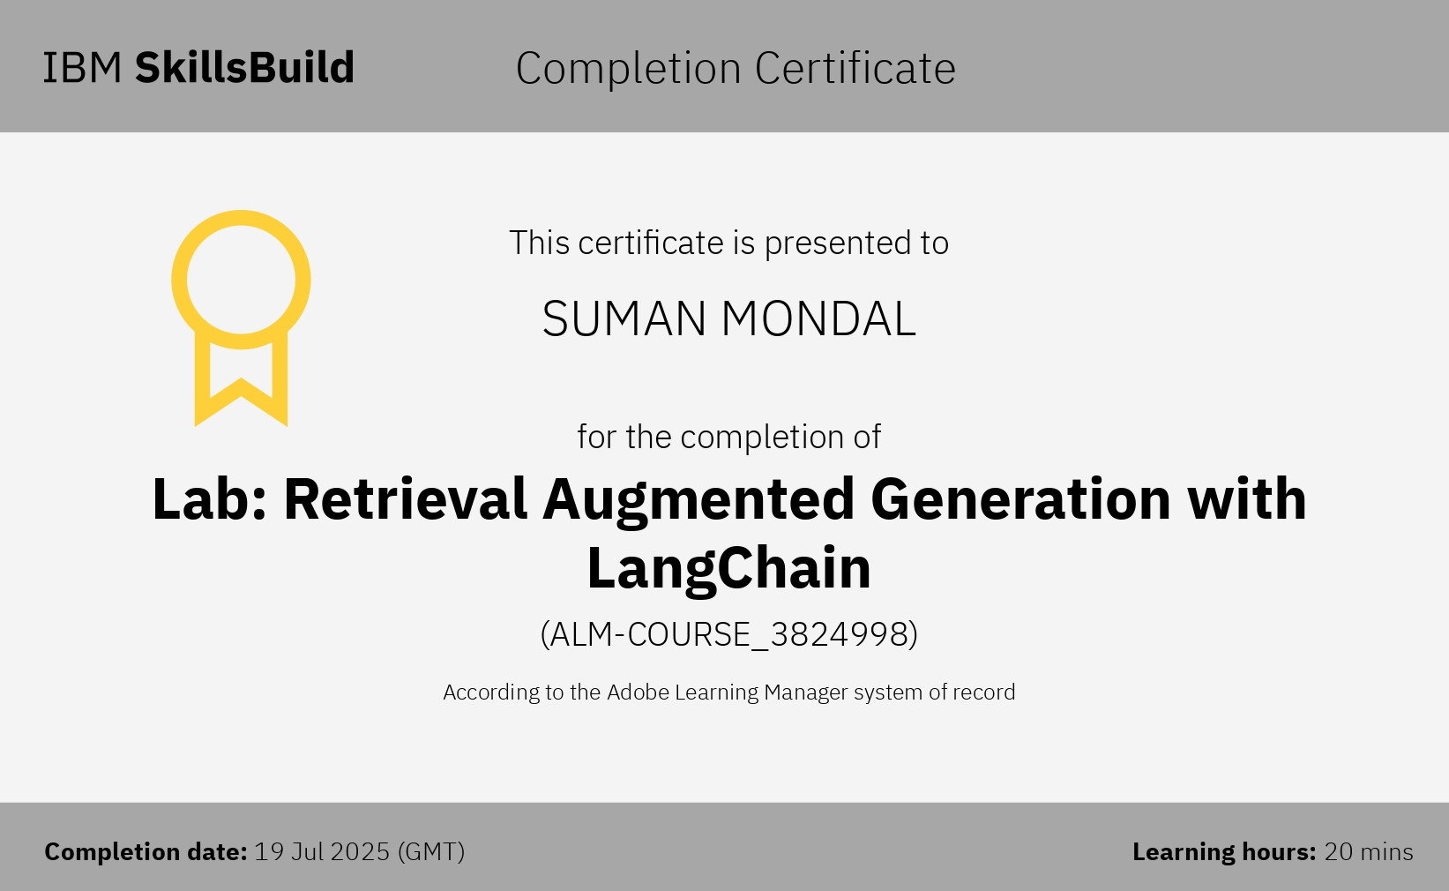
IBM Certifications
Screenshot/ credly certificate( RAG Lab)

Slide 18
THANK YOU

