Slide 1


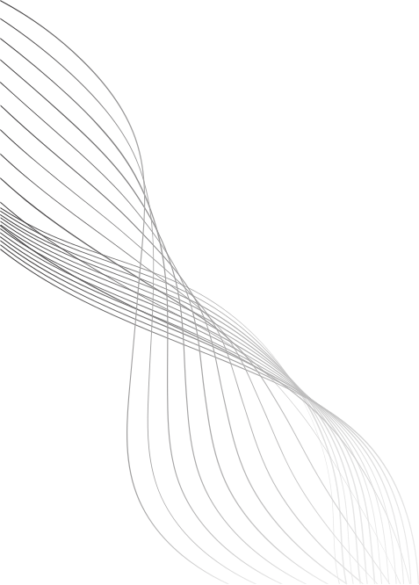

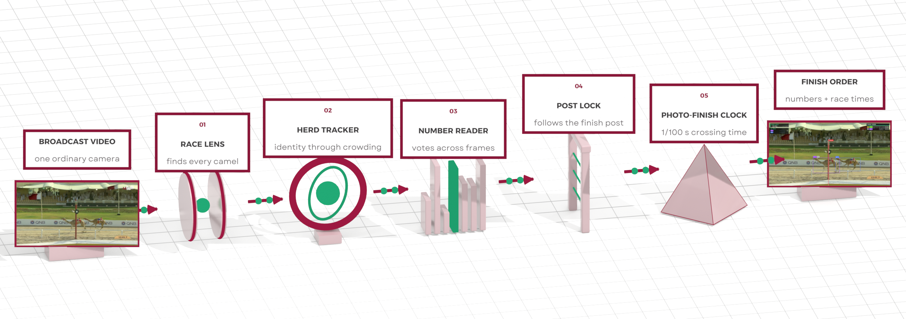
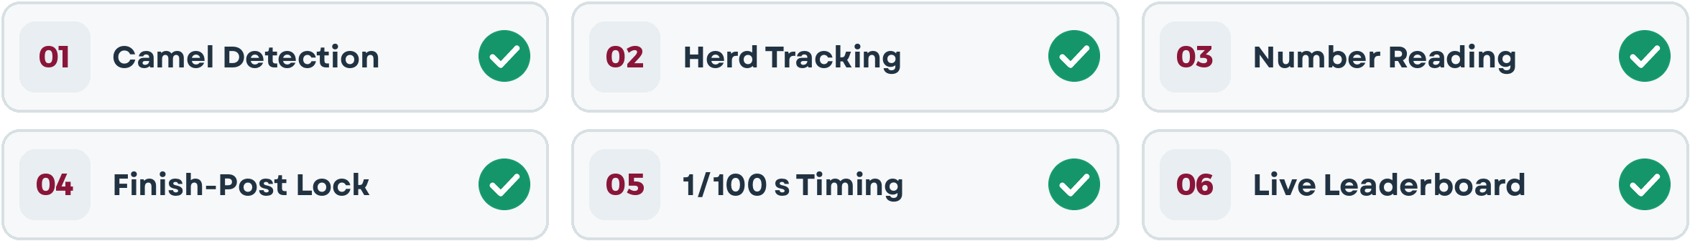

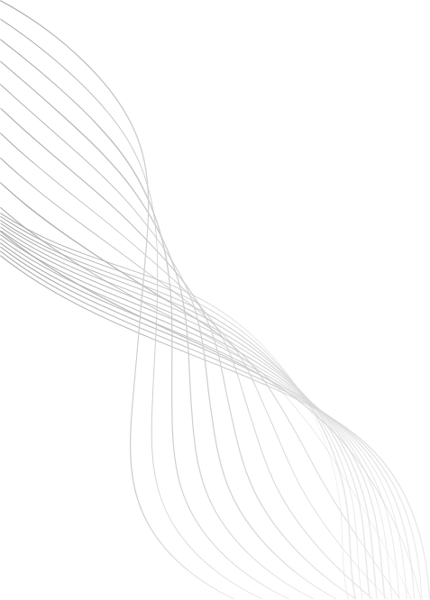
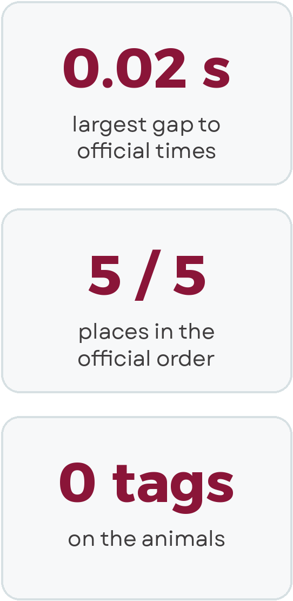
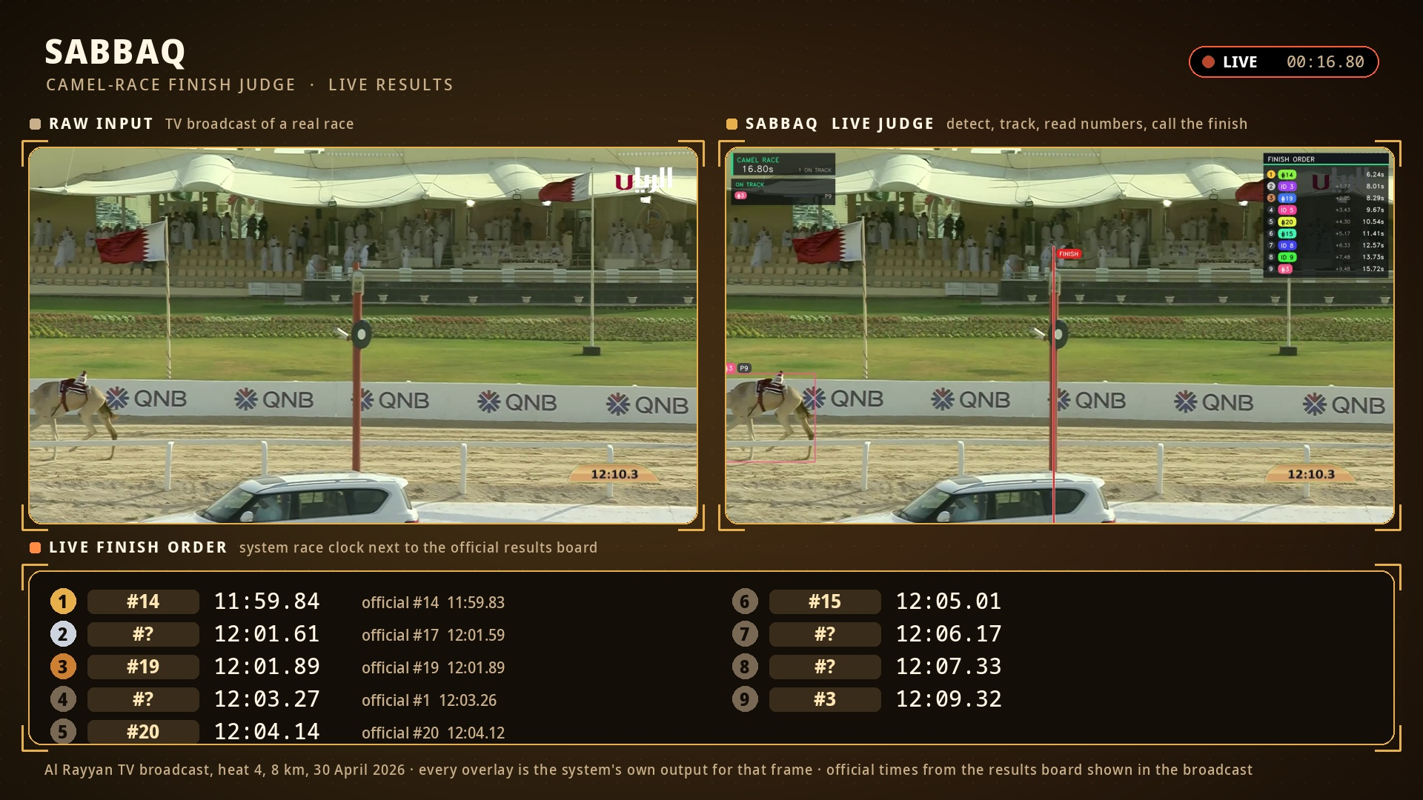
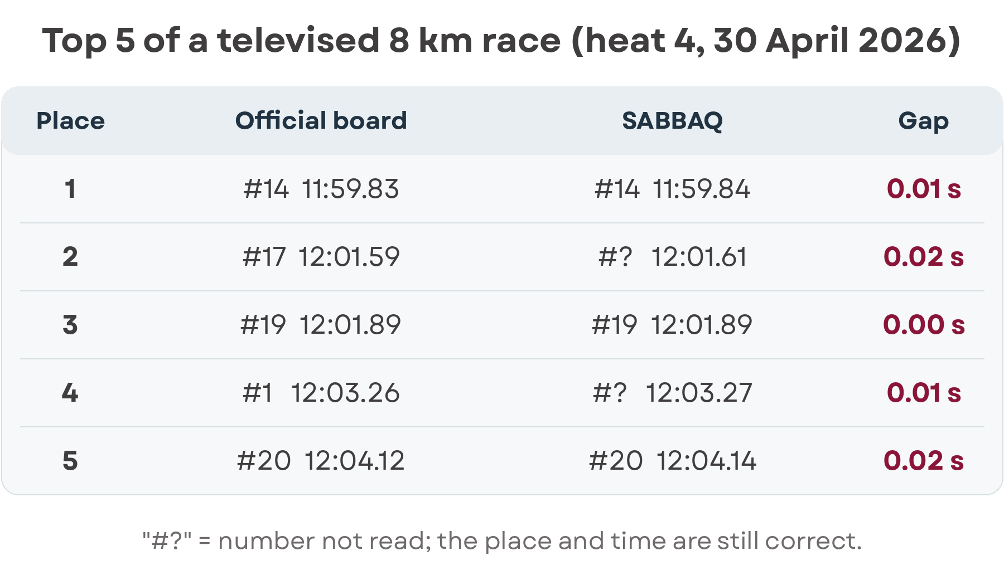
SABBAQ: An AI Race Judge That Reads the Finish of a Camel Race From One Ordinary Camera
Problem
Solution
Camel racing is a heritage sport with serious prizes, and every race is decided at the finish line, in a flash.
Results rely on human eyes, disputed replays and imported photo-finish hardware that still needs a judge to read it.
Knowing which camel is which needs chips or tags on every animal: slow, intrusive and open to substitution.
TV cameras pan, so the finish line moves; camels bunch and hide each other, and race numbers are small and blurred.
SABBAQ finds, tracks and identifies every camel in plain race video, with nothing attached to the animals.
It reads each race number across frames and times every crossing to 1/100 s, even while the camera pans.
On a televised 8 km race, its top-5 times are within 0.02 s of the official results board, in the official order.
It runs at about 15 frames per second on a laptop GPU and draws a live leaderboard on the video.
Official Results Check
At a Glance
Live Results
Notes:
Sources: SABBAQ, most accurate configuration re-run on the televised race (heat 4, 8 km, 30 April 2026): places 1-5 at 11:59.84, 12:01.61, 12:01.89, 12:03.27, 12:04.14 against the official board 11:59.83, 12:01.59, 12:01.89, 12:03.26, 12:04.12. Architecture: illustrative view.

Slide 2
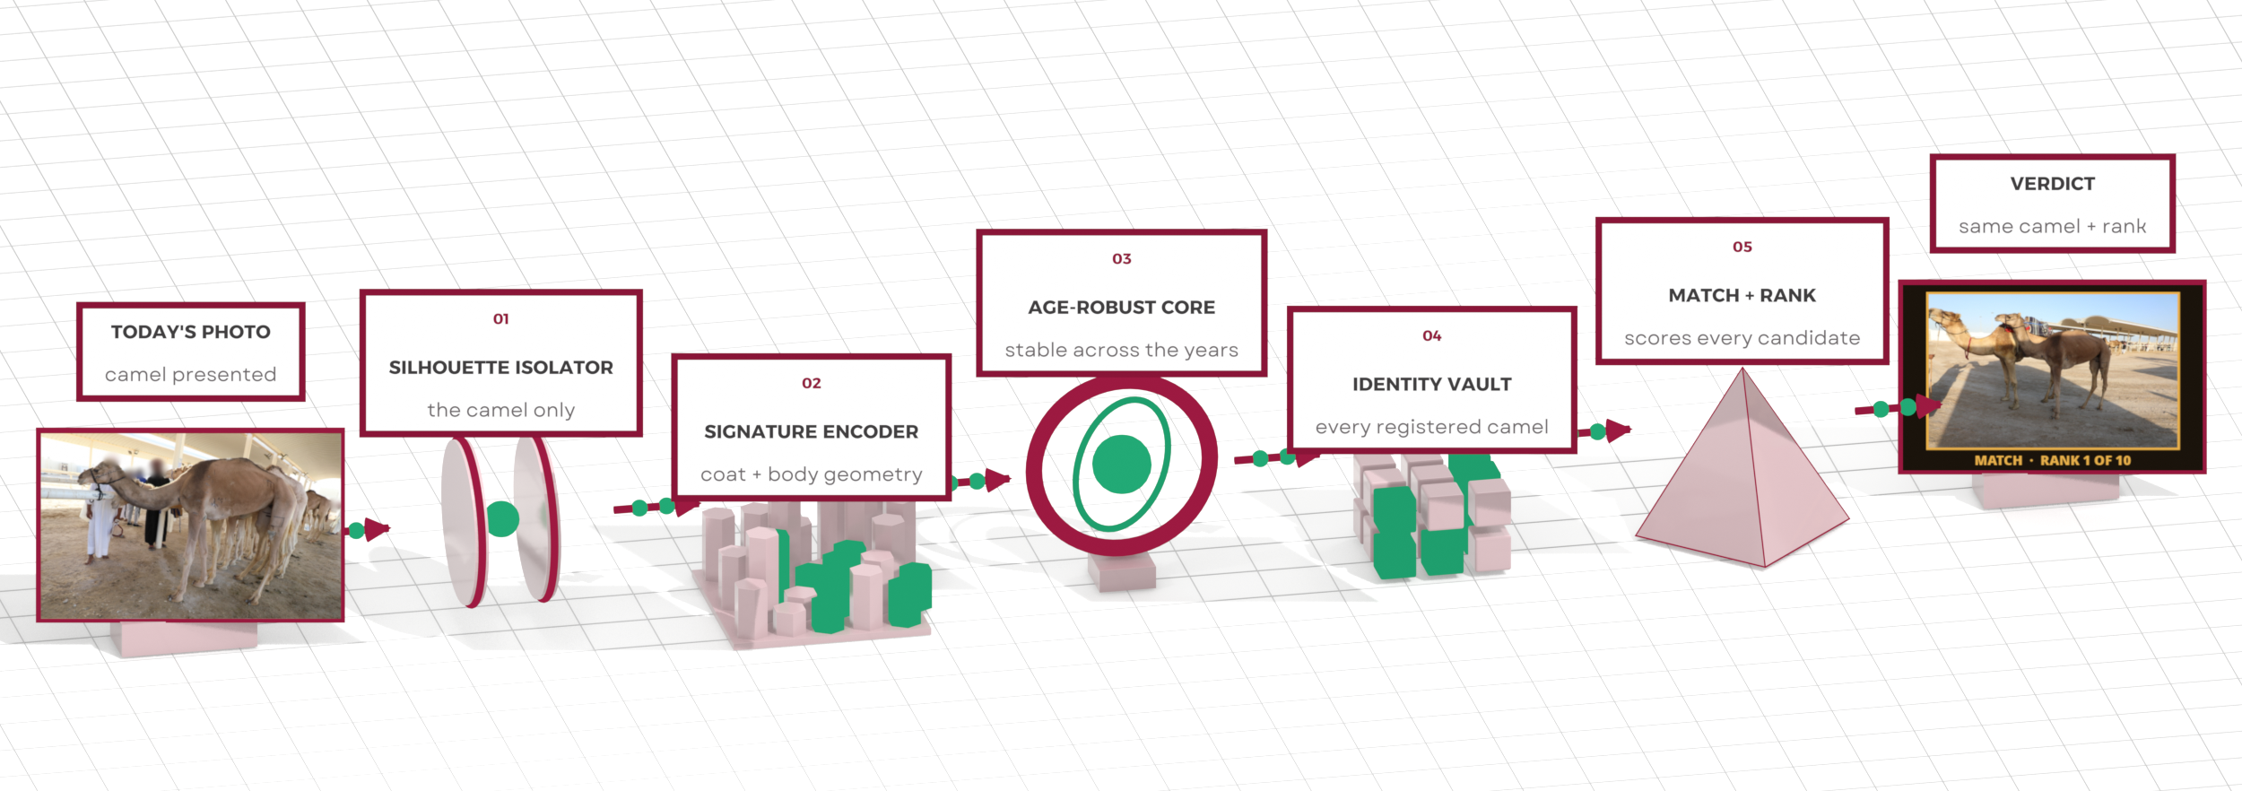
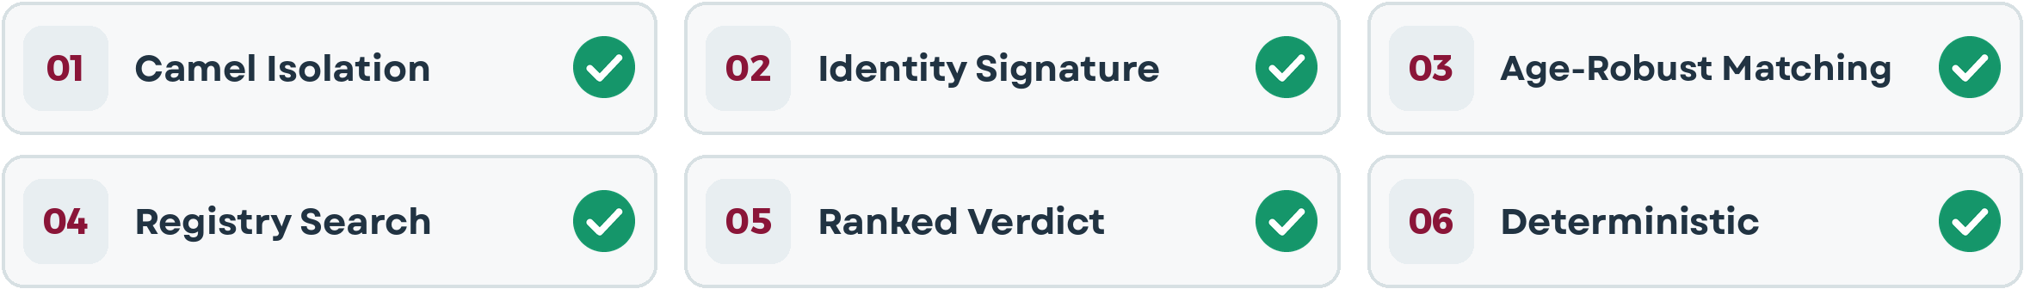
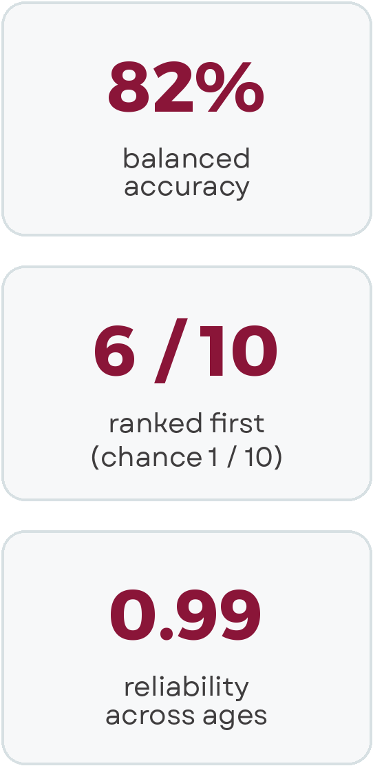
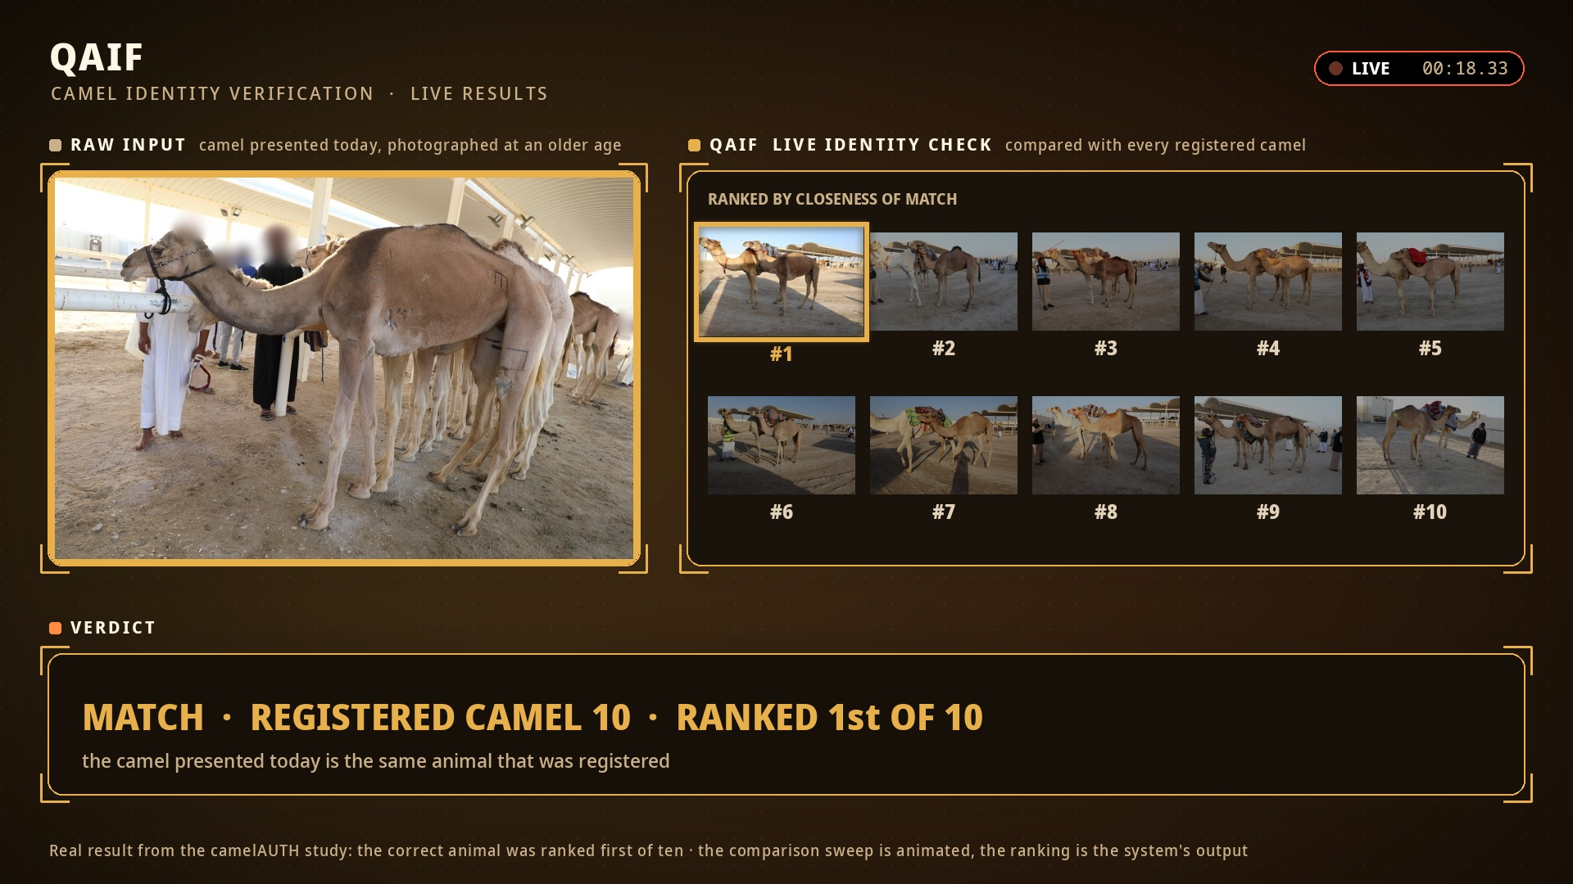
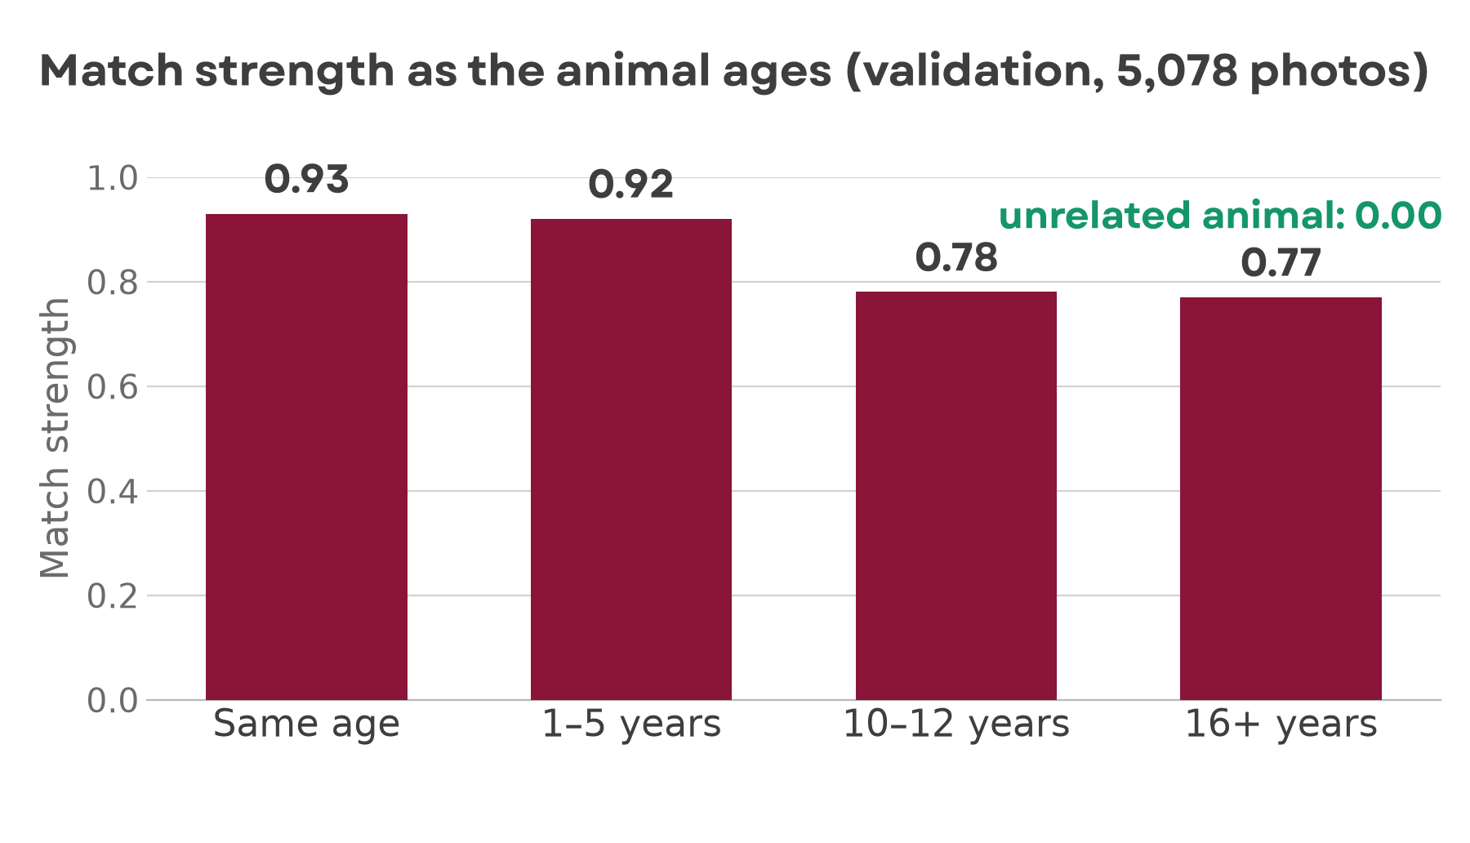
QAIF: Automated Camel Identity Verification Against Substitution in Camel Racing
Problem
Solution
A substituted camel can be raced in place of the registered one, so officials run the tashbeeh check.
Today it is done by eye: today’s camel is compared with its registration photo, months or years old.
Camels change as they grow, and face-recognition tools are built for people, not camels.
That body markings stay stable for life is asserted in the literature, but had never been measured.
QAIF compares today’s photo with every registered camel and returns a verdict and a ranked list.
On our camels it reaches 82% balanced accuracy, accepts 90% of genuine camels, and ranks the right camel first in 6 of 10.
On 5,078 photos of wild animals spanning up to 37 years, matching stays reliable across ages (0.99).
It is fully deterministic: reruns give identical results, ready to help judges flag doubtful cases.
Ageing Is Not the Obstacle
At a Glance
Live Results
Notes:
Sources: camelAUTH results report and validation study: 82% balanced accuracy, 90% of genuine camels accepted, correct camel first in 6 of 10, reliability 0.85; validation on 5,078 photos of wild animals, 0.99 across ages, up to 37 years; match strength 0.93 / 0.92 / 0.78 / 0.77 by age gap. Architecture: illustrative view.

