Slide 1


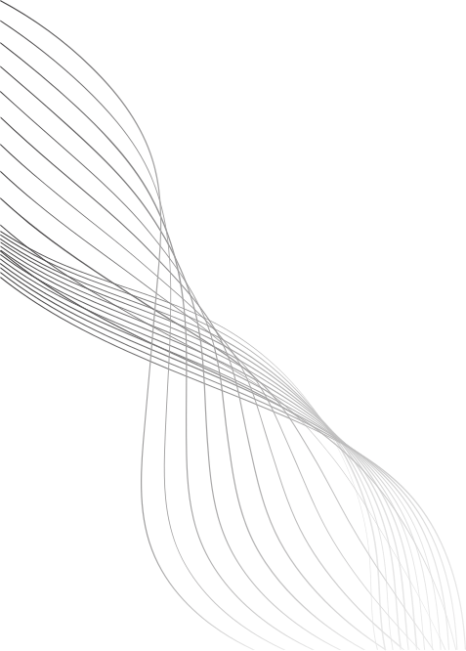

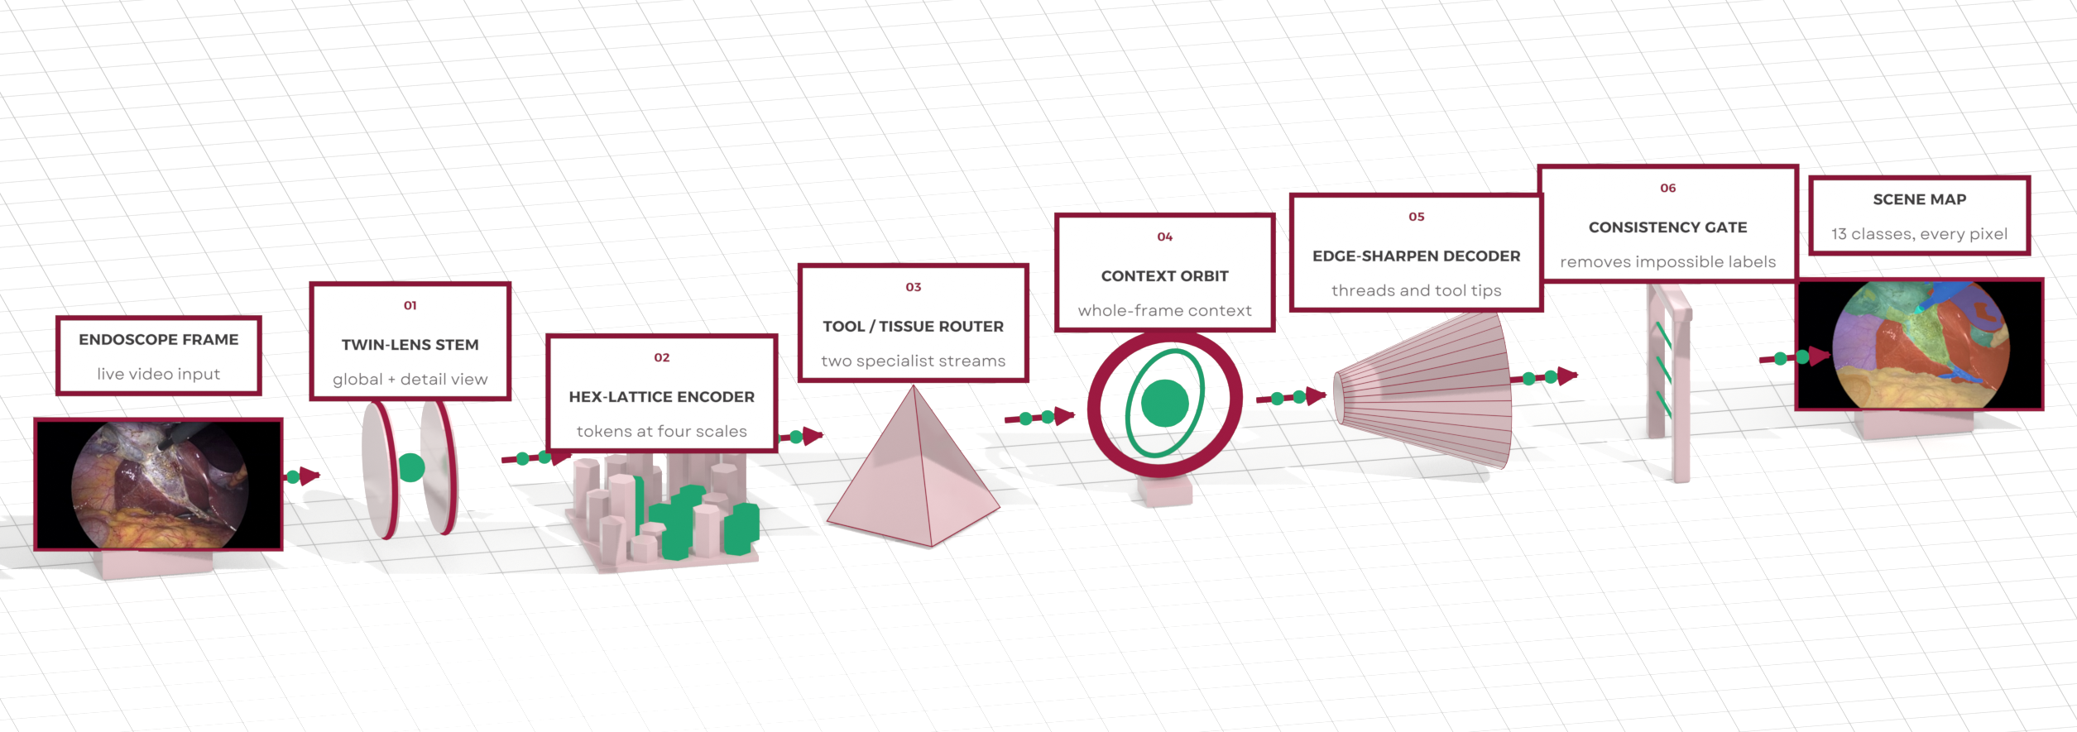
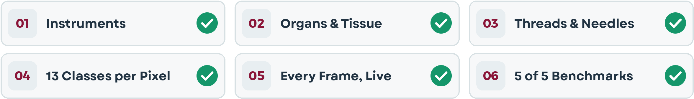


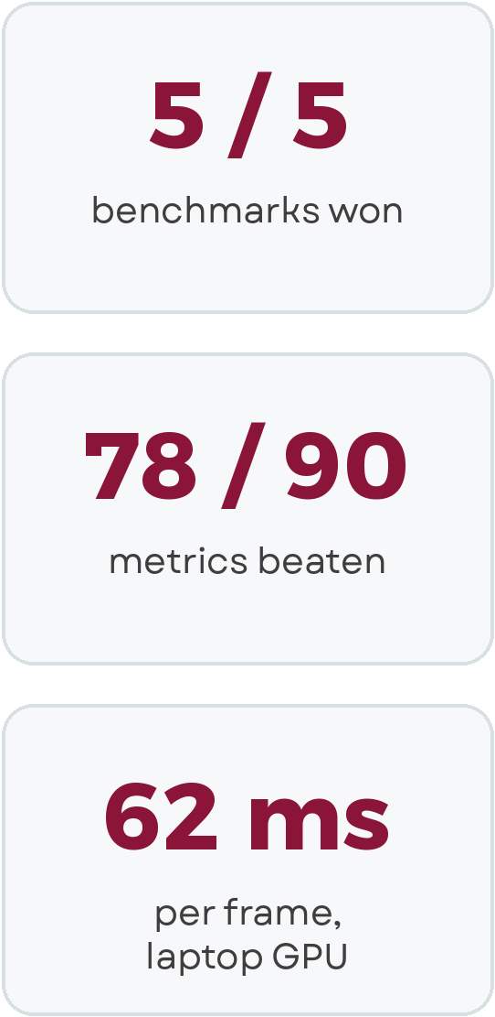
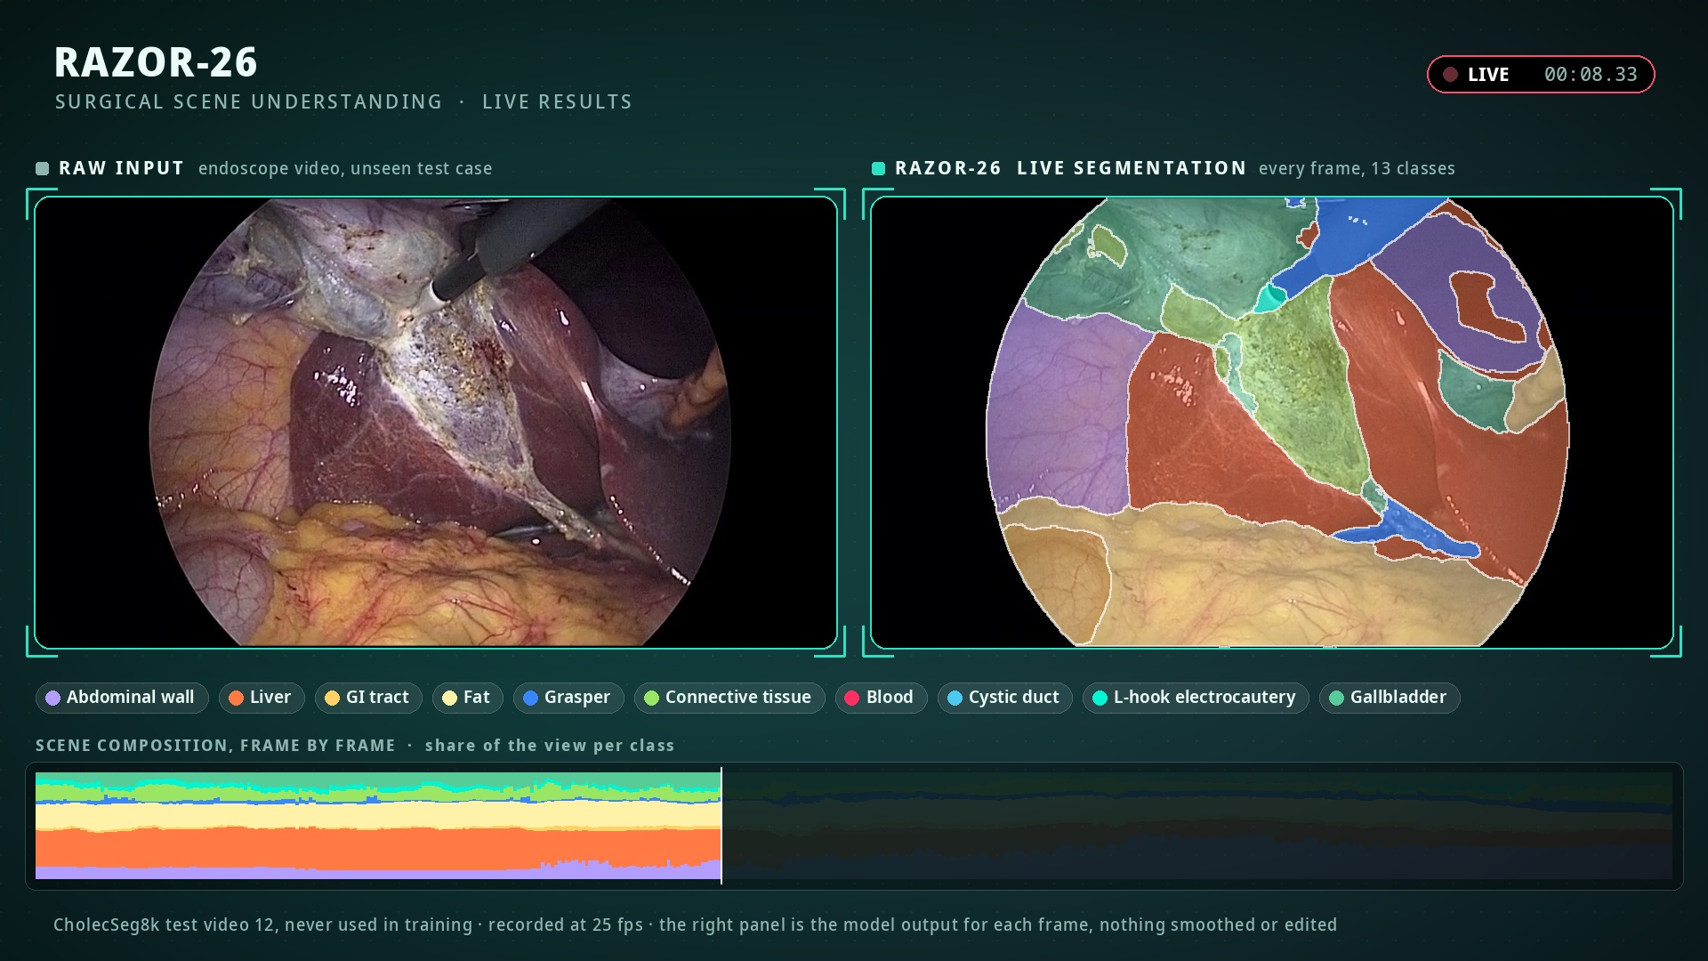
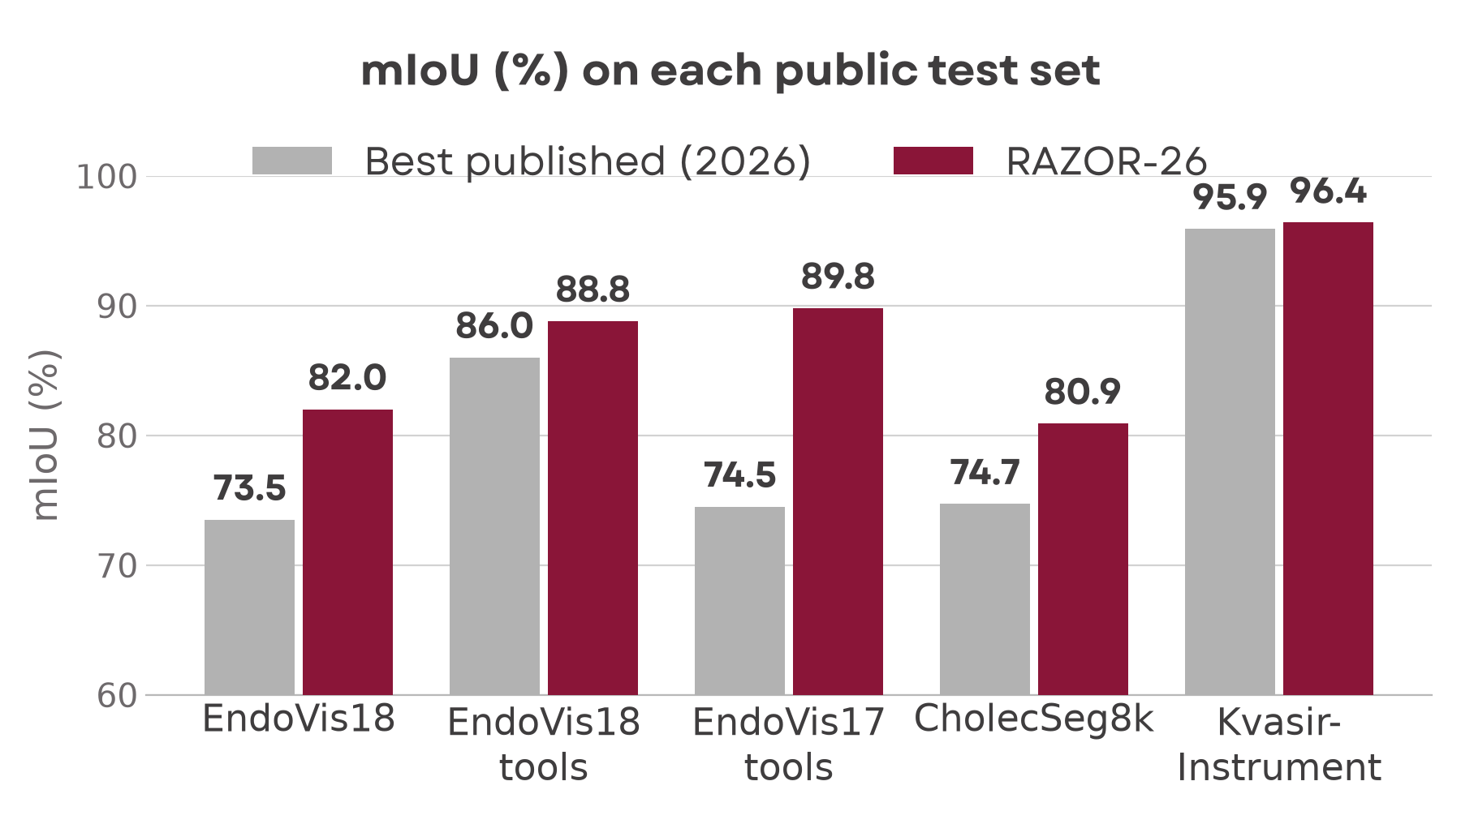
RAZOR-26: Real-Time Segmentation of Every Instrument and Tissue in Minimally Invasive Surgery Video
Problem
Solution
In minimally invasive and robotic surgery, a tiny camera inside the patient is the surgeon’s eyes, and every move is filmed.
To help in real time, a computer must label every pixel of every frame: each instrument part and each tissue.
Surgical scenes are hard: smoke, blood and glare hide the tools, and threads and needles are only a few pixels wide.
The best published method (2026) predicts at low resolution, is too heavy for live video, and its metric rewards classes that are not in the picture.
RAZOR-26 labels every pixel of every frame at full resolution: 13 instrument and tissue classes in one pass.
It runs the whole pipeline in 62 ms per frame on a laptop GPU, fast enough for live surgical video.
It beats the best published method on all 5 public benchmarks, winning 78 of 90 comparable metrics.
Every test set was evaluated once, with the published splits and the published metric code.
Benchmark Results
At a Glance
Live Results
Notes:
Sources: RAZOR-26 results report (each test set evaluated once, published splits and metric code). mIoU: EndoVis18 82.0 vs 73.5, EndoVis18 tools 88.8 vs 86.0, EndoVis17 tools 89.8 vs 74.5, CholecSeg8k 80.9 vs 74.7, Kvasir-Instrument 96.4 vs 95.9; 78 of 90 metrics beaten; 62.3 ms per frame (whole pipeline, laptop GPU). Architecture: illustrative view.

