Slide 1




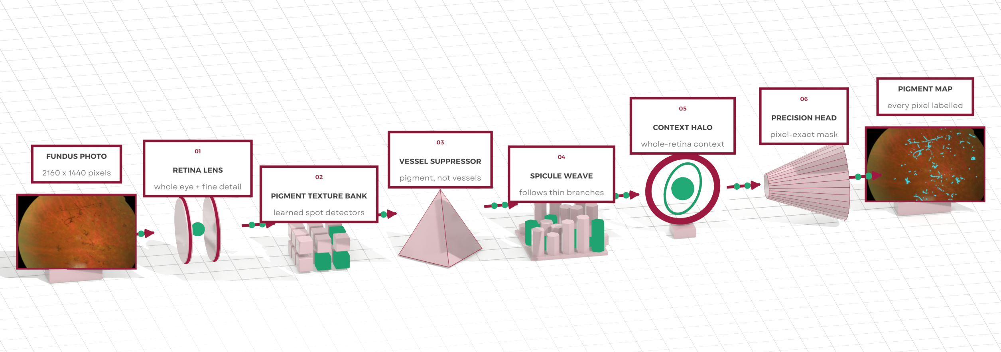



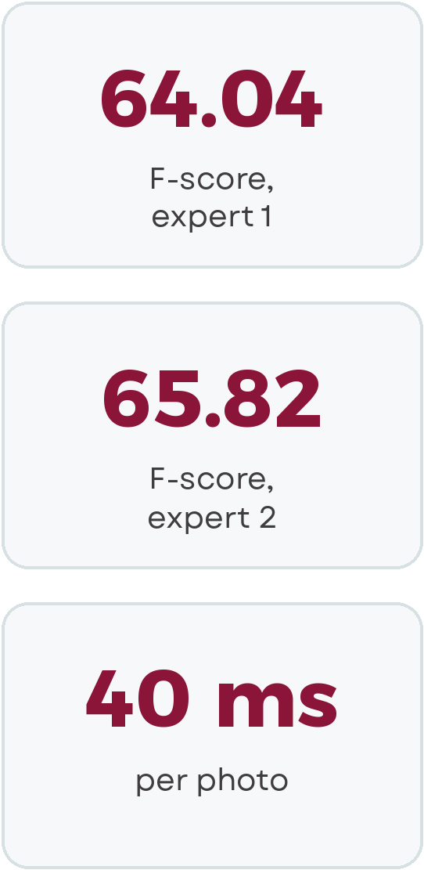
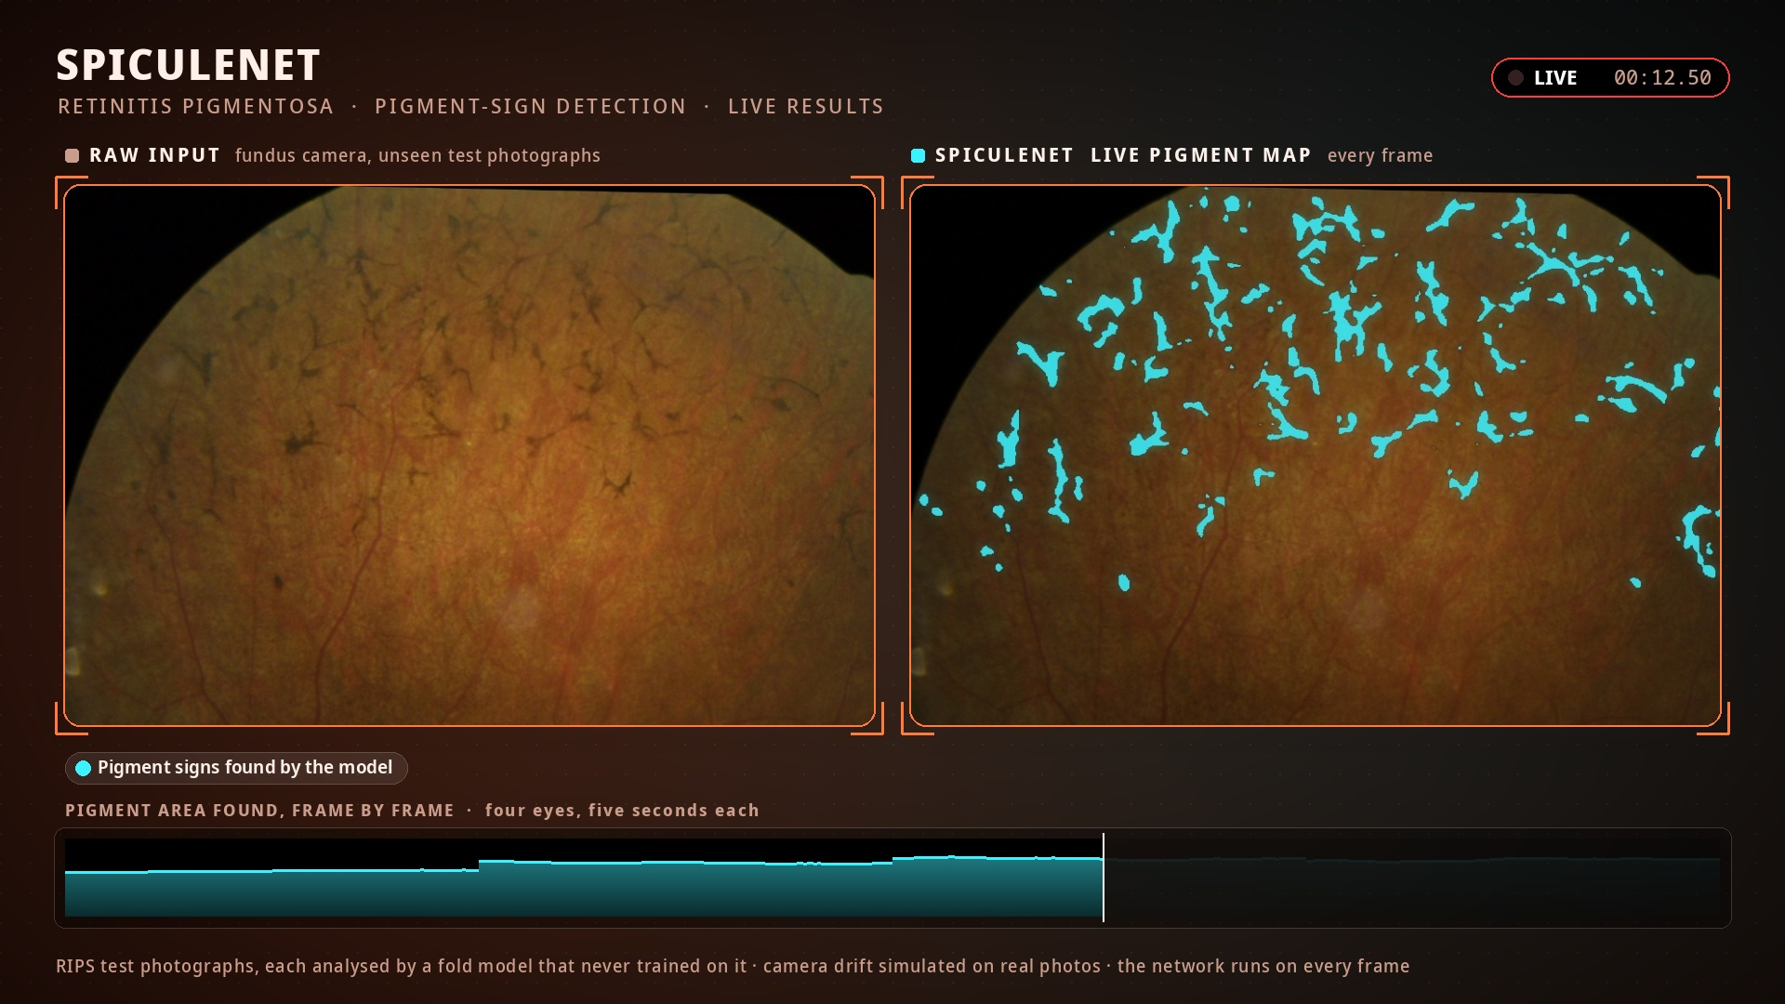
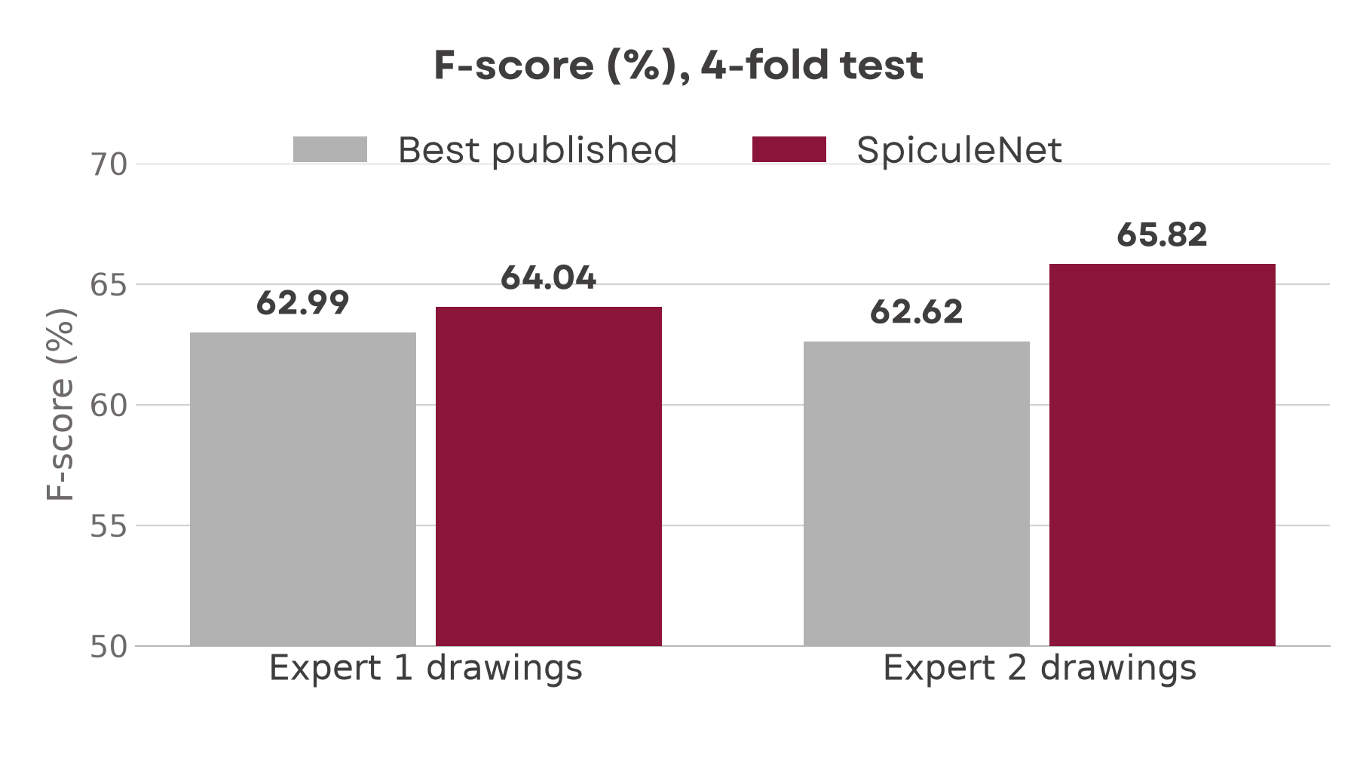
SpiculeNet: Automated Detection of Pigment Signs in Retinitis Pigmentosa Fundus Photographs
Problem
Solution
Retinitis pigmentosa is an inherited disease that slowly steals sight; it affects about 1 in 4,000 people.
Its signature is tiny dark pigment deposits (bone spicules) across the retina, which doctors map to follow the disease.
Mapping them by hand is slow: many deposits are only a few pixels wide and hide among dark blood vessels.
Even two expert graders outline them differently, and the best published networks stopped near an F-score of 63.
SpiculeNet finds every pigment deposit in a full 2160 × 1440 fundus photograph, pixel by pixel.
It analyses a photograph in 40 ms on a laptop GPU, fast enough for routine clinical use.
It beats the best published results against both expert graders: F-score 64.04 vs 62.99 and 65.82 vs 62.62.
It rarely marks healthy retina (99.7% specificity), and every number is the mean of 4 independent folds.
Benchmark Results
At a Glance
Live Results
Notes:
Sources: SpiculeNet final checkpoint report (mean of 4 folds, threshold 0.5 declared in advance): F 64.04 / 65.82 against expert 1 / 2 (best published 62.99 / 62.62), specificity 99.66%, 40 ms per 2160 x 1440 photo. Architecture: illustrative view.

