Slide 1





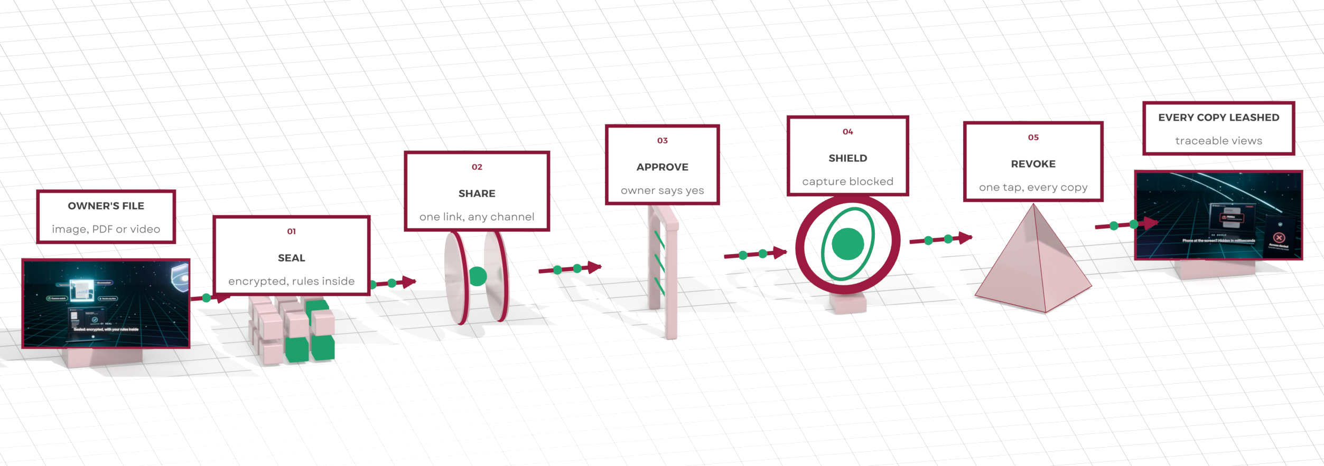



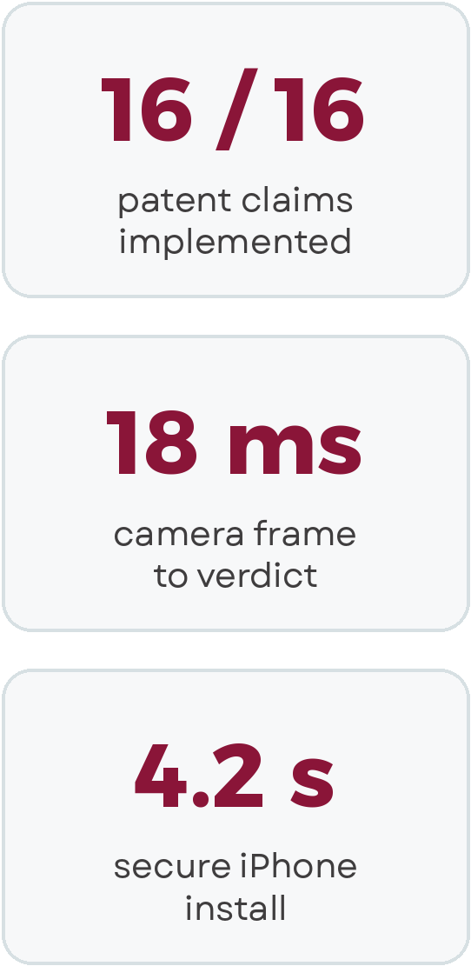
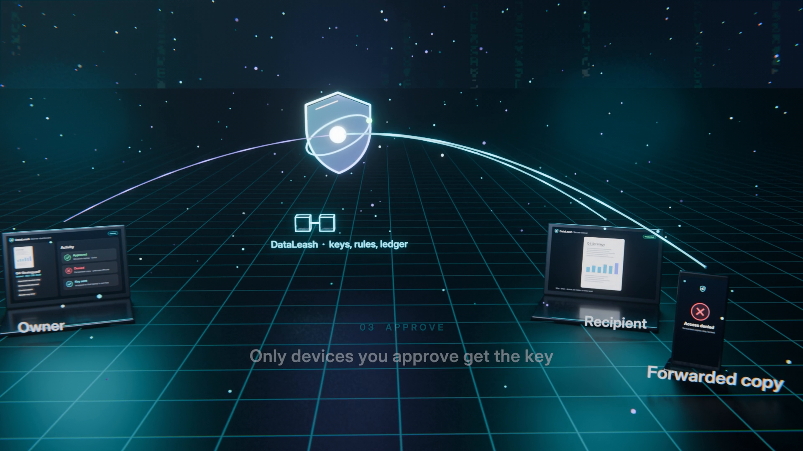
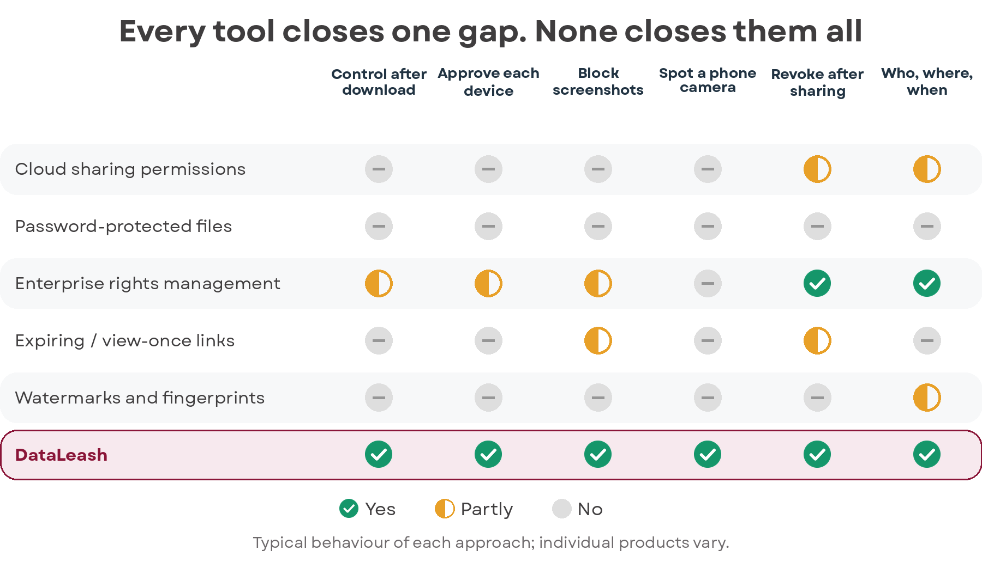
DataLeash: Keeping Control of Images, PDFs and Video After They Are Shared
Problem
Solution
Once an image, PDF or video is shared, its owner loses control: no view of who opens it, no way to stop the next forward or take it back.
Most leaks need no hacking: a forward, a download, a screenshot, or a phone held up to the screen.
Cloud permissions stop at the download, passwords travel with the file, and watermarks only help after a leak.
Rights-management tools need special clients and still cannot see a phone camera pointed at the screen.
DataLeash turns every file into a self-protecting object: encrypted, with the owner’s rules sealed inside.
One link works on every device; each new device must be approved by the owner before the key is released.
While a file is open, screenshots are blocked where the OS allows, and a phone camera or second face hides the view.
One tap revokes every copy, and every event lands in a tamper-evident ledger. Patent pending (US provisional 64/085,062).
How It Compares
Status
See It Working
Notes:
Sources: DataLeash deck (US provisional 64/085,062, filed 8 June 2026): 16/16 filed claims implemented, 76 automated claim checks, 18 ms camera frame to verdict, 4.2 s one-step secure iPhone install. Comparison: typical behaviour of each approach, from the background of the invention.

