Slide 1
BLADE
IVF AI · EMBRYO ANALYSIS
Every part of a human embryo, mapped pixel by pixel.
90.5% mean Jaccard
best published 87.9%
0.19 s per embryo (fast edition)
Live results inside: 20 s videos of the system working on unseen data
Notes:
Sources: BLADE results on the 35 public test images (mean Jaccard): BLADE-A+ 90.51, BLADE-LQ 90.37 (238 MiB file), BLADE-L 90.29 (0.37 s), BLADE-S 89.28 (0.19 s); first-generation network GENESIS-1 87.50; best other published 87.90. BLADE-L vs GENESIS-1: +2.79 points (95% CI +1.91 to +3.67), better on 31 of 35 images. Infertility, about 1 in 6 people: WHO 2023. Video: BLADE-S on test embryos 5, 13, 21 and 30, every frame.

Slide 2
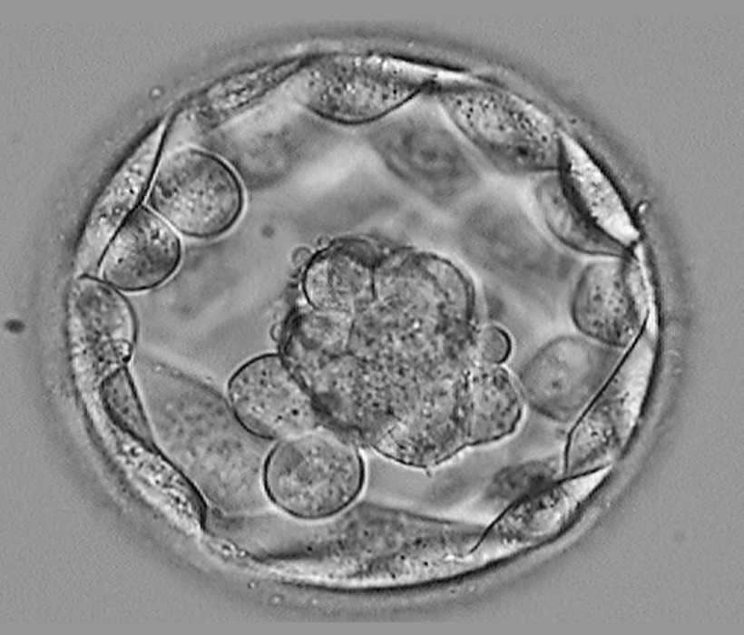
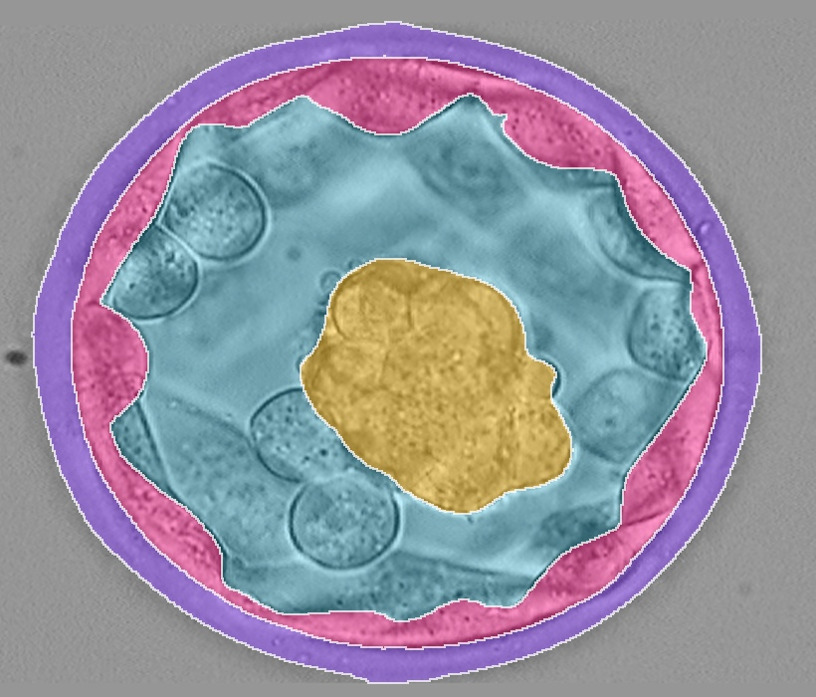
Choosing the right embryo
01 · THE PROBLEM
1 in 6
people worldwide experience infertility
1
IVF depends on one choice
Many couples turn to IVF, and its success depends on which embryo is transferred.
2
Day 5: the blastocyst
INPUT · microscope image
Five days after fertilisation the embryo is a hollow ball of cells, smaller than a grain of sand.
3
Judged by eye today
Embryologists grade four parts: zona pellucida, trophectoderm, fluid cavity and inner cell mass.
OUTPUT · four compartments
Notes:
Sources: BLADE results on the 35 public test images (mean Jaccard): BLADE-A+ 90.51, BLADE-LQ 90.37 (238 MiB file), BLADE-L 90.29 (0.37 s), BLADE-S 89.28 (0.19 s); first-generation network GENESIS-1 87.50; best other published 87.90. BLADE-L vs GENESIS-1: +2.79 points (95% CI +1.91 to +3.67), better on 31 of 35 images. Infertility, about 1 in 6 people: WHO 2023. Video: BLADE-S on test embryos 5, 13, 21 and 30, every frame.

Slide 3
Why existing methods fail
02 · WHY EXISTING METHODS FAIL
×
Low contrast
×
Experts disagree
The microscope image is grey, and the trophectoderm is a thin, wavy ribbon one cell thick.
Two embryologists can grade the same embryo differently.
×
Progress had stalled
×
Little data
Published networks reach 86 to 88% mean Jaccard; the thin outer layer stays below 81%.
The public benchmark has only 200 training images and 35 test images.
Notes:
Sources: BLADE results on the 35 public test images (mean Jaccard): BLADE-A+ 90.51, BLADE-LQ 90.37 (238 MiB file), BLADE-L 90.29 (0.37 s), BLADE-S 89.28 (0.19 s); first-generation network GENESIS-1 87.50; best other published 87.90. BLADE-L vs GENESIS-1: +2.79 points (95% CI +1.91 to +3.67), better on 31 of 35 images. Infertility, about 1 in 6 people: WHO 2023. Video: BLADE-S on test embryos 5, 13, 21 and 30, every frame.

Slide 4
Why BLADE is better
03 · WHY OURS IS BETTER
90.51%
mean Jaccard on the 35 test images (best published 87.90%)
+2.79
points for BLADE-L over our first-generation network GENESIS-1; better on 31 of 35 images
0.19 s
per embryo with the fast edition BLADE-S (89.28%)
238 MiB
compact edition file, still 90.37%
Mean Jaccard over 5 classes, public test set; every test evaluation logged. 95% CI of the +2.79 gain: +1.91 to +3.67.
Notes:
Sources: BLADE results on the 35 public test images (mean Jaccard): BLADE-A+ 90.51, BLADE-LQ 90.37 (238 MiB file), BLADE-L 90.29 (0.37 s), BLADE-S 89.28 (0.19 s); first-generation network GENESIS-1 87.50; best other published 87.90. BLADE-L vs GENESIS-1: +2.79 points (95% CI +1.91 to +3.67), better on 31 of 35 images. Infertility, about 1 in 6 people: WHO 2023. Video: BLADE-S on test embryos 5, 13, 21 and 30, every frame.

Slide 5
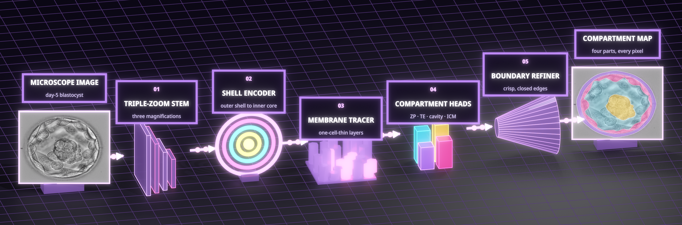
HALO-SHELL: inside BLADE
04 · ARCHITECTURE
Illustrative view
01
02
03
04
05
Triple-Zoom Stem
Shell Encoder
Membrane Tracer
Compartment Heads
Boundary Refiner
Looks at the embryo at three magnifications.
Encodes the embryo shell by shell, from the outer zona to the inner core.
Follows the one-cell-thin trophectoderm all the way round.
One head per part: zona, trophectoderm, cavity, inner cell mass.
Turns every boundary into a crisp, closed edge.
Notes:
Illustrative view of the architecture. Sources: BLADE results on the 35 public test images (mean Jaccard): BLADE-A+ 90.51, BLADE-LQ 90.37 (238 MiB file), BLADE-L 90.29 (0.37 s), BLADE-S 89.28 (0.19 s); first-generation network GENESIS-1 87.50; best other published 87.90. BLADE-L vs GENESIS-1: +2.79 points (95% CI +1.91 to +3.67), better on 31 of 35 images. Infertility, about 1 in 6 people: WHO 2023. Video: BLADE-S on test embryos 5, 13, 21 and 30, every frame.

Slide 6
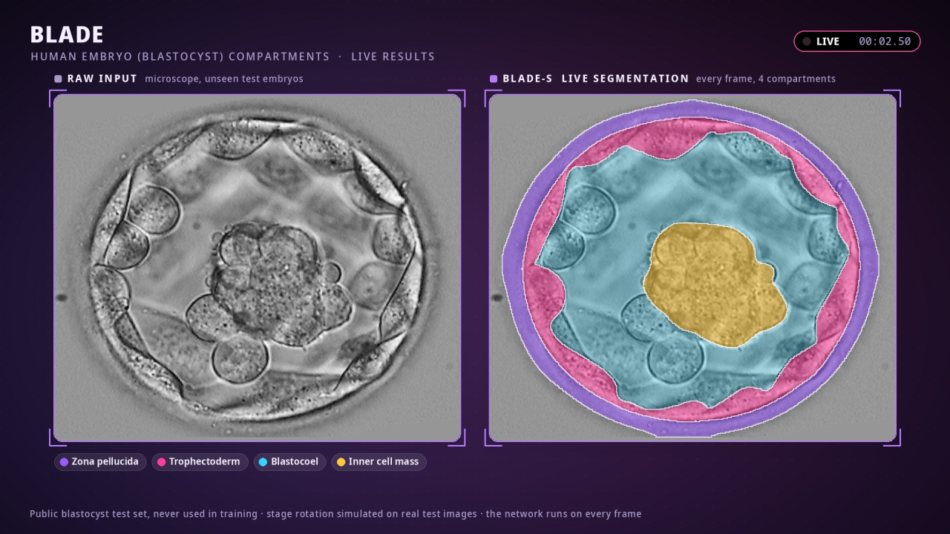
Live results on unseen test embryos
05 · LIVE RESULTS
20 s · LIVE
Left: test embryos of the public benchmark (stage rotation simulated on the real images). Right: the BLADE-S compartment map, computed on every frame. 20 s.
Notes:
Left: test embryos of the public benchmark (stage rotation simulated on the real images). Right: the BLADE-S compartment map, computed on every frame. 20 s. Sources: BLADE results on the 35 public test images (mean Jaccard): BLADE-A+ 90.51, BLADE-LQ 90.37 (238 MiB file), BLADE-L 90.29 (0.37 s), BLADE-S 89.28 (0.19 s); first-generation network GENESIS-1 87.50; best other published 87.90. BLADE-L vs GENESIS-1: +2.79 points (95% CI +1.91 to +3.67), better on 31 of 35 images. Infertility, about 1 in 6 people: WHO 2023. Video: BLADE-S on test embryos 5, 13, 21 and 30, every frame.

