Slide 1

ME -322 Project
Kinetic Energy powered Backpack
Grinders
1) Aishwarya (220103004) 2) Ayush Gupta (220103026)
3) Ayush Singh (220103027) 4) Anupam A.P. Singh (220103137)
Department of Mechanical Engineering
Indian Institute of Technology Guwahati

Slide 2
Outline
Motivation
Problem Formulation
Market Survey
Working Ideas
Mechanism Design
CAD
Kinematic Analysis
Force Analysis
Basic Dimensional Details
Cost Evaluation

Slide 3
Motivation
Why this Project ?
The growing dependence on electronic devices like smartphones, tablets, and smartwatches requires constant power, especially during travel or outdoor activities.
Traditional power banks rely on stored energy, which eventually runs out, leaving users without power in critical moments.
Harnessing kinetic energy from natural human motion (like walking or running) offers a sustainable and renewable solution.
Environmental benefits : Reduces dependency on batteries, contributing to reduced e-waste.
Practical benefits : Convenient and eco-friendly way to keep devices charged during daily commutes, trekking, or emergencies.
Example:
Imagine you’re on a trek, and your phone runs out of charge — with a kinetic energy-powered
backpack,your movement would automatically generate power!

Slide 4
Problem Formulation
Problem Statement :-
Current portable charging solutions (e.g., power banks) are limited by battery capacity and require pre-charging for their use.
There’s a lack of a continuous and sustainable power source for personal devices, especially during travel or outdoor activities.
Need for a system that:
Generates power during regular human movement (walking, running, hiking).
Efficiently stores and delivers power to electronic devices.

Slide 5
Problem Formulation
Objective :-
Develop an ergonomic backpack that:
Converts kinetic energy from walking or running into electrical energy.
Stores the generated energy in a battery or capacitor.
Provides a standard charging output (e.g., USB) for mobile devices.
Scope :-
Suitable for students, travelers, and outdoor enthusiasts.
Focus on maximizing energy conversion efficiency while maintaining comfort and usability.

Slide 6
Market Survey
Existing Solution
Solar Backpacks - Use solar panels to generate electricity but depend on sunlight availability.
Power Banks - Provide portable energy storage but require prior charging from an external source.
Hand Crank Generators - Allow manual generation of electricity but require continuous effort from the user.
Limitations of Current alternatives
Solar backpacks are ineffective in low-light conditions or at night.
Power banks have limited capacity and need frequent recharging.
Hand-crank generators are inefficient and inconvenient for prolonged use.

Slide 7
Potential Market Segments
Military & Defense Personnel: Can reduce reliance on traditional power sources in field operations.
Emergency Responders & Disaster Relief Workers: Provides power in situations where electricity is unavailable.
Hikers & Outdoor Enthusiasts: Reliable energy source in remote areas without electricity access.
Competitive Advantage of Kinetic Energy-Powered Backpack
Energy generation is independent of external sources like sunlight or manual cranking.
Utilizes wasted energy from walking to generate electricity, making it an effortless solution.
Potential for integration with IoT features, tracking energy generation and usage in real time.

Slide 8
Working Ideas
Piezoelectric Energy Harvesting
Piezoelectric strips are embedded in areas experiencing high pressure, such as shoulder straps or back padding.
As the user moves, mechanical stress (compression and tension) is applied to these strips.
Piezoelectric materials convert this mechanical stress into small electrical currents through direct piezoelectric effects.
The generated electricity is collected and stored in a battery for later use or used directly for low-power applications.
Features -
Power Output: Generates approximately 5–10 watts depending on activity level and stress applied.
Weight Added: Minimal (~0.5–1 kg), making it lightweight and portable.
Challenges -
Low Power Output: Generates less electricity, limiting its use for high-demand applications.
Scalability Issue: Requires a larger surface area for sufficient energy harvesting, complicating integration into smaller backpacks.

Slide 9
Pendulum-Based Mechanism
A pendulum is mounted at the top section of the backpack frame. As the user walks or runs, vertical and horizontal movements cause the pendulum to swing back and forth.
This kinetic energy is transferred to a mechanical linkage system (e.g., gears or rack-and-pinion). The linkage drives a generator to convert mechanical energy into electrical power.
The generated electricity is stored in a battery or used directly to charge devices.
Features -
Power Output: Generates 16–22 watts during walking and up to 40 watts during running.
Energy Efficiency: Increasing the pendulum weight enhances power generation. For example, with a 10 kg load, it can produce enough electricity to power small devices like GPS systems or emergency beacons.
Weather Independence: Operates in all weather conditions, unlike solar-powered alternatives.
Challenges -
Added Weight: The pendulum system increases the overall weight of the backpack, which may affect user comfort.
Ergonomics: Requires optimization to minimize bulkiness and improve portability for extended use.

Slide 10
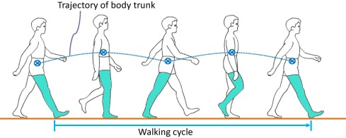
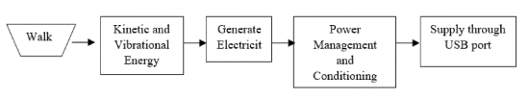
Mechanism Design
Suspended Load Mechanism - The backpack’s internal load is mounted on a sliding frame that allows vertical movement independent of the outer frame. This setup enables the load to oscillate slightly in sync with the user’s walking motion.
Relative Motion for Energy Generation - As the user walks, the vertical displacement between the outer frame (worn by the user) and the suspended load creates a relative motion. This oscillation is harnessed using a mechanical linkage connected to an energy harvesting system.

Slide 11
Mechanism Design
Electromechanical Conversion - A rack and pinion or cable-pulley system converts the vertical motion into rotational energy. This rotational motion is then used to drive an electric generator (e.g., DC motor or electromagnetic coil).
Energy Storage - The electrical energy generated is regulated and stored in a rechargeable battery or capacitor system for later use, such as charging portable devices.
Design Advantages -
Utilizes walking motion without requiring user effort
Maintains comfortable load handling by reducing peak forces on the user
Generates power sustainably during regular mobility

Slide 12
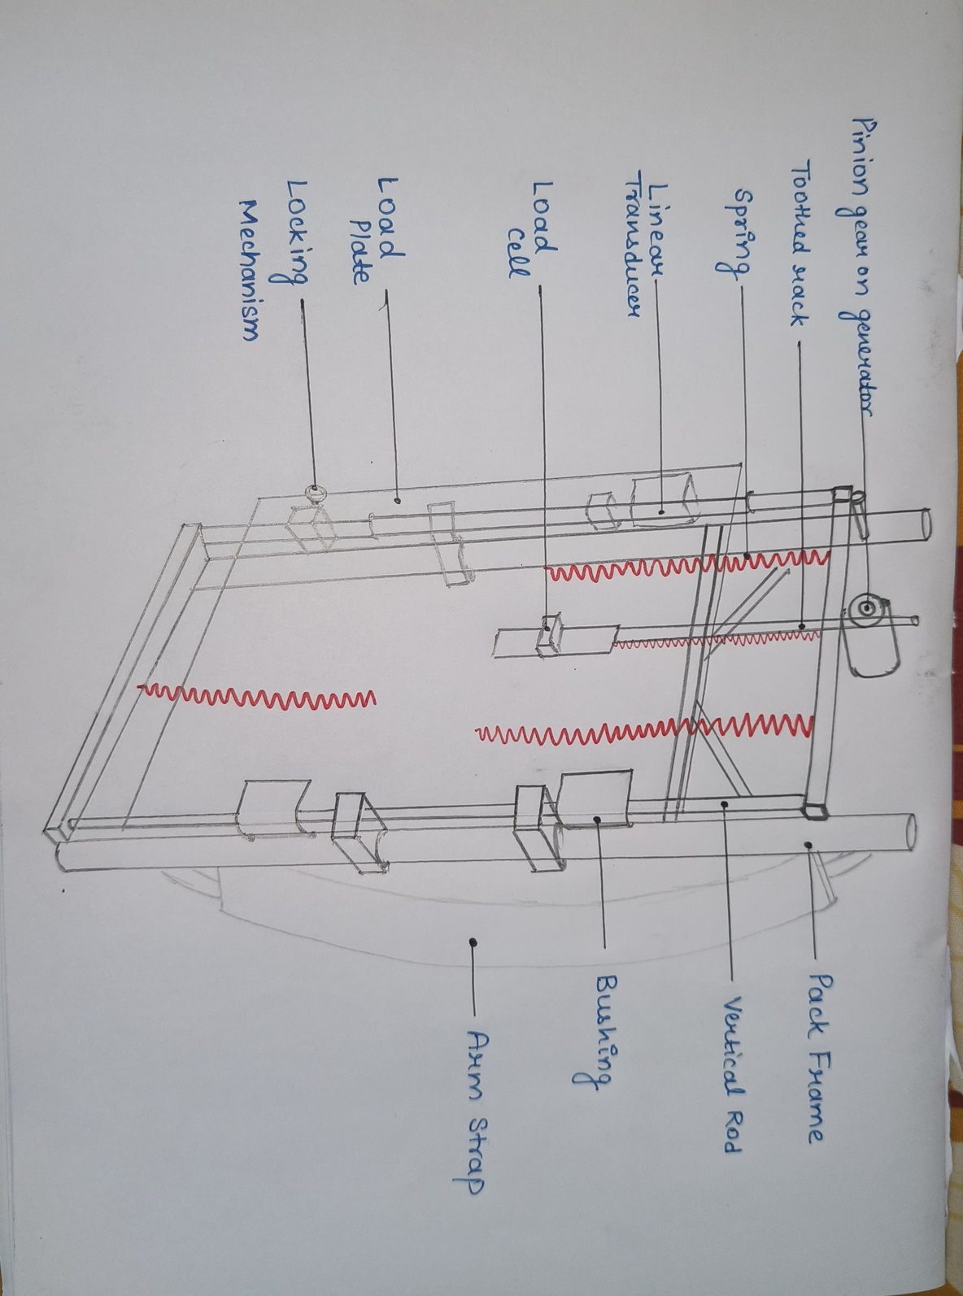
Mechanism Design
In the suspended-load backpack, the pack frame is fixed to the body, but the load, mounted on the load plate, is suspended by springs (red) from the frame.
During walking, the load is free to ride up and down on bushings constrained to vertical rods.
Electricity generation was accomplished by attaching a toothed rack to the load plate, which when moving up and down during walking, meshed with a pinion gear mounted on a geared dc motor, functioning as a generator, rigidly attached to the backpack frame.

Slide 13
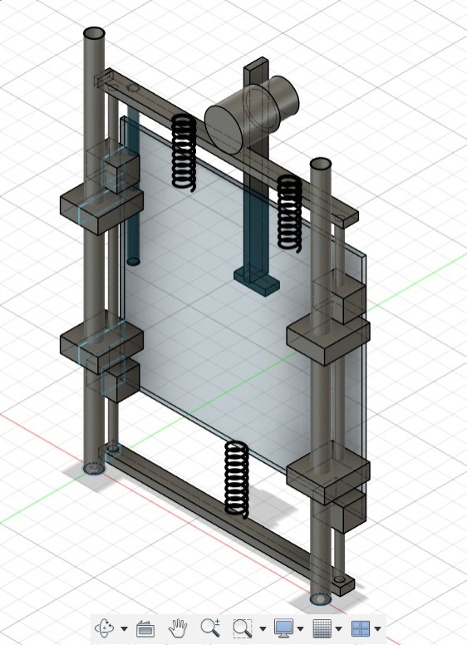
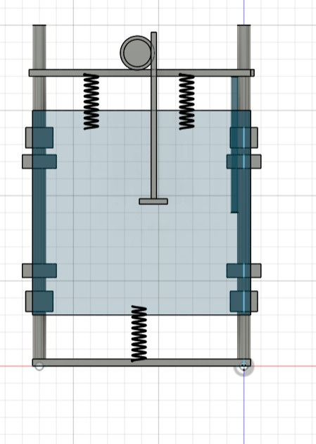
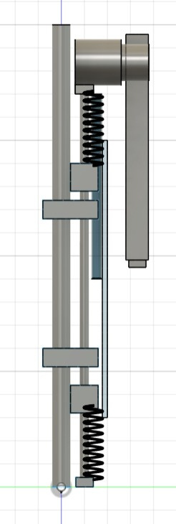
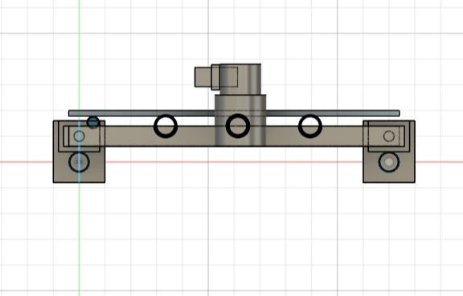
CAD

Slide 14
Kinematic Analysis
Walking Motion Basis -
Human walking resembles inverted pendulum motion – the hip undergoes vertical
displacement of 5–7cm every step.
Load Oscillation -
The suspended load moves vertically up and down in sync with the walking motion.
Relative Travel -
Rack displacement ≈ 6 cm per step
Step frequency ≈ 2 steps/sec → oscillation frequency = 2 Hz
Rack Pinion Rotation -
7 cm travel → 1 rack rotations per step
Speed of pinion rotation ≈ 2400–5000 rpm
Result -
This motion drives a DC motor, converting mechanical input into useful electric power
(8-10 W)

Slide 15
Force Analysis
Load Weight assumed - 10 kg
Dynamic Vertical Acceleration - 2m/s2
Resulting Force on Rack
F=m.a = 10 x 2 = 20m/s2 (excluding gravitational force)
Spring Force (Compression Type) -
Spring stiffness k=200 N/m, travel = 6 cm
Fspring = k.x = 200 x 0.06 = 12N
Torque on Generator Gear -
Gear radius = 2.5 cm
Torque T = F.r = 20 x 0.025 = 0.5Nm
Power Transmitted -
Approx. 8 - 10 W to generator depending on gait and load movement

Slide 16
Basic Dimensional Details
Basic Dimensions (Outer Frame) -
Height - 50cm Width - 35cm Depth - 20cm (Comparable to a standard hiking backpack,
ensuring comfort and usability
Internal Sliding Frame (Load Suspension System)
Vertical travel range: 6–8 cm (oscillation allowance)
Mechanical Transmission System
Rack & Pinion or Pulley setup size: 15 cm × 10 cm × 5 cm
Generator (small brushed DC motor) 5 cm Diameter, 10 cm Length
Battery/Energy Storage Unit
Size: 10 cm × 5 cm × 3 cm Type: Li-ion rechargeable battery (e.g., 3.7V, 2200 mAh)
Total Estimated Weight
Backpack frame & suspension: 2.0–2.5 kg
Generator & electronics: 1 kg
Load (carried by user): variable
Total system (excluding load): ~3.0 - 3.5 kg

Slide 17
Cost Evaluation
Component
Cost(INR)
Backpack frame + Load Suspension
Rs 800
Spring + Rail Guides
Rs 500
Rack & Pinion Gear Mechanism
Rs 500
Generator (DC Motor)
Rs 1000
Voltage Regulation + USB Output
Rs 400
Battery (2200 mAh Li-ion)
Rs 1000
Miscellaneous
Rs 200
Total Estimated Cost
Rs 3500 - 4500

Slide 18
Thank
You

