Slide 1

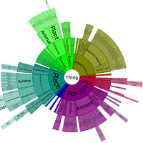


US Air Pollution Explorer
(D3.js + Leaflet)
Information Visualisation
2025-2026
By:
Muhammad Ahmad, ED-DAHMANI Soulaimane, Muhammad Zaryab, Tachon-Panafieu Matthys

Slide 2

Table of Contents
1.
Introduction
2.
Presentation of our dataset
3.
Preprocessing Pipeline
4.
Dashboard Design
5.
Overview of our project
02
Notes:
Human consciousness is influence by a lot of factor including internal, social or environmental factors
Linear mixed models extend simple linear regression. it make LMM ideal for analyzing non independent data arising from hierarchical structures

Slide 3
Our goal
How can we transform a massive multidimensional dataset on air pollution into an intuitive dashboard that provides both a quick overview and the ability to explore the data in depth ?
04
Notes:
Human consciousness is influence by a lot of factor including internal, social or environmental factors
Linear mixed models extend simple linear regression. it make LMM ideal for analyzing non independent data arising from hierarchical structures

Slide 4
Why This Dataset
Motivation & relevance
Real-world relevance
Air quality is a pressing public health issue. Data comes directly from the U.S. EPA — authoritative and well-documented.
Rich temporal data
17 years of daily measurements enable time series analysis, trend detection and seasonal pattern discovery.
Geographic diversity
All 50 U.S. states are represented, enabling spatial comparisons between urban/rural and industrial/residential regions.
Multiple dimensions
Four pollutants × five metrics each = rich multivariate data ideal for interactive visualisation and linked views.
Large enough to require meaningful preprocessing, but structured enough to remain tractable within project scope.
Adequate size
03
Notes:
Human consciousness is influence by a lot of factor including internal, social or environmental factors
Linear mixed models extend simple linear regression. it make LMM ideal for analyzing non independent data arising from hierarchical structures

Slide 5
Data set
U.S. Pollution Data — Kaggle (sogun3/uspollution)
Source
U.S. Environmental Protection Agency (EPA)
Period
2000 – 2016 (17 years of daily readings)
28
Granularity
One row per monitoring site per day
fields per record
Fields
28 columns across 4 pollutants + location + date
Pollutants
NO2, O3, SO2, CO
4
fields per record
Each pollutant
Mean · 1st Max Value · 1st Max Hour · AQI
Coverage
All 50 U.S. states, hundreds of monitoring sites
~1.7M
daily records
Format
CSV, publicly available on Kaggle
05
Notes:
Human consciousness is influence by a lot of factor including internal, social or environmental factors
Linear mixed models extend simple linear regression. it make LMM ideal for analyzing non independent data arising from hierarchical structures

Slide 6
Target Users & Tasks
Who are we designing for, and what do they need to do?
Primary User
Environmental Policy Analyst / Public Health Researcher
Monitors long-term trends in air quality across the U.S.
Compares pollution levels between states and cities
Identifies peak pollution periods and locations
Evaluates impact of environmental policies over time
Communicates findings to non-technical stakeholders
06
Notes:
Human consciousness is influence by a lot of factor including internal, social or environmental factors
Linear mixed models extend simple linear regression. it make LMM ideal for analyzing non independent data arising from hierarchical structures

Slide 7
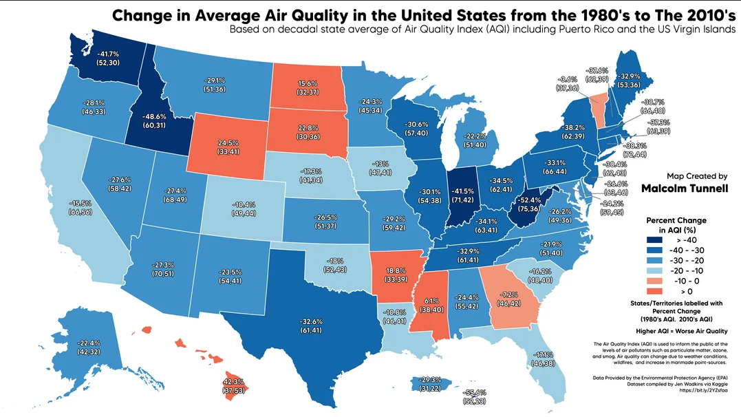
07
Notes:
Human consciousness is influence by a lot of factor including internal, social or environmental factors
Linear mixed models extend simple linear regression. it make LMM ideal for analyzing non independent data arising from hierarchical structures

Slide 8
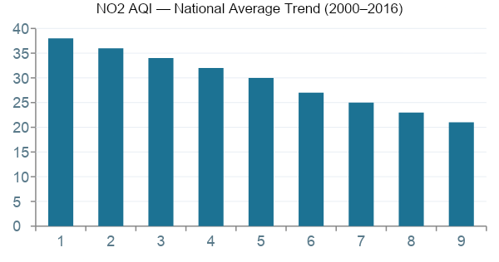
Data Exploration
Initial findings from exploratory data analysis
NO2
O3
SO2
CO
~20 ppb
~20 ppb
~20 ppb
~20 ppb
avg daily mean
avg daily mean
avg daily mean
avg daily mean
Key Findings
NO2 and CO have declined significantly since 2000 — likely due to stricter vehicle emission standards.
O3 shows seasonal spikes in summer months, peaking in hot inland cities.
SO2 has the sharpest decline — attributed to power plant regulations.
Urban areas consistently show 2–4× higher AQI values than rural areas.
Missing values are most common in the CO field — requires imputation strategy.
09
Notes:
Human consciousness is influence by a lot of factor including internal, social or environmental factors
Linear mixed models extend simple linear regression. it make LMM ideal for analyzing non independent data arising from hierarchical structures

Slide 9
Preprocessing Pipeline
Steps taken to clean and prepare the dataset
01 Load & Inspect
Loaded the CSV into Python (pandas). Verified column types, checked for null values, counted unique sites and date ranges.
04 Feature Engineering
Extracted Year, Month, DayOfWeek, Season and IsWeekend from Date Local. Label-encoded State, County, City for ML use.
02 Missing Values
CO field has the most NaNs. Strategy: drop rows missing >2 pollutants; interpolate single-pollutant gaps using date-aware forward-fill within each site.
05 Normalisation
To make different pollutants comparable in visualizations.
03 Deduplication
Multiple sensors at same site on same day. Resolved by grouping by (State, County, City, Date) and averaging numeric fields.
06 Export
Export two datasets:
(a) Cleaned dataset for visualization (original scales preserved),
(b) Normalized dataset for analysis and modeling purposes.
10
Notes:
Human consciousness is influence by a lot of factor including internal, social or environmental factors
Linear mixed models extend simple linear regression. it make LMM ideal for analyzing non independent data arising from hierarchical structures

Slide 10
Framework Justification
Why D3.js + Leaflet.js?
Strengths of D3.js for this project
Full programmatic control over every visual element and interaction
Native support for SVG-based time series, bar charts and heatmaps
Seamless integration with Leaflet.js for geospatial choropleth maps
Brushing and linking between views is a D3 strength
Widely used in academic and journalistic vis — appropriate for this course
Large ecosystem: topojson for U.S. state boundaries, d3-annotation for callouts
Why not alternatives?
Tableau / Power BI
Not allowed per assignment rules.
Plot.ly / Bokeh
Less flexibility for linked spatial+temporal views.
R Shiny
Better for statistical output; less suitable for rich interactive web dashboards.
Challenges & how we will address them
Steeper learning curve than Plot.ly or Bokeh
More boilerplate code required for basic charts
No built-in dashboard layout — requires manual CSS/HTML structure
11
Notes:
Human consciousness is influence by a lot of factor including internal, social or environmental factors
Linear mixed models extend simple linear regression. it make LMM ideal for analyzing non independent data arising from hierarchical structures

Slide 11
Design principles
Who are we designing for, and what do they need to do?
Primary User
Explain the final design decisions:
• Default overview fits on one screen
• Map is the main visual anchor
• Secondary views are separated from the overview
• Consistent pollutant colours across charts
• Overview = quick understanding
• State Profile and Compare = deeper analysis
• Removed unsafe free resizing because it caused overlap
• Focus mode only for the map
12
Notes:
Human consciousness is influence by a lot of factor including internal, social or environmental factors
Linear mixed models extend simple linear regression. it make LMM ideal for analyzing non independent data arising from hierarchical structures

Slide 12
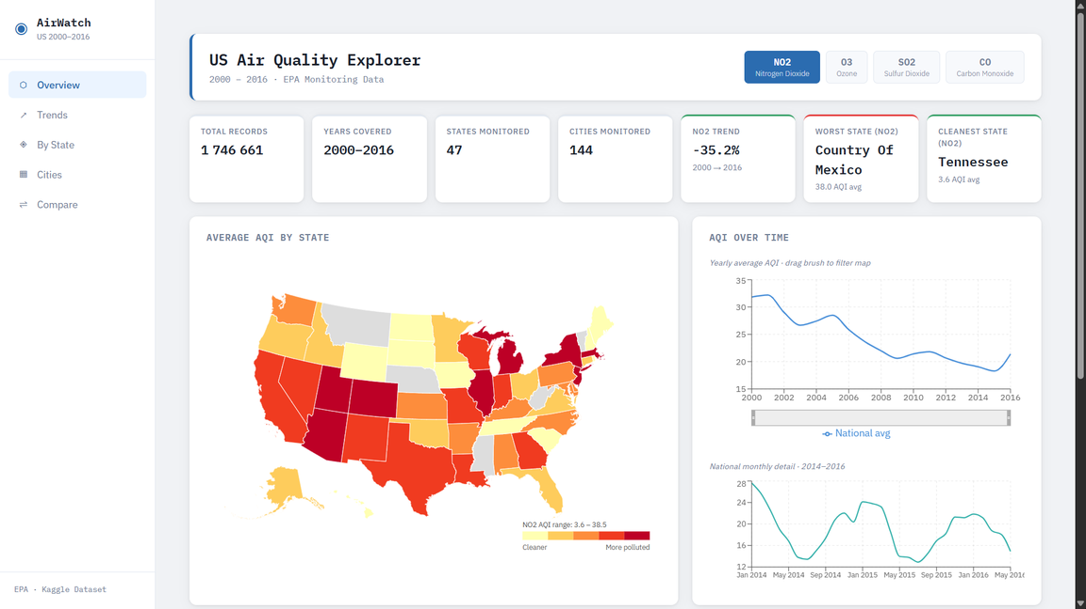
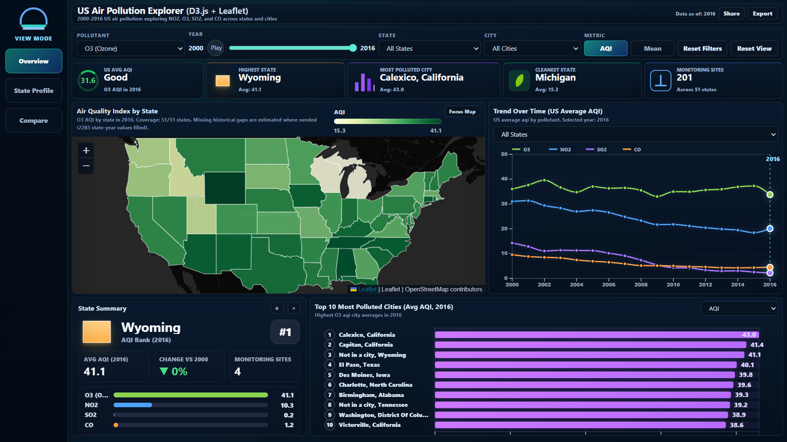
Dashboard Design
Our first Dashboard Design
Our Dashboard Design now
13
Notes:
Human consciousness is influence by a lot of factor including internal, social or environmental factors
Linear mixed models extend simple linear regression. it make LMM ideal for analyzing non independent data arising from hierarchical structures

Slide 13
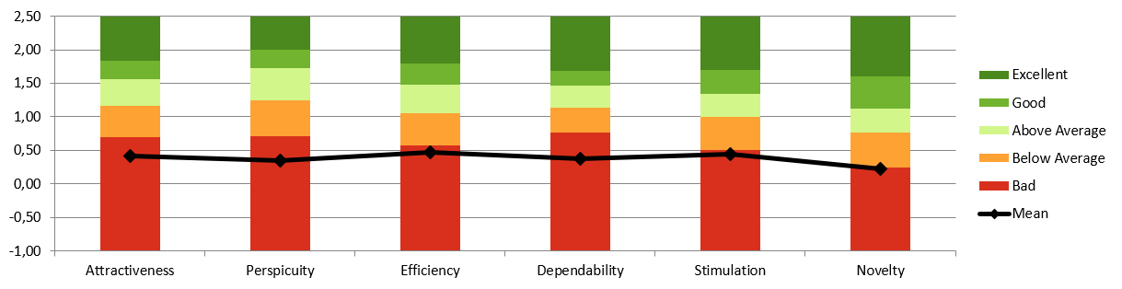
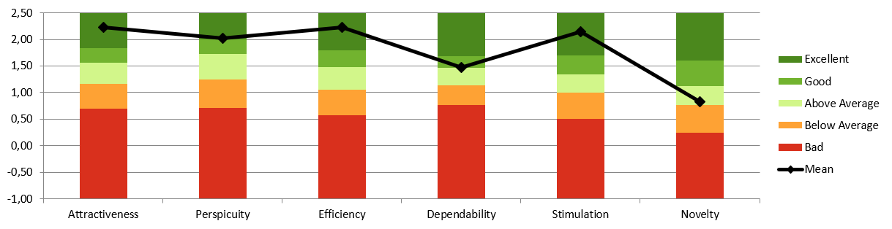
Design Evaluation
Who are we designing for, and what do they need to do?
Before
After
14
Notes:
Human consciousness is influence by a lot of factor including internal, social or environmental factors
Linear mixed models extend simple linear regression. it make LMM ideal for analyzing non independent data arising from hierarchical structures

Slide 14
US Air Pollution Explorer
15
Notes:
Human consciousness is influence by a lot of factor including internal, social or environmental factors
Linear mixed models extend simple linear regression. it make LMM ideal for analyzing non independent data arising from hierarchical structures

Slide 15
Header + Filters
KPI Cards
15
Notes:
Human consciousness is influence by a lot of factor including internal, social or environmental factors
Linear mixed models extend simple linear regression. it make LMM ideal for analyzing non independent data arising from hierarchical structures

Slide 16
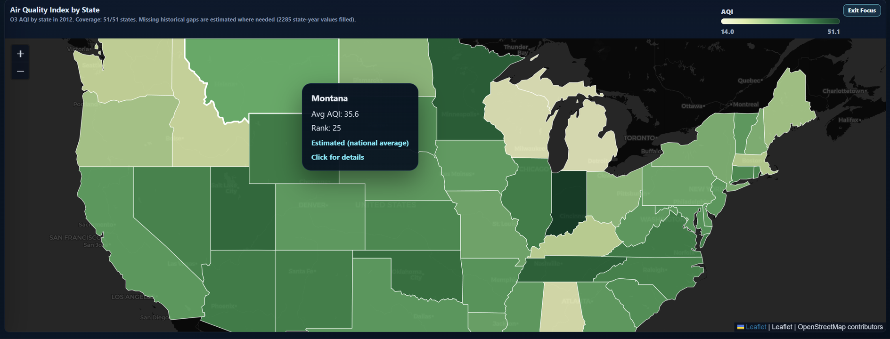
US Pollution Map
15
Notes:
Human consciousness is influence by a lot of factor including internal, social or environmental factors
Linear mixed models extend simple linear regression. it make LMM ideal for analyzing non independent data arising from hierarchical structures

Slide 17
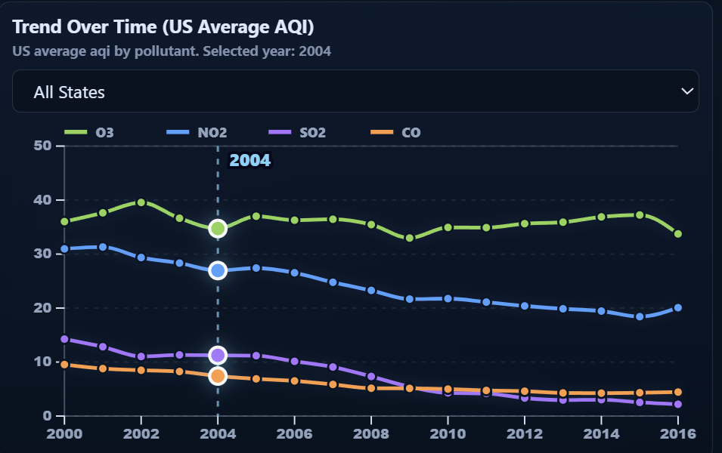
Trend Over Time
15
Notes:
Human consciousness is influence by a lot of factor including internal, social or environmental factors
Linear mixed models extend simple linear regression. it make LMM ideal for analyzing non independent data arising from hierarchical structures

Slide 18

State Summary
15
Notes:
Human consciousness is influence by a lot of factor including internal, social or environmental factors
Linear mixed models extend simple linear regression. it make LMM ideal for analyzing non independent data arising from hierarchical structures

Slide 19
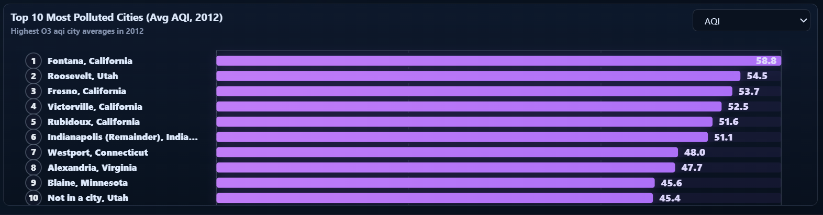
Top 10 Most Polluted Cities
15
Notes:
Human consciousness is influence by a lot of factor including internal, social or environmental factors
Linear mixed models extend simple linear regression. it make LMM ideal for analyzing non independent data arising from hierarchical structures

Slide 20
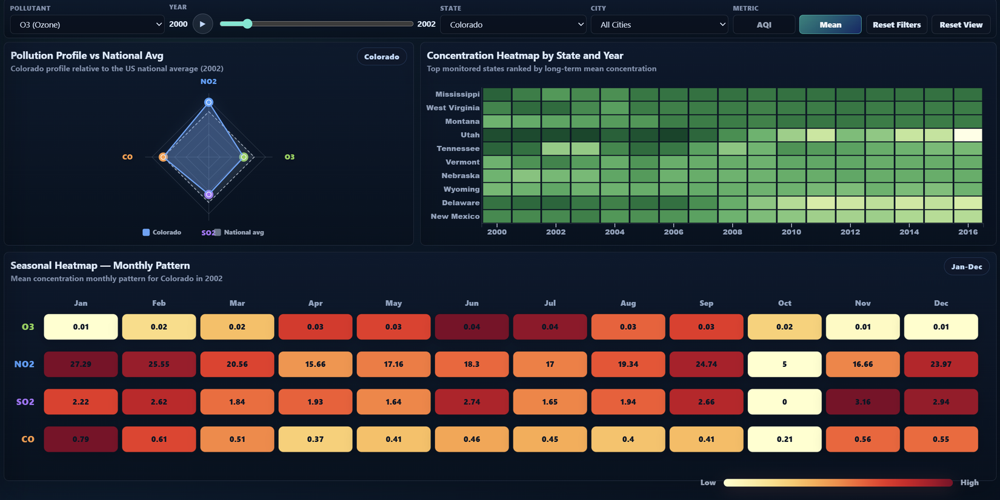
State Profile
(secondary analysis view)
15
Notes:
Human consciousness is influence by a lot of factor including internal, social or environmental factors
Linear mixed models extend simple linear regression. it make LMM ideal for analyzing non independent data arising from hierarchical structures

Slide 21

Compare Mode
15
Notes:
Human consciousness is influence by a lot of factor including internal, social or environmental factors
Linear mixed models extend simple linear regression. it make LMM ideal for analyzing non independent data arising from hierarchical structures

Slide 22
Simulation mode
15
Notes:
Human consciousness is influence by a lot of factor including internal, social or environmental factors
Linear mixed models extend simple linear regression. it make LMM ideal for analyzing non independent data arising from hierarchical structures

Slide 23
Limitations and future work
Who are we designing for, and what do they need to do?
Some AQI gaps remain.
State-level aggregation hides within-state differences.
City rankings are based on monitoring observations, not population exposure.
More complete EPA AQI files would improve data completeness.
Future deployment could make the dashboard easier to access.
More user evaluation would strengthen the conclusions.
16
Notes:
Human consciousness is influence by a lot of factor including internal, social or environmental factors
Linear mixed models extend simple linear regression. it make LMM ideal for analyzing non independent data arising from hierarchical structures

Slide 24
Thanks for your attention

