Slide 1
Master Thesis: Prediction of L3 Handover Event using 3, 4 and 6 features with Machine Learning
Soulaimene Jaoua – MSc Student, Linköping University
Supervisors: Rida Khan, Eunjeong Jeong
Examiner: Nikolaos Pappas
Soulaimene Jaoua
Ericsson
2025-06-10

Slide 2
Objective and context
Goal:
Predict L3 handover events using simulation database (db) files.
Source:
db file data from 30 different seeds simulating “Pedestrian” and “Vehicular” mobility scenarios.
Approach:
ML pipeline using two supervised learning models “XGBoost" and "Random Forest".

Slide 3
L3-handover Triggering – RRC-Based Mobility Management
3. Handover Decision:
The source base station evaluates report and makes a decision to send RRC HO Command
Measurement Configuration:
The UE is configured to monitor signal strength/ quality
2. Measurement Configuration:
The UE monitors signal and sends reports when conditions are met
4. Handover Execution:
The UE connects to the target cell via RRC signaling
Database (db) files are generated for the L3-mobility scenario

Slide 4
Machine learning models
XGBoost Classifier:
Applied for supervised learning to classify handover is happening in the files.
Learns from labeled .db file data to distinguish handover/non-handover occurrences based on the feature importance.
Random Forest Classifier:
Used for supervised learning classification tasks to determine handover occurrence.
Helps the model to classify the two different scenarios of handover occurrence across different number of seeds.

Slide 5
Machine Learning Pipeline
Preprocess data
Extract desired features from db file
Generate
Train
Train random forest and XGboost classifiers on the data
Evaluate
Evaluate and compare the performance of the classifiers using classification metrics
Generate handover labels using event matching

Slide 6
Simulation dataset
db Files Processed: 30 seeds and 4 cases (Single UE Pedestrian, Single UE Vehicle, 10 UEs Pedestrian, 10 UEs Vehicle)
Features:
3 features: {servingCellRSRP, bestCellRSRP, num_cells_fulfilled}
4 features: {servingCellId, bestCellId, rsrp_diff, num_cells_fulfilled}
6 features: {servingCellId, bestCellId, servingCellRSRP, bestCellRSRP, rsrp_diff, num_cells_fulfilled}
Labels: Labeled for handover and non-handover using event matching
Feature Importance: Calculated using permutation importance

Slide 7
Simulation KPI – Receiver Operating Characteristic
What is it?
Evaluates model performance in binary classification.
Key Terms:
TPR (Recall) = TP / (TP + FN)
FPR = FP / (FP + TN)
AUC = Area under ROC curve → higher = better
Interpretation of ROC curve:
Curve closer to top-left = better performance
Diagonal line = random guess
In this thesis:
We measure how well models balance sensitivity vs. specificity in handover prediction

Slide 8
Model configuration
Random Forest Parameters:
n_estimators = 5
Max_depth = 2
Class_weight = 'balanced'
XGBoost Parameters:
n_estimators = 100
max_depth = 5
scale_pos_weight = (class 0 / class 1)

Slide 9
Performance Metrics Summary and Model evaluation
Confusion Matrix
Shows correct and incorrect predictions
Handover vs. non-handover events
Main Metrics
Accuracy: percentage of correct handover predictions
Precision: percentage of correctly predicted samples per class.
Recall: percentage of real handovers found
F1-score: Balance between precision and recall
Why Use Them?
shows how well the model works
F1-score helps when data is imbalanced

Slide 10
Experiment: 3 Features
Features Used:
servingCellRSRP
bestCellRSRP
num_cells_fulfilled
Algorithms:
Random Forest
XGBoost
All scenarios:
1 UE / 10 UEs
Pedestrian / Vehicle

Slide 11
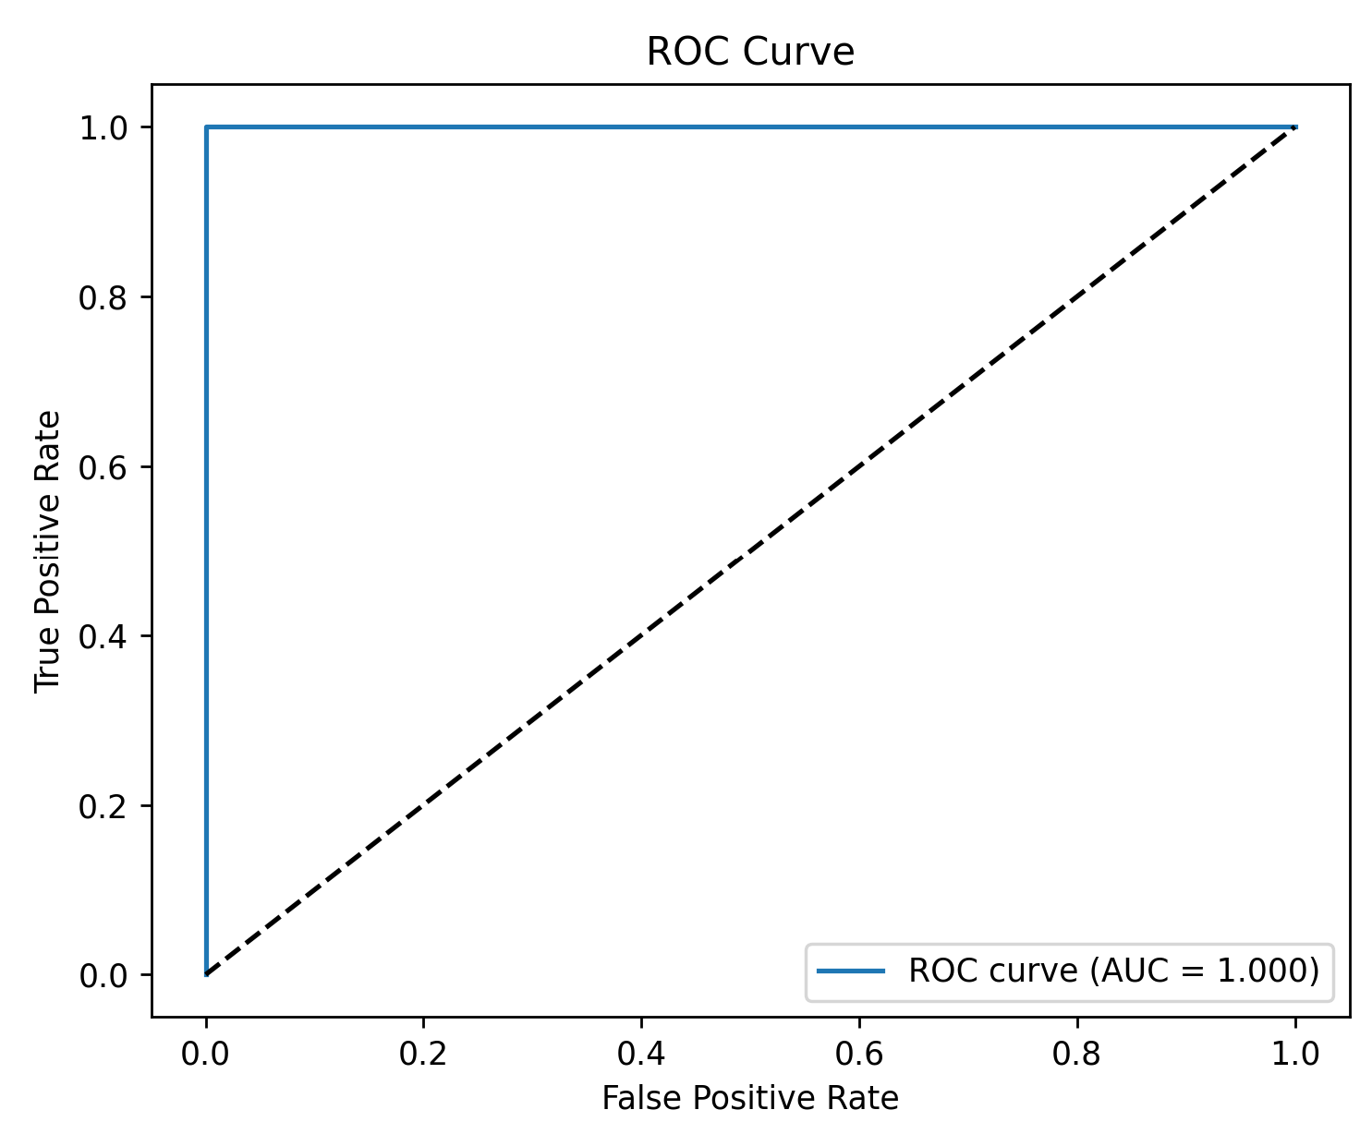
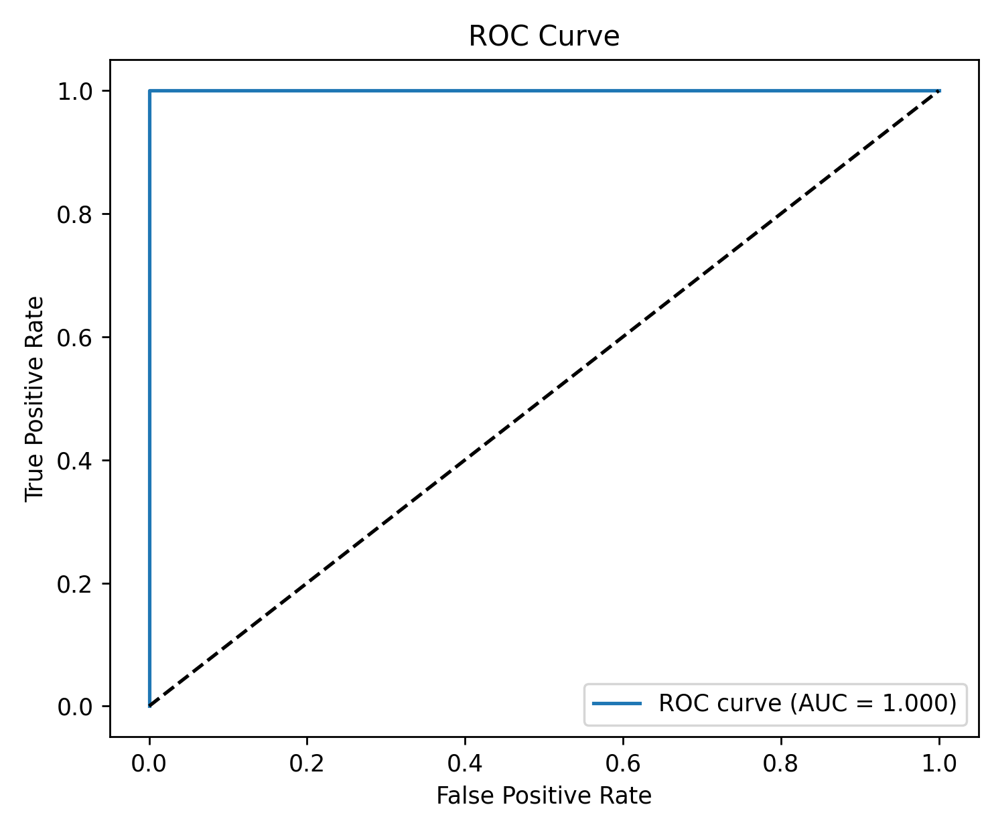
ROC Curve – Vehicle Handover Classifier random forest scenarios for both 1 UE and 10 UE data
Vehicle 1 UE data:
ROC AUC = 1.000 indicating perfect separability
Model predicts flawlessly on test data
Result may reflect either strong feature-label correlation or excellent signal separability in 1 UE scenario
Vehicle 10 UE data:
ROC AUC = 1.000 indicates a complete class separability
Model correctly distinguishes all handover and non-handover samples
Perfect result likely due to features encoding the label logic (fulfilled cells)

Slide 12
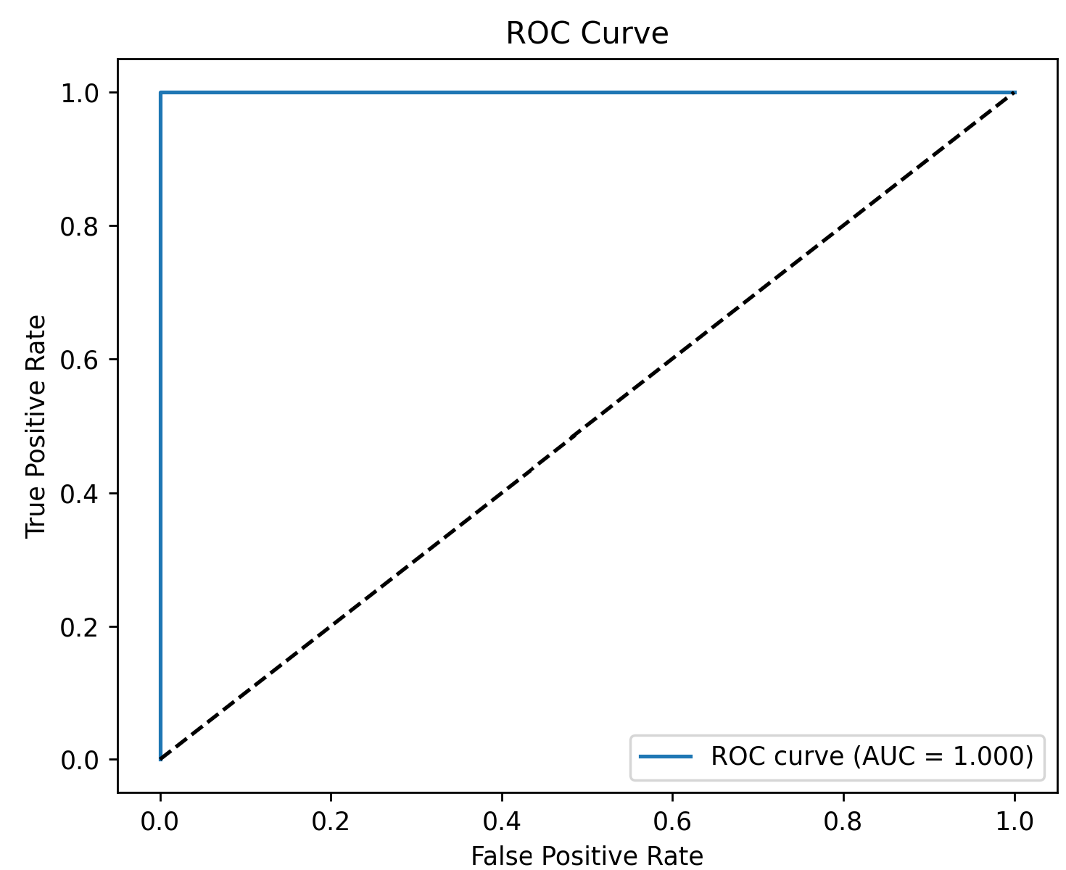
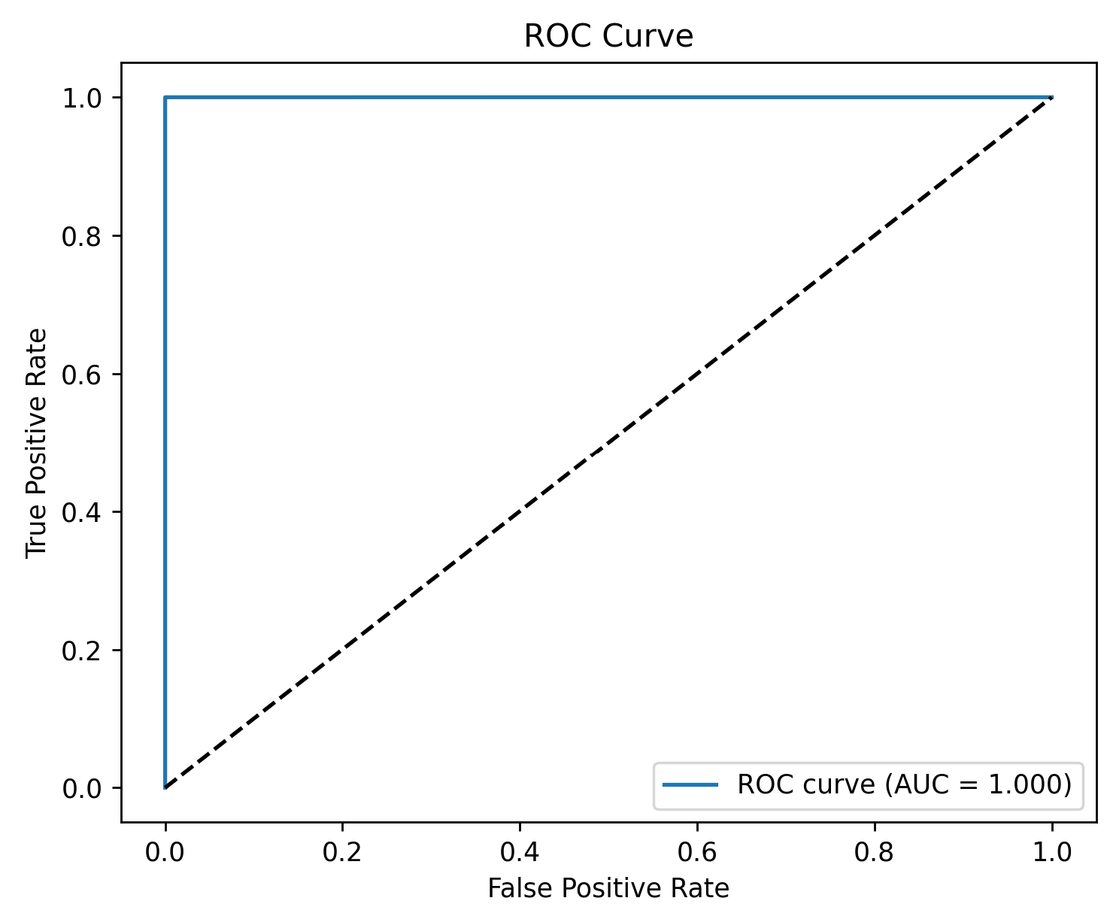
ROC Curve – Pedestrian Handover Classifier random forest scenarios for both 1 UE and 10 UE data
Pedestrian 1 UE data:
AUC = 1.000 (perfect ROC curve)
Model achieves zero test error
Likely influenced by rsrp_diff encoding label condition
Pedestrian 10 UE data:
AUC = 1.000 (perfect classification)
Consistent performance across multiple UEs
Feature-label correlation likely explains result

Slide 13
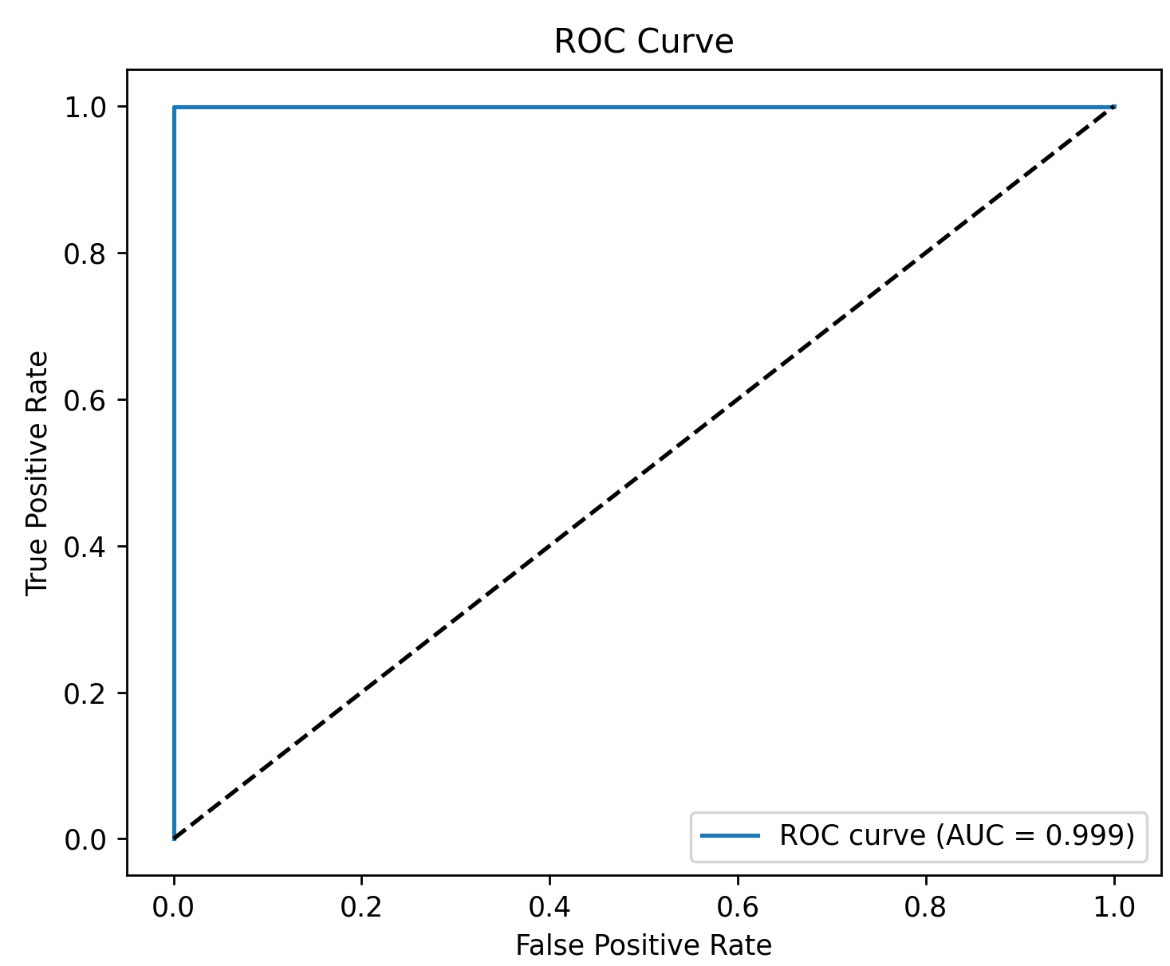
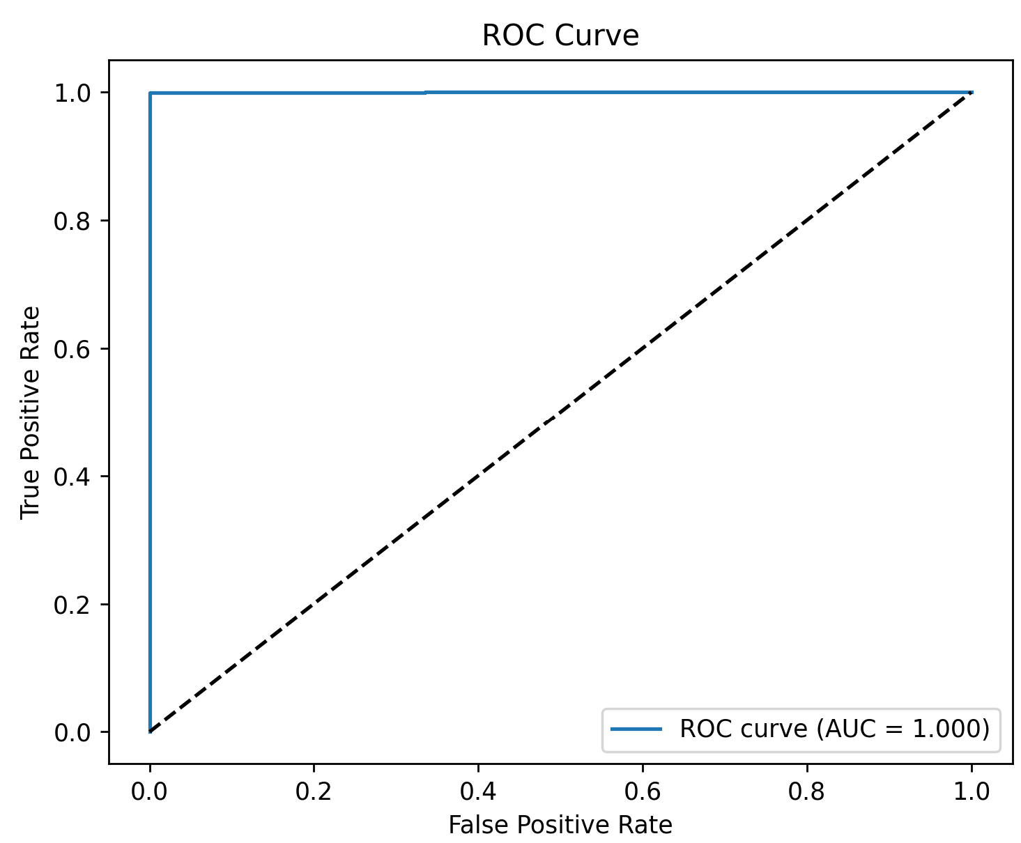
ROC Curve – Vehicle Handover Classifier XGBoost scenarios for both 1 UE and 10 UE data
1 UE Vehicle:
AUC = 0.999 (near perfect classification)
Model separates handover and non-handover events with high accuracy
10 UE Vehicle:
AUC = 1.000 (perfect classification)
Model maintains flawless performance even with increased user density
Results highlight a strong correlation between selected features and handover outcome

Slide 14
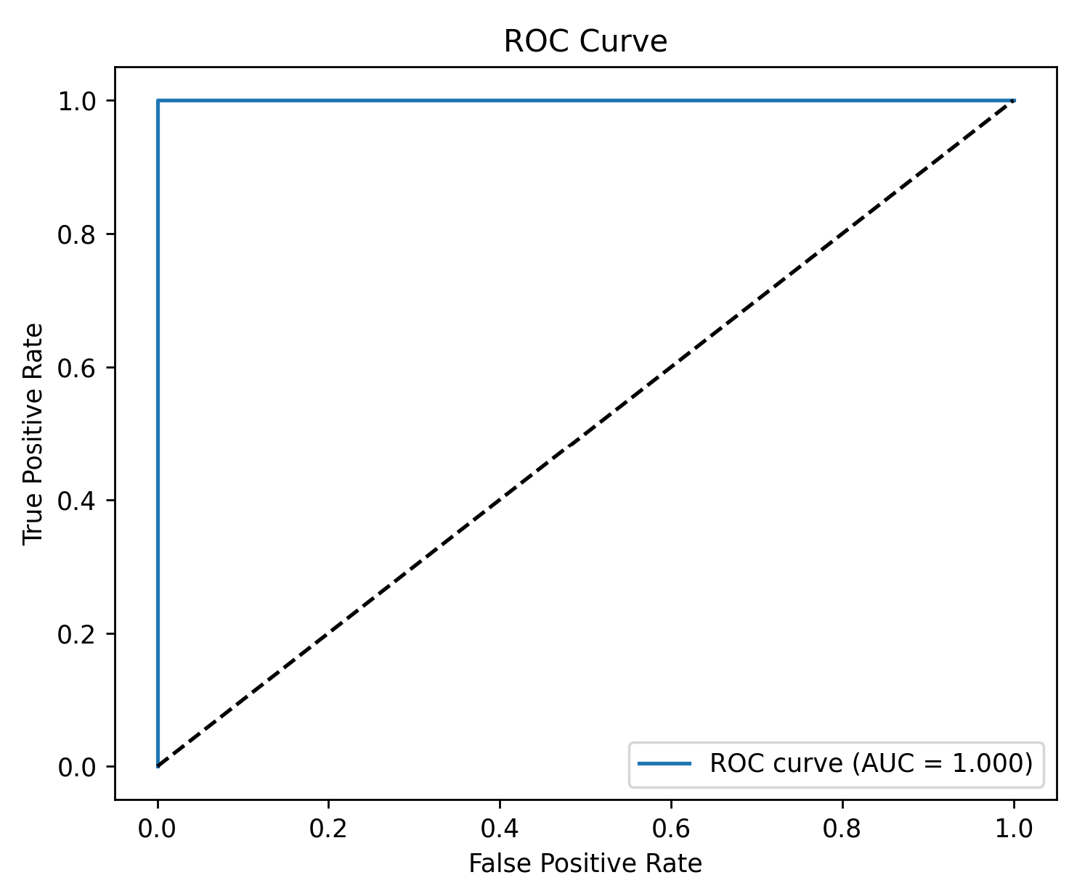

ROC Curve – Pedestrian Handover Classifier XGBoost scenarios for both 1 UE and 10 UE data
1 UE Pedestrian:
AUC = 1.000, indicating near-perfect model performance
Classifier accurately separates handover vs. non-handover events.
Likely due to strong signal separation and low data complexity.
10UE Pedestrian
AUC = 1.000, also showing perfect classification.
Suggests that the feature set (e.g., RSRP difference) is highly predictive even under multi-user interference.

Slide 15
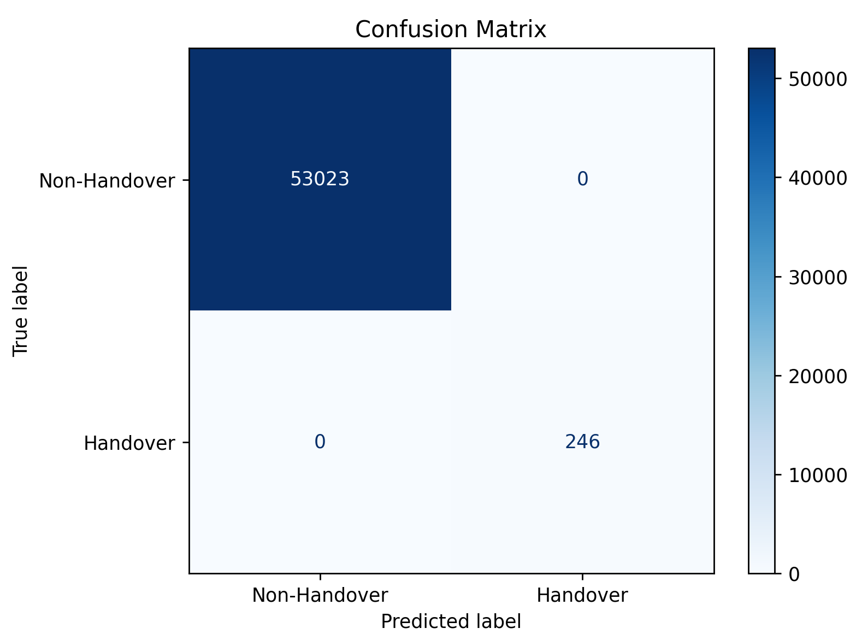
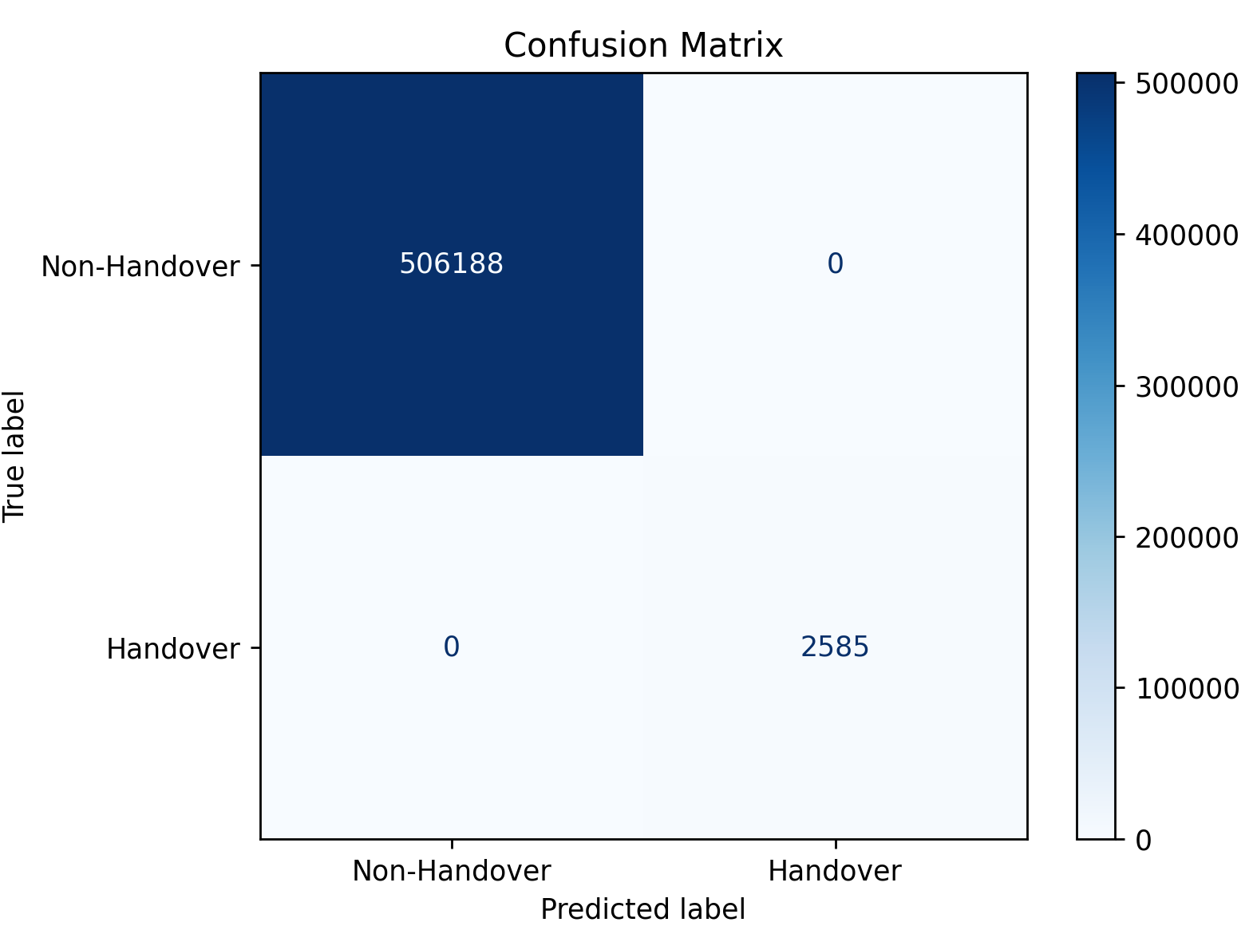
Confusion Matrix Vehicle Data with Random Forest
Single UE Vehicular Mobility data:
All 53023 no-handover and 246 handover samples are classified correctly
Zero false positives or false negatives
Perfect accuracy likely due to feature-label overlap
10 UE Vehicular Mobility data:
506188 no-handover and 2585 handover samples predicted with 100% accuracy
Zero misclassifications

Slide 16
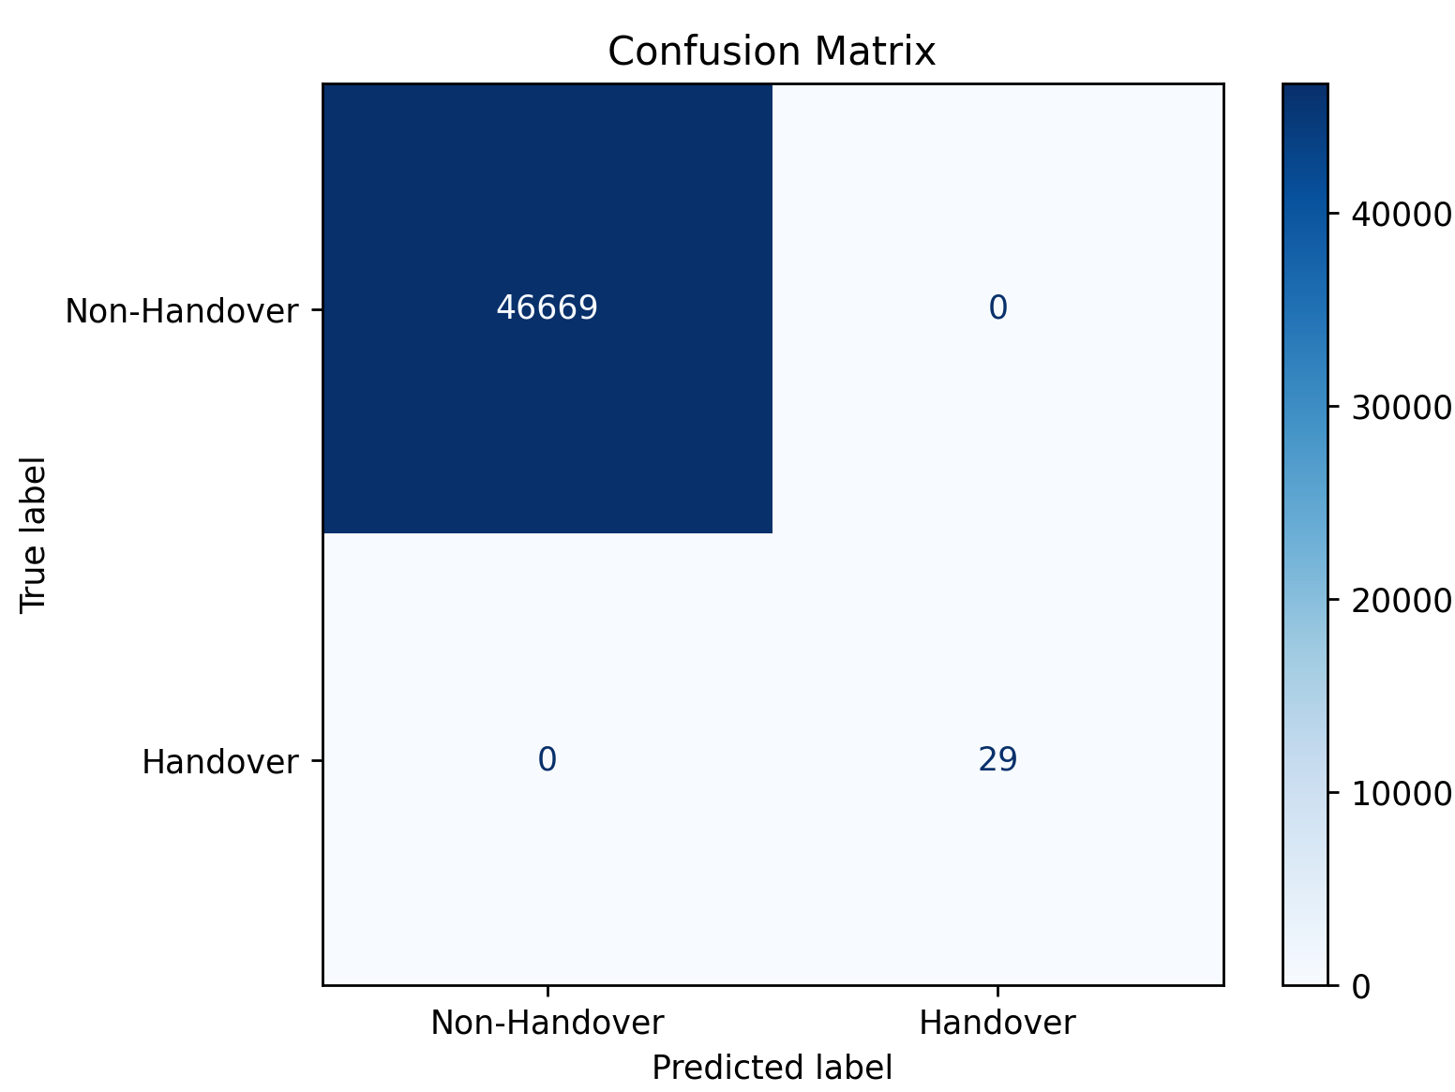
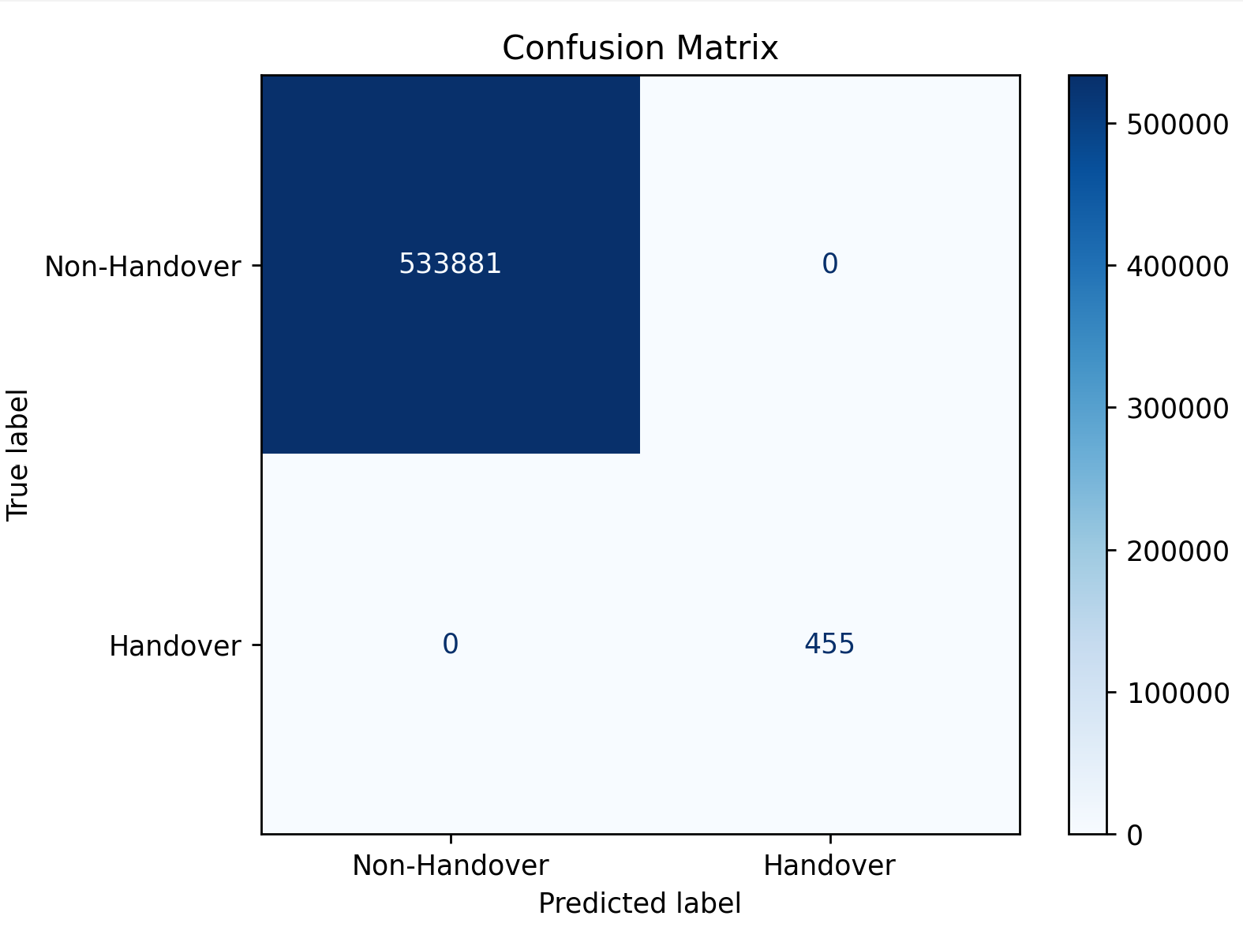
Confusion Matrix Pedestrian Data with Random Forest
Single UE pedestrian Mobility data:
46669 no-handover and 29 handover samples correctly classified
AUC = 1.000, accuracy = 100%
Model perfectly separates classes even without SMOTE
10 UE pedestrian Mobility data:
533881 no-handover and 455 handover samples classified correctly
AUC = 1.000, accuracy = 100%
Model generalizes well across higher user load

Slide 17

Confusion Matrix Vehicle Data with XGBoost
10 UE Vehicular Mobility data
506188 no-handover and 2588 handover samples classified with zero error
AUC = 1.000, no false positives or negatives
Even under higher load the model maintains perfect accuracy
Single UE Vehicular Mobility data:
53023 no-handover and 246 handover samples predicted correctly
AUC = 1.000, accuracy = 100%
Model achieved perfect classification without SMOTE

Slide 18

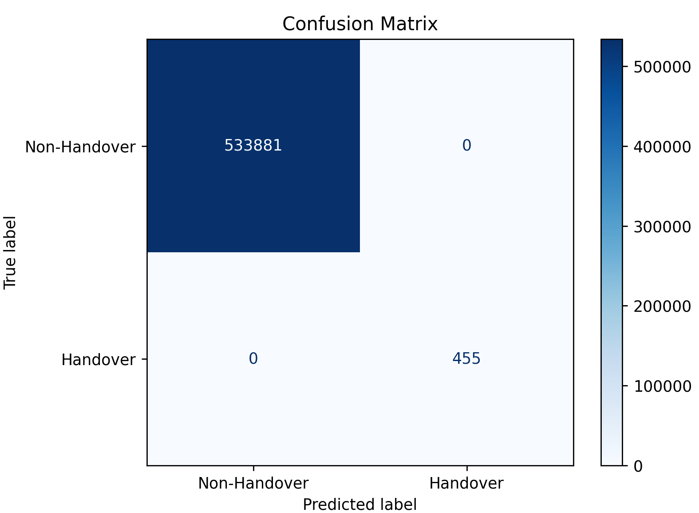
Confusion Matrix Pedestrian Data with XGBoost
10 UE Pedestrian Mobility data:
533881 no-handover and 455 handover samples classified with zero error
AUC = 1.000, accuracy = 100%
High performance reflects model’s sensitivity to signal features and user mobility patterns
Single UE Pedestrian Mobility data:
46669 no-handover and 29 handover samples predicted correctly
AUC = 1.000, accuracy = 100%
SMOTE balanced class 1 (handover) in training

Slide 19
Evaluation Across number of UE and the UE mobility scenarios for Random Forest
Metric | Pedestrian – 1 UE | Pedestrian – 10 UEs | Vehicle – 1 UE | Vehicle – 10 UEs
Accuracy | 1.0 | 1.0 | 1.0 | 1.0
Precision (0) | 1.0 | 1.0 | 1.0 | 1.0
Recall (0) | 1.0 | 1.0 | 1.0 | 1.0
F1-Score (0) | 1.0 | 1.0 | 1.0 | 1.0
Precision (1) | 1.0 | 1.0 | 1.0 | 1.0
Recall (1) | 1.0 | 1.0 | 1.0 | 1.0
F1-Score (1) | 1.0 | 1.0 | 1.0 | 1.0

Slide 20
Evaluation Across number of UE and the UE mobility scenarios for XGBoost
Metric | Pedestrian – 1 UE | Pedestrian – 10 UEs | Vehicle – 1 UE | Vehicle – 10 UEs
Accuracy | 1.0 | 1.0 | 1.0 | 1.0
Precision (0) | 1.0 | 1.0 | 1.0 | 1.0
Recall (0) | 1.0 | 1.0 | 1.0 | 1.0
F1-Score (0) | 1.0 | 1.0 | 1.0 | 1.0
Precision (1) | 1.0 | 1.0 | 1.0 | 1.0
Recall (1) | 1.0 | 1.0 | 1.0 | 1.0
F1-Score (1) | 1.0 | 1.0 | 1.0 | 1.0

Slide 21
Experiment: 4 Features
Features Used:
servingCellId
bestCellId
rsrp_diff
Algorithms:
Random Forest
XGBoost
All scenarios:
1 UE / 10 UEs
Pedestrian / Vehicle
num_cells_fulfilled

Slide 22

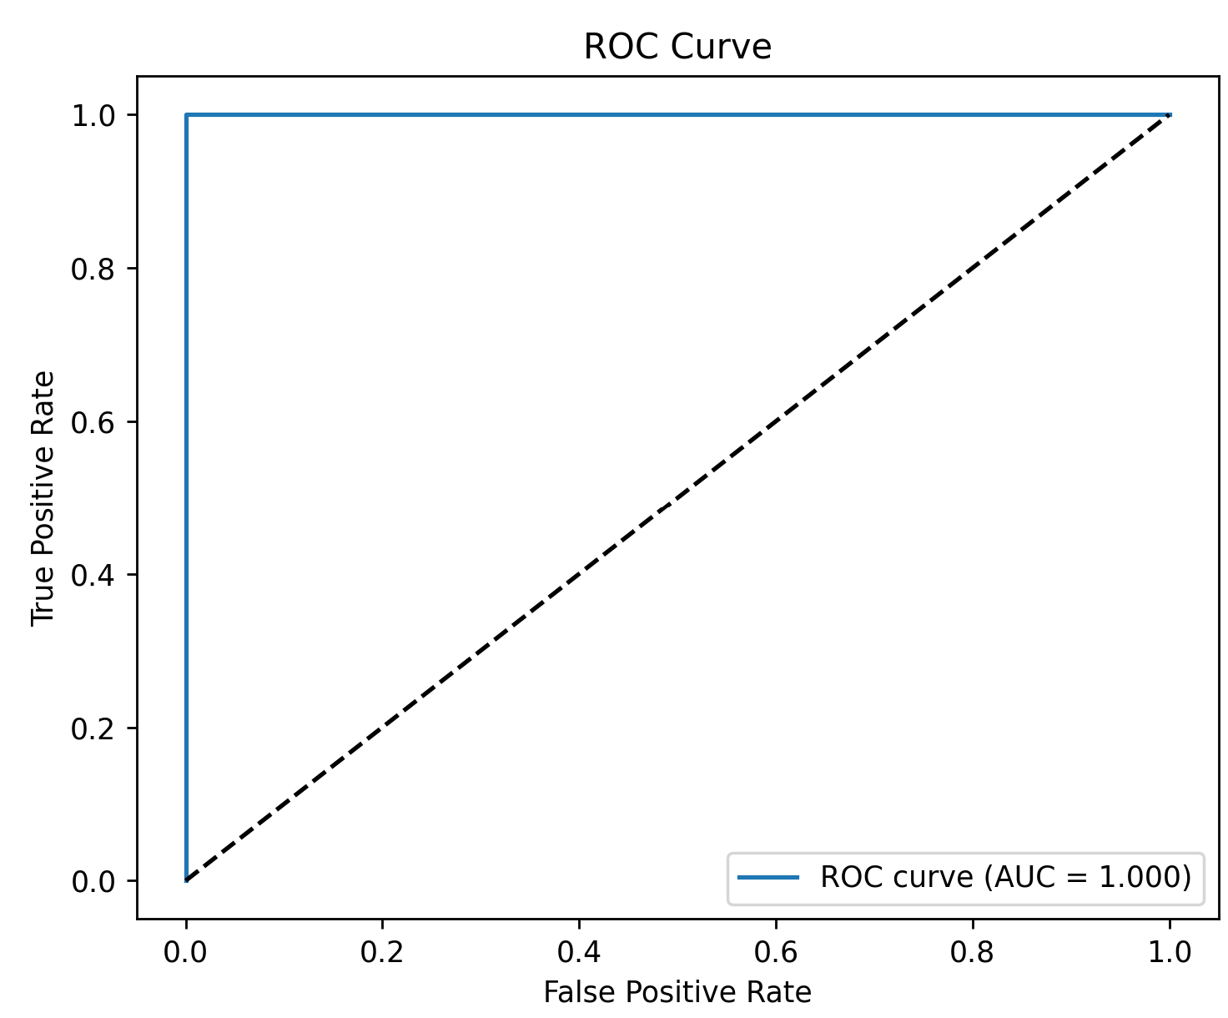
ROC Curve – Vehicle Handover Classifier random forest scenarios for both 1 UE and 10 UE data
Vehicle 1 UE data:
ROC AUC = 1.000 indicating perfect separability
Model predicts flawlessly on test data
Result may reflect either strong feature-label correlation or excellent signal separability in 1 UE scenario
Vehicle 10 UE data:
ROC AUC = 1.000 indicates a complete class separability
Model correctly distinguishes all handover and non-handover samples
Perfect result likely due to features encoding the label logic (RSRP difference or fulfilled cells)

Slide 23
ROC Curve – Pedestrian Handover Classifier random forest scenarios for both 1 UE and 10 UE data
Pedestrian 1 UE data:
AUC = 1.000 (perfect ROC curve)
Model achieves zero test error
Likely influenced by rsrp_diff encoding label condition
Pedestrian 10 UE data:
AUC = 1.000 (perfect classification)
Consistent performance across multiple UEs
Feature-label correlation likely explains result

Slide 24
ROC Curve – Vehicle Handover Classifier XGBoost scenarios for both 1 UE and 10 UE data
1 UE Vehicle:
AUC = 1.000 (perfect classification)
Model separates classes without error
10 UE Vehicle:
AUC = 1.000 (flawless prediction)
Similar result despite higher user density
This indicates strong feature-label correlation

Slide 25
ROC Curve – Pedestrian Handover Classifier XGBoost scenarios for both 1 UE and 10 UE data
1 UE Pedestrian:
AUC = 1.000, indicating perfect model performance.
Classifier accurately separates handover vs. non-handover events.
Likely due to strong signal separation and low data complexity.
10UE Pedestrian
AUC = 1.000, also showing perfect classification.
Suggests that the feature set (e.g., RSRP difference) is highly predictive even under multi-user interference.
However, perfect AUC may signal overfitting or data leakage — further validation may be required.

Slide 26

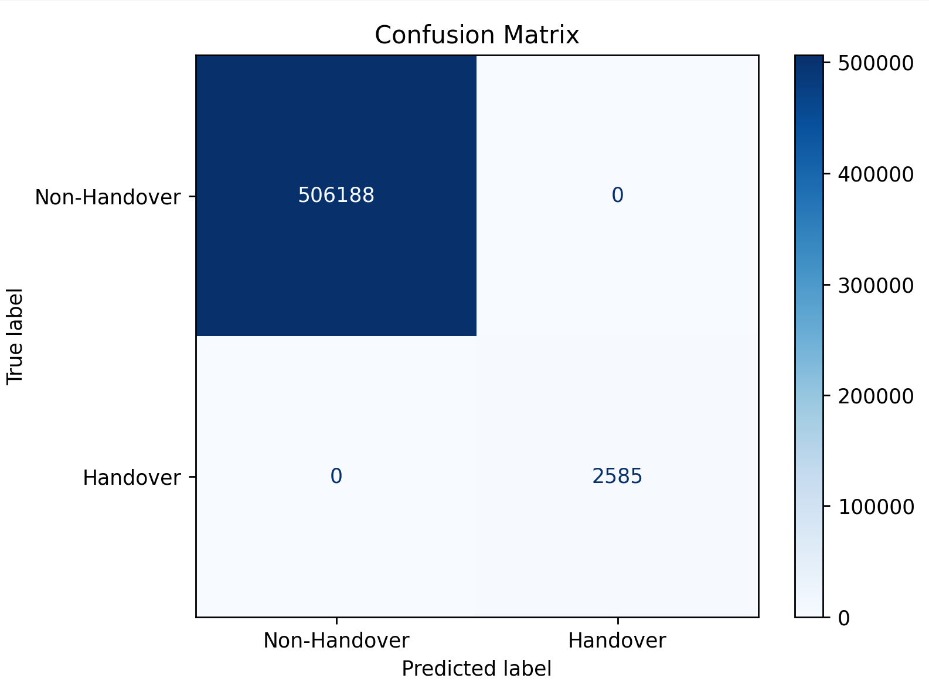
Confusion Matrix Vehicle Data with Random forest
Single UE Vehicular Mobility data:
All 53023 no-handover and 246 handover samples are classified correctly
Zero false positives or false negatives
Perfect accuracy likely due to feature-label overlap
10 UE Vehicular Mobility data:
506188 no-handover and 2588 handover samples predicted with 100% accuracy
Zero misclassifications
Feature set likely reveals label condition directly, suggesting overfitting

Slide 27
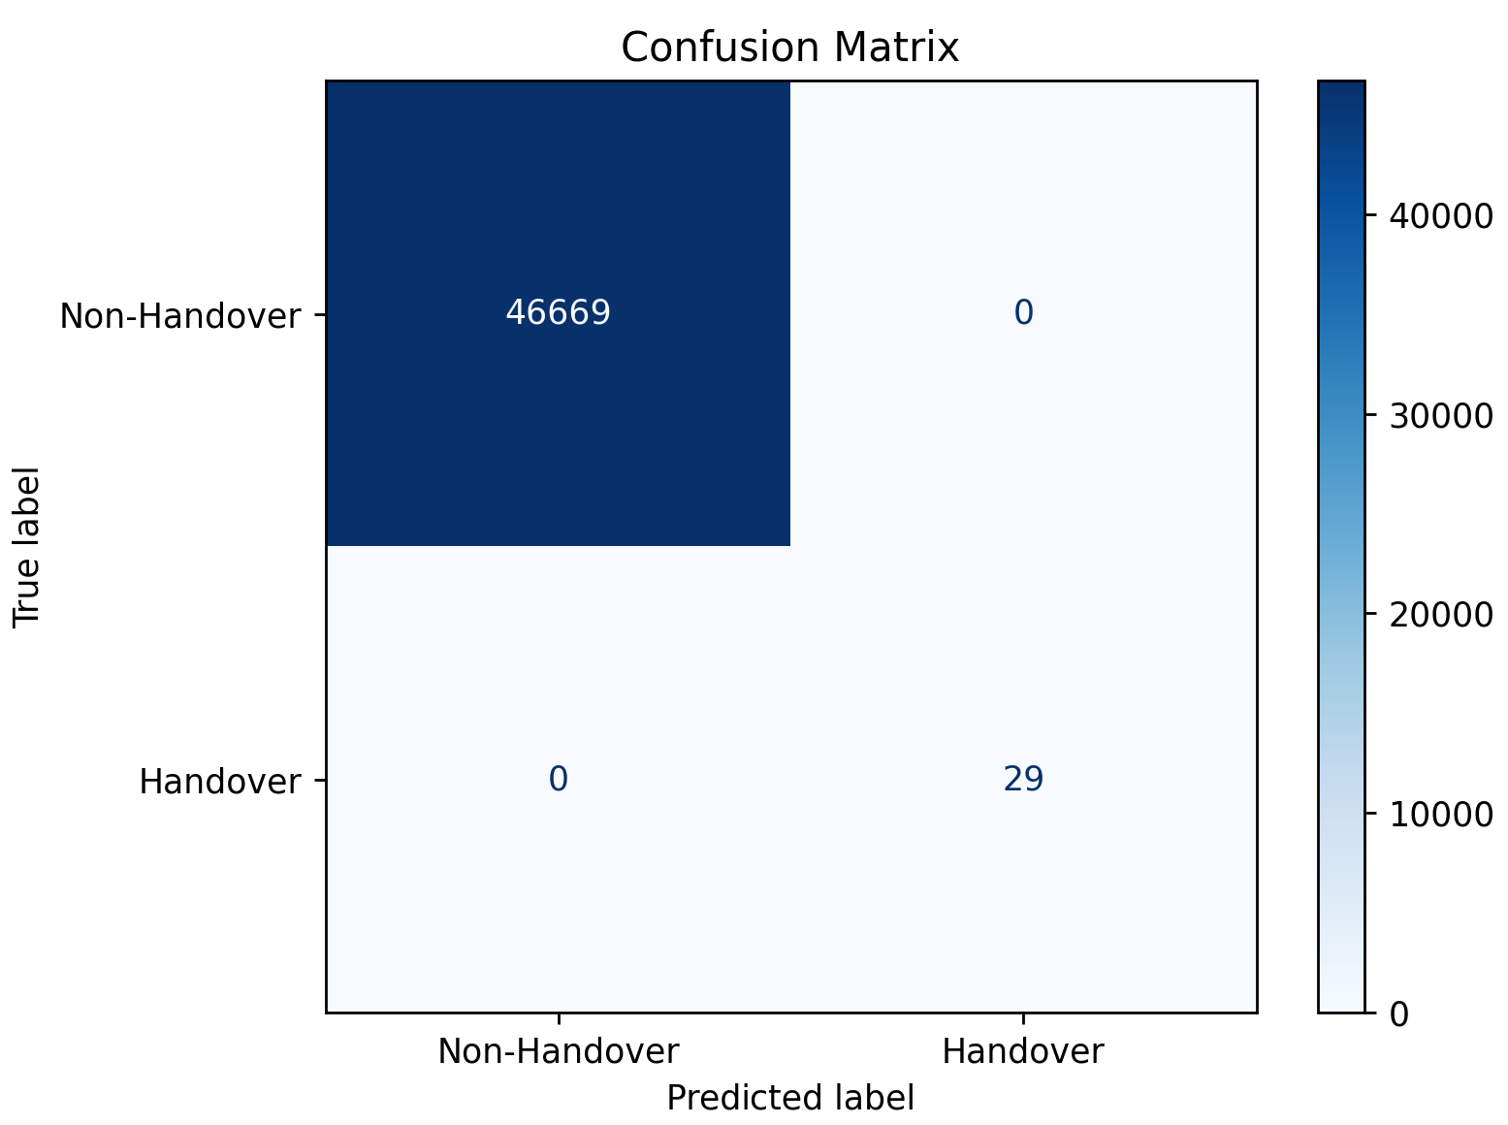
Confusion Matrix Pedestrian Data with Random forest
Single UE pedestrian Mobility data:
46669 no-handover and 29 handover samples correctly classified
AUC = 1.000, accuracy = 100%
Model perfectly separates classes even without SMOTE
Likely driven by strong RSRP feature separation
10 UE pedestrian Mobility data:
533881 no-handover and 455 handover samples classified correctly
AUC = 1.000, accuracy = 100%
Model generalizes well across higher user load

Slide 28


Confusion Matrix Vehicle Data with XGBoost
10 UE Vehicular Mobility data
506188 no-handover and 2585 handover samples classified with zero error
AUC = 1.000, no false positives or negatives
Even under higher load, model maintains perfect accuracy
Performance suggests strong feature-label correlation
Single UE Vehicular Mobility data:
53023 no-handover and 246 handover samples predicted correctly
AUC = 1.000, accuracy = 100%
Model achieved perfect classification without SMOTE

Slide 29
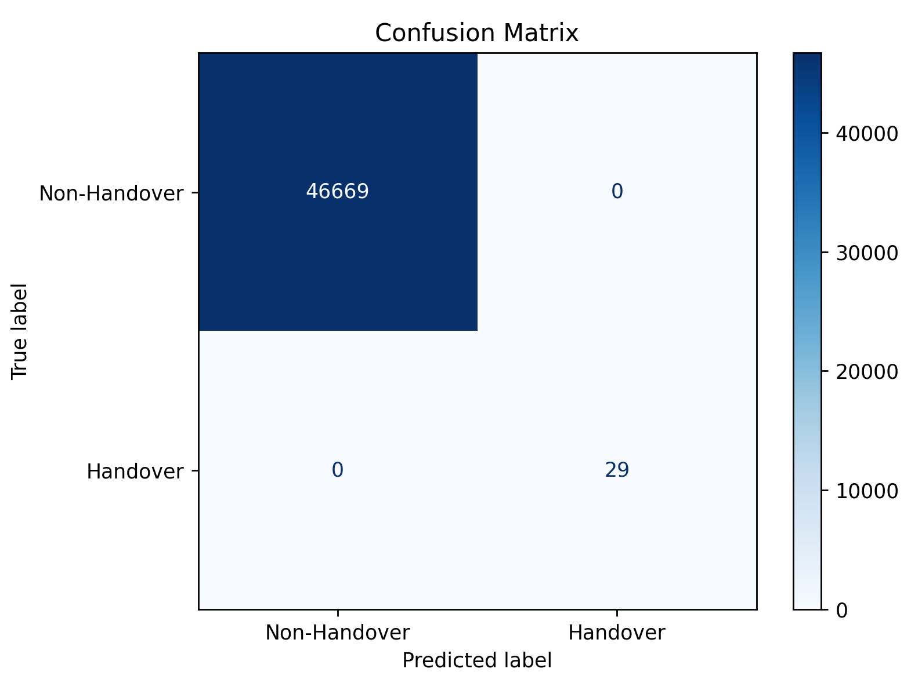

Confusion Matrix Pedestrian Data with XGBoost
10 UE Pedestrian Mobility data:
533881 no-handover and 455 handover samples classified with zero error
AUC = 1.000, accuracy = 100%
SMOTE helped to rebalance handover samples before training
High performance reflects model’s sensitivity to signal features and user mobility patterns
Single UE Pedestrian Mobility data:
46669 no-handover and 29 handover samples predicted correctly
AUC = 1.000, accuracy = 100%
SMOTE balanced class 1 (handover) in training
Model performed perfectly, likely due to strong alignment between features and label logic (rsrp_diff, cell ID)

Slide 30
Evaluation Across number of UE and the UE mobility scenarios for Random forest
Metric | Pedestrian–1 UE | Pedestrian – 10 UEs | Vehicle – 1 UE | Vehicle – 10 UEs
Accuracy | 1.0 | 1.0 | 1.0 | 1.0
Precision (0) | 1.0 | 1.0 | 1.0 | 1.0
Recall (0) | 1.0 | 1.0 | 1.0 | 1.0
F1-Score (0) | 1.0 | 1.0 | 1.0 | 1.0
Precision (1) | 1.0 | 1.0 | 1.0 | 1.0
Recall (1) | 1.0 | 1.0 | 1.0 | 1.0
F1-Score (1) | 1.0 | 1.0 | 1.0 | 1.0

Slide 31
Evaluation Across number of UE and the UE mobility scenarios for XGBoost
Metric | Pedestrian – 1 UE | Pedestrian – 10 UEs | Vehicle – 1 UE | Vehicle – 10 UEs
Accuracy | 1.0 | 1.0 | 1.0 | 1.0
Precision (0) | 1.0 | 1.0 | 1.0 | 1.00
Recall (0) | 1.0 | 1.0 | 1.0 | 1.00
F1-Score (0) | 1.0 | 1.0 | 1.0 | 1.00
Precision (1) | 1.0 | 1.0 | 1.0 | 1.00
Recall (1) | 1.0 | 1.0 | 1.0 | 1.00
F1-Score (1) | 1.0 | 1.0 | 1.0 | 1.00

Slide 32
Experiment: 6 Features
Features Used:
servingCellId
bestCellId
servingCellRSRP
Algorithms:
Random Forest
XGBoost
All scenarios:
1 UE / 10 UEs
Pedestrian / Vehicle
bestCellRSRP
rsrp_diff
num_cells_fulfilled

Slide 33
ROC Curve – Vehicle Handover Classifier random forest scenarios for both 1 UE and 10 UE data
Vehicle 1 UE data:
ROC AUC = 1.000 indicating perfect separability
Model predicts flawlessly on test data
Result may reflect either strong feature-label correlation or excellent signal separability in 1 UE scenario
Vehicle 10 UE data:
ROC AUC = 1.000 indicates a complete class separability
Model correctly distinguishes all handover and non-handover samples
Perfect result likely due to features encoding the label logic (RSRP difference or fulfilled cells)

Slide 34
ROC Curve – Pedestrian Handover Classifier random forest scenarios for both 1 UE and 10 UE data
Pedestrian 1 UE data:
AUC = 1.000 (perfect ROC curve)
Model achieves zero test error
Likely influenced by rsrp_diff encoding label condition
Pedestrian 10 UE data:
AUC = 1.000 (perfect classification)
Consistent performance across multiple UEs
Feature-label correlation likely explains result

Slide 35

ROC Curve – Vehicle Handover Classifier XGBoost scenarios for both 1 UE and 10 UE data
1 UE Vehicle:
AUC = 1.000 (perfect classification)
Model separates classes without error
10 UE Vehicle:
AUC = 1.000 (flawless prediction)
Similar result despite higher user density
This indicates strong feature-label correlation

Slide 36
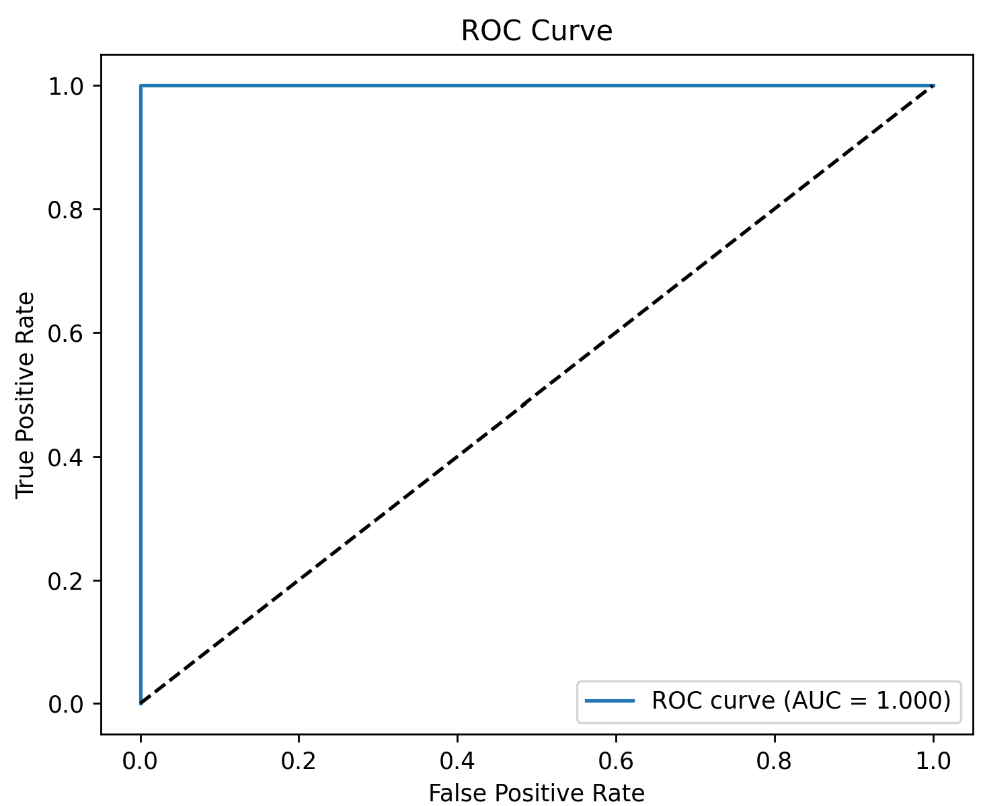

ROC Curve – Pedestrian Handover Classifier XGBoost scenarios for both 1 UE and 10 UE data
1 UE Pedestrian:
AUC = 1.000, indicating perfect model performance.
Classifier accurately separates handover vs. non-handover events.
Likely due to strong signal separation and low data complexity.
10UE Pedestrian
AUC = 1.000, also showing perfect classification.
The feature set (RSRP difference) is highly predictive even under multi-user interference.

Slide 37


Confusion Matrix Vehicle Data with Random forest
Single UE Vehicular Mobility data:
There are 246 handover samples and 52182 non handover samples
841 false handovers (precision = 0.23)
High sensitivity, low specificity due to class imbalance
10 UE Vehicular Mobility data:
All 506188 non-handovers and 2585 handovers correctly classified
No false positives or false negatives
Precision and recall = 1.00 (perfect accuracy)

Slide 38


Confusion Matrix Pedestrian Data with Random forest
Single UE pedestrian Mobility data:
28/29 handovers correctly detected (recall = 0.97)
All 46669 non-handovers correctly classified (no false positives)
One handover missed (false negative)
High precision and recall; near-perfect classification
10 UE pedestrian Mobility data:
All 533881 handovers and 455 non-handover samples are correctly classified
No missed handovers.

Slide 39
Confusion Matrix Vehicle Data with XGBoost
10 UE Vehicular Mobility data
All 506188 non-handovers and 2585 handovers correctly classified
No false positives or false negatives
Perfect accuracy: precision and recall = 1.00
Single UE Vehicular Mobility data:
All 246 handovers and 53,023 non-handovers correctly classified
No false positives or false negatives
Perfect accuracy: precision and recall = 1.00

Slide 40
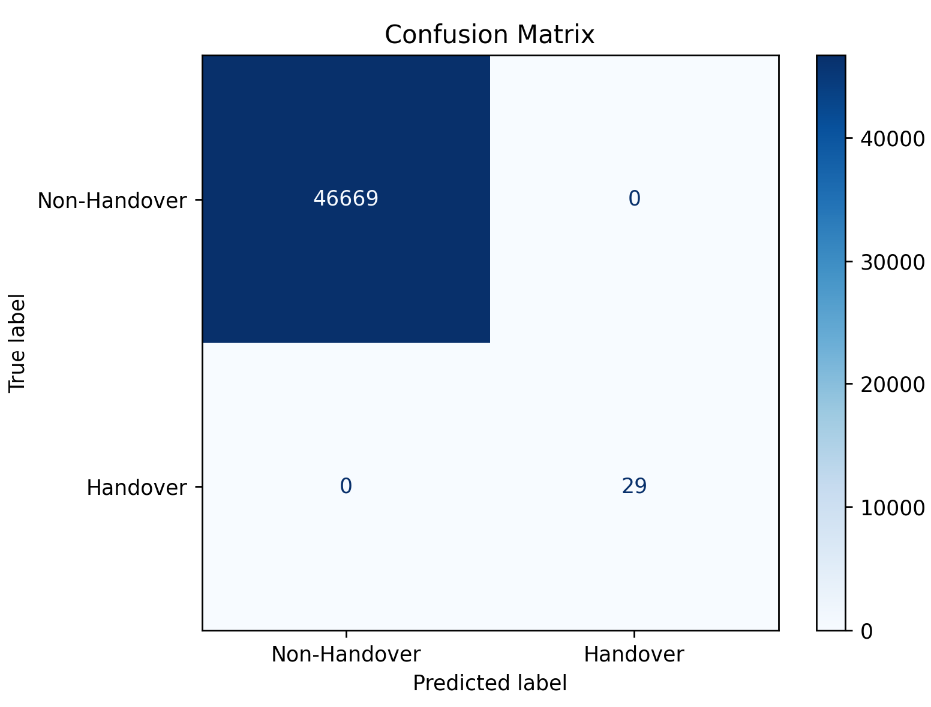
Confusion Matrix Pedestrian Data with XGBoost
10 UE Pedestrian Mobility data:
All 455 handovers and 533,881 non-handovers correctly classified
No false positives or false negatives
Perfect accuracy: precision and recall = 1.00
Single UE Pedestrian Mobility data:
All 29 handovers and 46669 non-handovers correctly classified
No false positives or false negatives
Perfect accuracy: precision and recall = 1.00

Slide 41
Evaluation Across number of UE and the UE mobility scenarios for Random forest
Metric | Pedestrian-1UE | Pedestrian-10UEs | Vehicle-1UE | Vehicle–10UEs
Accuracy | 1.0 | 1.0 | 0.98 | 1.0
Precision (0) | 1.0 | 1.0 | 1.0 | 1.0
Recall (0) | 1.0 | 1.0 | 0.98 | 1.0
F1-Score (0) | 1.0 | 1.0 | 0.99 | 1.0
Precision (1) | 1.0 | 1.0 | 0.23 | 1.0
Recall (1) | 0.97 | 1.0 | 1.0 | 1.0
F1-Score (1) | 0.98 | 1.0 | 0.37 | 1.0

Slide 42
Evaluation Across number of UE and the UE mobility scenarios for XGBoost
Metric | Pedestrian–1UE | Pedestrian–10 UEs | Vehicle–1UE | Vehicle–10UEs
Accuracy | 1.0 | 1.0 | 1.0 | 1.0
Precision (0) | 1.0 | 1.0 | 1.0 | 1.00
Recall (0) | 1.0 | 1.0 | 1.0 | 1.00
F1-Score (0) | 1.0 | 1.0 | 1.0 | 1.00
Precision (1) | 1.0 | 1.0 | 1.0 | 1.00
Recall (1) | 1.0 | 1.0 | 1.0 | 1.00
F1-Score (1) | 1.0 | 1.0 | 1.0 | 1.00

Slide 43
Results analysis
Lower precision only for Random Forest with 6-features results (there are more false positives)
Need to investigate further if data balancing will have an impact on the performance of machine learning models
High accuracy and recall for all feature sets (3,4,6)
Accurate models' performance likely due to the handover event occurrence being directly related to number of cells fulfilling L3 event

Slide 44
Next steps
Evaluate the machine learning models' performance while tuning them with different parameters
Try other binary classifiers for handover classification, besides the ones already used up till now
Investigate the results after applying some data balancing technique, e.g. SMOTE, to see if minority handover events do cause a bias in classification
Try training the machine learning models on other sub-sets of features and evaluate their performance

