Slide 1

Master Thesis: Applications of AI/ML Algorithms in L3 Handover
Soulaimene Jaoua – MSc Student, Linköping University
Supervisors: Sahar Imtiaz, Rida Khan, Eunjeong Jeong
Examiner: Nikolaos Pappas
Soulaimene Jaoua
Ericsson
2025-10-15

Slide 2
Contents
Introduction & Background
Research Statement
Methodology
Results & Discussion
Conclusions & Future Work

Slide 3
Introduction & Background - I
Measurement Configuration:
The UE is configured to monitor signal strength/ quality
2. Measurement Configuration:
The UE monitors signal and sends reports when conditions are met
3. Handover Decision:
The source base station evaluates report and makes a decision to send RRC HO Command
4. Handover Execution:
The UE connects to the target cell via RRC signaling
Database (db) files are generated for the L3-mobility scenario

Slide 4
Research Statement
How can AI/ML improve the accuracy and efficiency of L3 handover decisions in LTE & 5G?
Which mobility-related features have the greatest impact on predicting L3 handover success?
How do supervised models ( XGBoost , Random Forest ) compare to traditional threshold-based methods ?
What limitations affect AI/ML-based mobility management, and what future directions are promising?

Slide 5
Methodology - I
Goal: Predict L3 handover events using simulation database ( db ) files.
Source: db file data from 30 different seeds simulating “Pedestrian” and “Vehicular” mobility scenarios.
Approach: ML pipeline using two supervised learning models “ XGBoost " and "Random Forest".

Slide 6
Methodology - II
XGBoost Classifier:
Applied for supervised learning to classify handover is happening in the files.
Learns from labeled .db file data to distinguish handover/non-handover occurrences based on the feature importance.
Random Forest Classifier:
Used for supervised learning classification tasks to determine handover occurrence.
Helps the model to classify the two different scenarios of handover occurrence across different number of seeds.

Slide 7
Methodology - III Simulation KPI – Receiver Operating Characteristic
What is it?
Evaluates model performance in binary classification.
Key Terms:
TPR (Recall) = TP / (TP + FN)
FPR = FP / (FP + TN)
AUC = Area under ROC curve → higher = better
Interpretation of ROC curve:
Curve closer to top-left = better performance
Diagonal line = random guess
In this thesis:
measure how well models balance sensitivity vs. specificity in handover event prediction. The ROC results were done during model evaluation, but the detailed results are not included in today’s presentation

Slide 8
Methodology - IV
Confusion Matrix
Shows correct and incorrect predictions
Handover vs. non-handover events
Main Metrics
Accuracy: percentage of correct handover predictions
Precision: percentage of correctly predicted samples per class.
Recall: percentage of real handovers found
F1-score: Balance between precision and recall
Why Use Them?
shows how well the model works
F1-score helps when data is imbalanced

Slide 9
Results & discussions - I
Random Forest Parameters:
XGBoost Parameters:
Scenarios | n_estimators | max_depth
1UE Pedestrian | 50 | 5
10UE Pedestrian | 50 | 5
1UE Vehicle | 10 | 5
10UE Vehicle | 10 | 5
Scenarios | n_estimators | max_depth | Learning_rate
1UE Pedestrian | 100 | 5 | 0.5
1UE Pedestrian | 100 | 5 | 0.5
1UE Vehicle | 10 | 2 | 0.05
10UE Vehicle | 10 | 2 | 0.05

Slide 10
Results & discussions - II
Data Processed: 30 seeds across 4 cases (Single UE Pedestrian, Single UE Vehicle, 10 UEs Pedestrian, 10 UEs Vehicle)
Features Used:
3 features: {servingCellId, bestCellId, rsrp_diff}
Labels: Labeled for handover and non-handover using event matching

Slide 11
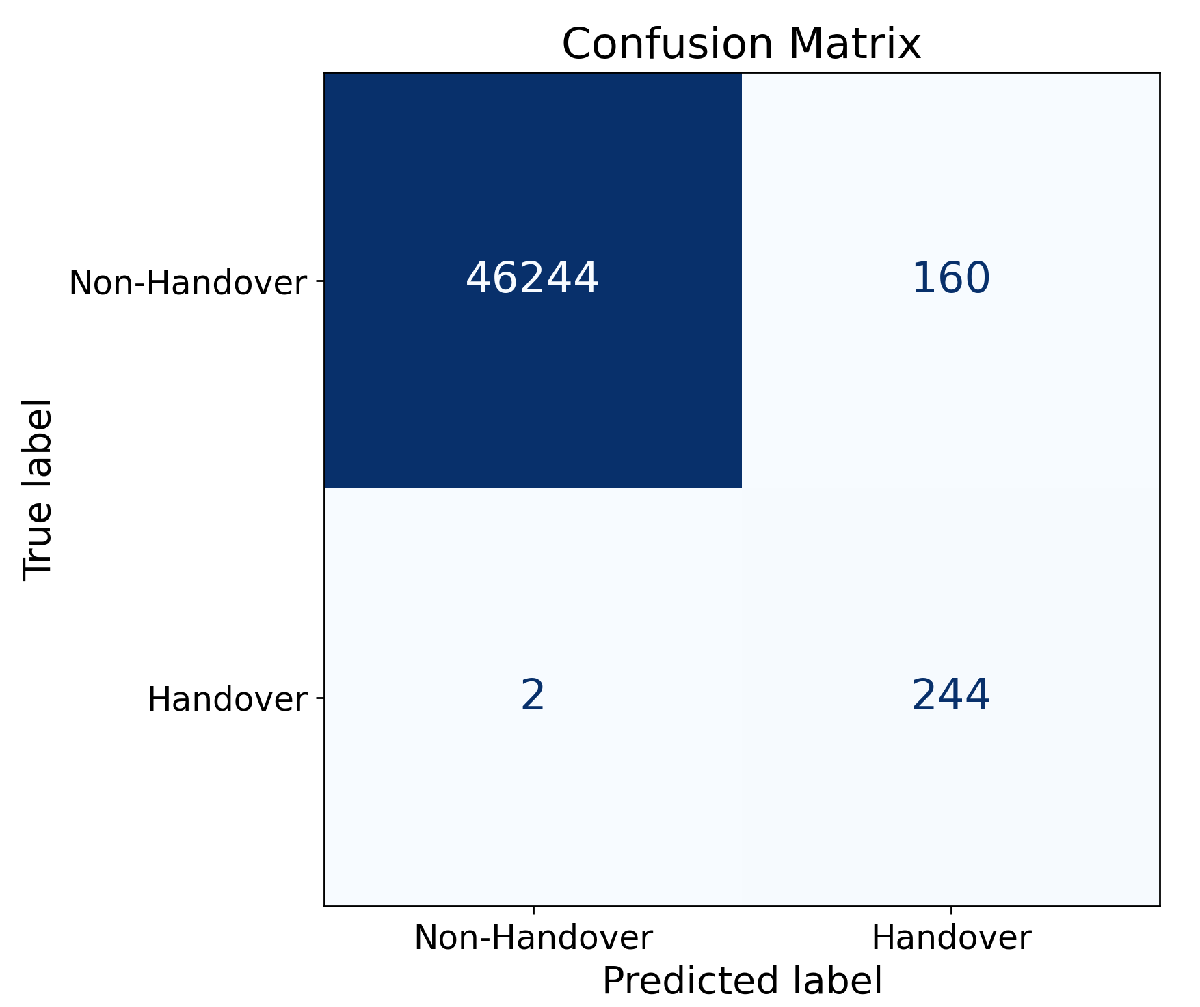
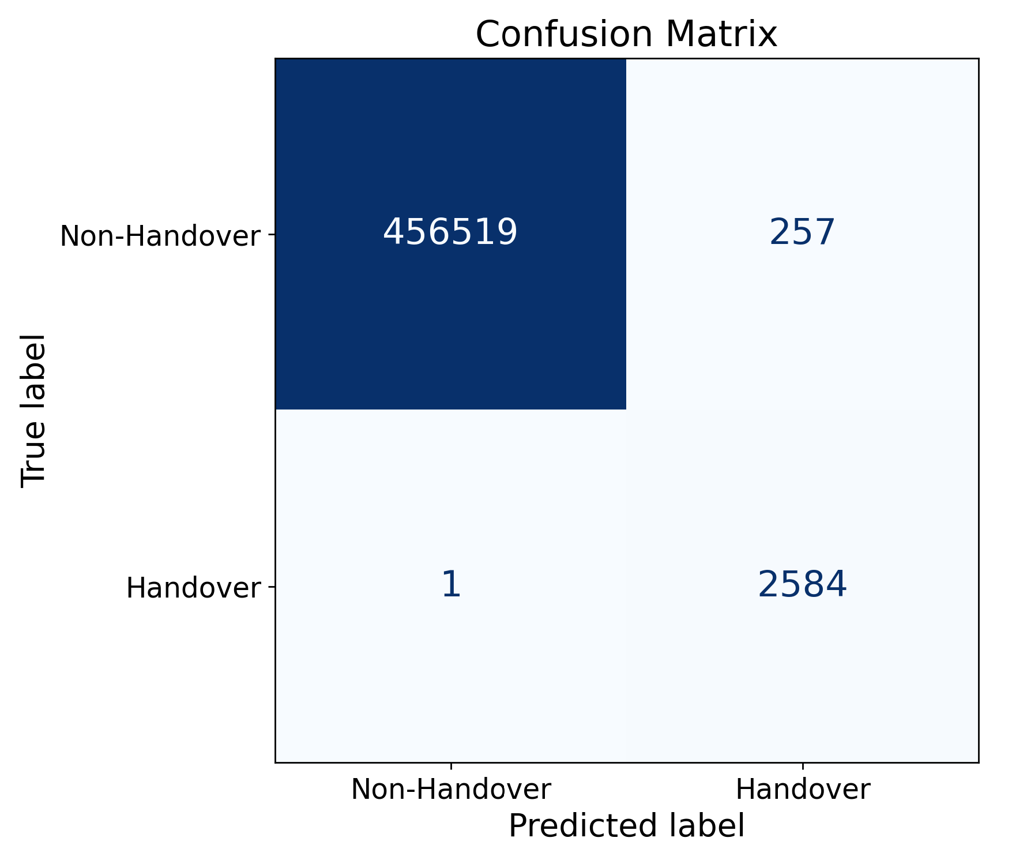
Results & discussions – III: Handover Detection Results for Vehicular Mobility Using Random Forest
Single UE Vehicular Mobility data:
Detected 244 of 246 handovers → 99 % recall
160 false detections
Strong handover detection
10 UE Vehicular Mobility data:
Detected 2 584 / 2 585 handovers → 99 % recall
257 false detection
Near-perfect detection of handover under higher load

Slide 12


Results & discussions – IV Handover Detection Results for Pedestrian Mobility Using Random Forest
Single UE pedestrian Mobility data:
Detected 29 / 29 handovers → 100 % recall
198 false handover detections
Excellent detection, but some false positives remain
10 UE pedestrian Mobility data:
Detected 452 / 455 handovers → 99.3 % recall
3 missed, 739 false detections
Strong handover detection under higher UE load

Slide 13
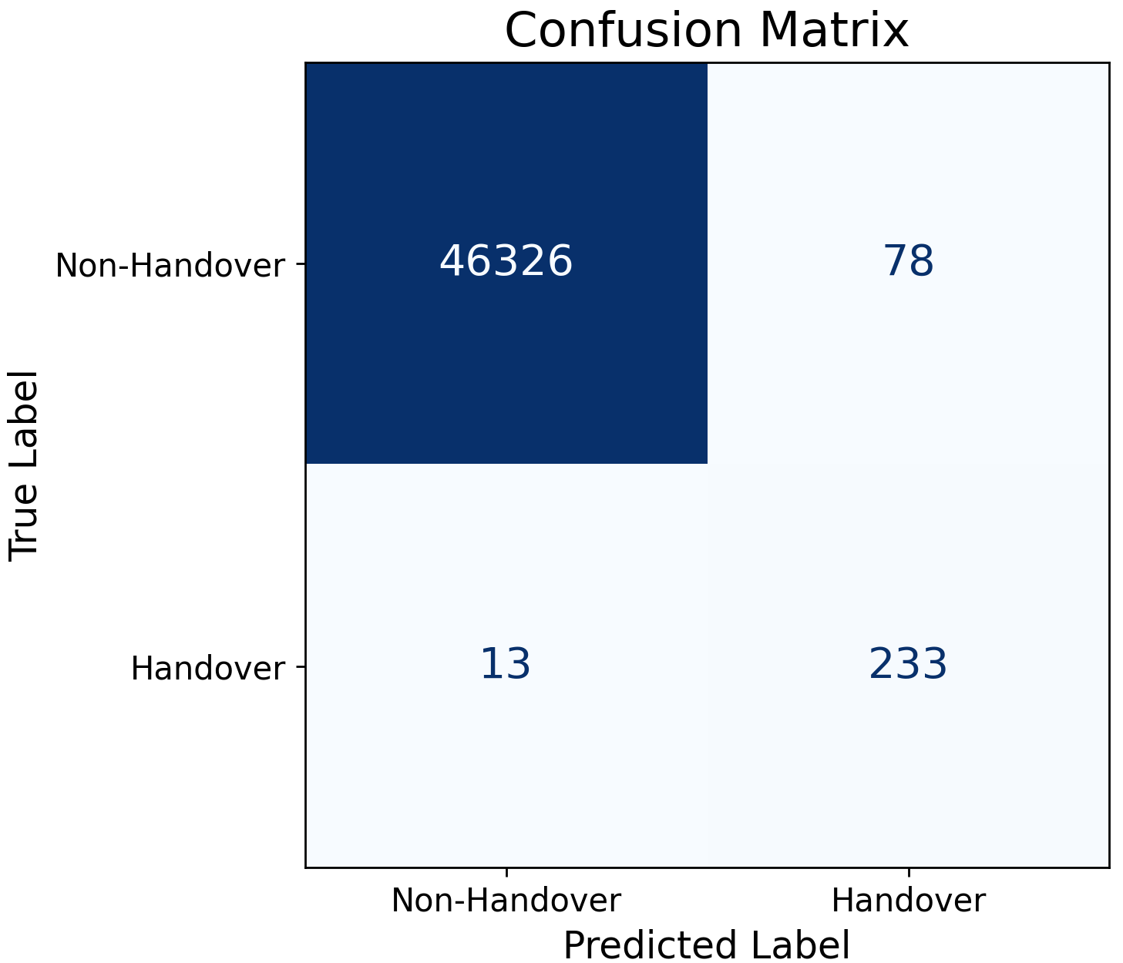

Results & discussions – V Handover Detection Results for Vehicular Mobility Using XGBoost
10 UE Vehicular Mobility data:
Detected 2 571 / 2 585 handovers → 99.5 % recall
14 missed, 250 false detections
Excellent handover detection under higher UE load
Single UE Vehicular Mobility data:
Detected 233 / 246 handovers → 94.7 % recall
13 missed, 78 false detections
Good detection, but slightly lower recall at high speed

Slide 14


Results & discussions – VI Handover Detection Results for Pedestrian Mobility Using XGBoost
10 UE Pedestrian Mobility data:
Detected 362 / 455 handovers → 79.5 % recall
93 missed, 96 false detections
➤ Detection improves with more UEs but remains limited
Single UE Pedestrian Mobility data:
Detected 14 / 29 handovers → 48 % recall
15 missed, 9 false detections
Weak detection; model too conservative in slow mobility

Slide 15
Results analysis
Random Forest achieved the highest detection accuracy, reaching 99–100 % recall in most scenarios. → It consistently detected almost all handovers with very few misses.
XGBoost showed strong results in vehicular scenarios (up to 99.5 % recall) → but struggled in pedestrian cases, where recall dropped to 48 %.
Pedestrian scenarios introduced more false detections due to slower signal variations, → indicating the model is more sensitive to mobility speed.
Detection improves with higher UE load (10 UE > 1 UE) → because more data samples make mobility patterns easier to learn.
Overall, Random Forest outperformed XGBoost in stability, precision, and recall, → confirming it is the most reliable model for handover detection.

Slide 16
Conclusion
ML models were trained and evaluated using simulation data.
Both Random Forest and XGBoost effectively detect L3 handovers.
Random Forest achieved the best balance between accuracy and recall.
The study confirms that AI/ML methods can enhance handover decision-making using realistic network data.

Slide 17
Future work
Investigate additional ML models for comparison.
Extend evaluation to new mobility scenarios and different network configurations.
Apply the approach to 5G or multi-cell environments.

