Slide 1
AMES House Price
2015-30194 김광훈
2015-20935 서효원

Slide 2
Data Process
Discrete, Continuous attributes: as it is
Ordinal: Integer value
Nominal: One-hot encode

Slide 3
Ordinal and Nominal Example
ExterQual (Ordinal)
Rawdata: Po, Fa, TA, Gd, Ex
Processed: 0, 1, 2, 3, 4
MSSubClass (Nominal)
Raw Data: 20, 30, 40, 45….
Processed: MSSubClass_20 - 0 or 1
MSSubClass_30 - 0 or 1

Slide 4
KNN(Price Prediction)
Training Data
Test Data
Predicted Price = Average(Sale Price of Neighbors)
145000
165000
155000

Slide 5
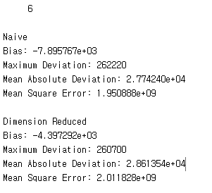
KNN(Price Prediction)
Training Data
Test Data
145000
165000
155000

Slide 6
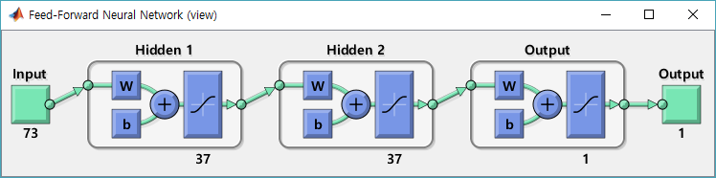
Multilayer Perceptron ANN (P. P.)
Dimension Reduced Input
Sigmoid
Linear

Slide 7
MLP
Loss Function=MSE
 | Training |  |  |  | Test
epochs | Bias | MD | MAD | MSE | Bias | MD | MAD | MSE
1 | 11.7 | 504471.4 | 34503.4 | 2472711663.1 | -397.2 | 279549.5 | 37510.8 | 2758683336.1
500 | -10.6 | 501244.7 | 34034.9 | 2417893138.8 | -440.8 | 281271.5 | 37395.8 | 2754422249.3
1000 | -8.2 | 497610.2 | 33659.5 | 2372882426.9 | -448.5 | 281430.0 | 37222.2 | 2744701549.0
1500 | -7.0 | 494341.5 | 33324.9 | 2332988745.7 | -438.2 | 280972.9 | 37037.4 | 2732209940.4
2000 | -6.3 | 491417.9 | 33020.8 | 2296892472.2 | -420.1 | 280255.1 | 36852.2 | 2718982451.9

Slide 8
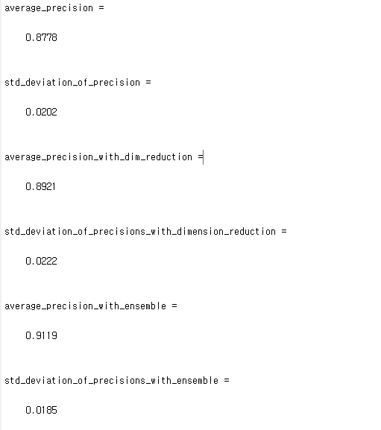
KNN(Price Classification)
Training Data
Test Data
Predicted Label = Mode(Label of Neighbors)
0
1
0

Slide 9
KNN with Ensemble(Price Classification)
Predicted Label=0
Predicted Label=1
Majority Vote
Predict Label=0
Predicted Label=0
Predicted Label=0

Slide 10
MLP (Price Classification)
Dimension Reduced Input
Sigmoid
Sigmoid

Slide 11
MLP Result
 | Training (Error Rate)
1000 | 0.1329
 | Test (Error Rate)
1000 | 0.1547

