Slide 1
AMES House Price
2015-30194 김광훈
2015-20935 서효원

Slide 2
Data Process
Discrete, Continuous attributes: as it is
Ordinal: Integer value
Nominal: One-hot encode

Slide 3
Ordinal and Nominal Example
ExterQual (Ordinal)
Rawdata: Po, Fa, TA, Gd, Ex
Processed: 0, 1, 2, 3, 4
MSSubClass (Nominal)
Raw Data: 20, 30, 40, 45….
Processed: MSSubClass_20 - 0 or 1
MSSubClass_30 - 0 or 1

Slide 4
KNN(Price Prediction)
Training Data
Test Data
Predicted Price = Average(Sale Price of Neighbors)
145000
165000
155000

Slide 5
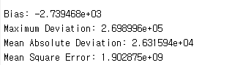
KNN(Price Prediction)
Training Data
Test Data

Slide 6

KNN(Price Classification)
Training Data
Test Data
Predicted Label = Mode(Label of Neighbors)
0
1
0

Slide 7
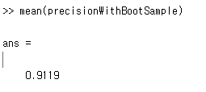
KNN with Ensemble(Price Classification)
Predicted Label=0
Predicted Label=1
Majority Vote
Predict Label=0
Predicted Label=0
Predicted Label=0

