Slide 2
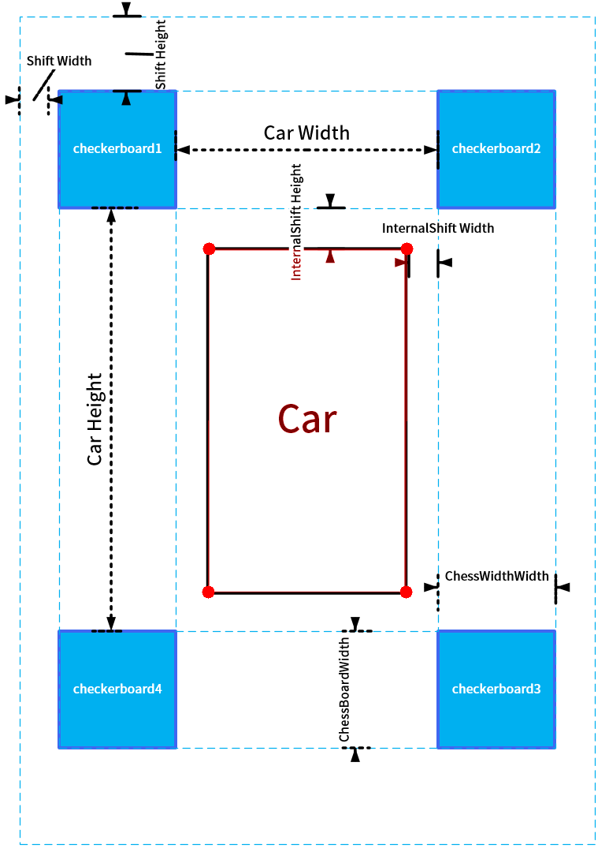
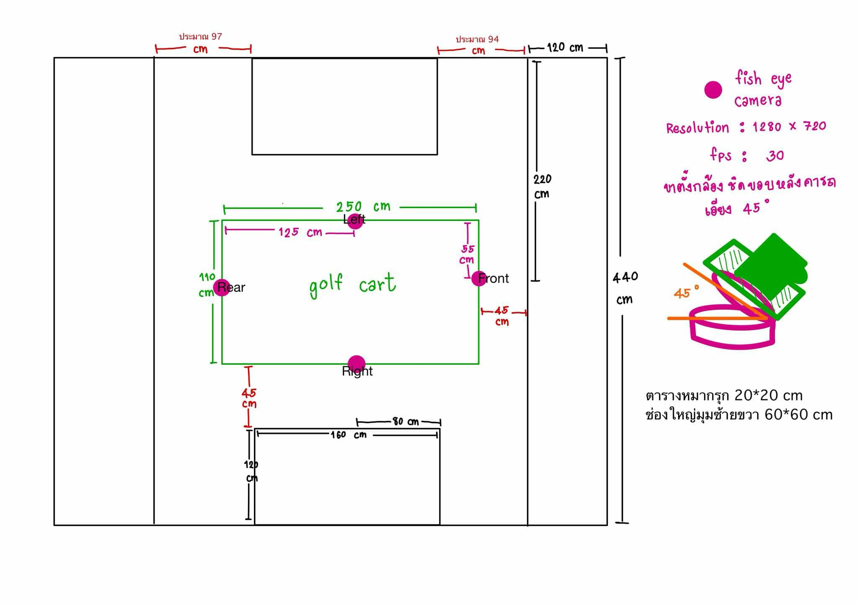

Slide 3
0,0
590,300
300 cm
300,300
450,310
520,300
570,310
300,300
300
330,330
120 cm
520,420
330,380
300,420
450,410
120
45
570,410
94
590,420
110
310,524
410,524
45
260,
310,624
410,624

Slide 4
0,0
300 cm
300,300
300
120 cm
120
420,420
45
94
110
310,524
410,524
45
260,
310,624
410,624

