Slide 1

NM1026 – ANDROID APPLICATIONDEVELOPMENT
SNACK ORDERING AND DELIVERY APP
Team members:
GODWIN THOMSON -711222104015
MANIMARAN S -711222104026
MOHAMED HAARISH K -711222104027
SREENIVASAN S -711222104049

Slide 2
Abstract
Easy Ordering: User-friendly platform for selecting and ordering snacks.
Timely Delivery: Real-time order tracking ensures reliable delivery.
Personalized Offers: AI suggests snacks and exclusive deals.

Slide 3
Introduction
What is Snack Ordering and Delivery?
Importance of Snack Accessibility : Saves time and meets demand for quick food solutions.
Motivation : Tackling on-demand food delivery needs with tech.

Slide 4
Problem Definition
Challenges:
- Limited access to quality snacks.
- Inconvenience in finding on-demand snack delivery.
Impact:Frustration due to delays and missed opportunities for quick hunger satisfaction.

Slide 5
Solution Overview
Proposed Solution: Snack Ordering and Delivery App.
Key Features:
- Wide variety of snack options.
- Real-time order tracking.
- AI-driven personalized recommendations.

Slide 6
Advantages
Improves Snack Accessibility.
Encourages Healthy Snacking.
Customizable and User-Friendly Interface.
Cost-Effective.

Slide 7
Software Requirements
Platform: Android/iOS.
Technologies:
- Programming Languages: Kotlin/Swift.
- Database: Firebase/SQLite.
- API: Snack Recommendation and Delivery Integration.

Slide 8
Hardware Requirements
Devices Supported:
- Smartphones.
- Optional Wearables (e.g., Smartwatch).
Sensors Used:
- Location Tracking (for delivery tracking)
- Device Usage Data (for personalized snack recommendations).

Slide 9
System Architecture
Visual diagram of how the app works:
Input → Processing → Output
Inputs: Snack Preferences, Location Data, Order History.
Processing: Personalization Algorithm, Order Management System.
Outputs: Snack Recommendations, Order Confirmation, Delivery Tracking.

Slide 10
Implementation
Development Stages:
- Ideation and Prototyping.
- Backend Development.
- Frontend Interface Design.
- Integration and Testing.

Slide 11
Modules Overview
User Registration/Login.
Snack Selection and Order.
Order Processing and Tracking.
Notifications and Alerts.

Slide 12
Module Details
Example: Snack Ordering and Delivery Module
- Tracks snack preferences, location, and order history
- Uses GPS for location tracking and app analytics for personalized suggestions

Slide 13
Results and Insights
Visual Example: Sample Snack Order Graphs and Reports (Order Frequency , Snack Preference and Delivery Time).
Example Insights: Average order delivery time reduced by 10% over the last month.

Slide 14
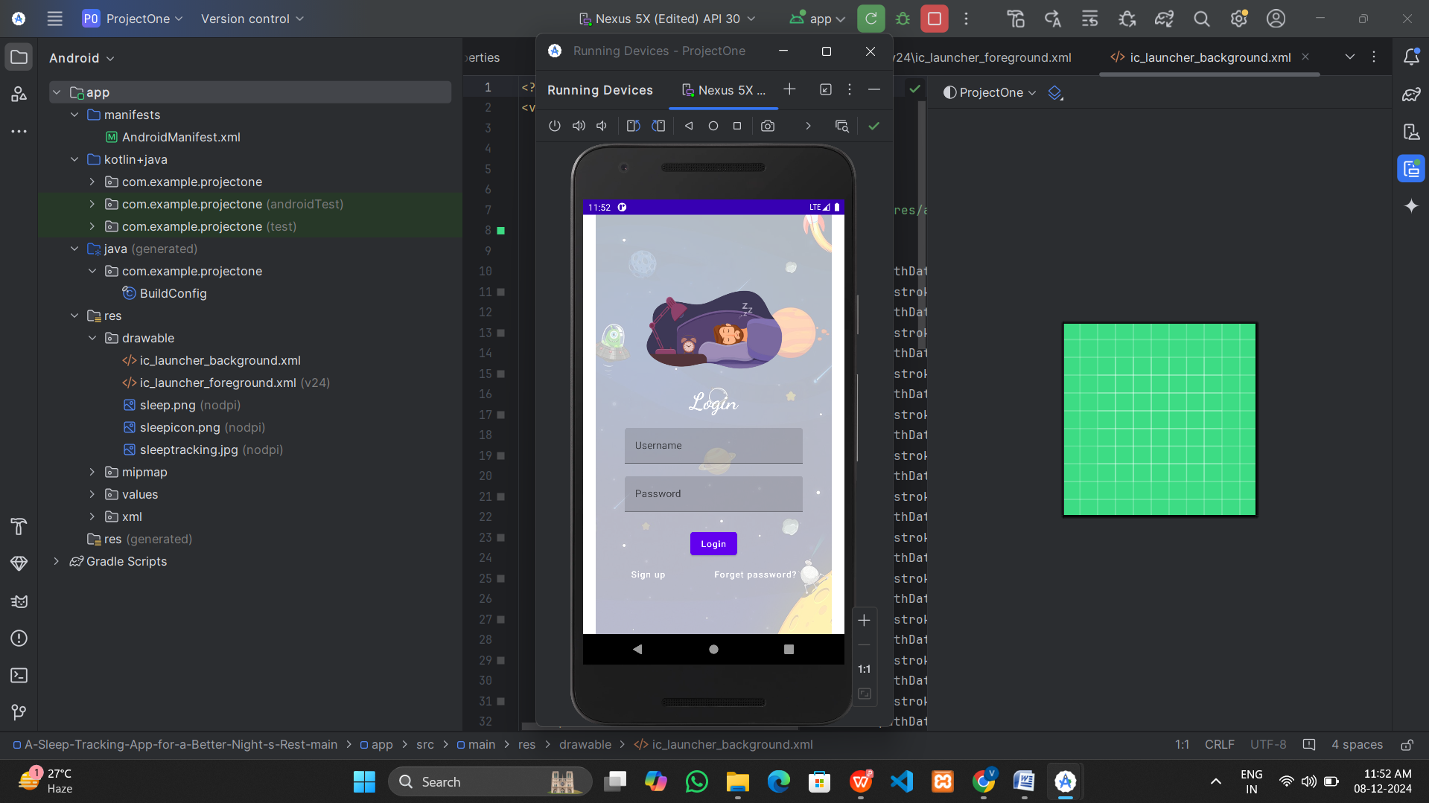
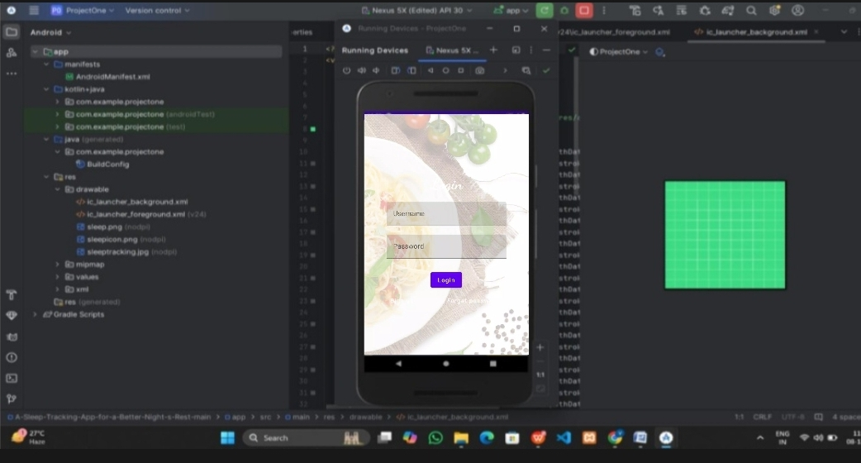
OUTPUT

Slide 15
Conclusion
Summary:
- Tackles key snack delivery challenges.
- Combines technology and convenience.
Future Scope:
- Integration with voice assistants and smart home devices.
- Advanced AI for even more personalized snack recommendations.

Slide 16



