Slide 1
CUDA编程实训
刘寿生
2015-12

Slide 2
目录
例子：Reduction 规约
例子：Matrix multiply 矩阵相乘
例子：Matrix transpose 矩阵转置

Slide 3
例1
例1 求距离
计算一点到N多边形各个顶点的距离
d=sqrt( (x1-x0)^2+ (y1-y0)^2 )
要求：n=2^10 [n=2^20]
例1延伸 距离平均
归并求和reduction
sum( d[i] ) / n
Notes:
新例子——例2，矩阵相乘
C算法
CUDA算法
C优化-block
CUDA优化 … …

Slide 4
Parallel Reduction并行规约
Parallel Reduction (sum)
S=
0
1
2
3
4
5
6
7
int sum( int* array, int size ) {
int result = 0;
for (int i=0;i<size;i++) {
result += array[i];
}
return result;
}

Slide 5
Parallel Reduction并行规约
0
1
2
3
4
5
6
7
1
5
9
13

Slide 6
Parallel Reduction并行规约
0
1
2
3
4
5
6
7
1
5
9
13
6
22

Slide 7
Parallel Reduction并行规约
0
1
2
3
4
5
6
7
1
5
9
13
6
22
28

Slide 8
Parallel Reduction并行规约 CPU 实现
int reduction_cpu( int* array, int size )
{
int result = 0;
for ( int d=1;d<=size/2; d=d*2 )
{
for ( int i=0;i< size; i+=2*d )
{
array[i] += array[i+d];
}
}
result = array[0];
return result;
}

Slide 9
Parallel Reduction并行规约
类似篮球锦标赛的淘汰过程
n 个元素进行log(n) 个回合
如何在CUDA上实现？

Slide 10
unsigned int i = threadIdx.x;
for (unsigned int d = 1;
d < blockDim.x;
d *= 2)
{
__syncthreads();
if (i % (2 * d) == 0)
array[i] += array[i + d];
}
Code from http://courses.engr.illinois.edu/ece498/al/Syllabus.html

Slide 11
unsigned int i = threadIdx.x;
for (unsigned int d = 1;
d < blockDim.x;
d *= 2)
{
__syncthreads();
if (i % (2 * d) == 0)
array[i] += array[i + d];
}
Stride:
1, 2, 4, …
Code from http://courses.engr.illinois.edu/ece498/al/Syllabus.html

Slide 12
unsigned int i = threadIdx.x;
for (unsigned int d = 1;
d < blockDim.x;
d *= 2)
{
__syncthreads();
if (i % (2 * d) == 0)
array[i] += array[i + d];
}
Why?
Code from http://courses.engr.illinois.edu/ece498/al/Syllabus.html

Slide 13
unsigned int i = threadIdx.x;
for (unsigned int d = 1;
d < blockDim.x;
d *= 2)
{
__syncthreads();
if (i % (2 * d) == 0)
array[i] += array[i + d];
}
当步长增加时，多余的线程在干什么？
Code from http://courses.engr.illinois.edu/ece498/al/Syllabus.html

Slide 14
Parallel Reduction并行规约
Thread
0
Thread
1
Thread
2
Thread
3
Thread
4
Thread
5
Thread
6
Thread
7
0
1
2
3
4
5
6
7
1
5
9
13
6
22
28

Slide 15
Parallel Reduction并行规约
Thread
0
Thread
1
Thread
2
Thread
3
Thread
4
Thread
5
Thread
6
Thread
7
0
1
2
3
4
5
6
7
1
5
9
13
6
22
28
第1轮：线程1、3、5、7闲置
n个元素实际只需要 n/2 个线程

Slide 16
Parallel Reduction并行规约
Thread
0
Thread
1
Thread
2
Thread
3
Thread
4
Thread
5
Thread
6
Thread
7
0
1
2
3
4
5
6
7
1
5
9
13
6
22
28
第2轮：线程2、6闲置

Slide 17
Parallel Reduction并行规约
Thread
0
Thread
1
Thread
2
Thread
3
Thread
4
Thread
5
Thread
6
Thread
7
0
1
2
3
4
5
6
7
1
5
9
13
6
22
28
第3轮：线程4闲置

Slide 18
Parallel Reduction并行规约
Thread
0
Thread
1
Thread
2
Thread
3
Thread
4
Thread
5
Thread
6
Thread
7
0
1
2
3
4
5
6
7
1
5
9
13
6
22
28
总之, 每轮所需线程数减半

Slide 19

例2
例2 矩阵相乘
C算法
CUDA算法
[ C优化-block ]
要求：
A(HA, N) B(N, WB)
HA = N = WB = 2^10
[N = 2^11]
soulsheng@qq.com
Notes:
新例子——例2，矩阵相乘
C算法
CUDA算法
C优化-block
CUDA优化 … …

Slide 20
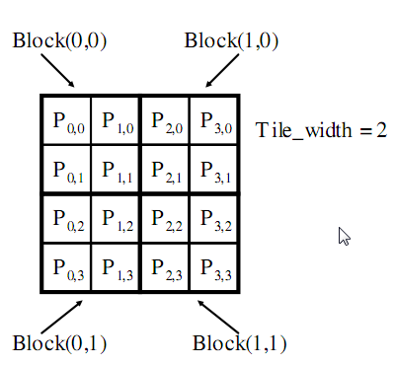
Matrix Multiply
例如
矩阵: 4x4
TILE_WIDTH = 2
Block 尺寸: 2x2
Image from http://courses.engr.illinois.edu/ece498/al/textbook/Chapter3-CudaThreadingModel.pdf

Slide 21
Matrix Multiply
Nd_{0,0}
Nd_{1,0}
例如
矩阵: 4x4
TILE_WIDTH = 2
Block 尺寸: 2x2
Nd_{0,1}
Nd_{1,1}
Nd_{0,2}
Nd_{1,2}
Nd_{0,3}
Nd_{1,3}
Md_{0,0}
Md_{1,0}
Md_{2,0}
Md_{3,0}
Pd_{0,0}
Pd_{1,0}
Pd_{2,0}
Pd_{3,0}
Md_{0,1}
Md_{1,1}
Md_{2,1}
Md_{3,1}
Pd_{0,1}
Pd_{1,1}
Pd_{2,1}
Pd_{3,1}
Pd_{0,2}
Pd_{1,2}
Pd_{2,2}
Pd_{3,2}
Pd_{0,3}
Pd_{1,3}
Pd_{2,3}
Pd_{3,3}
Image from http://courses.engr.illinois.edu/ece498/al/Syllabus.html

Slide 22
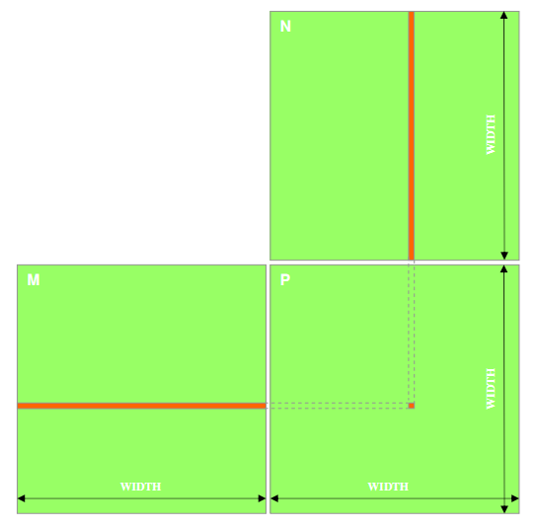
Matrix Multiply: CPU 实现
void MatrixMulOnHost(float* M, float* N, float* P, int width)‏
{
for (int i = 0; i < width; ++i)‏
for (int j = 0; j < width; ++j)
{
float sum = 0;
for (int k = 0; k < width; ++k)
{
float a = M[i * width + k];
float b = N[k * width + j];
sum += a * b;
}
P[i * width + j] = sum;
}
}
Code from: http://courses.engr.illinois.edu/ece498/al/lectures/lecture3%20cuda%20threads%20spring%202010.ppt

Slide 23
Matrix Multiply: GPU 实现
__global__ void MatrixMulKernel(
float* Md, float* Nd, float* Pd, int Width)
{
int Row = blockIdx.y * blockDim.y + threadIdx.y;
int Col = blockIdx.x * blockDim.x + threadIdx.x;
float Pvalue = 0;
for (int k = 0; k < Width; ++k)
Pvalue += Md[Row * Width + k] * Nd[k * Width + Col];
Pd[Row * Width + Col] = Pvalue;
}
Code from http://courses.engr.illinois.edu/ece498/al/Syllabus.html

Slide 24
Matrix Multiply: GPU 实现
计算矩阵Pd 和M的行索引
__global__ void MatrixMulKernel(
float* Md, float* Nd, float* Pd, int Width)
{
int Row = blockIdx.y * blockDim.y + threadIdx.y;
int Col = blockIdx.x * blockDim.x + threadIdx.x;
float Pvalue = 0;
for (int k = 0; k < Width; ++k)
Pvalue += Md[Row * Width + k] * Nd[k * Width + Col];
Pd[Row * Width + Col] = Pvalue;
}
Code from http://courses.engr.illinois.edu/ece498/al/Syllabus.html

Slide 25
Matrix Multiply: GPU 实现
计算矩阵Pd 和N的列索引
__global__ void MatrixMulKernel(
float* Md, float* Nd, float* Pd, int Width)
{
int Row = blockIdx.y * blockDim.y + threadIdx.y;
int Col = blockIdx.x * blockDim.x + threadIdx.x;
float Pvalue = 0;
for (int k = 0; k < Width; ++k)
Pvalue += Md[Row * Width + k] * Nd[k * Width + Col];
Pd[Row * Width + Col] = Pvalue;
}
Code from http://courses.engr.illinois.edu/ece498/al/Syllabus.html

Slide 26
Matrix Multiply
每个线程计算块内子矩阵的一个元素
__global__ void MatrixMulKernel(
float* Md, float* Nd, float* Pd, int Width)
{
int Row = blockIdx.y * blockDim.y + threadIdx.y;
int Col = blockIdx.x * blockDim.x + threadIdx.x;
float Pvalue = 0;
for (int k = 0; k < Width; ++k)
Pvalue += Md[Row * Width + k] * Nd[k * Width + Col];
Pd[Row * Width + Col] = Pvalue;
}
Code from http://courses.engr.illinois.edu/ece498/al/Syllabus.html

Slide 27
Matrix Multiply: GPU 实现
调用 kernel:
dim3 dimGrid(Width / TILE_WIDTH, Height / TILE_WIDTH);
dim3 dimBlock(TILE_WIDTH, TILE_WIDTH);
MatrixMulKernel<<<dimGrid, dimBlock>>>(
Md, Nd, Pd, TILE_WIDTH);

Slide 28
Matrix Multiply: block
N
每个输入元素被Width 个线程读取
使用栈内存（局部变量）来减少堆内存访问
WIDTH
M
P
ty
WIDTH
tx
WIDTH
WIDTH
Image from http://courses.engr.illinois.edu/ece498/al/Syllabus.html

Slide 29
Matrix Multiply : block
bx
0
1
2
tx
0
TILE_WIDTH-1
1
2
Nd
大矩阵拆分成多个小矩阵块
每个块用 Md 和 Nd 的子集累加Pd
每个块有很好的数据局部性
TILE_WIDTH
WIDTH
TILE_WIDTH
Md
Pd
0
0
Pd_{sub}
1
ty
2
WIDTH
by
1
TILE_WIDTHE
TILE_WIDTH-1
TILE_WIDTH
TILE_WIDTH
TILE_WIDTH
2
WIDTH
WIDTH
Image from http://courses.engr.illinois.edu/ece498/al/Syllabus.html

Slide 30
Matrix Multiply : block
bx
0
1
2
tx
0
TILE_WIDTH-1
1
2
Nd
块(瓦片)内每次循环
读入瓦片内 Md 和 Nd 的一个元素存入栈内存
m
TILE_WIDTH
bx
k
WIDTH
TILE_WIDTH
Md
Pd
by
0
m
0
Pd_{sub}
1
k
ty
2
WIDTH
by
1
TILE_WIDTHE
TILE_WIDTH-1
TILE_WIDTH
TILE_WIDTH
TILE_WIDTH
2
WIDTH
WIDTH
Image from http://courses.engr.illinois.edu/ece498/al/Syllabus.html

Slide 31
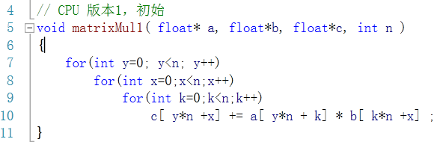
提示 matrixMultiply cpu block

Slide 32
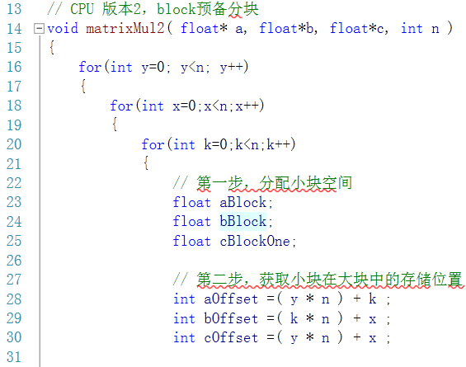

Slide 33
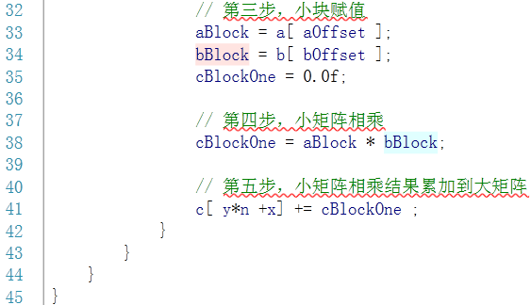

Slide 34
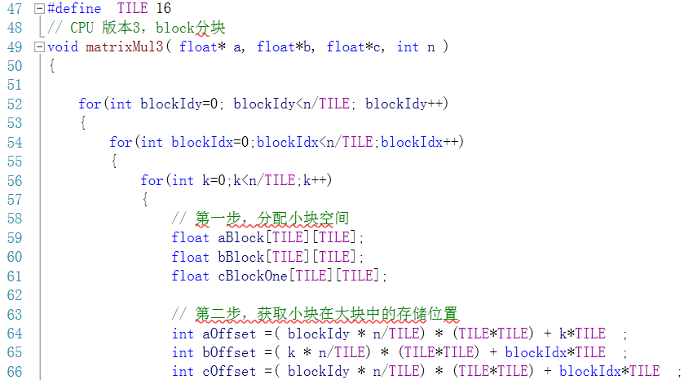

Slide 35
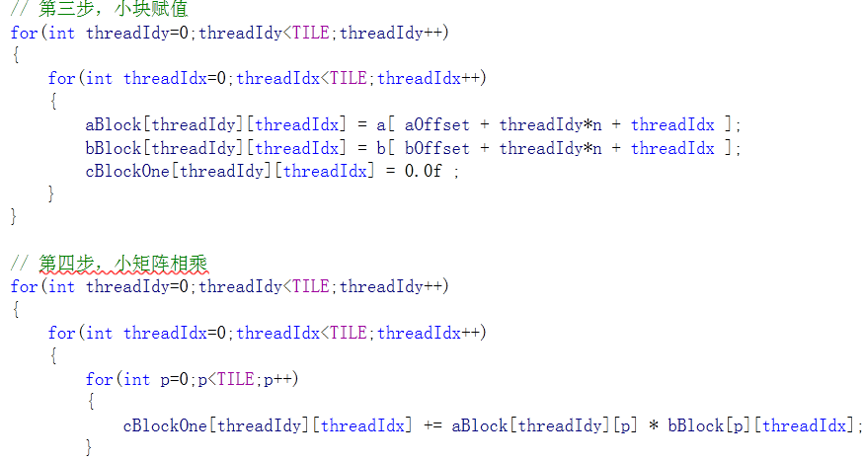

Slide 36
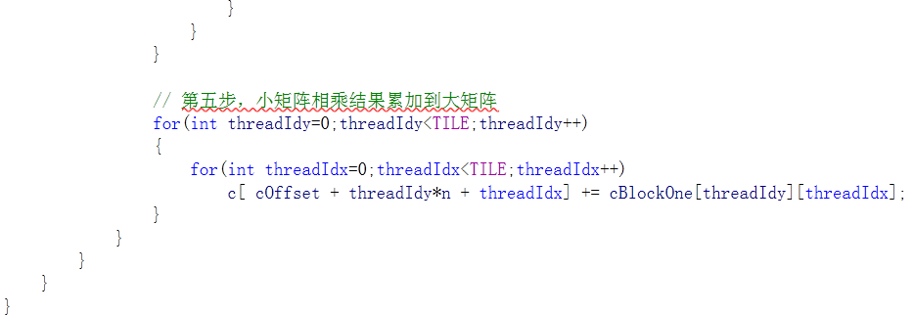

Slide 37
例3
例3 矩阵转置
C算法： B[i][j] = A[j][i]
CUDA算法
[ C优化-block ]
要求：
A(M, N) B(N, M)
M = N = 2^10
[2^11]
soulsheng@qq.com
Notes:
新例子——例2，矩阵相乘
C算法
CUDA算法
C优化-block
CUDA优化 … …

Slide 38

矩阵转置 CPU 算法
void computeTransposeGold(float *gold, float *idata, const int size_x, const int size_y)
{
for (int y = 0; y < size_y; ++y)
{
for (int x = 0; x < size_x; ++x)
{
gold[(x * size_y)+ y]= idata[(y * size_x)+ x];
}
}
}
idata
odata
38

Slide 39
矩阵转置 GPU kernel
__global__ void transposeNaive(float *odata, float *idata, int width, int height)
{
int xIndex = blockIdx.x * TILE_DIM + threadIdx.x;
int yIndex = blockIdx.y * TILE_DIM + threadIdx.y;
int index_in = xIndex + width * yIndex;
int index_out = yIndex + height * xIndex;
odata[index_out] = idata[index_in];
}
39

Slide 40

通过 shared memory 实现合并优化
先将瓦片的多列元素存入shared memory ，再以连续化的数据写入global memory
需要同步 __syncthreads() 因为线程需要用到其它线程存储到shared memory 的数据
idata
odata
tile
Elements transposed by a half-warp of threads
40

Slide 41
通过 shared memory 实现合并优化
__global__ void transposeCoalesced(float *odata, float *idata,
int width, int height)
{
__shared__ float tile[TILE_DIM][TILE_DIM];
int xIndex = blockIdx.x * TILE_DIM + threadIdx.x;
int yIndex = blockIdx.y * TILE_DIM + threadIdx.y;
int index_in = xIndex + (yIndex)*width;
xIndex = blockIdx.y * TILE_DIM + threadIdx.x;
yIndex = blockIdx.x * TILE_DIM + threadIdx.y;
int index_out = xIndex + (yIndex)*height;
tile[threadIdx.y][threadIdx.x] = idata[index_in];
__syncthreads();
odata[index_out] = tile[threadIdx.x][threadIdx.y];
}
41

Slide 42
Transpose 存在 Bank 冲突
瓦片内 16x16 个floats 存于shared memory
列中的数据存于相同的bank
读入瓦片一列数据时存在 16-way bank conflict
解决方案 – 填充 shared memory 数组
__shared__ float tile[TILE_DIM][TILE_DIM+1];
反对角线上的数据存于相同的bank
idata
odata
tile
42

