Slide 1
NVIDIA Tegra K1 CUDA编程与调试
刘寿生
2014/12

Slide 2
目录
TK1简介
CUDA安装与配置
CUDA编译
CUDA-gdb调试
Notes:
TK1简介
CUDA安装与配置
CUDA编译
CUDA-gdb调试

Slide 3

TK1简介
Features main
GPU
192 CUDA cores Kepler
CPU
ARM Cortex A15
4-Plus-1 quad-core
Features more
Memory: 2G / 16G
IO basic
USB / HDMI / LAN
IO extra
- RS232 / SATA / audio

Slide 4
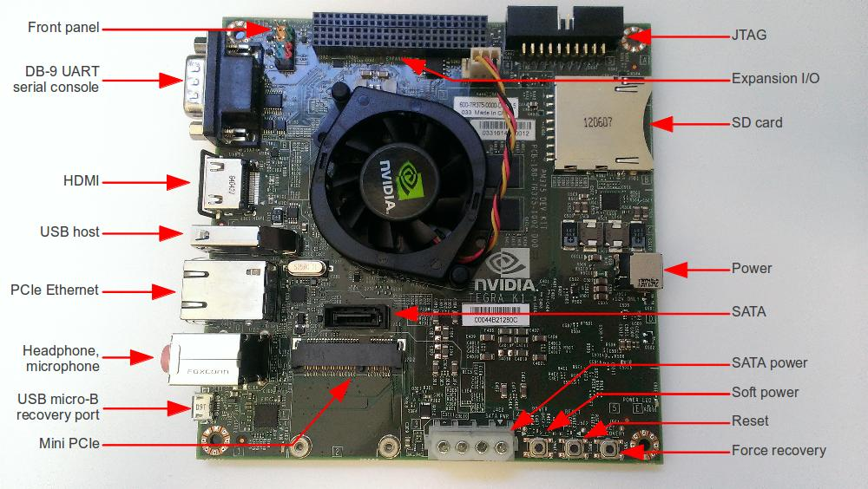

Slide 5
CUDA安装与配置
toolkit
download
install
add paths
verify
samples
copy to home
build && run deviceQuery
http://elinux.org/Jetson/Installing_CUDA
Notes:
toolkit
# install
cd ~/Downloads
sudo dpkg -i cuda-repo-l4t-r19.2_6.0-42_armhf.deb
sudo apt-get update
sudo apt-get install cuda-toolkit-6-0
sudo usermod -a -G video $USER
# Add the CUDA paths
echo "export PATH=/usr/local/cuda/bin:$PATH" >> ~/.bashrc
echo "export LD_LIBRARY_PATH=/usr/local/cuda/lib:$LD_LIBRARY_PATH" >> ~/.bashrc
source ~/.bashrc
# verify
nvcc -V
Samples
# copy to home
cuda-install-samples-6.0.sh /home/ubuntu
# build
cd ~/NVIDIA_CUDA-6.0_Samples/1_Utilities
make
# run
cd deviceQuery
deviceQuery

Slide 6
CUDA编译
makefile
custom
make
Eg.1
nvcc [-g –G] kernel.cu
Eg.2
nvcc –o kernel.o
-c kernel.cu
nvcc –o kernel kernel.o

Slide 7
CUDA-gdb调试
常用指令：
cuda-gdb / file *
(r)un (q)uit
(b)reak (c)ontinue
(s)tep (n)ext
(p)rint
参考
调试步骤：
配置export PATH /-g G
启动cuda-gdb * / run
break
break my_function
break my_file:185
Notes:
CUDA-gdb调试 —— http://soulsheng.1kapp.com/it/?p=1587
常用指令
cuda-gdb *
(r)un (q)uit
(b)reak (c)ontinue
(s)tep (n)ext
(p)Rint
调试步骤：
配置路径
export PATH=/usr/local/cuda-6.0/bin:$PATH
编译选项 -g G
启动调试 cuda-gdb * / run
break my_function break my_file:185

Slide 8
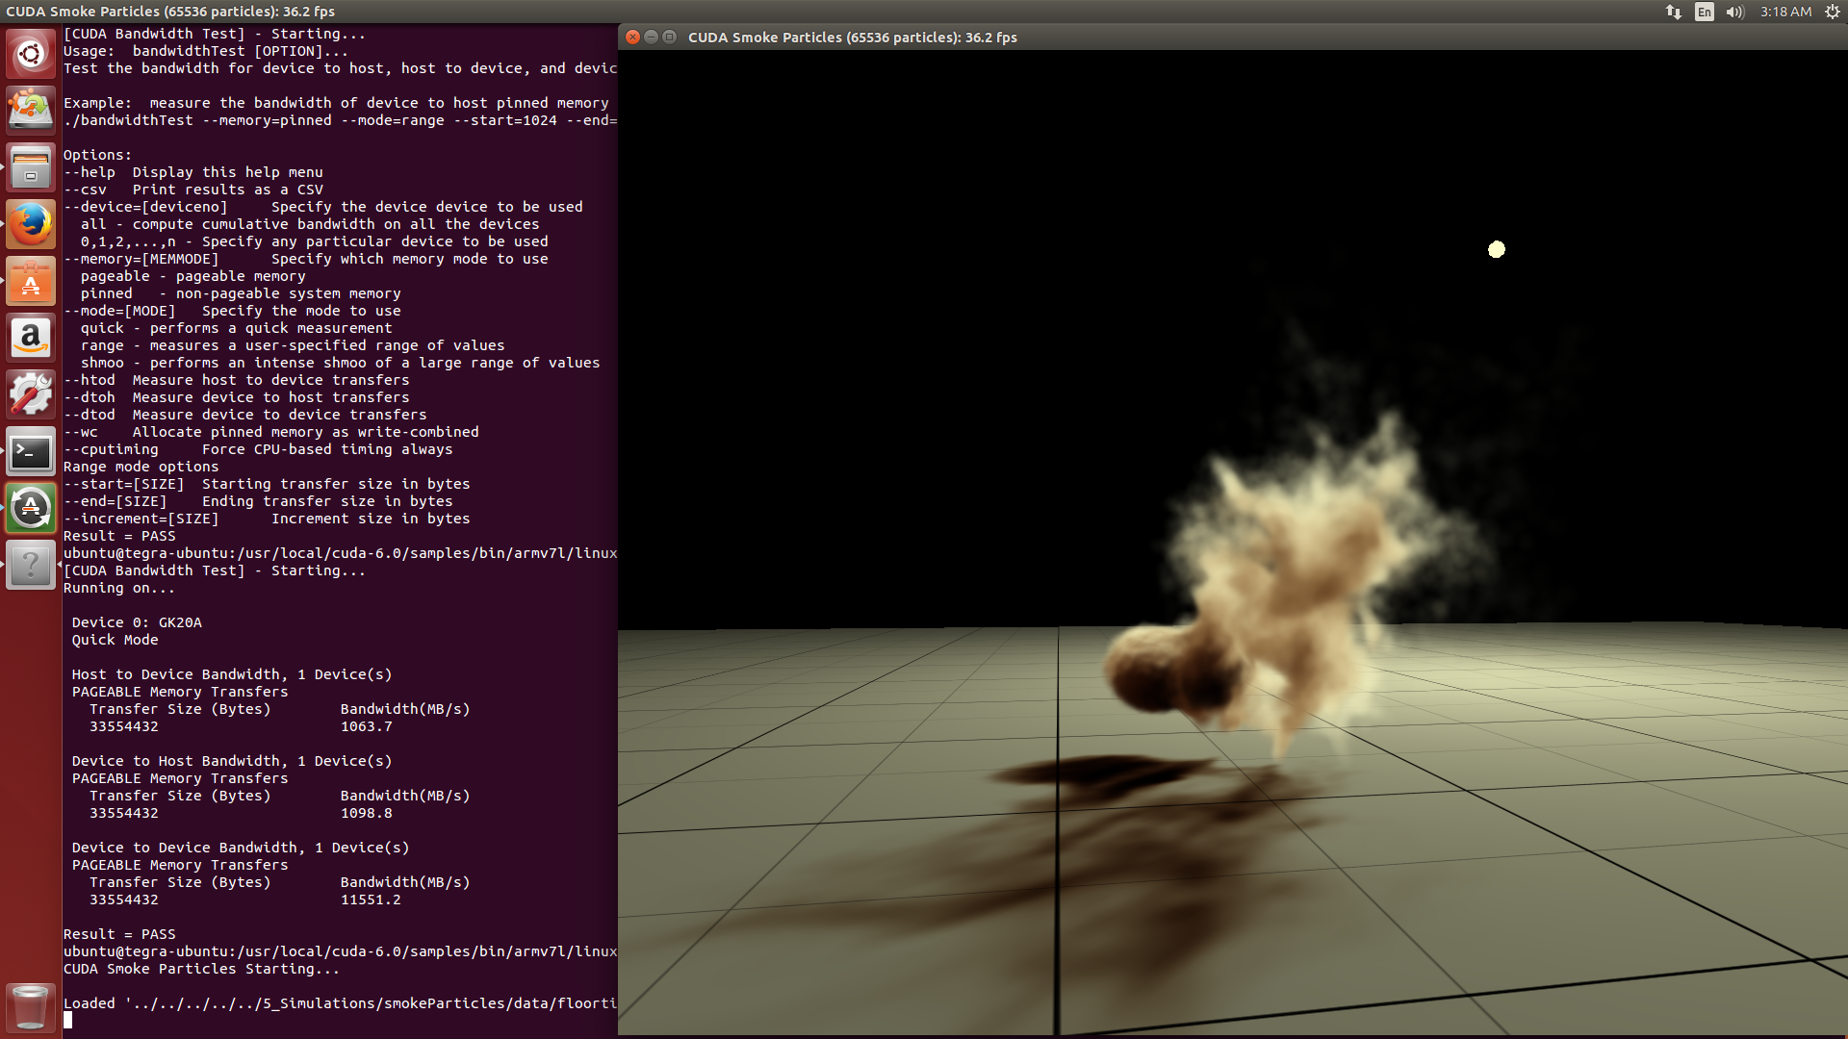
TK1 烟雾仿真

