Slide 1
NVIDIA Tegra K1 系统生态环境与开发配置
刘寿生
2015/12

Slide 2
目录
TK1生态环境
远程访问TK1
CUDA安装与配置
CUDA DEMO编译测试
OpenCV安装与配置
附录
Notes:
TK1简介
CUDA安装与配置
CUDA编译
CUDA-gdb调试

Slide 3
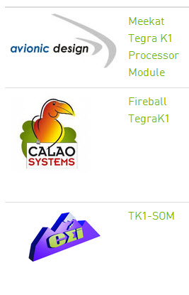

TK1生态环境
为嵌入式量身定做
航空电子设计
无风扇版本
可视化，视频，数据分析
小尺寸 多接口
2” X 2.3”，GPIO/Radar/WiFi/蓝牙
Notes:
参考：
https://developer.nvidia.com/embedded/community/ecosystem

Slide 4
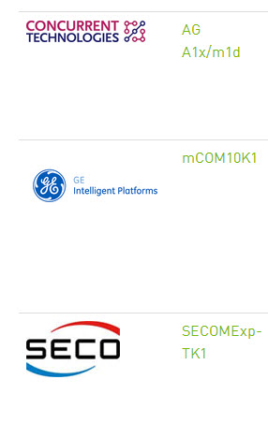
TK1生态环境
集成4块TK1
图像处理，解密，高性能
COM Express
326 GFLOPS，10 Watt
移动体验
可视化，自动驾驶，车载娱乐系统

Slide 5
远程访问TK1
HDMI接口连接显示器或投影仪
SSH协议访问TK1
putty
远程登录终端Terminal
FileZilla
FTP上传下载文件
安装编译器
sudo apt-get install build-essential g++
安装编辑工具
sudo apt-get install vim
vim使用手册见附录
Notes:
通过1根网线，台式机或笔记本与TK1实现2机互联。
之前需要一次性通过连接显示器手动设置TK1的固定IP，如192.168.1.101，以后就可以网线连接。

Slide 6
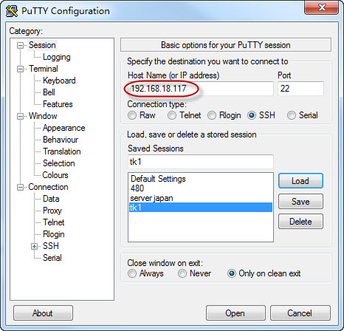
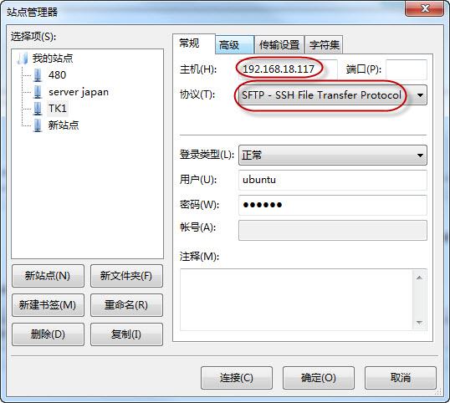
远程访问TK1
Putty
FileZilla
Notes:
参考：
http://soulsheng.1kapp.com/it/?p=1709

Slide 7
CUDA安装与配置
Toolkit安装包 – TK1专用
下载cuda-repo-l4t-r21.2-6-5-prod_6.5-34_armhf.deb
Install安装
cd ~/Downloads
sudo dpkg -i cuda-repo-l4t-r21.2-6-5-prod_6.5-34_armhf.deb
sudo apt-get update
sudo apt-get install cuda-toolkit-6-5
sudo usermod -a -G video ubuntu
允许访问GPU
Notes:
参考网址：http://elinux.org/Jetson/Installing_CUDA
Toolkit安装包
下载地址Download：http://developer.download.nvidia.com/compute/cuda/6_5/rel/installers/cuda-repo-l4t-r21.2-6-5-prod_6.5-34_armhf.deb
# install 安装
cd ~/Downloads
sudo dpkg -i cuda-repo-l4t-r21.2-6-5-prod_6.5-34_armhf.deb
sudo apt-get update
sudo apt-get install cuda-toolkit-6-5
sudo usermod -a -G video $USER

Slide 8

CUDA安装与配置
添加路径到环境变量
echo "export PATH=/usr/local/cuda/bin:$PATH" >> ~/.bashrc
echo "export LD_LIBRARY_PATH=/usr/local/cuda/lib:$LD_LIBRARY_PATH" >> ~/.bashrc
source ~/.bashrc
运行测试
nvcc -V
Notes:
# Add the CUDA paths
echo "export PATH=/usr/local/cuda/bin:$PATH" >> ~/.bashrc
echo "export LD_LIBRARY_PATH=/usr/local/cuda/lib:$LD_LIBRARY_PATH" >> ~/.bashrc
source ~/.bashrc
# verify
nvcc -V
Samples
# copy to home
cuda-install-samples-6.5.sh /home/ubuntu
# build
cd ~/NVIDIA_CUDA-6.5_Samples/1_Utilities
make
# run
cd deviceQuery
deviceQuery

Slide 9
CUDA DEMO编译测试
安装DEMO
cuda-install-samples-6.5.sh /home/ubuntu
编译DEMO
cd ~/NVIDIA_CUDA-6.5_Samples/1_Utilities/deviceQuery
make
./deviceQuery
cd ../../5_Simulations/smokeParticles
make
./smokeParticles
常用UBUNTU命令使用手册见文档末尾附录
Notes:
Samples
# copy to home
cuda-install-samples-6.5.sh /home/ubuntu
# build
cd ~/NVIDIA_CUDA-6.5_Samples/1_Utilities/deviceQuery
make
# run
cd deviceQuery
deviceQuery
cd ../../5_Simulations/smokeParticles

Slide 10
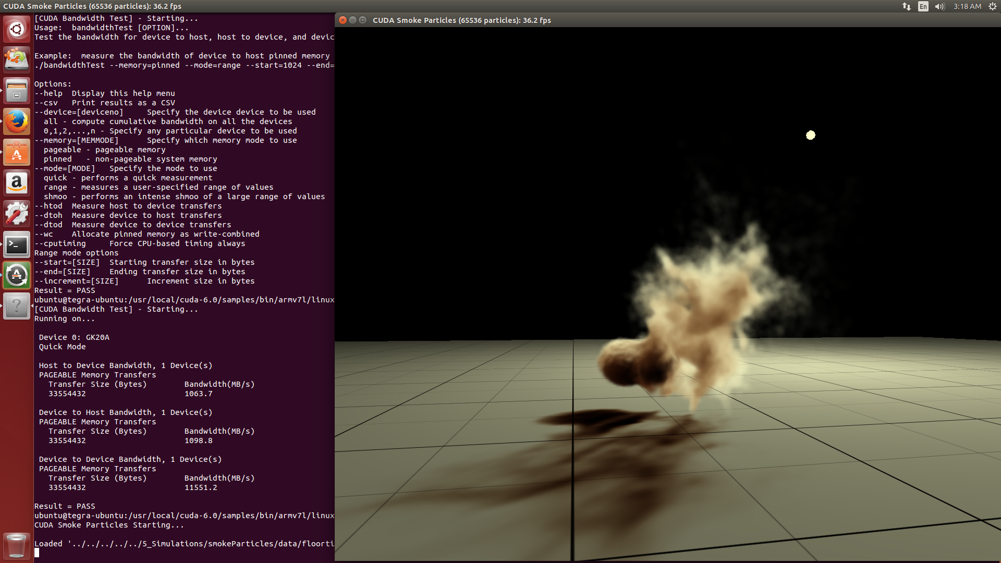
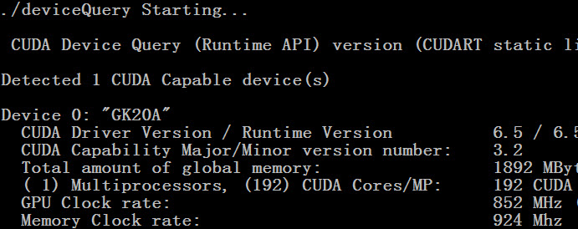
CUDA DEMO编译测试
Notes:
Samples
# copy to home
cuda-install-samples-6.5.sh /home/ubuntu
# build
cd ~/NVIDIA_CUDA-6.5_Samples/1_Utilities/deviceQuery
make
# run
cd deviceQuery
deviceQuery

Slide 11
OpenCV安装与配置
OpenCV安装包 – TK1专用
下载 libopencv4tegra-repo_l4t-r21_2.4.10.1_armhf.deb
Install安装
cd ~/Downloads
sudo dpkg -i libopencv4tegra-repo_l4t-r21_2.4.10.1_armhf.deb
sudo apt-add-repository universe
sudo apt-get update
sudo apt-get install libopencv4tegra libopencv4tegra-dev
OpenCV依赖库
Notes:
参考网址：http://elinux.org/Jetson/Installing_OpenCV
Toolkit安装包
下载地址Download：http://developer.download.nvidia.com/embedded/OpenCV/L4T_21.2/libopencv4tegra-repo_l4t-r21_2.4.10.1_armhf.deb
# install 安装
cd ~/Downloads
sudo dpkg -i libopencv4tegra-repo_l4t-r21_2.4.10.1_armhf.deb
sudo apt-get update
sudo apt-get install cuda-toolkit-6-5
sudo usermod -a -G video $USER

Slide 12
OpenCV编译测试
安装DEMO
下载 opencv-2.4.10.tar.gz
tar xzvf opencv-2.4.10.tar.gz
编译DEMO
cd opencv-2.4.10/samples/cpp
g++ edge.cpp -lopencv_core -lopencv_imgproc -lopencv_highgui -o edge
./edge
Notes:
Samples
下载 opencv-2.4.10.tar.gz
https://github.com/Itseez/opencv/archive/2.4.10.tar.gz
# extract
tar xzvf opencv-2.4.10.tar.gz
# build
cd opencv-2.4.10/samples/cpp
g++ edge.cpp -lopencv_core -lopencv_imgproc -lopencv_highgui -o edge
# run
./edge

Slide 13
OpenCV编译测试
测试GPU版本的Hough直线检测算法
g++ houghlines.cpp -lopencv_core -lopencv_imgproc -lopencv_highgui -lopencv_calib3d -lopencv_contrib -lopencv_features2d -lopencv_flann -lopencv_gpu -lopencv_legacy -lopencv_ml -lopencv_objdetect -lopencv_photo -lopencv_stitching -lopencv_superres -lopencv_video -lopencv_videostab -o houghlines
./houghlines ../cpp/logo_in_clutter.png
Notes:
cd ../gpu
g++ houghlines.cpp -lopencv_core -lopencv_imgproc -lopencv_highgui -lopencv_calib3d -lopencv_contrib -lopencv_features2d -lopencv_flann -lopencv_gpu -lopencv_legacy -lopencv_ml -lopencv_objdetect -lopencv_photo -lopencv_stitching -lopencv_superres -lopencv_video -lopencv_videostab -o houghlines
./houghlines ../cpp/logo_in_clutter.png

Slide 14



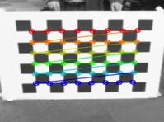
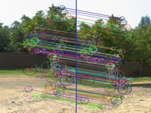




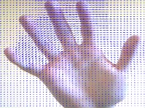

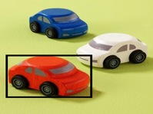
OpenCV编译测试
Portable, open API
900+ functions
OpenCV4Tegra - Accelerated CUDA+NEON+GLSL+TBB multithreading
Image processing
Video, Stereo, and 3D
General Image Processing
Segmentation
Machine Learning, Detection
Camera Calibration
Features
Depth Maps
Image Pyramids
Transforms
Fitting
Optical Flow
Inpainting
Tracking

Slide 15
附：常用UBUNTU命令使用手册
文件与文件夹
mkdir 目录名
创建一个目录
rmdir 空目录名
删除一个空目录
rm 文件名
删除一个文件或多个文件
rm –rf 非空目录名
删除一个非空目录
touch 文件名
创建一个空文件
mv 重命名文件/夹
cp 复制文件/夹
l 列出你当前工作目录下的文件
Notes:
参考：
http://soulsheng.1kapp.com/it/?p=1709

Slide 16
附：常用UBUNTU命令使用手册
cd跳转/改变目录
1.进入root目录
输入 "cd /"
2.进入到您自己的目录（home目录）
输入 "cd"
3.进入当前目录的上一层目录
输入 "cd .."
4.进入前一个操作的目录
输入 "cd -"
5.一次进入多层目录
输入 "cd /var/www"

Slide 17
附：常用UBUNTU命令使用手册
Tab 自动补全单词
Ctrl + l (L) 清屏
tar 压缩/解压gz
eg. tar czvf *.tar.gz path
eg. tar xzvf *.tar.gz
dpkg 压缩/解压deb
eg. dpkg -i *.deb
man 显示某命令的用法

Slide 18
附：vim使用手册
gedit 文件名
图形界面打开文件，远程不可用
vim 文件名
终端打开文件
i ——进入编辑
Esc ——退出编辑
:w ——保存
:q ——退出vim
:q! ——放弃修改退出vim
Notes:
vim使用手册

