Slide 1
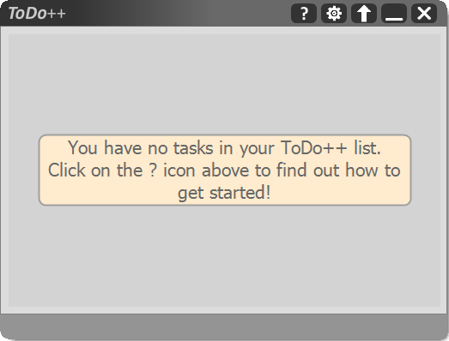
Settings/Preferences: Where you customize your command keywords, startup settings and more
Exit: Click this to quit Todo++
Help
Hide: Click this to minimize ToDo++
Collapser: Click this to hide and show the feedback box
Feedback box: Where the feedback messages are output
Input box: Where you enter your commands

Slide 2
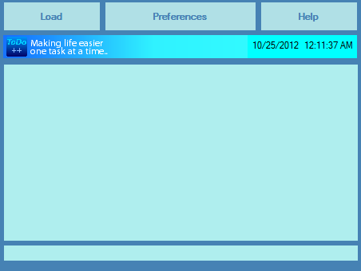
Settings/Preferences: Where you customize your keyboard shortcuts, command keywords and more
Help: Where you can find useful information when you are lost
Feedback box: Where the feedback messages are output
Input box: Where you enter your commands

Slide 3
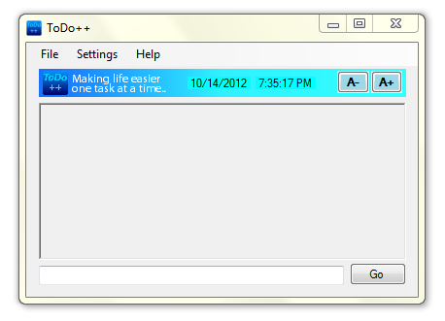
TimeDateControl (TimeDateControl.cs):
Displays Date and Time
increaseSizeButton:
Increase Size of Text
decreaseSizeButton:
Decrease Size of Text
Menu Control (Menu.cs): Requires an instance of UI and SettingsManager to be passed in
OutputBox Control (Menu.cs):
Requires an instance SettingsManager to be passed in
goButton: ToDo++ executes the command. Alternatively, just hit Enter (keyboard shortcut)
textInput: Place where user inputs commands

Slide 4
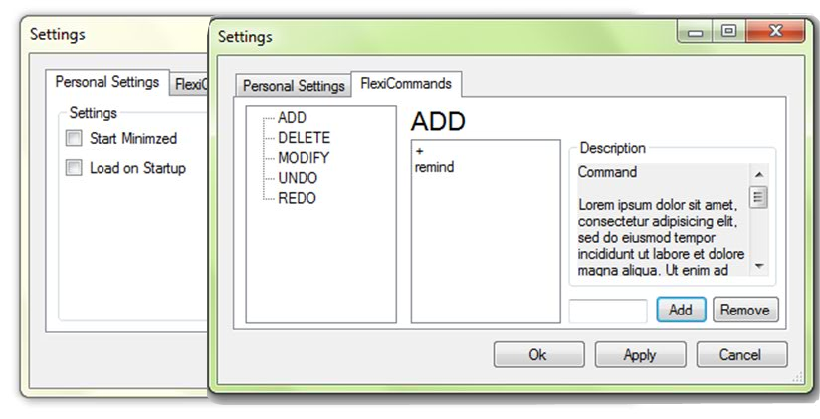
CommandTree:
This is where all user customized keywords for modifiable Commands are added
commandPreview:
TextBox that shows the current command
listOfCommands:
Lists all user Commands
commandDescription:
Description of selected Command
addUserCommandButton:
removeUserCommandButton:
Add remove items from/to the list
okayButton
applyButton
cancelButton
minimisedCheckbox
loadOnStartupCheckbox

