Slide 1

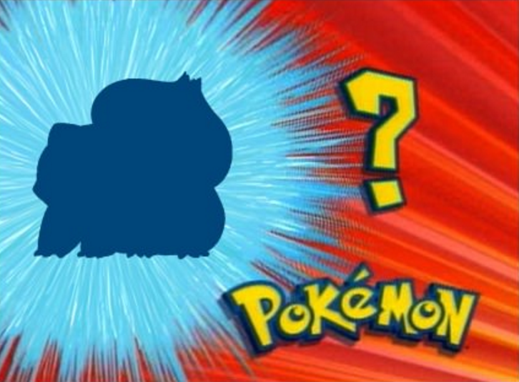
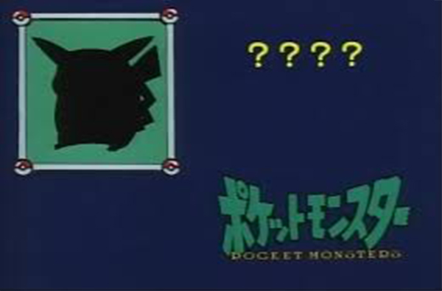
Pokémon game and animation is famous all around the world
By Generation VII, 809 Pokémon in total
Each Pokémon has an No. index from 001 to 809
Test & Enhance your memory of their names!

Slide 2


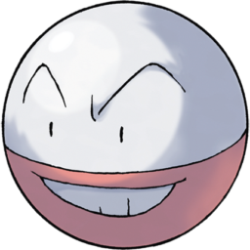





Some Pokémon look similar in their outline

Slide 3


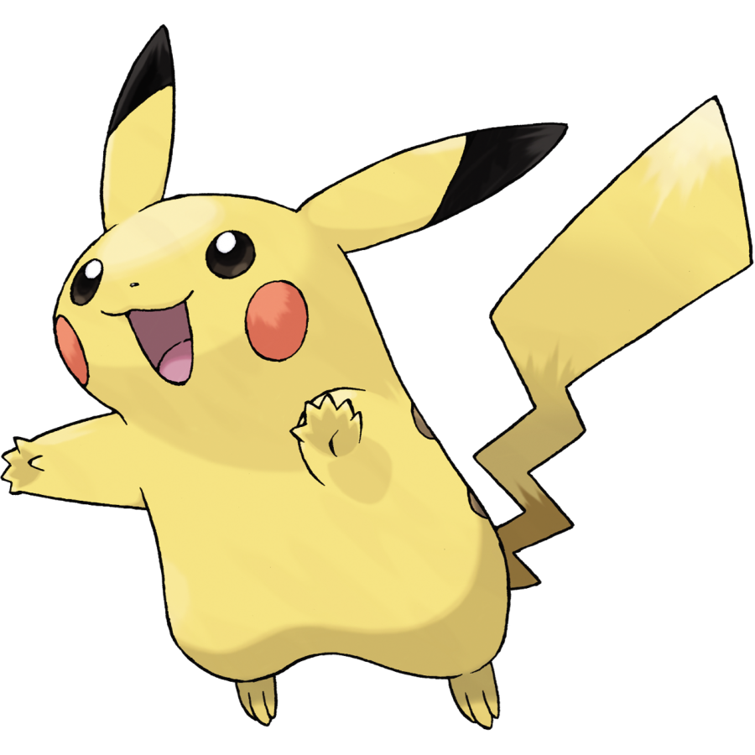


Work Flow
025Pikachu | …
… | …
809 raw Pokemon raw images (png) from Wiki
Pre-possessing
(resize, binarize, etc)
Finding similar shapes and their names
Rotation
Building game GUI

Slide 4
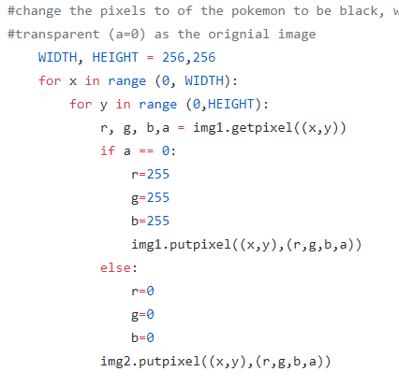
Prepossessing
PNG image has 4 tunnels: R, G, B, A
(transparency, 0 = transparent )
Use PIL modulus to resize and change pixels

Slide 5
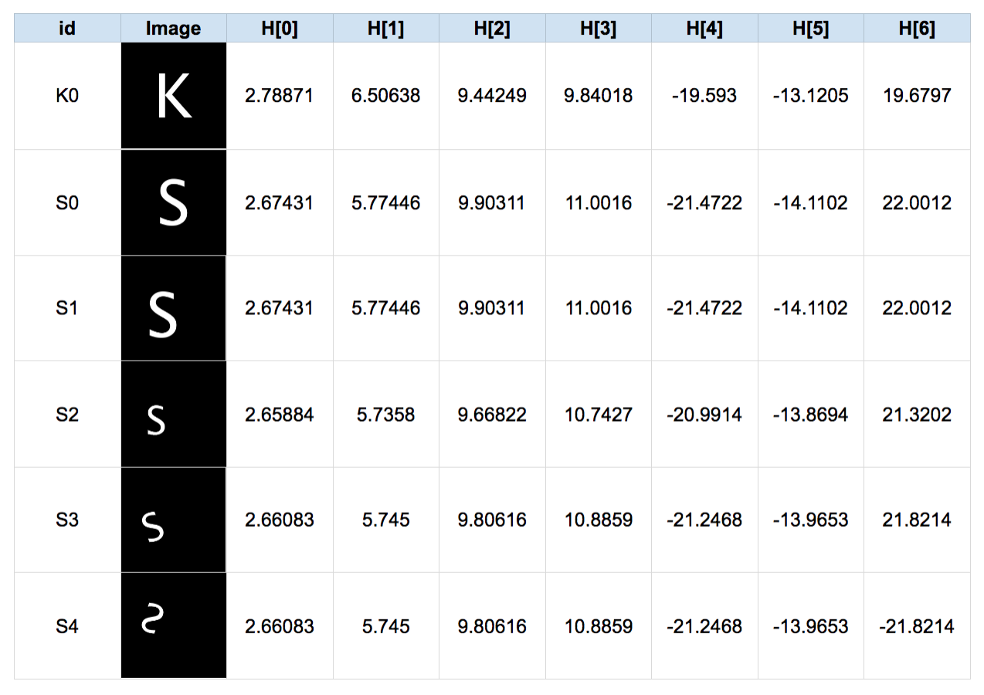

Shape Matching using HuMoments
Invariant to translation, scale, and rotation, and reflection.
Need to use binary images
Install OpenCV modulus to calculate moments and match
Results are not very close to human perception

Slide 6
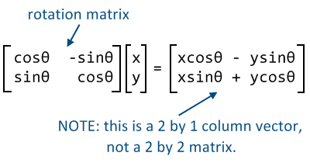
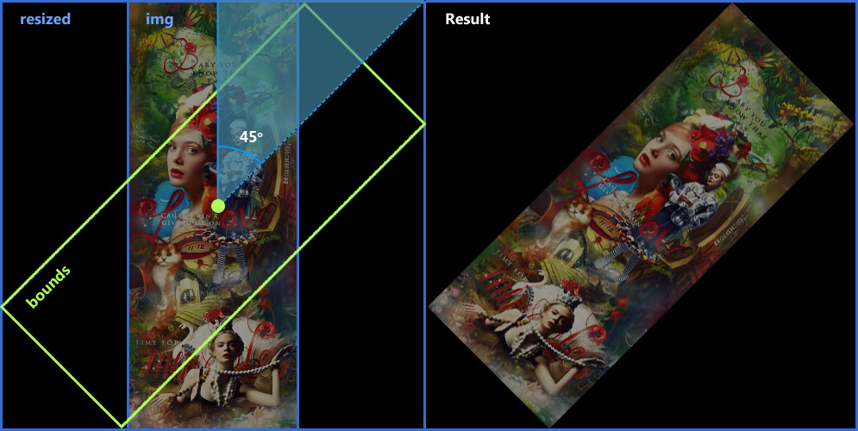
Rotation (OpenCV)
Rotation matrix:
Translation matrix: for expansion the border
256x256 will be 512x512 after rotation
Need to adjust the background color

Slide 7
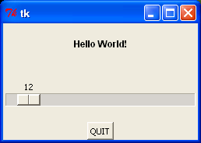
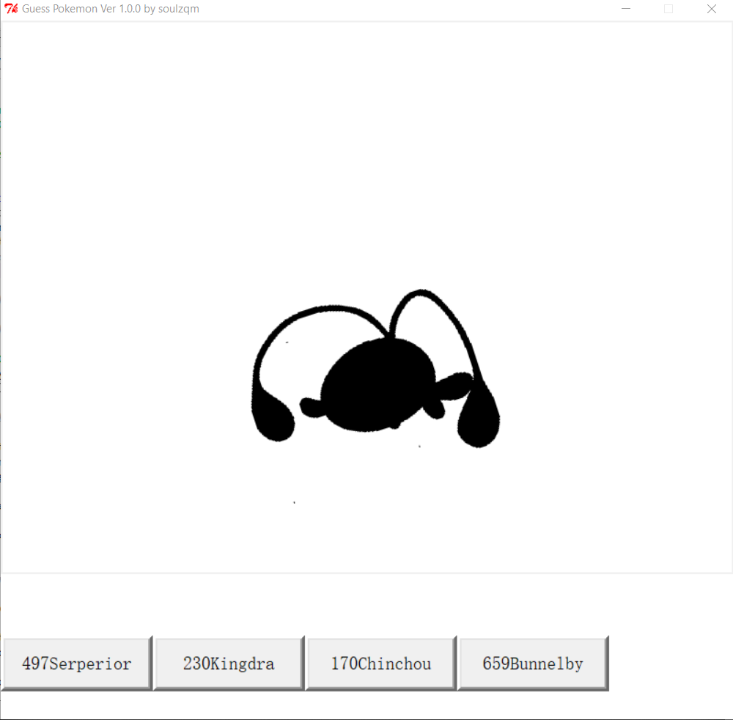
Building GUI
Python built-in GUI: Tkinter

