Slide 1

IDRPred - A Computational Protocol for enhancement of accuracy in identification of Intrinsically Disordered Regions of proteins
Soumak Dalapati, MTech(BI) - MBI2021017
Supervisor - Prof. Dr. Tapobrata Lahiri

Slide 2
Intrinsically Disordered Proteins(IDPs) and IDRs
Many biologically active proteins fail to form unique three-dimensional (3D) structures under physiological conditions, either along their entire lengths or locally. These proteins are known as intrinsically disordered proteins (IDPs).
Intrinsically disordered protein regions (IDRs) — regions that do not fold into a fixed three-dimensional structure but instead exist in a heterogeneous ensemble of conformations.
V.N. Uversky, in Brenner's Encyclopedia of Genetics (Second Edition), 2013
Erik W. Martin; Alex S. Holehouse

Slide 3
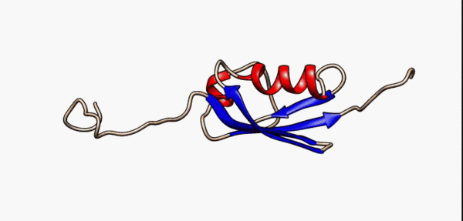
Example of IDR:-
Fig. Conformational flexibility in SUMO-1 protein (PDB:1a5r). The central part shows relatively ordered structure. Conversely, the N- and C-terminal regions (left and right, respectively) show ‘intrinsic disorder’, although a short helical region persists in the N-terminal tail.
https://en.wikipedia.org/wiki/Intrinsically_disordered_proteins#Disorder_and_disease

Slide 4
Motivation Behind the Project:-
Intrinsically unstructured proteins have been implicated in a number of diseases. It has been observed that IDRs are also some of the regions of mutations and may cause genetic diseases which includes cardiovascular cancer, and others.
An accurate understanding of multilevel complexity of IDPs/IDPRs will require the development of new rules and new technologies to study them. It will help in understanding the disease and effective treatment can be initiated.

Slide 5
Methods of Prediction:-
Convolutional and recurrent neural networks, among other deep learning techniques, have recently become effective tools for IDP prediction. These methods can process large amounts of sequence data and learn complex features, allowing for more accurate and efficient IDP prediction.
Another approach for predicting intrinsically disordered regions (IDRs) within intrinsically disordered proteins (IDPs) is the use of window-based methods. These methods involve breaking up the protein sequence into shorter segments, or windows, and predicting the disorder propensity of each window.

Slide 6
Methods of Prediction:-
Window-based methods offer a useful approach for predicting IDRs within IDPs, but careful consideration must be given to the choice of window size and overlap.
Additionally, other factors, such as the choice of features and machine learning algorithms, can also affect the accuracy of predictions.
By comparing the accuracy of predictions across different window sizes and overlaps, we can identify the optimal window size and overlap for predicting IDRs in specific types of IDPs.
This data can be utilized to increase the precision of forecasts and to direct the creation of brand-new prediction techniques.

Slide 7
Data Collection and Preparation of data for Window-Based study:-
We have collected data from FIDPNN is a widely used dataset for predicting IDRs in IDPs. It contains protein sequences from the DisProt database that are annotated with experimentally verified disorder regions. DisProt database, which is a curated database of experimentally characterized IDPs and their interactions.
The total number of IDR sequences were 721.

Slide 8
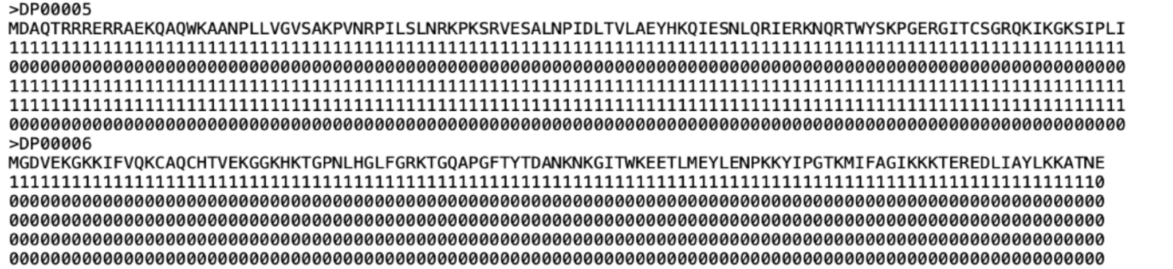
Fig. Snapshot of FIDPNN Data Set

Slide 9
Data Collection and Preparation of data for Window-Based study:-
We have collected data from FIDPNN is a widely used dataset for predicting IDRs in IDPs. It contains protein sequences from the DisProt database that are annotated with experimentally verified disorder regions. DisProt database, which is a curated database of experimentally characterized IDPs and their interactions.
The total number of IDR sequences were 721. The data were given in three different files named as Training, Validation, Testing data. I have classified these files by making subsequences of window sizes 5, 7, 9, 11, 13, 15, 17, 19, 21, 23, 25, 27, 29, 31, 33, 35, 37, 39, 41, 43, 45, 47, 49, 51, 53, 55, 57, 59.

Slide 10
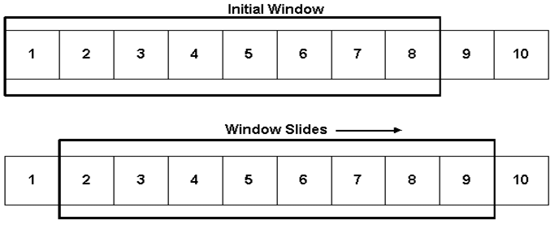
Fig. How Window Slides

Slide 11
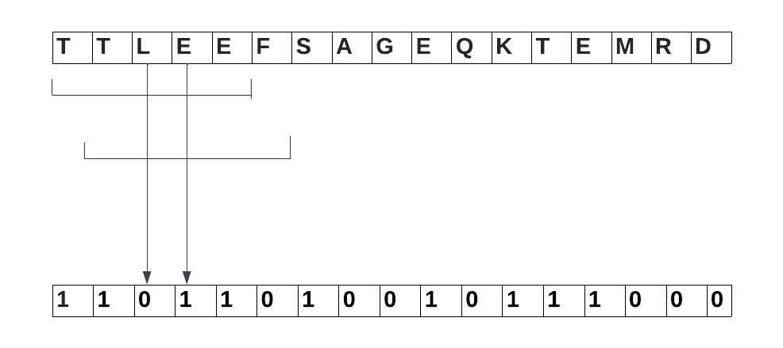
TTLEE will have class as 0
TLEEF will have class as 1
Fig. Class Annotation for Window of length 5(Without Padding)

Slide 12
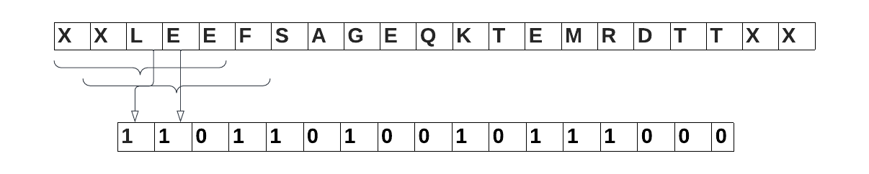
Fig. Class Annotation for Window of length 5(With Padding)
Now after padding, XXLEE has been assigned class as 1 and XLEEF has been assigned class as 1

Slide 13
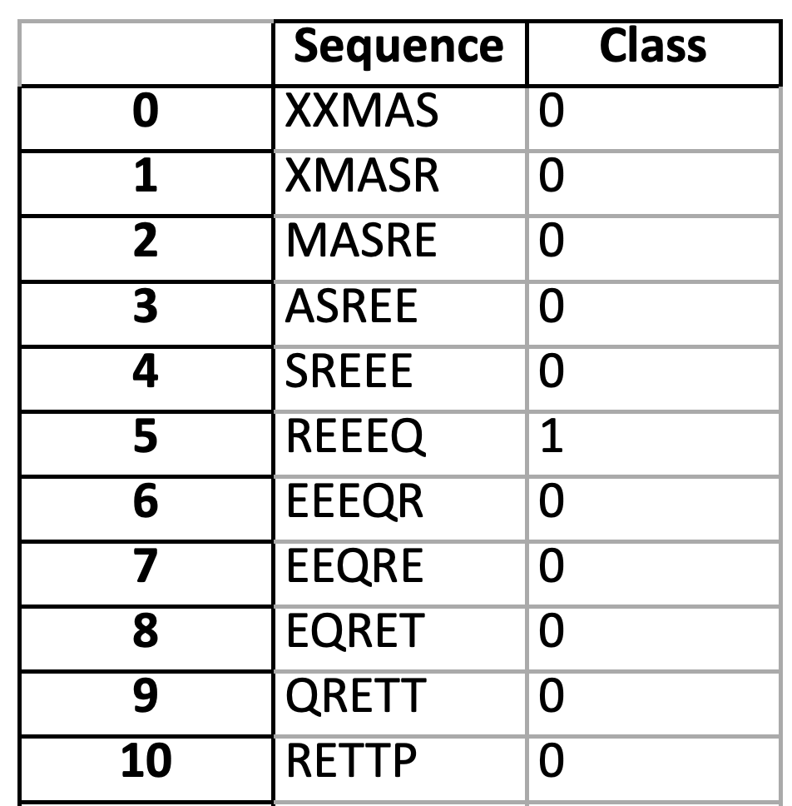
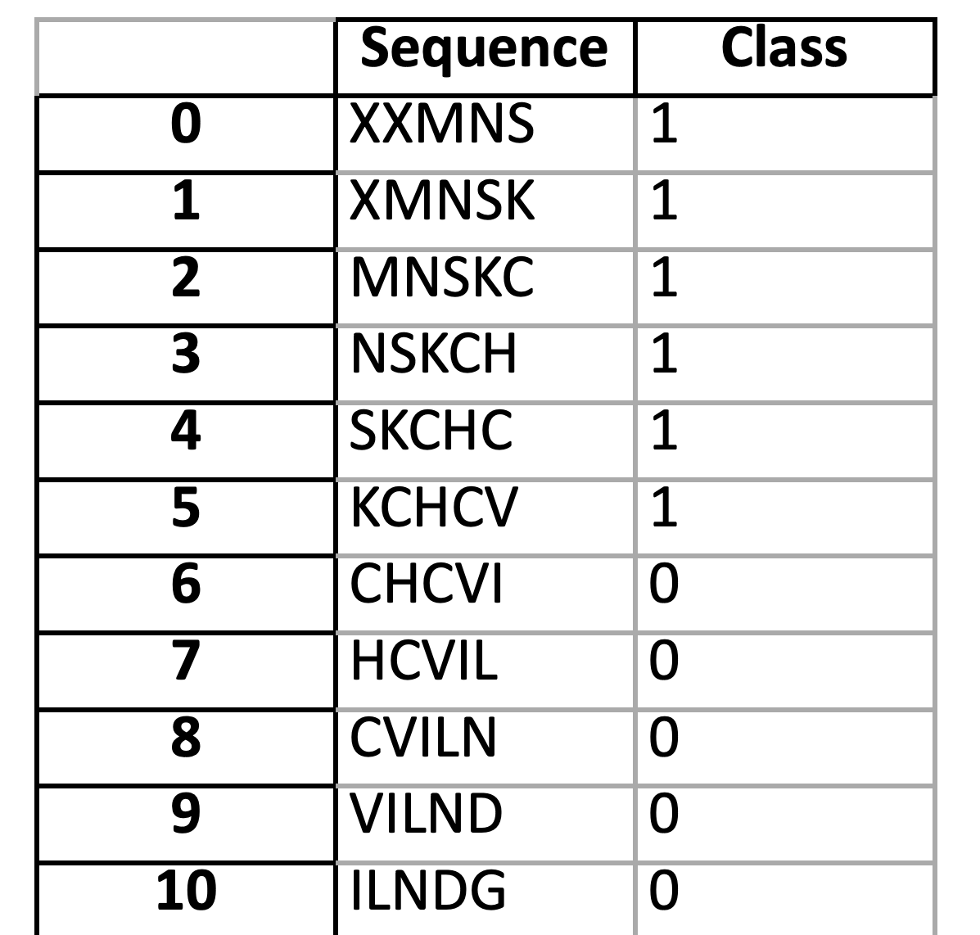
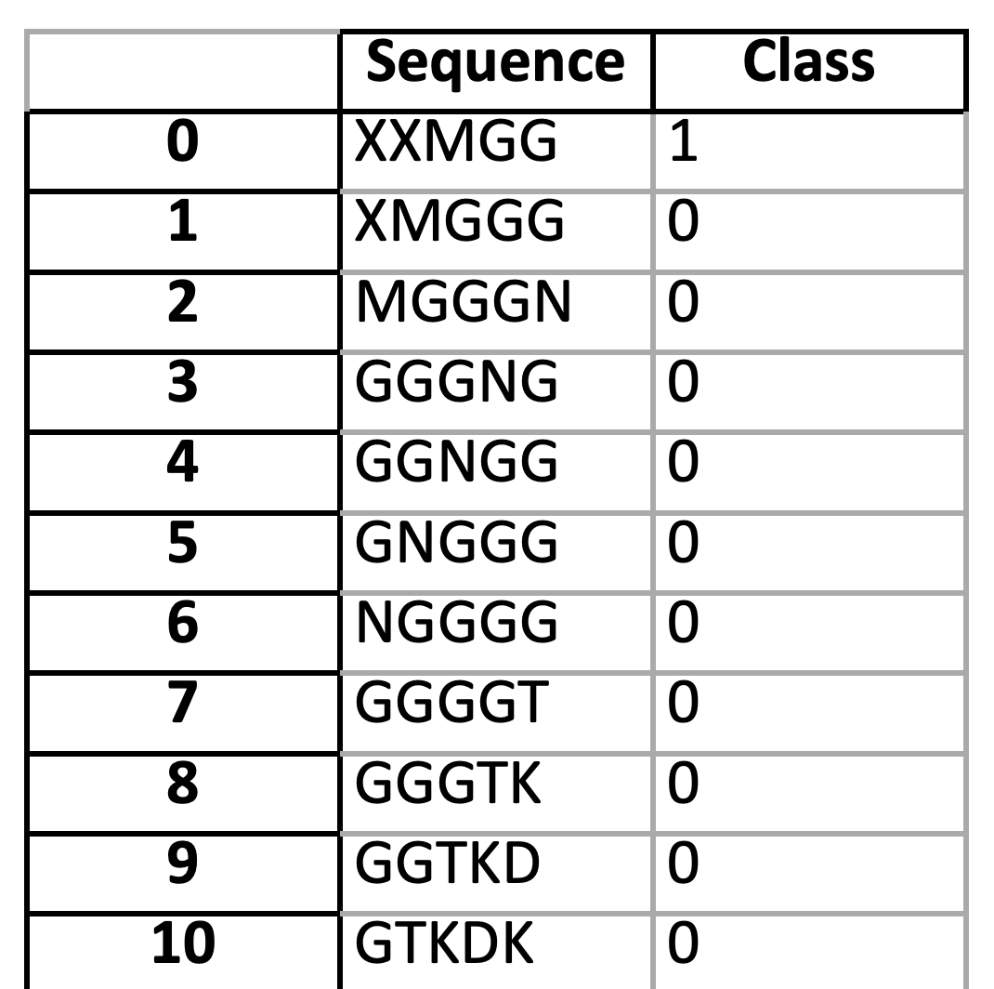
Fig. How Dataset looks after making Window of length 5

Slide 14
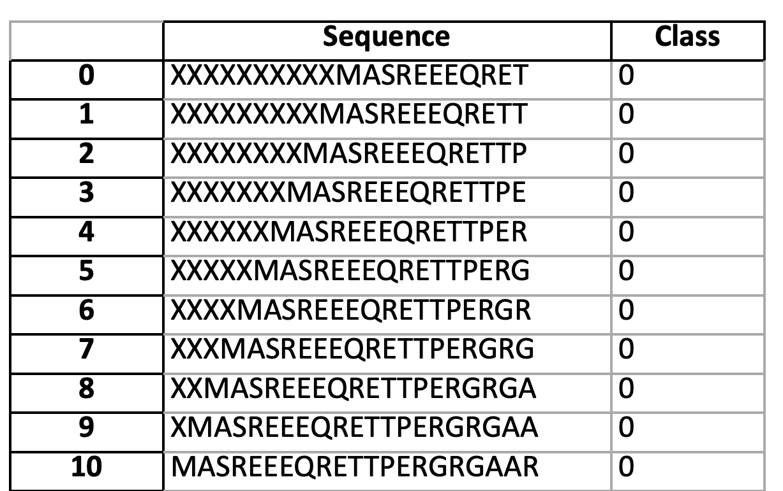
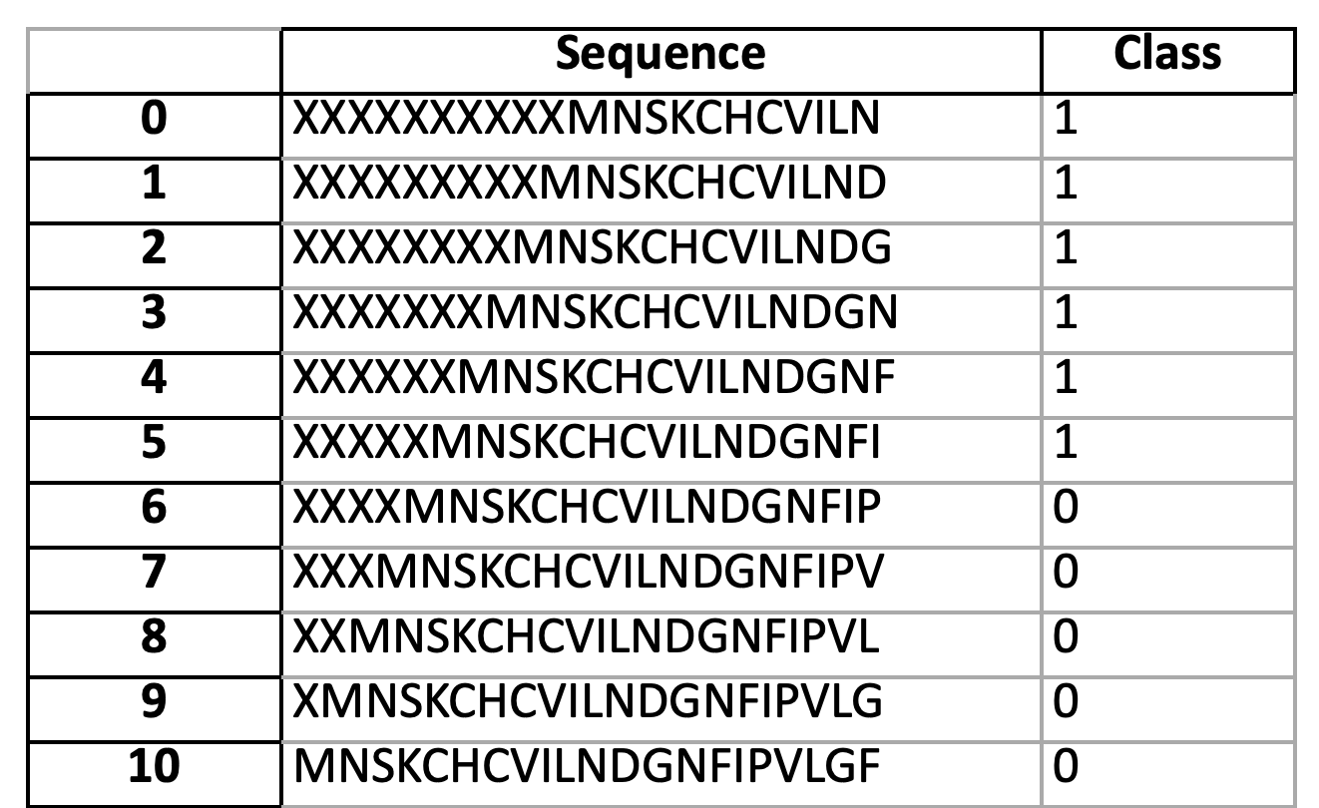
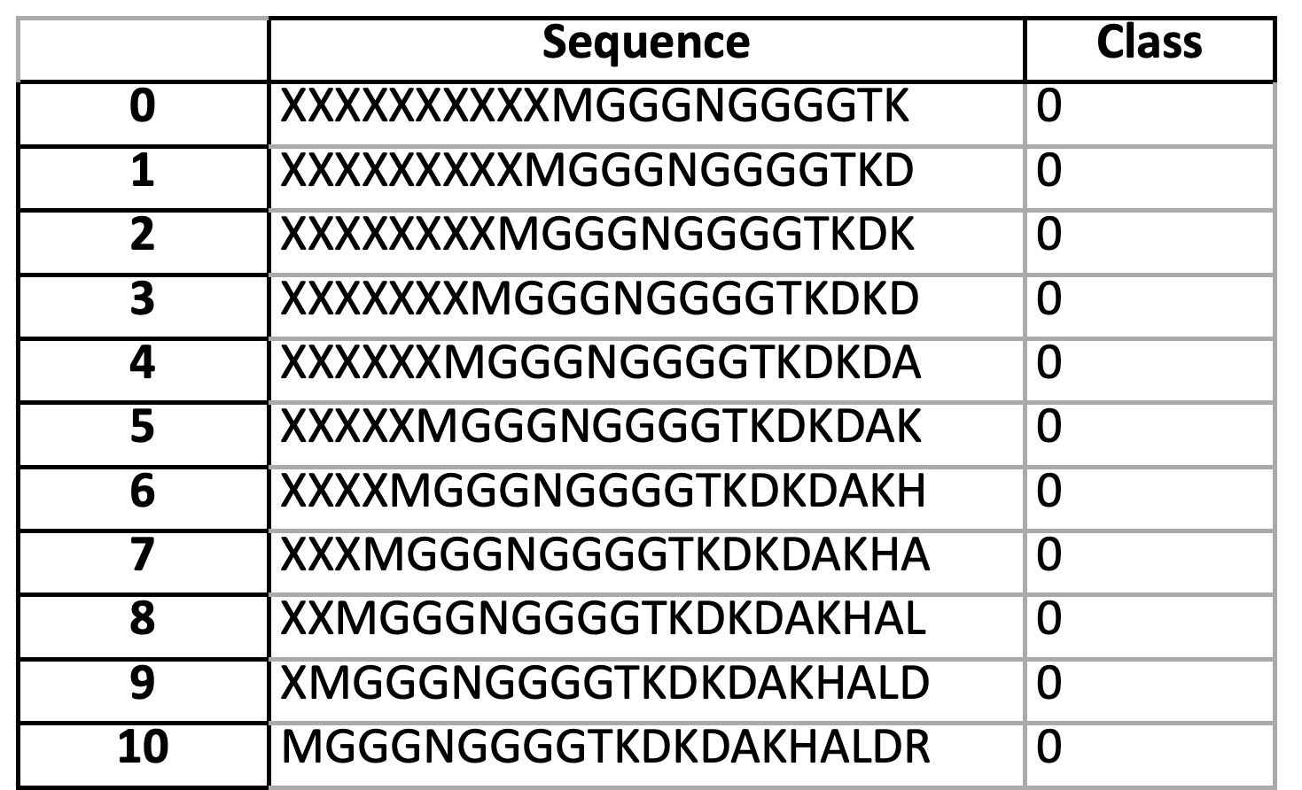
Fig. How Dataset looks after making Window of length 21

Slide 15
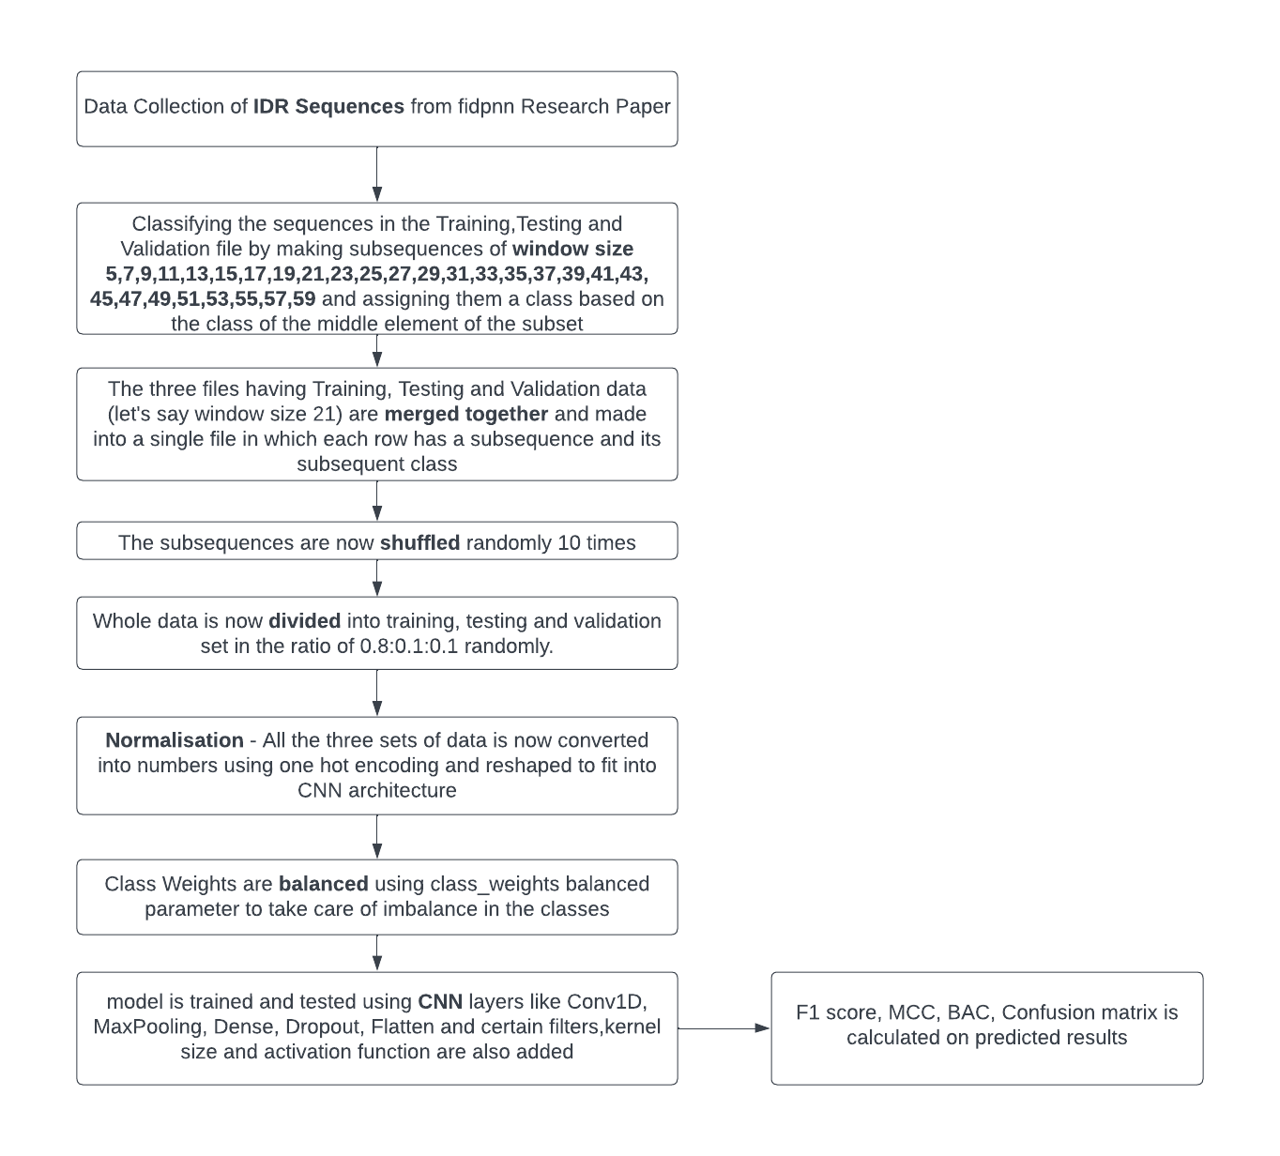
Fig. Flowchart of Training and Testing the Model

Slide 16
Data Collection and Preparation of data for Window-Based study:-
So, now we have 3 files for each window named as fidpnnTrainingLen_(no. of rows)Rows, fidpnnTestLen_(no. of rows)Rows, fidpnnValidationLen_(no. of rows)Rows.
Concatenate these 3 files and shuffle them randomly 10 times. Now, I have divided the data into three equal portions for training, validation, and testing in the ratio of 0.8:0.1:0.1.
The dataset is now saved as X_train_val, X_test, y_train_val, y_test, X_train, X_val, y_train, and y_val, where variables beginning with "X" stand for sequences and variables beginning with "y" stand for their respective class as 0/1.

Slide 17
CNN and Feature Extraction:-
The data has been normalised using one hot encoding. One-hot encoding is a popular method for transforming numerical data that may be input into a machine learning model from categorical data, such as amino acid residues.
This matrix can then be fed into the CNN model as input features.

Slide 18
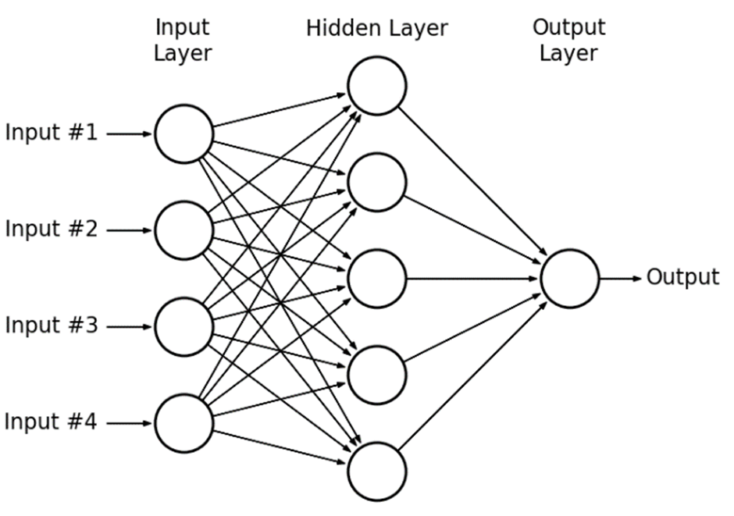
Fig. Example Multilayer Perceptron

Slide 19
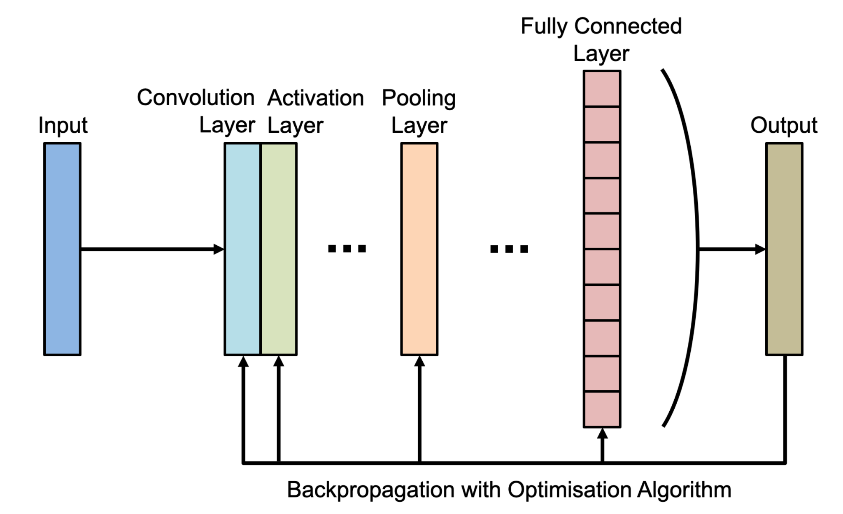

Slide 20
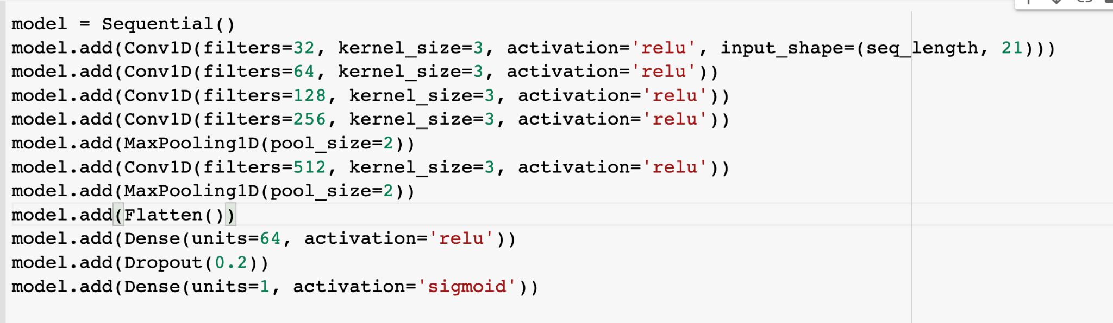
Fig. CNN Architecture Used for Training

Slide 21
https://docs.google.com/spreadsheets/d/18h-yuc4LBKNeEz4E9-aHtjzhq3oSJDx0iN65OZy8Wrc/edit#gid=0
 | Accuracy | Sensitivity | F1 Score | MCC | BAC | TP | FP | FN | TN
Sequences with Window Length 59 | 0.989122 | 0.984574 | 0.97833 | 0.97111 | 0.98761 | 23375 | 221 | 121 | 7723
Sequences with Window Length 57 | 0.985781 | 0.973951 | 0.97097 | 0.96157 | 0.98177 | 23511 | 247 | 200 | 7478
Sequences with Window Length 55 | 0.988005 | 0.971905 | 0.97572 | 0.96777 | 0.98261 | 23478 | 158 | 219 | 7576
Sequences with Window Length 53 | 0.986507 | 0.961761 | 0.97249 | 0.96366 | 0.97821 | 23507 | 126 | 298 | 7495

Slide 22
Sequences with Window Length 11 | 0.846652 | 0.642502 | 0.67425 | 0.57549 | 0.77806 | 21323 | 2016 | 2737 | 4919
Sequences with Window Length 9 | 0.810853 | 0.463244 | 0.54566 | 0.44208 | 0.69351 | 21547 | 1778 | 4067 | 3510
Sequences with Window Length 7 | 0.764122 | 0.149611 | 0.23815 | 0.20311 | 0.55733 | 22350 | 809 | 6440 | 1133
Sequences with Window Length 5 | 0.761452 | 0.036493 | 0.06785 | 0.07772 | 0.51213 | 21329 | 264 | 6495 | 246

Slide 23
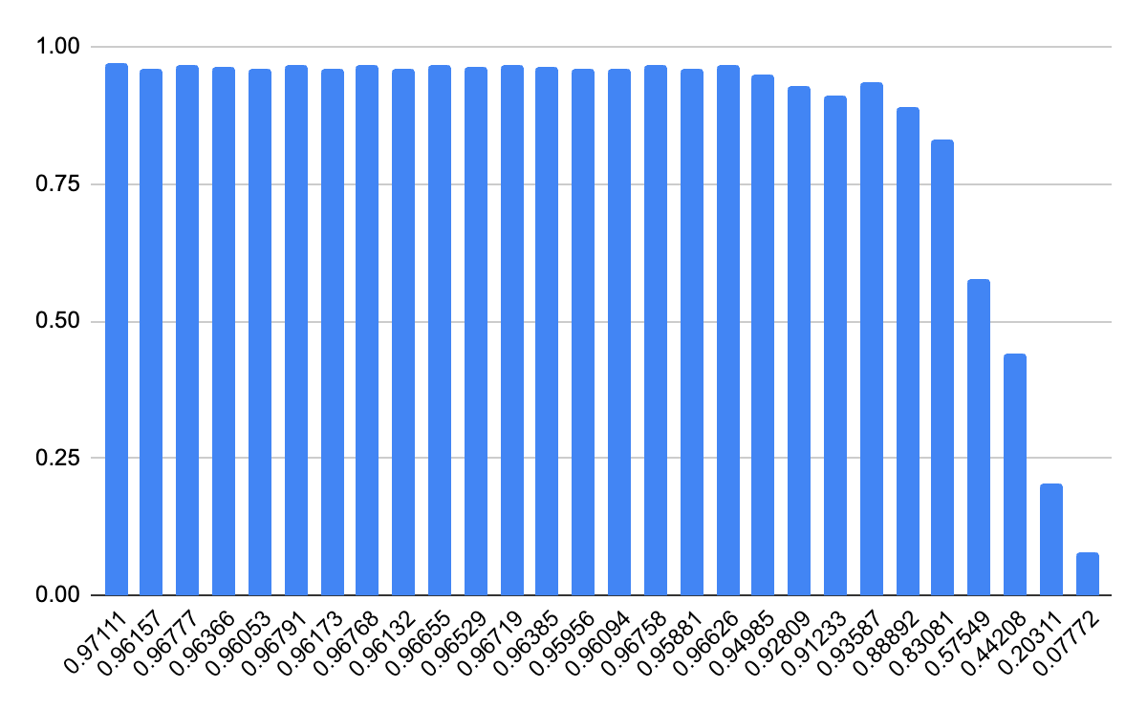
Fig. MCC scores starting from window length 59 to window length 5

Slide 24
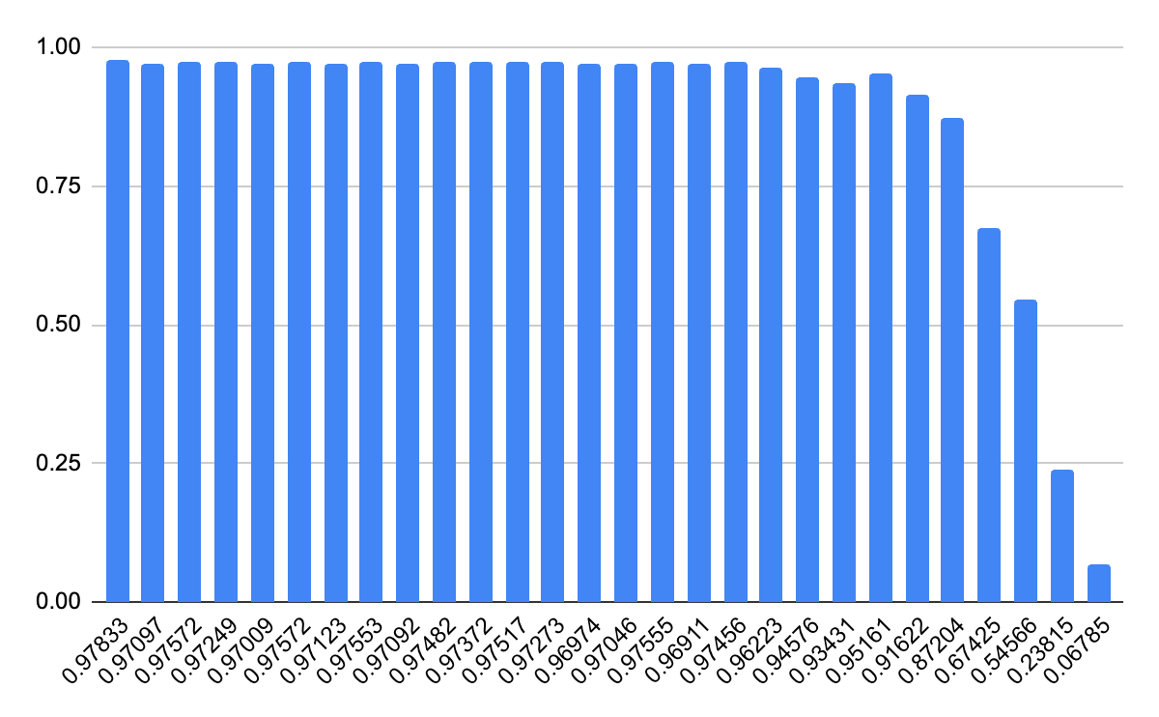
Fig. F1 scores starting from window length 59 to window length 5

Slide 25
Result Analysis:-
Our results show that, in general, larger window sizes result in higher performance metric scores, with windows of size 15 and above providing the best overall performance.
Larger window sizes also provide more context for the model to work with, which can be especially important when considering the relationship between adjacent regions.
For example, if a particular region is known to be disordered, adjacent regions may also be more likely to be disordered due to the local sequence characteristics. A larger window size can capture these types of patterns and improve the overall prediction accuracy.

Slide 26
Prediction Results:-
Disordered Predictors | Disordered Region Prediction
IDRPred | 44%
PONDR | 38%
NetSurfP-2.0 | 39%
PrDOS | 27%
IupredS | 21%
IupredL | 0.02%
SPOT Disorder | 23%
fidpnn | 100%
Test Sequence taken from Disprot Database - MQSINFRTARGNLSEVLNNVEAGEEVEITRRGREPAVIVSKATFEAYKKAALDAEFASLFDTLDSTNKELVNR
0000000000000000000000000000000000000000011111111111111111111111111111111

Slide 27
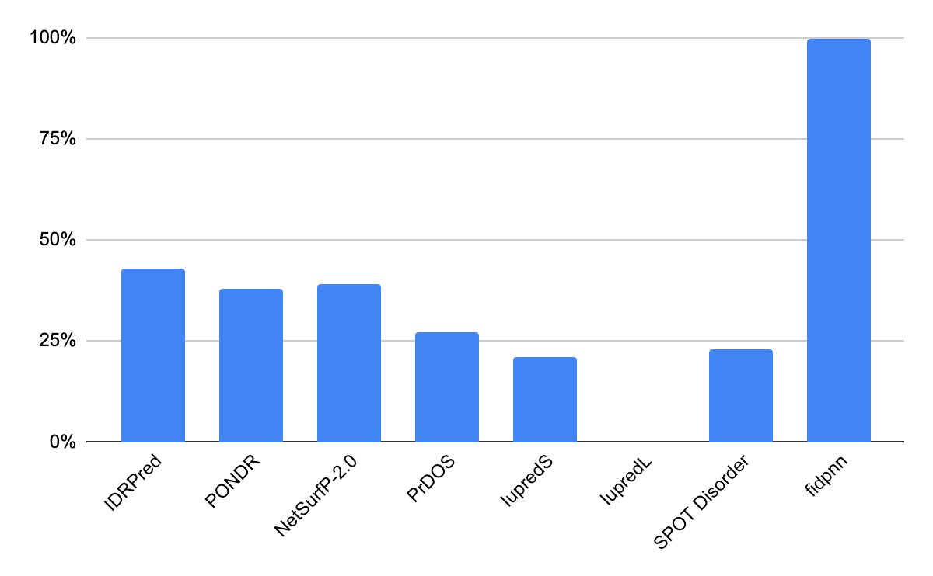
Comparison of Prediction Results:-

Slide 28
References
Uversky, V. N. (2013). Intrinsically disordered proteins and their “mysterious” (meta)physics. Frontiers in Physiology, 4, 1-17.
Ishida, T., & Kinoshita, K. (2007). PrDOS: prediction of disordered protein regions from amino acid sequence. Nucleic acids research, 35(suppl_2), W460-W464.
Xie, J., & Kurgan, L. (2018). Prediction of intrinsically disordered protein regions from sequence alone. BMC Bioinformatics, 19(1), 1-14.
Habchi, J., Tompa, P., Longhi, S., & Uversky, V. N. (2019). Introducing protein intrinsic disorder. Chemical Reviews, 119(18), 11594-11606
Yang, Y., Zhou, Y., & Gong, W. (2020). A deep learning approach for predicting intrinsically disordered protein regions from primary sequences. BMC Bioinformatics, 21(1), 1-13.
Zhou, Y., & Zhou, H. (2019). Methods for predicting intrinsically disordered regions of proteins. Methods in molecular biology (Clifton, N.J.), 2022, 163-180.

Slide 29
THANK YOU !

