Slide 1
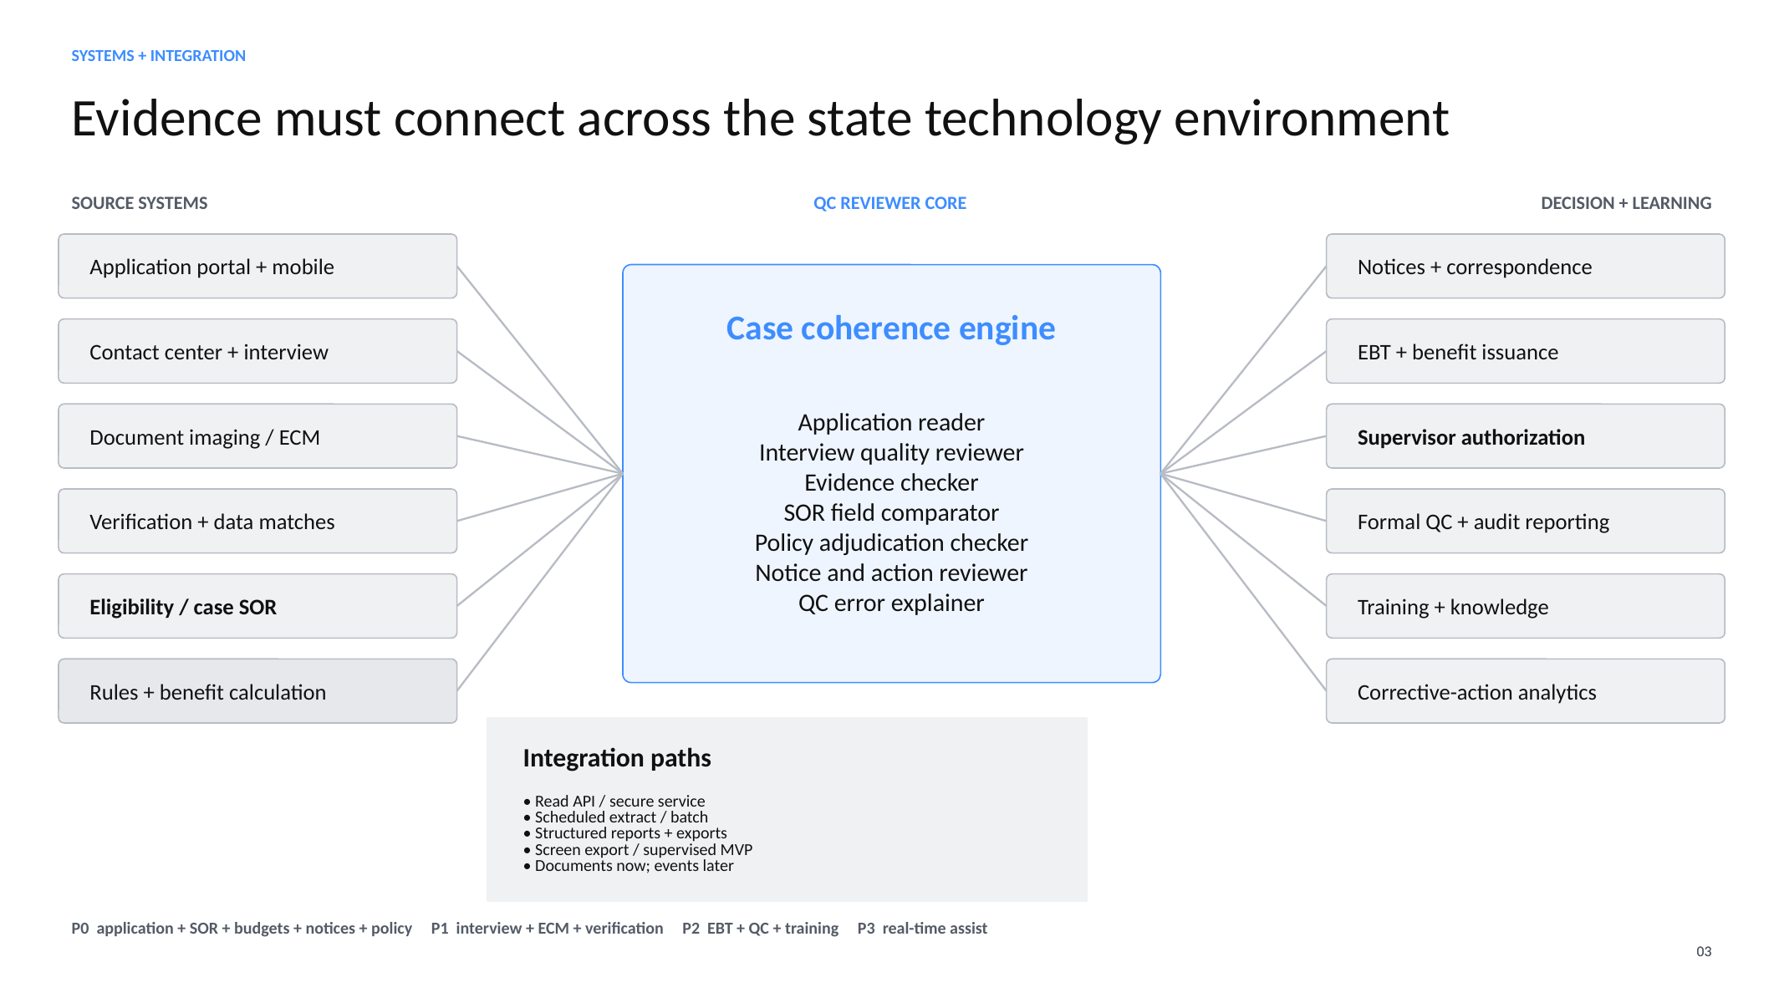
Notes:
Source: slide 3 of snap-qc-partnership-model.pptx. This is the product and integration concept for engineering discussion.

Slide 2
Initial people requirements for an India-led build
Working team model for review — validate the mix, seniority, availability and hiring sequence
INDIA DELIVERY CORE
ADJACENT SUPPORT
ROLE
FTE
PRIMARY CAPABILITY
Engineering Lead
1.0
Technical design, estimation, delivery planning, team allocation and release readiness
Production Systems Integration Engineer
US · FRACTIONAL
Production APIs, deployment and customer technical coordination
Full-stack Engineers
2.0
Application workflows, user experience, APIs and integration delivery
Program & Delivery Manager
US · FRACTIONAL
Delivery governance, financial tracking and escalation
AI / ML Engineer
1.0
AI workflows, evaluation, guardrails and model integration
Customer Success / FDE
Data / Knowledge Engineer
1.0
Policy, document, evidence and knowledge pipelines
US · GO-LIVE
Customer support, renewal and expansion
QA Engineer
1.0
Functional, regression and automated testing
FEEDBACK NEEDED
DevOps / SRE
0.5
Secure deployment, observability, reliability and operational support
Is the role mix and seniority right?
Which roles can initially be combined?
Implementation Analyst
0.5
Customer configuration, workflow mapping and rollout support
Who is available, and how quickly?
What should be contract vs full-time?
CORE POD
7.0 FTE equivalent
Add capacity only against signed backlog
Notes:
Discussion goal: confirm the initial India delivery pod, identify available people, and recommend role combinations or sequencing. Executive roles are outside this staffing discussion.

