Slide 1


Ansible Inventory & Variable Precedence Explained
Understanding configuration management with dynamic variables
Notes:
AI-generated content may be incorrect. ---

Slide 2
Introduction
Notes:
AutomateOps Branding and Overview

Slide 3

Session goals Learn Ansible Inventory & Variable Precedence Hands-on demos quizzes and challenges Focus on practical automation workflows
Notes:
Welcome to 'Ansible Inventory & Variable Precedence Explained' presented by AutomateOps, your go-to destination for mastering IT automation. This presentation is designed to provide a comprehensive understanding of how Ansible handles inventory structures and variable precedence. Whether you're managing a few servers or orchestrating complex infrastructure across multiple environments, mastering these concepts is essential for building scalable and predictable automation workflows. In this session, we will explore inventory file structures, variable inheritance, alphabetical merging, and real-world use cases. We will also walk through a hands-on demonstration, followed by a quiz and a practical challenge to reinforce your learning.

Slide 4
Understanding Inventory Structure

Slide 5
Inventory File Structure and Group Hierarchies
INI Format
[control]
localhost ansible_connection=local
[target]
target1 ansible_host= x.x.x.x
target2 ansible_host= y.y.y.y
# Explanation:
# ansible_connection=local → Used for localhost
# ansible_host → IP or DNS name of the target
Inventory File Formats
Ansible inventory files can be written in INI or YAML formats for defining hosts and groups.
Multiple Group Memberships
Hosts can belong to multiple groups, enabling flexible automation targeting.
Nested Group Hierarchies
Groups can have child groups to create nested hierarchical structures for better organization.
Effective Infrastructure Management
Understanding group structures is key for efficient playbook execution and infrastructure control.
YAML Format
all:
vars:
email_server: mail.google.com
children:
control:
hosts:
localhost:
ansible_connection: local
target:
vars:
email_server: mail.yahoo.com
hosts:
target1:
ansible_host: Z.Z.Z.Z
ansible_user: ec2-user
ansible_python_interpreter: "/usr/bin/python3.9"
target2:
ansible_host: M.M.M.M
ansible_user: ubuntu
ITESTATE:
children:
target: {}
control: {}
Multiple Group Memberships
[all]
host1
[webservers:children]
Frontend
[frontend]
host1
[groupA]
host1
[groupB]
host1

Slide 6

Inventory Explanation and Visual Hierarchy
Example
[all]
Host1
[webservers:children]
Frontend
[Frontend]
Host1
[groupA]
Host1
[groupB]
host1
Group Membership and Inheritance
Host1 belongs to multiple groups, inheriting variables from both parent and child groups for flexible configuration.
Same-level Group Variable Merging
Variables from same-level groups merge alphabetically, with later groups overriding earlier ones in case of conflicts.
Host-specific Variable Precedence
Host-specific variables have the highest priority, overriding group variables for precise control over configurations.
Importance of Hierarchy Understanding
Grasping Ansible's inventory and variable hierarchy ensures predictable and maintainable automation workflows.

Slide 7
Variable Precedence in Ansible
Notes:
Variable Precedence Impact and Hierarchy, Alphabetical Merge and Group Priority

Slide 8
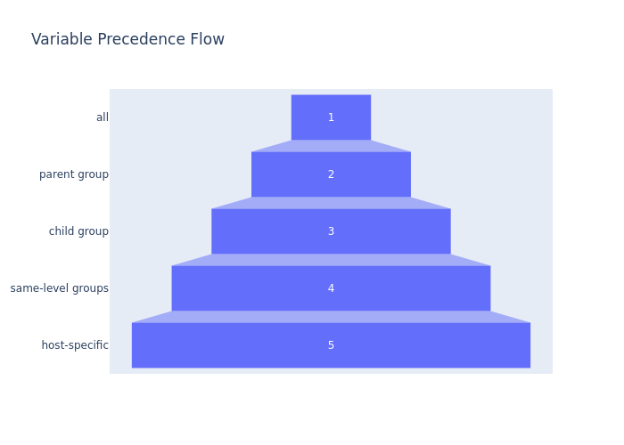
Variable Precedence Impact and Hierarchy
Variable Definition Locations
Variables can be defined in group_vars and host_vars directories to manage configurations effectively.
Precedence Hierarchy Order
Ansible applies variables starting from 'all' group, then parent, child, and same-level groups in order.
Same-Level Group Variable Merge
Variables from same-level groups merge alphabetically, with later groups overriding earlier ones if keys clash.
Host-Specific Variable Priority
Host-specific variables have the highest precedence and override any group-level variables for precision.

Slide 9

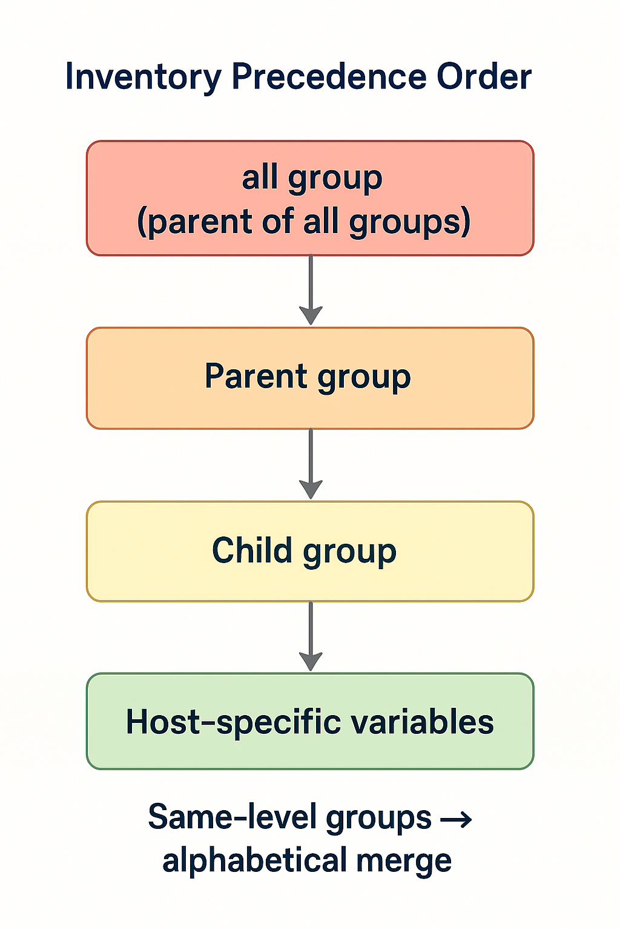
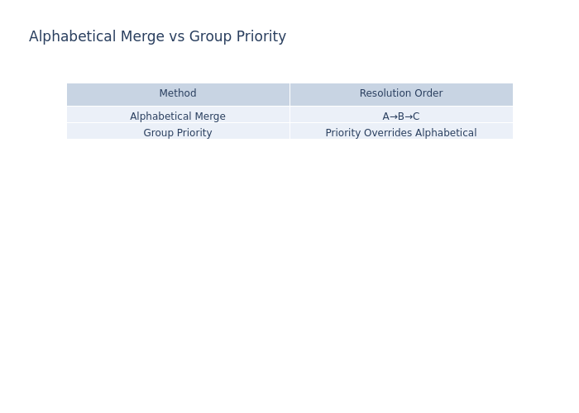
Alphabetical Merge and Group Priority
Alphabetical Variable Resolution
Ansible merges variables alphabetically when a host belongs to multiple groups at the same level, resolving conflicts predictably.
Group Priority Override
The 'ansible_group_priority' setting overrides alphabetical merging, allowing manual control over variable precedence.
Complex Environment Management
This mechanism helps manage complex environments with overlapping groups defining similar variables more predictably.

Slide 10
Real-World Applications
Notes:
Using Precedence in Staging and Production

Slide 11

Using Precedence in Staging and Production
Variable Precedence Concept
Variable precedence differentiates staging and production configurations by overriding default settings as needed.
Environment-Specific Variables
Environment variables in group_vars/staging.yml enable Ansible to apply correct settings for staging environments.
Host-Specific Configuration
Host-specific variables allow fine-tuning of server settings, such as SSH ports and application parameters.
Dynamic Playbook Behavior
A single playbook dynamically adjusts behavior based on the target environment, improving deployment efficiency.

Slide 12
Demonstration

Slide 13
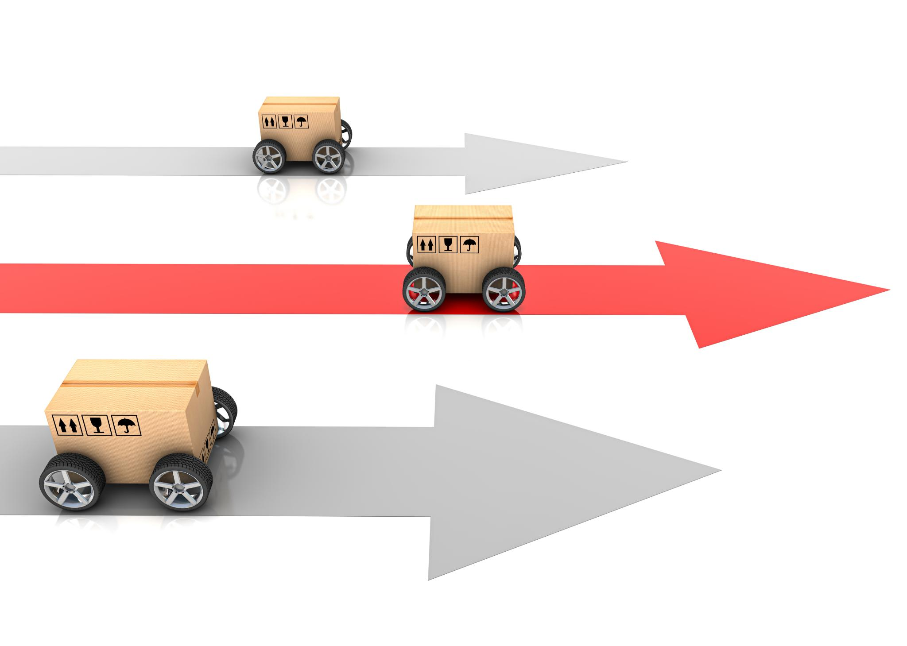
Step-by-Step Demo Plan
Inventory Setup
Create an inventory.ini file with parent-child and same-level groups for Ansible testing.
Variable Definition
Define variables in group_vars and host_vars with differing values for testing precedence.
Inventory Visualization
Use ansible-inventory commands to visualize inventory structure and variable resolution.
Inventory Conversion & Validation
Convert inventory formats and run a playbook to validate variable setup with ping.

Slide 14
Interactive Learning
Notes:
Quiz Questions, Hands-on Challenge

Slide 15

Quiz Questions
Question | Answer | Explanation
What is the default inventory file name in Ansible? | hosts | By default, Ansible looks for an inventory file named hosts in /etc/ansible/. You can override this using -i option.
Which group has the lowest precedence when applying variables? | all | The all group is the parent of all groups and has the lowest precedence. Variables defined here are overridden by group-specific and host-specific variables.
How does Ansible merge variables from same-level groups? | Alphabetically | When a host belongs to multiple same-level groups, Ansible merges variables alphabetically. For example, groupB overrides groupA if both define the same variable.
Which setting can override alphabetical merging of group variables? | ansible_group_priority | This setting allows you to assign a numeric priority to groups, so higher priority groups override lower ones regardless of alphabetical order. This setting allows you to assign a numeric priority to groups, so higher priority groups override lower ones regardless of alphabetical order.
Which variable type has the highest precedence? | Host-specific variables | Variables defined in host_vars or directly in the playbook for a host override all group-level variables, ensuring precise configuration.

Slide 16

Hands-on Challenge
Inventory Conversion Challenge
Convert INI inventory files to YAML and JSON formats using Python scripting for better automation management.
Variable Precedence Testing
Define variables in multiple locations and observe which value Ansible prioritizes during playbook execution.
Task Execution Visualization
Utilize Ansible's '--graph' option to visualize task order and convert DOT files to PNG with Graphviz.

Slide 17
Conclusion
Notes:
What’s Next?

Slide 18
What’s Next?
Upcoming Focus: Ansible Modules
Next session covers Ansible modules, key components for creating efficient automation playbooks.
Notes:
In the next session, we will explore Ansible modules in depth. These modules are the building blocks of Ansible playbooks and are essential for performing tasks such as package installation, file manipulation, and service management. Stay tuned to AutomateOps for more tutorials. Like, share, and subscribe to our channel, and hit the bell icon to get notified of new videos. Continue your journey to mastering IT automation with Ansible!

