Slide 1


Ansible ROI: REASON TO USE AND ROI Studies
Demonstrating Reason of Using Ansible and its automation benefits across various industries
Notes:
AI-generated content may be incorrect. ---

Slide 2
Why it matters
Informed Decision Making:
Understanding why Ansible is agentless, open-source, and easy to adopt helps IT leaders choose the right automation tool. ROI studies show tangible benefits like cost savings and efficiency, making it easier to justify investment to stakeholders.
Strategic Planning:
Knowing the ROI metrics (e.g., 667% over 5 years, break-even in 10 months) helps organizations forecast financial impact. Helps prioritize automation projects that deliver the highest returns.
Career Growth:
Professionals who can link technical solutions to business outcomes stand out. Learning ROI-driven automation makes you valuable for roles in DevOps, IT strategy, and cloud operations.
Risk Reduction:
ROI case studies highlight reduced downtime, fewer SLA breaches, and improved compliance. This knowledge helps teams design resilient, cost-effective systems.
Faster Adoption:
Real-world examples and ROI data build confidence among decision-makers and teams. Encourages quicker buy-in for automation initiatives.

Slide 3
reason to use Ansible
No Agent, No Licensing Cost
Ansible is agentless — it uses SSH or WinRM, so you don’t need to install or maintain agents on target systems.
Open-source: No licensing fees for the core tool.
Cost-saving: Reduces infrastructure overhead and software costs.
2. Faster Implementation = Lower Initial Cost
Simple YAML syntax: Easy to learn, reducing training time. Quick onboarding: Teams can start automating within days.
Reusable roles and playbooks: Speeds up deployment across environments.
We can automate repetitive tasks in hours instead of weeks, reducing implementation timelines and cost.” Provisioning time reduced from 45 mins to 5 mins in Financial Services.
3. Reduced Human Error = Lower Risk & Rework
Manual tasks are prone to mistakes.
Ansible ensures idempotency — tasks only apply changes when needed.
Fewer errors mean less downtime, less troubleshooting, and lower support costs. Healthcare patching errors eliminated with automated rollback
4. Scalable Automation = Operational Efficiency
One playbook can manage hundreds of servers.
Supports parallel execution, saving time during patching, provisioning, or remediation.
Easily integrates with tools like ServiceNow, AWS, Prometheus, etc.
💡 “We can scale operations without scaling headcount.” Telecom scaled auto-remediation across hundreds of servers
5. Maintenance-Friendly
Playbooks are version-controlled and documented.
Easy to update, audit, and reuse.
Supports auto-remediation (e.g., restart services, clean disk, reboot on high CPU) — reducing manual intervention.
💡 IT Services simplified audits with version-controlled playbooks
6. Integration-Ready
Works with existing tools: CI/CD pipelines, cloud platforms, monitoring systems.
Enables self-healing infrastructure when integrated with alerting tools.
Notes:
In the financial services industry, automation is critical for managing cloud infrastructure efficiently. A major financial firm faced challenges with manual provisioning of AWS EC2 instances, which took approximately 30 to 45 minutes per server. This process was not only time-consuming but also prone to human error and inconsistencies. By implementing Ansible playbooks to automate provisioning, tagging, and security group setup, the firm significantly streamlined its operations. The provisioning time was reduced to under 5 minutes per server, enabling faster deployment and improved consistency. This automation saved approximately 200 hours of manual effort per month, translating to an estimated cost savings of $50,000 annually. The use of Ansible also improved compliance and audit readiness by ensuring standardized configurations across all instances.

Slide 4
Ansible ROI: Industry-Specific Case Studies

Slide 5

Financial Services Industry
Imagine a financial firm managing hundreds of cloud servers.
Every time a new EC2 instance was needed, it took up to 45 minutes to provision manually.
The process was slow, error-prone, and inconsistent.
Then came Ansible. With a few well-crafted playbooks, provisioning, tagging, and security setup were automated.
What once took nearly an hour now took under 5 minutes.
The result?
Over 200 hours saved every month, and $50,000 in annual cost savings. But more than that — they gained compliance, consistency, and the ability to scale without stress.
Quick implementation and reduced initial cost of operations.

Slide 6

Healthcare Industry
A healthcare organization was drowning in patching tasks.
Over 500 servers needed monthly updates, and the manual process took three full days.
Mistakes were common, downtime was frequent, and compliance was always at risk.
With Ansible, patching became automated — complete with rollback and reporting.
The patch cycle shrank from three days to just four hours.
The result ? :
The team saved $80,000 a year, improved uptime, and met regulatory requirements with confidence.
Fewer mistakes, improved uptime, and compliance assurance.

Slide 7

Telecom Industry
In Telecom, every second counts.
One provider faced frequent outages due to high CPU and memory usage.
SLAs were breached, customers were unhappy, and the support team was overwhelmed.
They integrated Ansible with Prometheus and ServiceNow, creating a self-healing infrastructure.
When thresholds were crossed, Ansible playbooks kicked in — restarting services, cleaning up resources, or rebooting systems.
The result?
1.70% reduction in Mean Time to Repair, $100,000 saved annually, and a dramatic boost in reliability.
2. Operational efficiency without adding headcount.

Slide 8

E-commerce Industry
An e-commerce company struggled with failed deployments.
Inconsistent configurations across dev, staging, and production led to broken releases and frustrated customers.
By adopting Ansible roles and playbooks:
They standardized everything.
Deployment time dropped by 90%, failures were rare, and system stability soared.
Developers spent less time troubleshooting, saving $30,000 a year, while the business moved faster and more confidently.

Slide 9

IT Services Industry
For an IT services firm, onboarding new clients was a bottleneck. Setting up monitoring, access controls, and configurations took two days per client.
With Ansible, onboarding became a two-hour task. Clients were happier, the team could scale without hiring, and the company saved $20,000 annually.
The result?
1.Automation turned a painful process into a smooth, repeatable workflow.
2. Impact: Version-controlled playbooks simplified maintenance and ensured consistency.

Slide 10
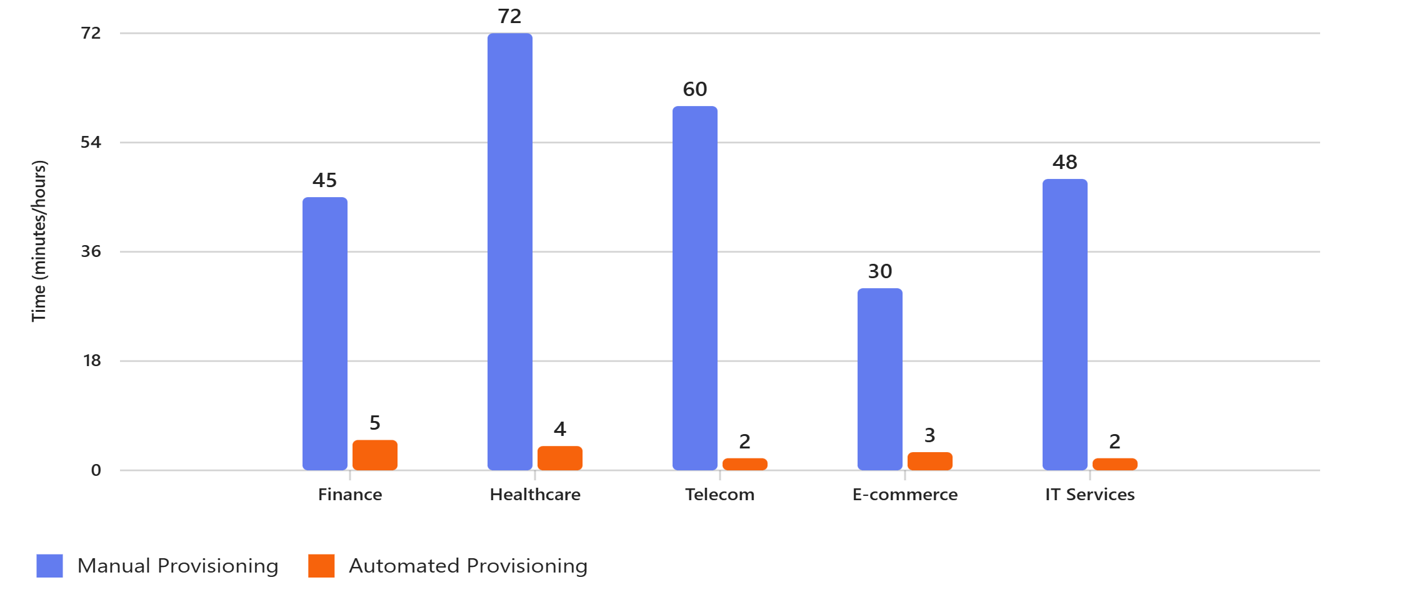

Provisioning Time Comparison
Shows how automation drastically reduces time across industries.
Annual Cost Savings Distribution
Highlights ROI by industry.

Slide 11
Executive Summary Why Ansible Delivers ROI
Key Drivers:
Agentless, Open Source, Fast Implementation
Reduced Errors, Scalable Automation, Easy Maintenance
Industry Impacts:
Finance: 200+ hours saved/month, $50K annual savings
Healthcare: Patch cycle cut from 3 days to 4 hours, $80K saved
Telecom: 70% MTTR reduction, $100K saved
Overall ROI:
667% ROI over 5 years using Ansible Automation Platform
Break-even point in just 10 months
30% more efficient IT infrastructure management
75% faster deployment of storage resources
25% boost in developer productivity
58% reduction in unplanned outages
44% faster resolution of outages
76% fewer hours lost per user due to downtime

Slide 12

What’s Next?
Discuss Ansible Architecture and Design using below
Ansible Configuration
Ansible Inventories
Ansible Modules

