Slide 1


🔥 Ready to unlock YAML secrets? Let’s make automation effortless!
Understanding the basics of data serialization formats
Summary of Learning
What is YAML?
YAML Syntax Rules
Data Types in YAML
Common Mistakes
Why Validation Matters (with workflow concept)
Yamllint Overview (purpose, criticality, workflow)Demo Code Snippets (basic YAML + yamllint command)
Demo Lab
Challenge
Quiz
Notes:
---

Slide 2
Introduction to YAML

Slide 3

💡 YAML is the backbone of Ansible – here’s why it matters!
Human-Readable Format
YAML is designed to be easy to read and write, using indentation and key-value pairs without brackets or tags.
Simplicity and Clarity
YAML emphasizes clarity and minimal syntax, reducing cognitive load and avoiding unnecessary clutter compared to JSON or XML.
Supports Complex Structures
YAML efficiently represents hierarchical data, ideal for defining playbooks, inventories, and roles in automation tools like Ansible.
Essential for Automation
Mastering YAML is critical for working with automation workflows, ensuring maintainable and scalable configuration scripts.

Slide 4

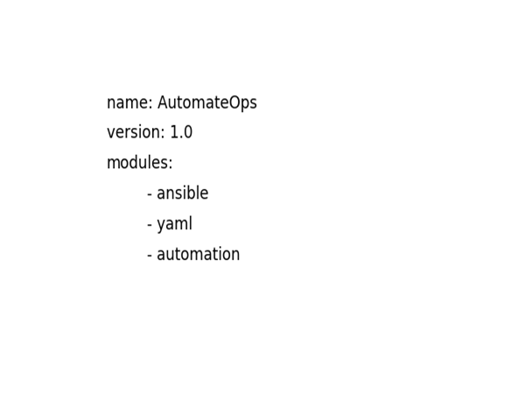
⚠ Golden Rule: Spaces, not tabs! Avoid automation nightmares
Indentation and Hierarchy
YAML syntax requires spaces, never tabs, to define hierarchy with precise indentation.
Key-Value Pairs and Lists
Key-value pairs use colon and space; lists use dash and space for item representation.
Comments and Data Types
Comments start with #; YAML supports scalars, lists, and dictionaries for data representation.
Importance of Syntax Discipline
Proper syntax prevents cryptic errors and ensures correct interpretation in automation tools. Starts with 3 dashes (---) and ends with 3 dots (…)

Slide 5
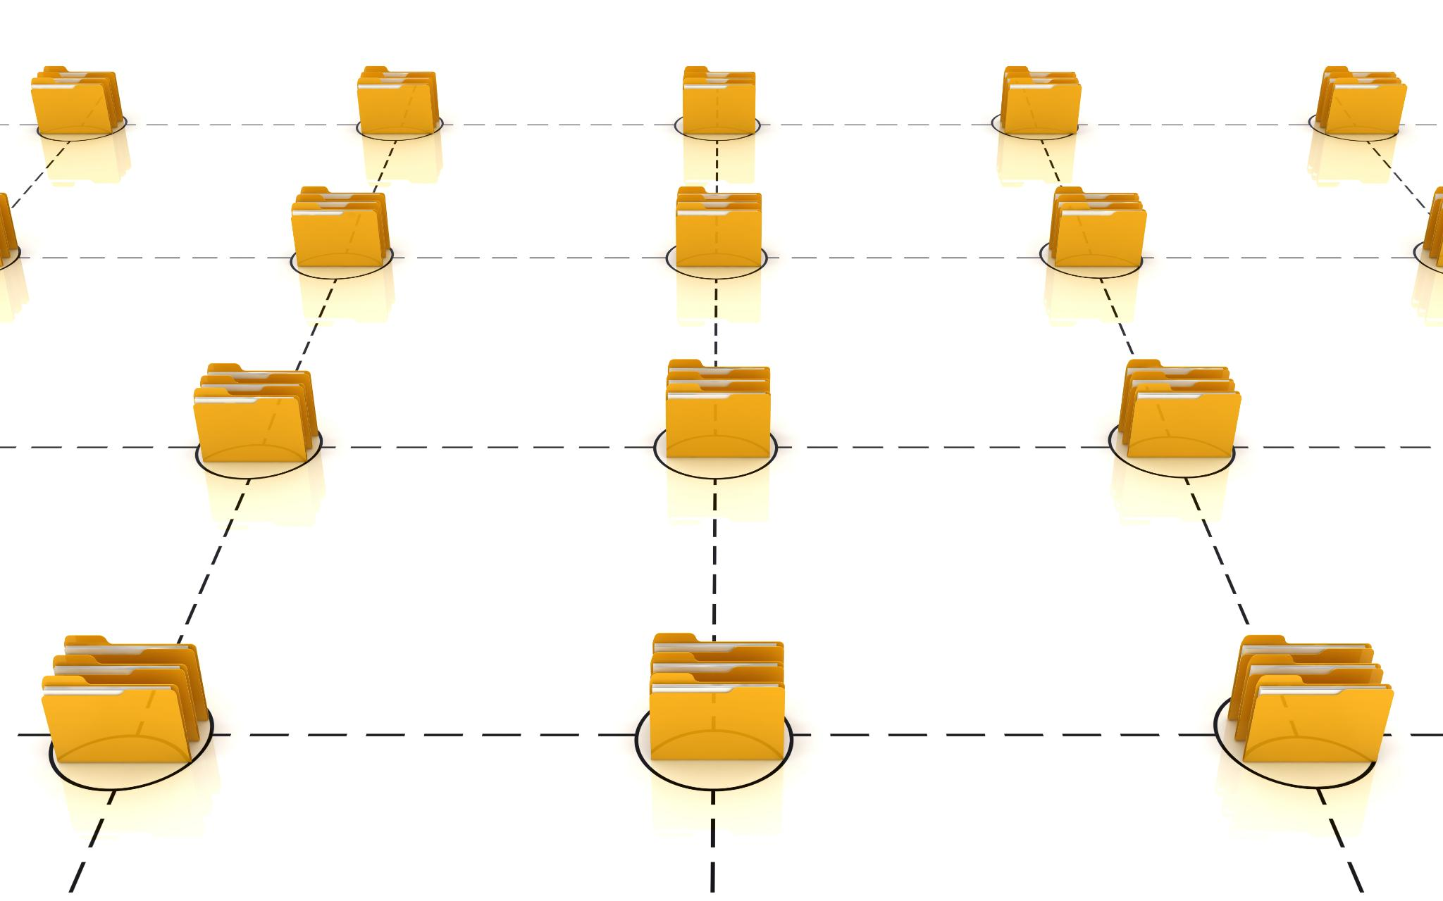
Data Types in YAML
Scalar Data Type
Scalars represent single values like strings, numbers, or booleans in YAML files.
List Data Type
Lists are ordered collections marked by dashes, useful for grouping multiple items sequentially.
Dictionary Data Type
Dictionaries are key-value pairs that define mappings, essential for organizing complex data structures.
Combining and Nesting Types
YAML allows nesting of lists and dictionaries to create complex, modular, and scalable configurations.

Slide 6
Data Types in YAML Example
1. Scalars (Single Values)
Scalars represent simple values like strings, numbers, or booleans.
Example:
name: AutomateOps # String
version: 1.0 # Number
active: true # Boolean
2. Lists (Ordered Collections)
Lists are sequences of items, written with a dash (-) followed by a space.
Example:
modules:
- ansible
- yaml
- automation
3. Dictionaries (Key-Value Pairs)
Dictionaries store data as key-value pairs. They can also be nested.
Example:
details:
author: Soumyendu
channel: AutomateOps
subscribers: 5000

Slide 7

❓ Common mistakes can break playbooks – let’s fix them!
Common YAML Mistakes
Tabs instead of spaces, missing spaces after colons, and wrong indentation cause YAML errors in playbooks.
Impact on Automation
YAML mistakes can cause silent failures or confusing errors, breaking automation workflows unexpectedly.
Importance of Validation
Validating YAML before running playbooks ensures syntax correctness and reduces downtime and troubleshooting.
Early Error Detection
Incorporate validation into workflow to catch errors early and maintain confidence in automation scripts.
Example
Tabs vs Spaces
Wrong: [tab]name: AutomateOps
Correct:[space]name:AutomateOpsA

Slide 8
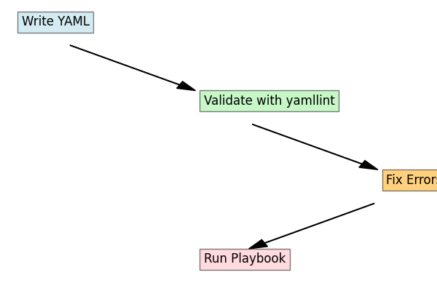
Yamllint: Your YAML bodyguard for error-free automation
Step | Description
Write YAML | Create configuration or playbook using YAML syntax
Validate with yamllint | Run yamllint to check for syntax and style errors
Execute Playbook | Run validated playbook in Ansible for automation

Slide 9

Demo Code Snippets
YAML File Structure
A simple YAML file example showing basic key-value pairs and list under modules.
YAML Validation
Using yamllint command to validate YAML syntax ensures error-free automation files.
Example YAML:
name: AutomateOps
version: 1.0
modules:
- ansible
- yaml
Command:
yamllint demo1.yml

Slide 10
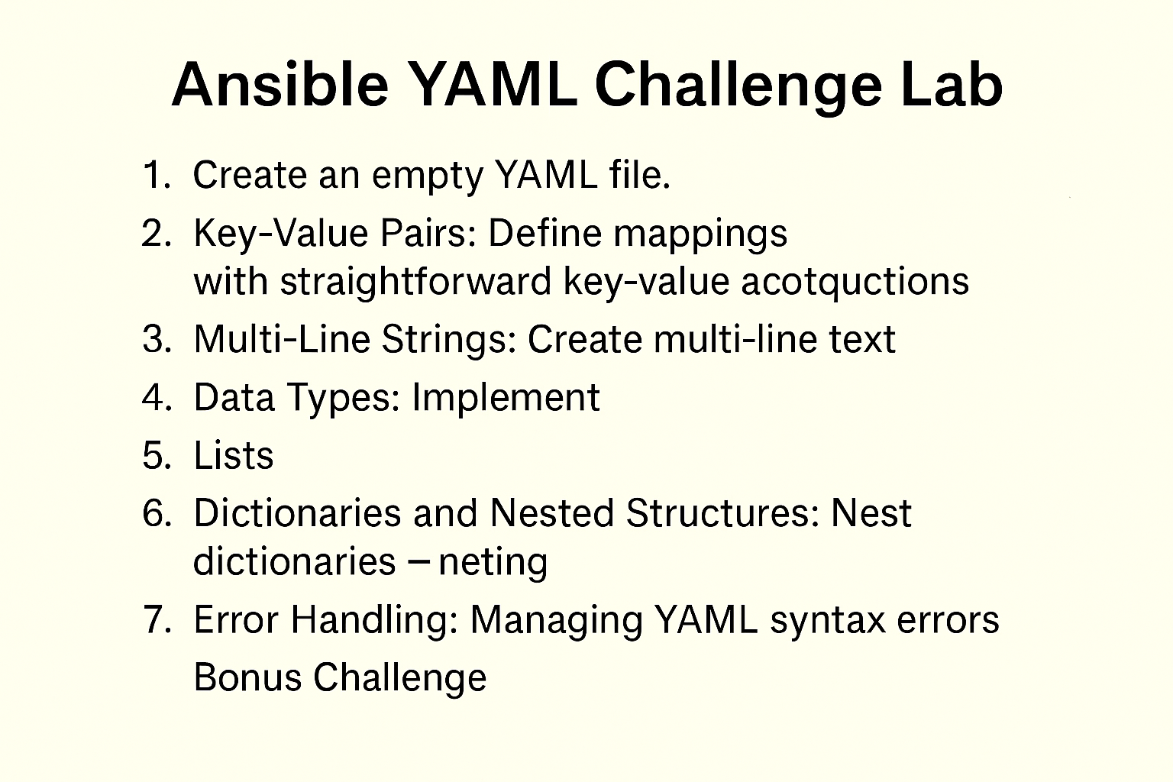
🎯 Challenge Time! Test your YAML skills now.
1. Create a Blank YAML File
- File name: `Test1.yaml`
- Add optional start (`---`) and end (`...`) markers.
- Validate using:
```bash
python3 -c "import yaml,pprint;pprint.pprint(yaml.load(open('Test1.yaml').read(), Loader=yaml.FullLoader))"
```
Expected output: `None`
2. Key-Value Pairs
- Create `Test2.yaml` with at least 2 key-value pairs.
- Validate using the same Python command.
- Expected output: Dictionary with keys and values.
3. Multi-Line Strings
- Use `|` and `>` styles.
- Validate and observe differences in output.
4. Data Types
- Add examples for Integer and Boolean.
- Validate and confirm Python interprets them correctly.
5. Lists and Dictionaries
- Create a YAML file with a list of items.
- Create nested dictionaries and dictionary with list values.
6. Error Handling
- Intentionally create malformed YAML and observe Python error.
Bonus:
------
7.Combine all concepts into one YAML file and validate for any errors using yamllint

Slide 11

🚀 Next Steps: Your automation journey continues!
YAML Fundamentals Overview
We reviewed YAML basics, syntax rules, common errors, and validation with yamllint for effective Ansible automation.
Importance of Validation
Validating YAML files ensures error-free automation scripts critical for reliable operations.
Next Episode Preview
Upcoming episode focuses on YAML structure in Ansible playbooks, including hosts, tasks, and variables.
💬 Drop your answers in the comments! Which YAML rule surprised you most?

Slide 12

Quiz
What does YAML stand for? A) Yet Another Markup Language B) YAML Ain’t Markup Language C) Your Automation Markup Language D) None of the above
Which symbol starts a comment in YAML? A) // B) # C) <!-- D) ;
Which of these is NOT allowed in YAML? A) Tabs for indentation B) Spaces for indentation C) Lists using - D) Key-value pairs separated by :
What is the correct way to represent a list in YAML? A) list: [item1, item2] B) list: item1, item2 C) list: {item1, item2} D) list: <item1, item2>
Which tool is used to validate YAML syntax? A) yamllint B) ansible-lint C) yaml-check D) lint-yaml
What happens if you use tabs instead of spaces in YAML? A) YAML ignores tabs B) YAML converts tabs to spaces C) YAML throws an error D) YAML works fine
Which scalar style preserves newlines in YAML? A) > B) |- C) | D) >-
What is the default data type for true in YAML? A) String B) Boolean C) Integer D) None
Which marker indicates the start of a YAML document? A) ... B) --- C) ### D) @@@
Which of these is a valid YAML key-value pair? A) key=value B) key: value C) key -> value D) key=value;

Slide 13
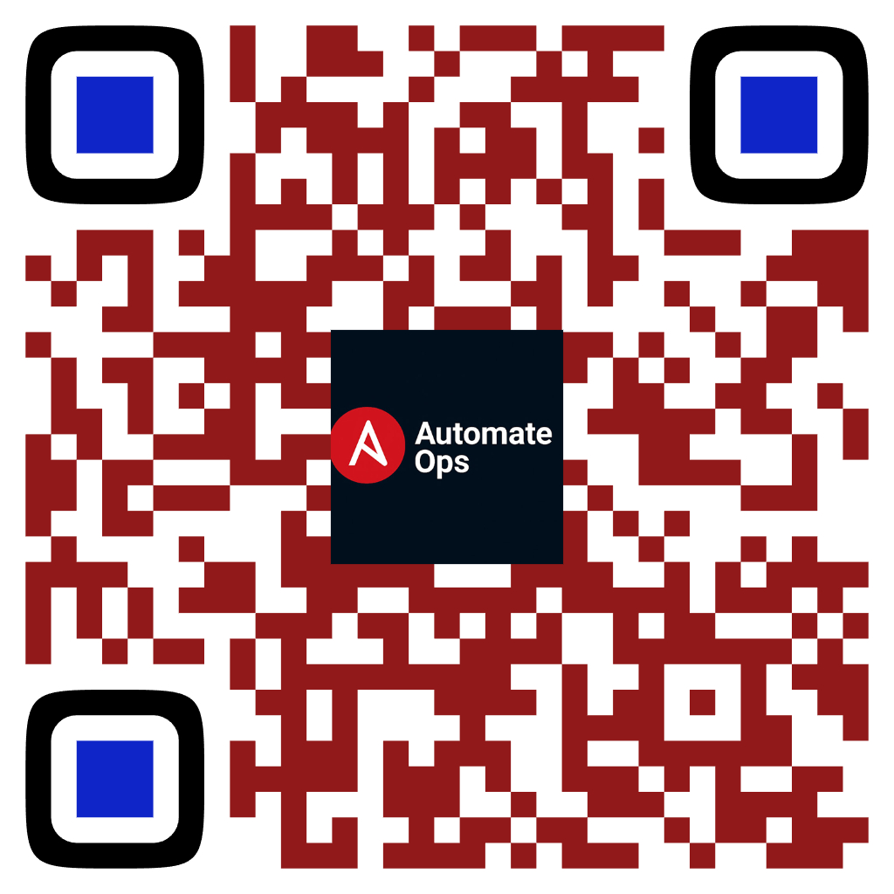
📢 Subscribe for more DevOps magic!
Like • Share • Comment
Scan to Subscribe
✔ Learn IT Automation with Ansible ✔ Like, Share & Subscribe for more DevOps content Follow us: YouTube: youtube.com/AutomateOps

