Slide 1
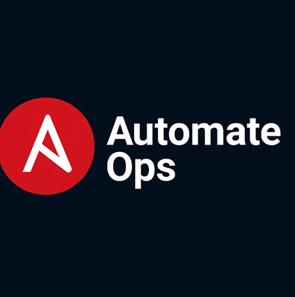
YAML Structure in Ansible Playbooks
Understanding key elements and syntax in YAML files
Summary of Learning
Understand YAML playbook section
Declare Variable
Override variable from command line
Use Handlers for post task execution
Create playbook to install and restart services for CentOS and Ubuntu with when directive
Notes:
AI-generated content may be incorrect. ---

Slide 2
Understanding Ansible Playbooks
Notes:
What is an Ansible Playbook?, Anatomy of a Playbook

Slide 3

What is an Ansible Playbook?
YAML-based Configuration
Ansible playbooks use YAML for simplicity, readability, and ease of collaboration among teams.
Declarative Syntax
Playbooks use declarative syntax, specifying what to achieve rather than how, simplifying automation.
Multi-Host Orchestration
Playbooks manage complex operations across multiple hosts or groups in distributed environments.
Key Automation Tasks
Playbooks automate installing packages, configuring services, deploying apps, and managing infrastructure.
Notes:
An Ansible playbook is a YAML-based configuration file that defines automation tasks for managing systems and applications. Playbooks are central to Ansible's automation framework because they provide a structured, human-readable way to describe desired states and actions. Unlike traditional scripts, playbooks use declarative syntax, which means you specify what you want rather than how to achieve it. YAML is chosen for its simplicity and readability, making it easier for teams to collaborate and maintain automation workflows. Playbooks can include multiple plays, each targeting specific hosts or groups, and can orchestrate complex operations across distributed environments. They are essential for tasks such as installing packages, configuring services, deploying applications, and managing infrastructure at scale. Understanding the purpose and structure of playbooks is the first step toward mastering Ansible automation.

Slide 4
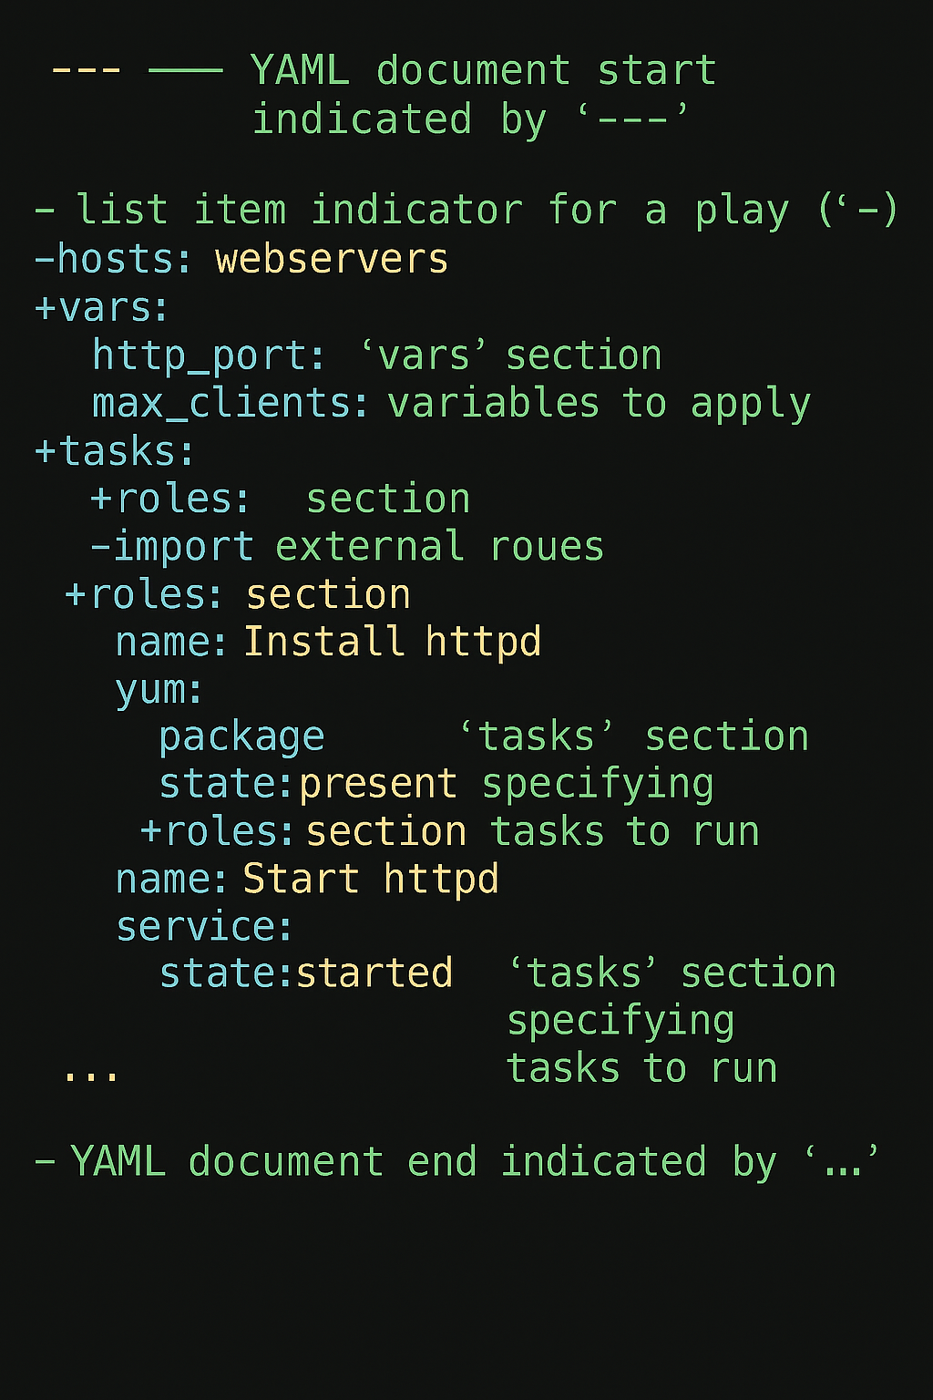
Anatomy of a Playbook
--- # Document separator: Indicates the start of the YAML document
# A playbook is a list of plays. Each play is represented by a dash (-)
- name: Configure Web Servers # Human-readable name for the play
hosts: webservers # Target hosts or inventory group where this play will run
become: yes # Enables privilege escalation (e.g., run as root)
vars: # Variables applied to this play
http_port: 80
max_clients: 200
tasks: # A list of tasks to execute on the target hosts
- name: Install Apache # Task description
ansible.builtin.yum: # Module used for package management on RHEL/CentOS
name: httpd ansible.builtin.yum # Package name
state: present # Ensure the package is installed
- name: Start Apache Service
ansible.builtin.service: # Module to manage services
name: httpd
state: started # Ensure the service is running
- name: Deploy Custom Index Page
ansible.builtin.copy: # Module to copy files
src: /files/index.html # Source file on control node
dest: /var/www/html/index.html # Destination on target host
handlers: # Special tasks triggered by notify statements
- name: Restart Apache
ansible.builtin.service:
name: httpd
state: restarted
... # Document end (optional)
Notes:
The anatomy of an Ansible playbook consists of several key sections that define its functionality. The 'hosts' section specifies the target systems where tasks will run. The 'tasks' section lists individual actions, such as installing packages or configuring files, and each task uses an Ansible module to perform its function. Variables, defined in the 'vars' section, allow dynamic customization of tasks, making playbooks reusable and flexible. Handlers are special tasks triggered by notifications, typically used for actions like restarting services after configuration changes. Playbooks can also include roles, which organize tasks, variables, and templates into reusable components. Understanding these sections helps in writing modular and maintainable playbooks. Proper structuring ensures clarity, reduces errors, and supports scalability in automation projects.

Slide 5
YAML Representation in Playbooks
Notes:
How YAML Structures Playbooks, Demo Code Snippet

Slide 6
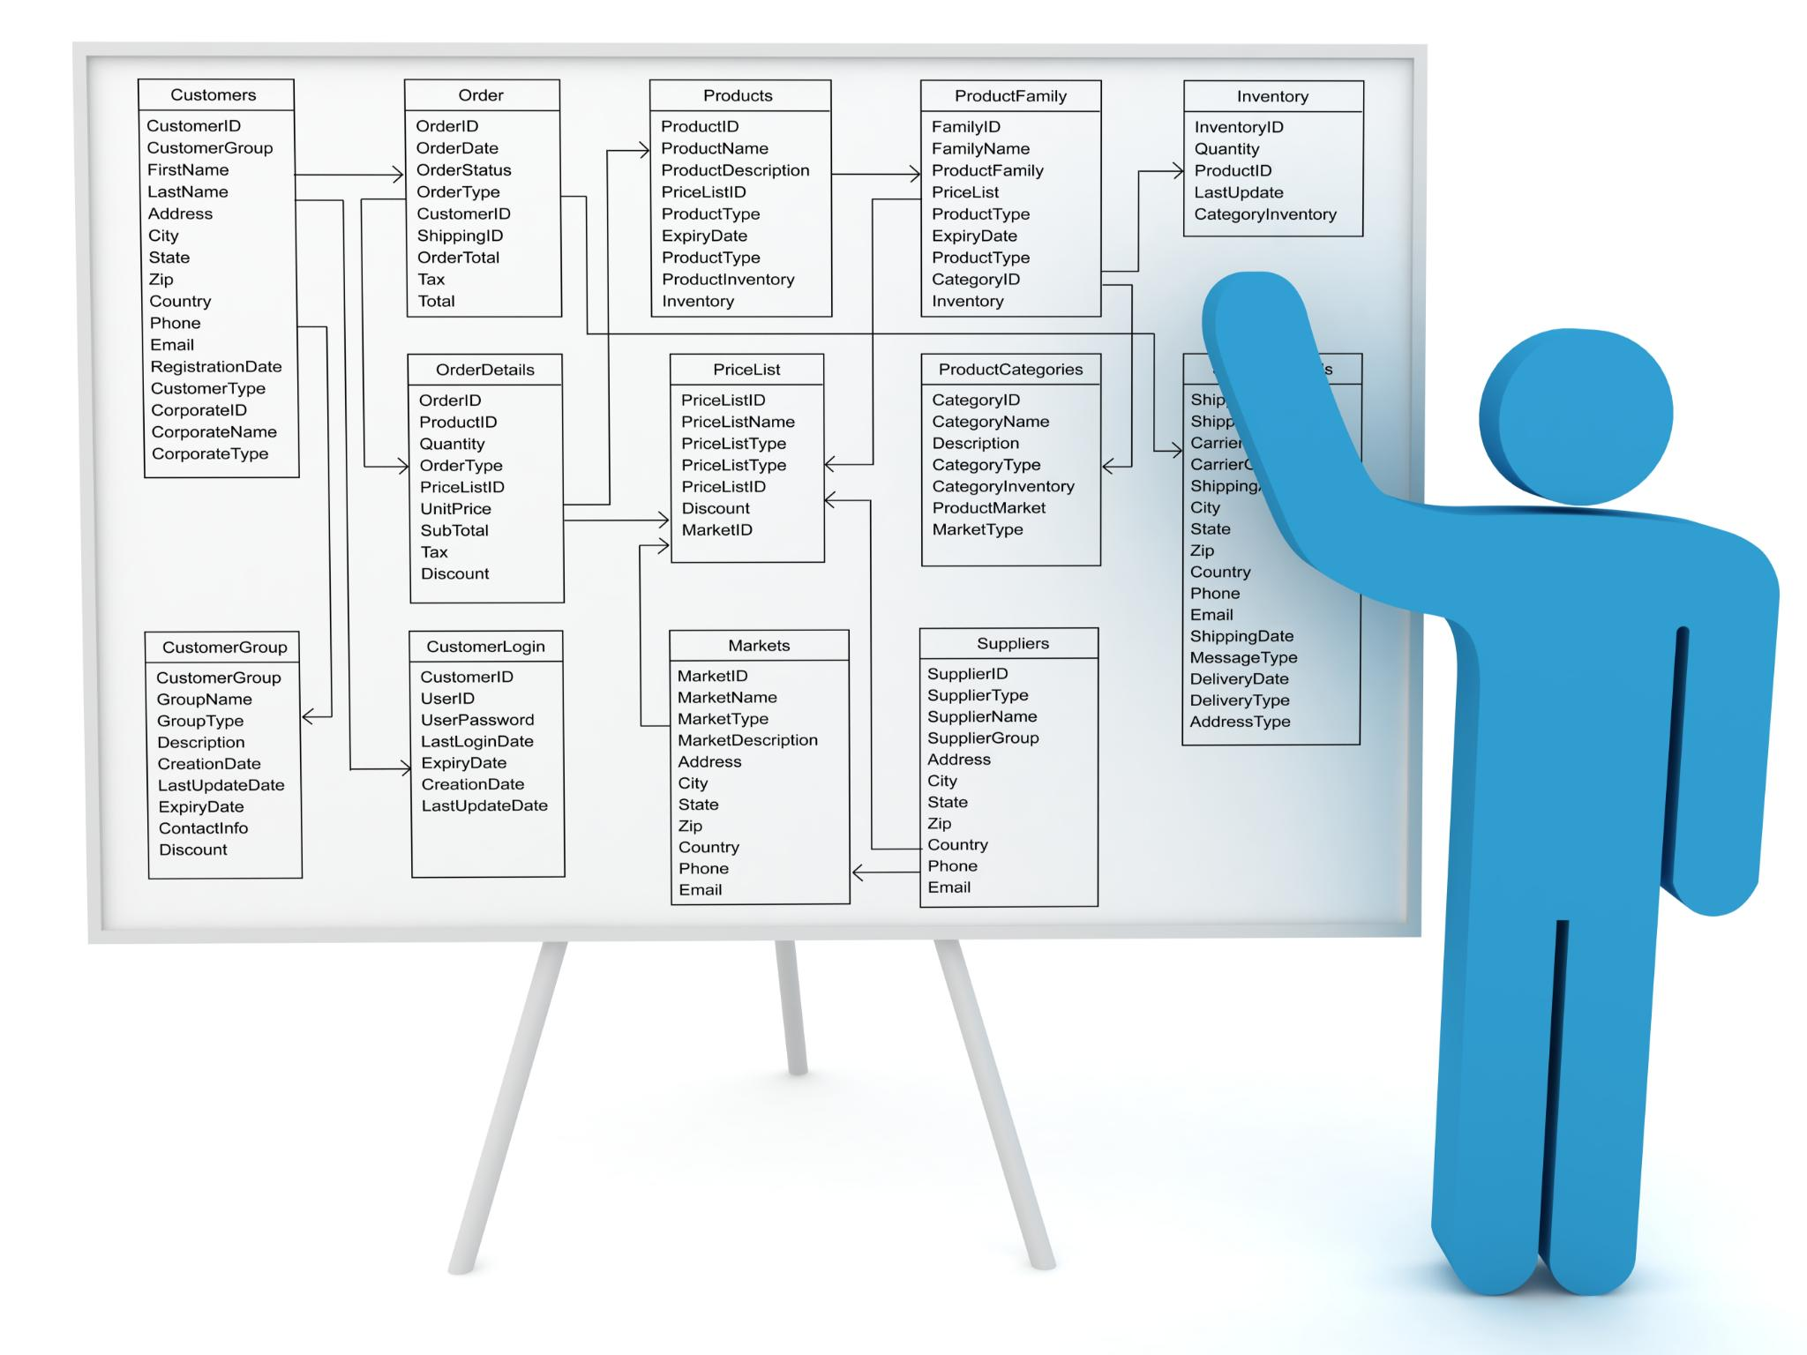
How YAML Structures Playbooks
Task Lists in YAML
Tasks in playbooks are represented as lists, each starting with a dash and followed by task details.
Module Arguments as Dictionaries
Module arguments use dictionaries with key-value pairs defining parameters like package names and service states.
Importance of Indentation
Indentation defines hierarchy in YAML, linking tasks to plays and arguments to tasks for correct interpretation.
Use of Comments
Comments starting with a hash (#) improve readability and document playbook elements effectively.
Notes:
YAML provides a clean and intuitive way to represent playbook elements. Lists are used for tasks, where each task begins with a dash followed by its attributes. Dictionaries represent module arguments, allowing key-value pairs to define parameters such as package names or service states. Comments, starting with a hash (#), improve readability and serve as documentation within the playbook. Indentation is critical in YAML, as it defines hierarchy and relationships between elements. For example, tasks are indented under plays, and module arguments are indented under their respective tasks. This structure ensures that Ansible interprets the playbook correctly. YAML's simplicity reduces syntax errors compared to formats like JSON or XML, but strict adherence to indentation rules is essential to avoid failures during execution.

Slide 7
Demo Code Snippet
--- # Document separator: Indicates the start of the YAML document
# A playbook is a list of plays. Each play is represented by a dash (-)
- name: Configure Web Servers
hosts: target
become: yes
vars:
http_port: 80
max_clients: 200
tasks:
- name: Install Apache
ansible.builtin.yum:
name: httpd
state: present
- name: Start Apache Service
ansible.builtin.service:
name: httpd
state: started
- name: Deploy Custom Index Page
ansible.builtin.copy:
src: /files/index.html
dest: /var/www/html/index.html
handlers:
- name: Restart Apache
ansible.builtin.service:
name: httpd
state: restarted
... # Document end (optional)
Element | Description
name | Describes the play or task for clarity
hosts | Specifies target systems
become | Enables privilege escalation
tasks | Contains a list of actions to perform
yum module | Installs or manages packages on Linux systems
Notes:
Here is an example of a basic Ansible playbook written in YAML: - name: Install Apache hosts: webservers become: yes tasks: - name: Install httpd yum: name: httpd state: present This snippet demonstrates the core structure of a playbook. The play begins with a name and specifies the target hosts. The 'become' directive allows privilege escalation for tasks requiring administrative access. Under 'tasks', a single task installs the Apache HTTP server using the 'yum' module. The module arguments are defined as a dictionary, specifying the package name and desired state. This example highlights YAML's readability and logical hierarchy, making it easy to understand and maintain.

Slide 8
Best Practices and Validation
Notes:
Best Practices for Writing Playbooks, Validation Workflow

Slide 9

Best Practices for Writing Playbooks
Consistent Indentation
YAML relies on whitespace, so consistent indentation is essential for defining structure and avoiding errors.
Clear Naming and Logical Grouping
Use descriptive names and group related tasks logically for easier understanding and maintainability.
Use of Variables and Templates
Avoid hardcoding by using variables and templates to increase flexibility and reuse in playbooks.
Comments and Validation
Include comments for complex logic and validate playbooks regularly to catch syntax errors early
Notes:
Writing effective playbooks requires adherence to best practices that enhance readability, maintainability, and reliability. Consistent indentation is crucial because YAML relies on whitespace to define structure. Use clear and descriptive names for plays and tasks to make the playbook self-explanatory. Group related tasks logically and leverage roles for modularity and reuse. Avoid hardcoding values; instead, use variables and templates to increase flexibility. Include comments to document complex logic or dependencies. Validate playbooks regularly to catch syntax errors early. Following these practices reduces errors, simplifies troubleshooting, and ensures that automation workflows remain scalable and easy to manage.

Slide 10
Validation Workflow
Step | Action
1 | Write the playbook in YAML format
2 | Validate syntax using yamllint
3 | Fix any errors detected
4 | Execute using ansible-playbook
Notes:
Validation is a critical step in ensuring that YAML files and playbooks are error-free before execution. The recommended workflow involves writing the playbook, validating it using tools like yamllint, and then executing it with ansible-playbook. Yamllint checks for syntax errors and style issues, helping prevent failures caused by incorrect indentation or formatting. This proactive approach saves time by catching problems early, reducing troubleshooting efforts during deployment. After validation, running the playbook with Ansible ensures that tasks execute as intended. Incorporating validation into your workflow is essential for maintaining reliability and consistency in automation projects.

Slide 11

Next Steps
Discussing Ansible Variable Declaration
Understanding different ways of declaring variable inside playbook and using them for getting the required output.
Notes:
In this chapter, we explored the structure of Ansible playbooks and how YAML represents their components. We discussed key sections, demonstrated a basic playbook, and emphasized best practices and validation workflows. Mastering these concepts is essential for building reliable automation scripts. In the next episode, we will dive into variables in YAML, learning how to define, use, and manage them effectively to create dynamic and reusable playbooks.

Slide 12
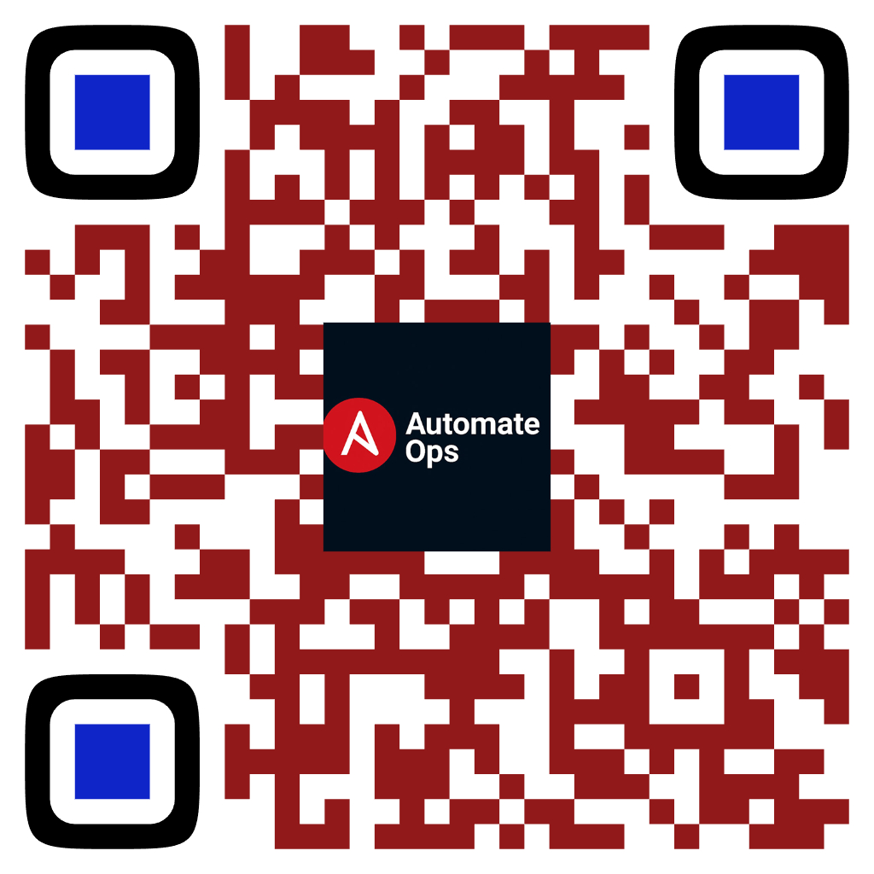
Subscribe to AutomateOps!
Scan to Subscribe
Like • Share • Comment
✔ Learn IT Automation with Ansible ✔ Like, Share & Subscribe for more DevOps content Follow us: https://www.youtube.com/channel/UCKBJsSR3qW3B7R16jeskEvw

