Slide 1
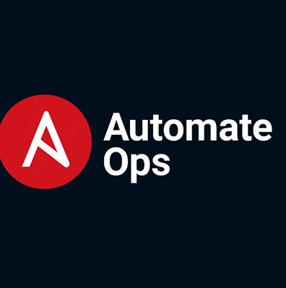
Template in Ansible Playbooks
Understanding Ansible Templates
Summary of Learning
Understanding ansible templates
Anatomy of a template
Best practices and validation
Demo Lab
Notes:
AI-generated content may be incorrect. ---

Slide 2
Understanding Ansible template
Notes:
What is an Ansible Playbook?, Anatomy of a Playbook

Slide 3

What is an Ansible template?
An Ansible Template is a text file that uses Jinja2 syntax to dynamically generate configuration files, scripts, or other text-based resources during automation. Templates allow you to: Insert variables ({{ var }}) for dynamic values. Use conditionals ({% if %}) and loops ({% for %}) for logic. Apply filters (e.g., upper, join, default) to format data. Render environment-specific or host-specific configurations without hardcoding. In Ansible, templates are typically .j2 files placed in a templates/ directory and deployed using the template module in a playbook You need to create the templates/ directory manually in your Ansible project structure. It is not created by default when you install Ansible or start a new playbook.
Why manually? Ansible expects the src path in the template module to point to a file inside a templates/ directory relative to the playbook or role. If the directory doesn’t exist, you’ll get an error like:
ERROR! could not find src in templates/
Notes:
An Ansible playbook is a YAML-based configuration file that defines automation tasks for managing systems and applications. Playbooks are central to Ansible's automation framework because they provide a structured, human-readable way to describe desired states and actions. Unlike traditional scripts, playbooks use declarative syntax, which means you specify what you want rather than how to achieve it. YAML is chosen for its simplicity and readability, making it easier for teams to collaborate and maintain automation workflows. Playbooks can include multiple plays, each targeting specific hosts or groups, and can orchestrate complex operations across distributed environments. They are essential for tasks such as installing packages, configuring services, deploying applications, and managing infrastructure at scale. Understanding the purpose and structure of playbooks is the first step toward mastering Ansible automation.

Slide 4
Anatomy of a template
--- # Document separator: start of the YAML document
# A playbook is a list of plays. Each play begins with a dash (-)
- name: Deploy App Configuration via Template # Human-readable name for the play
hosts: webservers # Target hosts or inventory group
become: yes # Enables privilege escalation (e.g., run as root)
vars: # Variables applied to this play
app_name: automateops # Example string variable
env: prod # Environment (used in template)
http_port: 8080 # Port used by the app (rendered in template)
features: # List demonstrating loops in the template
- metrics
- tracing
- http_api
limits: # Dictionary used for key/value iteration
max_clients: 200
timeout_sec: 30
enable_debug: false # Boolean used by conditional logic in template
tasks: # A list of tasks to execute on target hosts
- name: Render app.conf from template # Task description
ansible.builtin.template: # Module that renders Jinja2 templates
src: app.conf.j2 # Source template in templates/ directory
dest: /etc/myapp/app.conf # Destination on target host
mode: "0644" # File permissions
backup: yes # Backup existing file before overwriting
validate: "myapp --check-config %s" # Validate generated file BEFORE replacing (%s = path to temp file)
notify: Restart MyApp # Trigger handler if the file changes
- name: Ensure myapp binary is present # Example precondition step
ansible.builtin.command: which myapp # Simple check (replace with package/module as needed)
changed_when: false # Avoid marking as changed if binary exists
failed_when: false # Don't fail the play if command returns non-zero (demo-friendly)
handlers: # Special tasks triggered by notify (only run on change)
- name: Restart MyApp
ansible.builtin.systemd:
name: myapp # Systemd unit name
state: restarted # Restart service on template change
enabled: yes # Ensure service is enabled at boot
... # Document end (optional)
Playbook: Deploy an App config via Jinja2 template (with validation & handler)
Folder layout (recommended)
ansible-template-demo/ ├── playbook.yaml └── templates/ └── app.conf.j2
# ===========================
# MyApp Configuration (Jinja2)
# ===========================
# App Name (upper filter): converts to uppercase for emphasis
APP_NAME={{ app_name | upper }}
# Environment (default filter): falls back to 'dev' if env is undefined
ENV={{ env | default('dev') }}
# HTTP Port (simple variable)
HTTP_PORT={{ http_port }}
# Debug flags using conditional expressions (if/else)
DEBUG={{ 'true' if enable_debug else 'false' }}
LOG_LEVEL={{ 'DEBUG' if enable_debug else 'INFO' }}
# Features list rendered with a loop (whitespace-trim for tidy output)
FEATURES={% for f in features -%}
{{ f }}{% if not loop.last %},{% endif -%}
{% endfor %}
# Limits dictionary into key=value pairs (looping key/value)
{% for k, v in limits.items() %}
{{ k | upper }}={{ v }}
{% endfor %}
# JSON/YAML pretty prints (useful for diagnostics)
LIMITS_JSON={{ limits | to_nice_json }}
LIMITS_YAML:
{{ limits | to_nice_yaml }}
# Example of raw block (to show literal Jinja braces without rendering)
{% raw %}
# The next line is literal and will NOT render a variable:
# {{ this_is_literal_not_rendered }}
{% endraw %}
Notes:
The anatomy of an Ansible playbook consists of several key sections that define its functionality. The 'hosts' section specifies the target systems where tasks will run. The 'tasks' section lists individual actions, such as installing packages or configuring files, and each task uses an Ansible module to perform its function. Variables, defined in the 'vars' section, allow dynamic customization of tasks, making playbooks reusable and flexible. Handlers are special tasks triggered by notifications, typically used for actions like restarting services after configuration changes. Playbooks can also include roles, which organize tasks, variables, and templates into reusable components. Understanding these sections helps in writing modular and maintainable playbooks. Proper structuring ensures clarity, reduces errors, and supports scalability in automation projects.

Slide 5
Best Practices and Validation
Notes:
Best Practices for Writing Playbooks, Validation Workflow

Slide 6

Best Practices for Templates
Validate configs before applying
Use backup: yes for critical files
Keep templates modular
Store variables in group_vars/host_vars
Notes:
Discuss reliability and maintainability.

Slide 7
Validation Workflow
Step | Action
1 | Write the playbook in YAML format
2 | Use --check and --diff
3 | Validate configs with validate option
4 | Test templates in staging before production
Notes:
Validation is a critical step in ensuring that YAML files and playbooks are error-free before execution. The recommended workflow involves writing the playbook, validating it using tools like yamllint, and then executing it with ansible-playbook. Yamllint checks for syntax errors and style issues, helping prevent failures caused by incorrect indentation or formatting. This proactive approach saves time by catching problems early, reducing troubleshooting efforts during deployment. After validation, running the playbook with Ansible ensures that tasks execute as intended. Incorporating validation into your workflow is essential for maintaining reliability and consistency in automation projects.

Slide 8
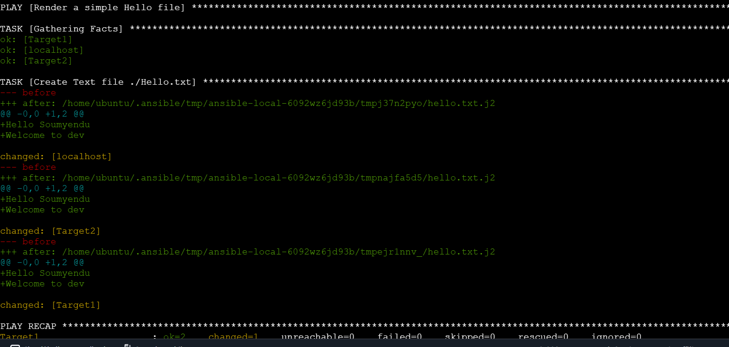
Sample code
Create Templates/hello.txt.j2 as below:
===================
Hello {{ user_name }},
Welcome to {{env | default(“’Dev’)}}
===================
Create Test.yaml as below:
---
- name: Render a simple Hello file
hosts: all
vars:
user_name: "Soumyendu"
tasks:
- name: Create Text file ./Hello.txt
ansible.builtin.template:
src: Templates/hello.txt.j2
dest: ./Hello.txt
mode: '0644'
...
Run:
ansible-playbook <filename.yaml> --diff --check
Notes:
Validation is a critical step in ensuring that YAML files and playbooks are error-free before execution. The recommended workflow involves writing the playbook, validating it using tools like yamllint, and then executing it with ansible-playbook. Yamllint checks for syntax errors and style issues, helping prevent failures caused by incorrect indentation or formatting. This proactive approach saves time by catching problems early, reducing troubleshooting efforts during deployment. After validation, running the playbook with Ansible ensures that tasks execute as intended. Incorporating validation into your workflow is essential for maintaining reliability and consistency in automation projects.

Slide 9

Next Steps
Learn Register and When
Notes:
In this chapter, we explored the structure of Ansible playbooks and how YAML represents their components. We discussed key sections, demonstrated a basic playbook, and emphasized best practices and validation workflows. Mastering these concepts is essential for building reliable automation scripts. In the next episode, we will dive into variables in YAML, learning how to define, use, and manage them effectively to create dynamic and reusable playbooks.

Slide 10
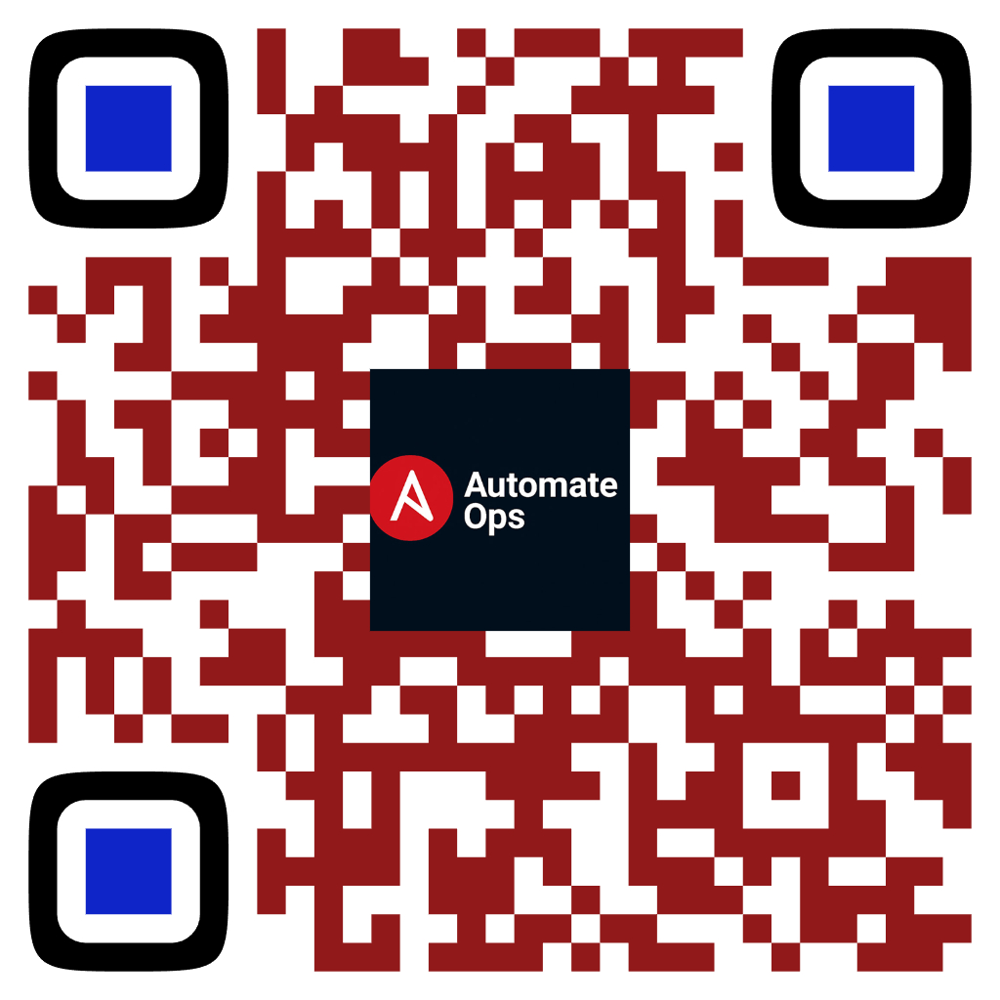
Subscribe to AutomateOps!
Scan to Subscribe
Like • Share • Comment
✔ Learn IT Automation with Ansible ✔ Like, Share & Subscribe for more DevOps content Follow us: https://www.youtube.com/channel/UCKBJsSR3qW3B7R16jeskEvw

