Slide 1

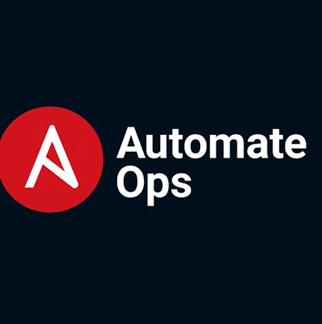
Dynamic Inventory for AutomateOps
Efficient management through automated inventory solutions
Notes:
---

Slide 2
Foundations of Dynamic Inventory

Slide 3

Concept and Purpose of Dynamic Inventory
Real-Time Host Information
Dynamic inventory generates host and group data at runtime, ensuring accurate reflection of infrastructure state.
Integration with Cloud Providers
Supports querying cloud APIs like AWS, Azure, GCP, and others to obtain current host lists and statuses.
Automation and Tagging
Uses tags to automatically group hosts by roles or environments, reducing manual inventory maintenance errors.
Enhanced Security and Flexibility
Eliminates stale hosts from inventory, minimizing risks and supporting flexible, autonomous infrastructure operations.
Notes:
Dynamic inventory in Ansible refers to the method of generating host and group information at runtime rather than relying on static inventory files. This approach is crucial in modern infrastructure environments, particularly those that involve large-scale cloud deployments, autoscaling systems, or frequently changing host pools. For example, in AWS environments where EC2 instances scale up and down based on demand, using a static file becomes impractical, as it cannot accurately reflect real-time infrastructure state. Dynamic inventory solves this by querying external data sources—such as cloud providers, CMDBs, APIs, or custom scripts—to pull the latest host information just before playbook execution. This makes the automation process more reliable, flexible, and aligned with actual system conditions. Additionally, dynamic inventory supports both script-based and plugin-based models, enabling users to either write custom logic in languages like Python or leverage built-in providers such as AWS EC2, Azure RM, GCP, VMware, Kubernetes, and OpenStack. Another major advantage includes reducing human error, since teams no longer need to manually maintain host lists. In enterprise workflows, dynamic inventory integrates tightly with tagging, allowing administrators to map hosts to roles or environments automatically. For example, a tag-based structure in AWS can allow Ansible to auto-group all instances tagged as “Production-Web” or “Database-Primary.” Beyond flexibility, dynamic inventory also enhances security by eliminating stale or outdated host references, reducing the risk of accidental automation against retired systems. Ultimately, dynamic inventory is an essential capability for modern automation pipelines and plays a foundational role in enabling fully autonomous infrastructure operations.

Slide 4
Types and Requirements of Dynamic Inventory

Slide 5

Script-Based and Plugin-Based Inventory Approaches
Script-Based Inventory
Script-based inventory uses custom executable scripts to produce JSON data, ideal for unique APIs and legacy systems.
Plugin-Based Inventory
Plugin-based inventory leverages pre-built plugins for cloud providers, requiring minimal setup and automatic host data retrieval.
Hybrid Inventory Approach
Combining scripts for legacy systems and plugins for cloud services offers a flexible, standardized automation inventory solution.
Notes:
Dynamic inventory in Ansible can be implemented through two primary approaches: script-based methods and plugin-based methods. Script-based dynamic inventory involves writing executable programs—commonly in Python, Bash, or Go—that output JSON-formatted data when invoked with `--list` or `--host <hostname>`. This method offers full control over logic, making it ideal for environments with custom APIs or non-standard data sources. For instance, a bespoke CMDB or proprietary monitoring tool may expose host details via REST APIs, requiring tailored parsing logic within the script. These scripts must be executable and must return valid JSON structures, including host groups and host variables, to maintain compatibility with Ansible’s expected schema. Conversely, plugin-based dynamic inventory utilizes built-in or community-provided plugins offering native integration with popular infrastructure platforms such as AWS EC2, Azure, GCP, VMware vCenter, Kubernetes, OpenStack, and more. These plugins typically require minimal configuration—often just credentials and filtering parameters—and automatically gather host information from the provider’s API. For example, the AWS EC2 inventory plugin can automatically group instances by tag, region, or instance type using options like `filters:` and `keyed_groups:`. Plugin-based inventory is generally preferred when working with cloud providers due to their reliability, feature completeness, and compatibility with caching and variable grouping. Understanding both script-based and plugin-based models allows engineers to choose the most appropriate method depending on their operational context. Additionally, organizations often use hybrid models where plugins handle cloud platforms while script-based logic supports legacy systems. This dual approach ensures flexibility while maintaining standardization across automation workflows.

Slide 6

Execution Requirements and JSON Output Structure
Script Execution Requirements
Dynamic inventory scripts must be executable and handle --list and --host commands, returning appropriate JSON data.
JSON Output Structure
Scripts must return JSON with host groups, hosts, and a _meta section containing host variables for performance optimization.
Plugin Configuration and Best Practices
Plugins use YAML configs for connection and caching, while dynamic sources should handle errors and avoid excessive API calls.
Scalability and Performance
Using caching and efficient logic reduces API calls, enabling optimal performance with large inventories.
Notes:
A functional dynamic inventory source in Ansible—whether script or plugin—must adhere to specific requirements to ensure compatibility with Ansible Core. First, if using a script, it must be executable on the target controller machine and capable of handling two command-line inputs: `--list` and `--host <hostname>`. When invoked with `--list`, the script must return a JSON dictionary containing all host groups, hosts, and a special `_meta` section containing host variables for improved performance. The `_meta.hostvars` structure enables Ansible to load host variables without additional calls to the inventory source, drastically reducing execution time for large environments. When invoked with `--host`, the script must return host-specific variables in a JSON dictionary. Plugins follow a similar structure but rely on YAML configuration files to determine connection parameters, filters, cache settings, and grouping rules. Beyond structural requirements, dynamic inventory sources should follow best practices such as consistent error handling, returning only valid JSON to stdout, and sending error logs exclusively to stderr or external log files. For scalability, they should avoid excessive API calls and use caching where possible. For example, querying a cloud provider’s API for each playbook run without caching can significantly slow down automation, particularly in large accounts with thousands of instances. Proper use of `_meta`, caching, and efficient logic ensures that even environments with hundreds or thousands of hosts perform optimally when used as dynamic inventory sources.

Slide 7
Implementation and Performance Optimization

Slide 8

Python-Based Dynamic Inventory Example and Logging
Dynamic Inventory Script Basics
The script uses argparse for argument parsing and json to output valid JSON for Ansible integration.
Logging and Error Handling
Structured logging writes to rotating log files, errors are logged and sent to stderr to avoid breaking JSON output.
Inventory and Host Variables
Host variables and groups are defined as dictionaries; fake hosts generated programmatically for testing scalability.
Performance Testing and Validation
Using fake hosts and Ansible commands validates script responsiveness and scalability with improved speed using _meta.
Notes:
A Python-based dynamic inventory script offers fine-grained control and is ideal for scenarios where automation must integrate with custom data sources. A well-designed script uses the `argparse` module to process the `--list` and `--host` arguments, the `json` module to output valid JSON, and structured logging mechanisms to track operations. For example, a script may set up a logging handler that writes to `/var/tmp/ansible_dynamic_inventory.log` with rotation settings to avoid large log files. Inside the script, host variables and groups are defined as dictionaries mapping hostnames to values. Fake hosts may be generated programmatically using list comprehensions to simulate large inventories and test performance. The script typically wraps logic in functions such as `build_full_inventory()` for handling the `--list` request and `build_hostvars(host)` for host-specific responses. Error handling is vital; no non-JSON output should appear on stdout, as this would break Ansible’s parsing. Instead, errors are logged and sent to stderr. This design ensures robustness while supporting scalability testing. For example, executing commands like `ansible all -i inventory.py --list-hosts` or `ansible -i inventory.py -m ping -o` validates both the structure and responsiveness of the script. The addition of fake hosts allows teams to perform real-world performance tests, measuring response times and verifying that the use of `_meta` improves speed dramatically in large inventories. This scripted approach also supports complex host group generation logic, making it suitable for heterogeneous or hybrid environments.

Slide 9

Optimization Through _meta and Inventory Caching
_meta.hostvars Efficiency
_meta.hostvars stores all host variables in one dictionary, reducing repeated inventory lookups and improving speed.
Inventory Caching Configuration
Caching in ansible.cfg stores inventory results locally, preventing repeated dynamic queries and improving performance.
Cloud Plugin Benefits
Cloud inventory plugins benefit from caching by reducing API calls, lowering costs, and avoiding rate limits.
Scalable Automation Best Practices
Combining caching with tag filtering ensures efficient, scalable automation with timely host information updates.
Notes:
Dynamic inventory performance depends heavily on two mechanisms: `_meta.hostvars` and inventory caching. The `_meta.hostvars` section contains all host-specific variables in a single dictionary, eliminating the need for Ansible to re-invoke the inventory source for each host lookup. In large environments, this can reduce execution time by several seconds or even minutes, especially when dozens or hundreds of hosts are involved. Script-based inventories benefit greatly from this approach, as each invocation of the script incurs overhead from both Python startup and any custom logic such as API calls. In addition to `_meta`, inventory caching can be configured in `ansible.cfg` using settings such as `cache=True`, `fact_caching=jsonfile`, and `cache_timeout=7200`. When enabled, Ansible stores inventory results in a local cache file, avoiding repeated dynamic queries unless the cache expires. Cloud inventory plugins like the AWS EC2 or Azure RM plugin particularly benefit from caching because they would otherwise make API calls during each playbook execution. This not only enhances performance but also reduces costs and API rate-limit issues. In production environments, combining caching with tag-based filtering ensures that automation runs efficiently while still incorporating up-to-date host information within acceptable time windows. Overall, using `_meta.hostvars` and caching together represents best practice in designing scalable, efficient dynamic inventory systems.

Slide 10
Practical Usage and Real-World Scenarios

Slide 11

Cloud Plugin Example: AWS EC2 and Grouping Techniques
Dynamic Inventory Retrieval
AWS EC2 plugin queries the AWS API to dynamically retrieve instance data using various credential methods.
Flexible Grouping Options
Hosts can be grouped automatically by tags, availability zones, instance types, or security groups using YAML configs.
Visualization and Safety
Inventory visualization commands provide a clear hierarchy, improving targeting accuracy and operational safety.
Cloud-Native Automation Benefits
Dynamic inventory reduces manual maintenance, enhances reliability, and aligns with scalable cloud operations.
Notes:
The AWS EC2 dynamic inventory plugin is one of the most widely used inventory providers in cloud-based automation. It retrieves information about EC2 instances by querying the AWS API using credentials configured either through environment variables, credential files, or IAM roles. Configuration files written in YAML allow users to specify regions, filters, and grouping options. For instance, the plugin can automatically group hosts based on tags, availability zones, instance types, and security groups. Using filters such as `tag:Environment=Prod` enables fine-grained targeting without manually curating host lists. The plugin supports `keyed_groups`, allowing dynamic creation of host groups based on metadata—for example, grouping all instances by their operating system or by their application role. Engineers can visualize the resulting inventory using commands like `ansible-inventory -i aws_ec2.yaml --graph`, providing a clear hierarchy of groups and hosts. This approach is vital in real-world automation, where infrastructure changes frequently. For example, in an autoscaling environment where web servers scale up and down, the EC2 plugin ensures Ansible always targets the correct set of instances. This not only simplifies operational workflows but also enhances safety by preventing accidental execution against non-target hosts. By adopting plugin-based dynamic inventory, teams benefit from reduced maintenance, improved reliability, and better alignment with cloud-native operational models.

Slide 12

Use Case: Automating Production WebServers with Dynamic Inventory
Dynamic Inventory Automation
Dynamic inventory enables automatic discovery of production web servers using tags without manual input.
Playbook Targeting by Tags
Automation runs playbooks targeting specific tagged groups, applying updates and compliance checks efficiently.
Support for Deployment Strategies
Dynamic inventory supports blue-green deployments, canary releases, and rolling updates for precise server targeting.
Granular Cloud Metadata Usage
Utilizing metadata like AMI IDs and subnet locations ensures safer, precise automation at scale.
Notes:
A practical real-world use case for dynamic inventory is the automation of production web servers in a cloud environment using tags and grouping. Consider an AWS setup where all production web servers are tagged with `Environment=Prod` and `Role=WebServer`. With dynamic inventory configured, Ansible can automatically discover these instances without requiring human intervention. A playbook can then be executed targeting this tag-defined group—such as applying security patches, updating configuration files, or performing compliance checks. This automation workflow eliminates the risk associated with maintaining static inventories, which often become outdated as servers are added, removed, or replaced. It also supports multi-step automation pipelines, where one stage detects infrastructure state and another consumes the updated inventory to orchestrate actions. A typical automation process might involve running `ansible-playbook -i aws_ec2.yaml site.yaml --limit tag_Role_WebServer`, ensuring only the intended hosts receive updates. This method is also highly effective in blue-green deployments, canary releases, and rolling updates, where subsets of servers must be targeted precisely. Additionally, using cloud-specific metadata such as AMI IDs, lifecycle states, or subnet locations allows deeper granularity and safer automation. Across enterprise environments, such dynamic behavior is essential to maintain scale, speed, and operational consistency.

Slide 13
Best Practices and Quality Assurance

Slide 14

Error Handling, Validation, and Robust Design
Script Output and Logging
Scripts must output valid JSON to stdout only, with errors sent to stderr and structured logging used for debug info.
Validation and Syntax Checking
Use validation tools to catch syntax and structure issues before execution to ensure inventory consistency and correctness.
Handling Plugin Errors and Rate Limits
Pre-validate plugins and implement caching with retries to handle errors from misconfiguration and cloud provider rate limits.
Idempotent and Robust Design
Design inventories to be idempotent, producing consistent output to ensure predictable automation in CI/CD and large deployments.
Notes:
Effective error handling and validation are essential to ensuring that dynamic inventory behaves reliably and consistently during automation workflows. For script-based inventories, the script must always return valid JSON to stdout, as any extraneous output can cause Ansible to fail with parsing errors. Logging should be implemented using structured logging frameworks, writing to dedicated log files rather than printing debug output directly. Error messages and tracebacks must go to stderr, preserving stdout exclusively for JSON output. The script should also exit with appropriate return codes—zero for success and non-zero when encountering errors. Validation tools such as `ansible-inventory --validate` can be used to test syntax, structure, and variable consistency before running playbooks. This helps catch issues like missing group definitions or incorrectly formatted JSON output. For plugin-based inventories, misconfigured filters or invalid credentials are common causes of failure, making pre-validation crucial. Additionally, rate limits from cloud providers can lead to transient API errors, so implementing caching and retry strategies is recommended. Beyond error handling, dynamic inventories must be designed for idempotency, ensuring that repeated calls produce consistent output unless infrastructure changes. This consistency is critical for predictable automation outcomes, especially in CI/CD pipelines or large-scale deployments.

Slide 15
Conclusion and End-to-End Workflow
Notes:
Summary and Practical Workflow for AutomateOps

Slide 16

Summary and Practical Workflow for AutomateOps
Dynamic Inventory Scripting
Create Python scripts to handle dynamic inventory lists and host details with JSON and logging.
Cloud Inventory Plugins
Configure cloud inventory plugins with filters, grouping, and caching to manage large-scale environments.
Performance Optimization
Implement caching and _meta.hostvars to enhance automation scalability and efficiency.
Real-World Automation
Apply automation in production tasks like patching servers and orchestrating updates effectively.
Notes:
An end-to-end dynamic inventory workflow integrates multiple concepts, including data sourcing, script or plugin configuration, performance optimization, validation, and automation execution. A typical workflow for AutomateOps training would begin with creating a Python-based dynamic inventory script to teach foundational concepts such as handling `--list` and `--host`, building JSON structures, and logging operations. Next, students would test the script using commands like `ansible all -i inventory.py --list-hosts` and run playbooks against the resulting dynamic inventory. Once fundamentals are mastered, training would shift to plugin-based cloud inventories, such as AWS EC2, where learners configure filters, grouping logic, and caching to enable large-scale cloud automation. Students would then explore performance techniques such as `_meta.hostvars` and enabling caching in `ansible.cfg` to understand scalability considerations. Finally, real-world automation exercises—such as patching production web servers, collecting host facts, or orchestrating updates—tie together all aspects of dynamic inventory. This comprehensive workflow equips practitioners with the knowledge and skills needed to manage modern, cloud-native environments effectively. By following best practices and leveraging dynamic inventory capabilities, AutomateOps teams can ensure accurate targeting, reduced manual effort, and increased automation reliability across infrastructure lifecycles.

Slide 17
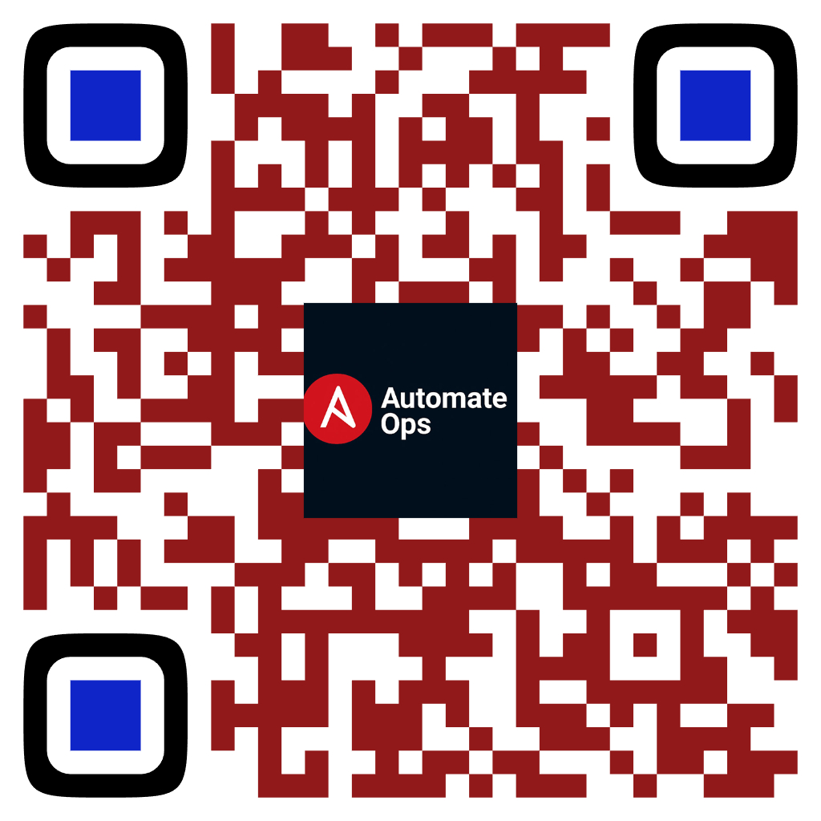
📢 Subscribe for more DevOps magic!
Like • Share • Comment
Scan to Subscribe
✔ Learn IT Automation with Ansible ✔ Like, Share & Subscribe for more DevOps content Follow us: YouTube: youtube.com/AutomateOps

