Slide 1

Mastering Jinja2 for Ansible Automation
Dynamic Automation with Jinja2
AutomateOps

Slide 2
What is Jinja2?
A Python-based templating engine
Used for dynamic content rendering in Ansible
Enables logic, loops, filters, and variable manipulation

Slide 3
Jinja2 in Ansible
Dynamic playbooks and templates
Conditional execution
Simplifies complex configurations
Purpose of Jinja2 in Ansible:
Dynamic Content Rendering: Jinja2 allows you to create templates that adapt based on variables, facts, and conditions.
Logic in Templates: Enables if, for, and other control structures inside playbooks and configuration files.
Data Transformation: Filters and tests help manipulate data (e.g., converting lists to strings, checking variable types).
Reusable Templates: Simplifies configuration management by avoiding hardcoding values.

Slide 4
Core Syntax
{{ ... }} → Expressions for output
{% ... %} → Statements (control structures)
{# ... #} → Comments

Slide 5
Whitespace Control
-{% and %}- for trimming spaces

Slide 6
Accessing Variables
Ansible facts and custom variables
Nested variables and dot notation

Slide 7
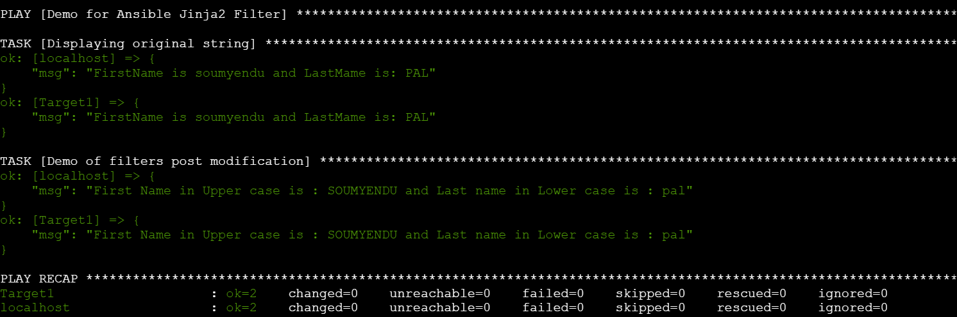
Filters
Common filters: default, upper, lower, join, split
Syntax: {{ variable | filter }}

Slide 8
Conditional Statements
if, elif, else
Logical operators: and, or, not
Example: hostname-based conditions

Slide 9
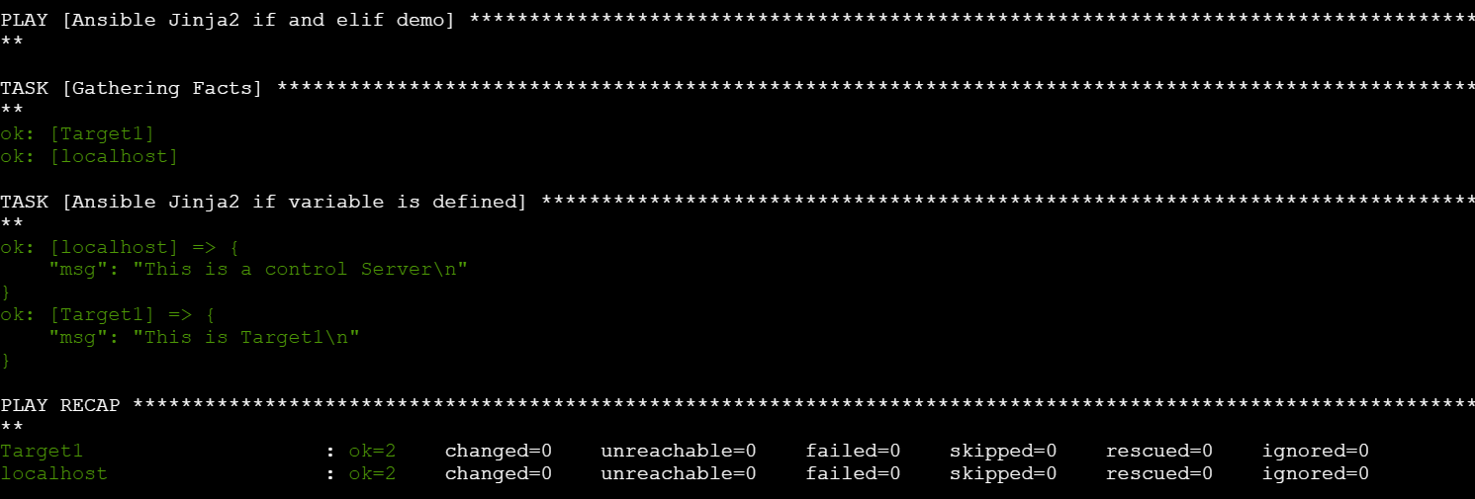
If – elif Conditional Statements
{% if ansible_hostname == 'Control' %} This is a control Server {% elif ansible_hostname == 'Target1' %} This is Target1 {% else %} Other host {% endif %}

Slide 10
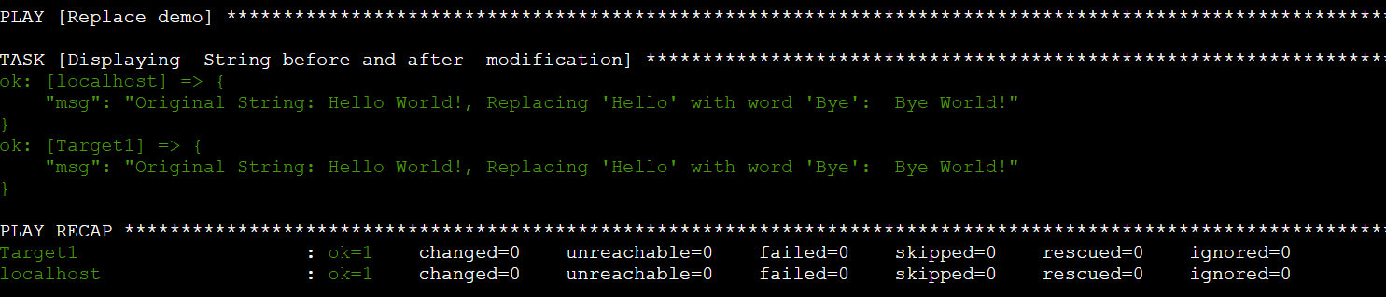
Filters
length, replace, map, selectattr
Chaining filters
Sample Code using Replace Filter:
---
- name: Replace demo
hosts: all
gather_facts: false
vars:
test_str: "Hello World!"
tasks:
- name: Displaying String before and after modification
ansible.builtin.debug:
msg: "Original String: {{test_str }}, Replacing 'Hello' with word 'Bye': {{ test_str | replace('Hello', 'Bye')}}"

Slide 11
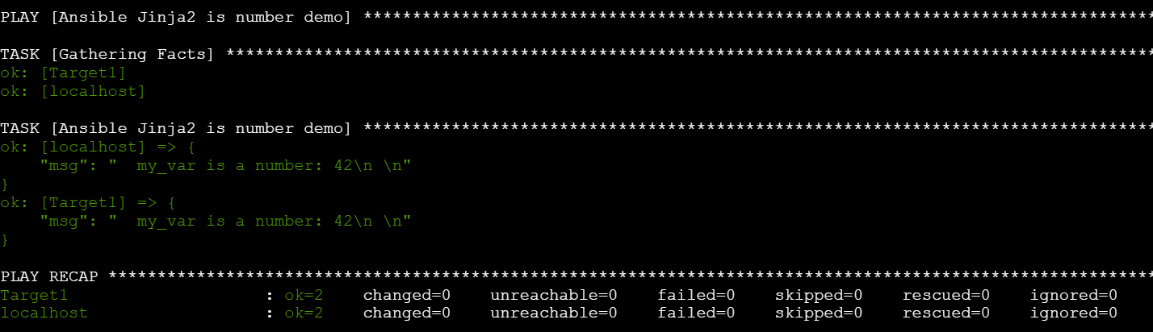
Tests
is defined, is string, is number
Example: Check if variable is a number
=====================
{% set my_var = 42 %}
{% if my_var is number %}
my_var is a number: {{ my_var }}
{% else %}
my_var is NOT a number
{% endif %}
=====================

Slide 12
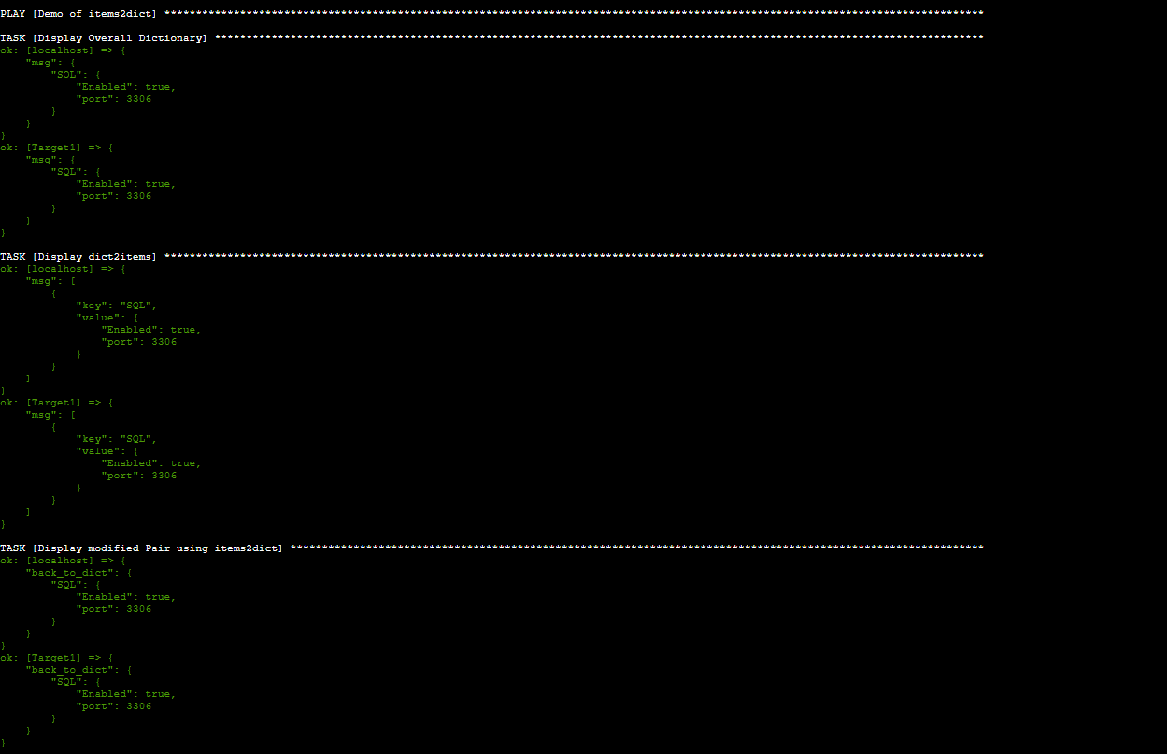
Data Transformation
dict2items and items2dict
Practical use cases in Ansible

Slide 13
Best Practices
Avoid complex logic in templates
Use set_fact for readability
Debugging with ansible.builtin.debug

Slide 14
Use cases
Practical Use Cases of Jinja2 in Real-World Ansible Projects:
Dynamic Configuration Files
Example:
Generating nginx.conf or httpd.conf based on inventory variables.
Jinja2 loops iterate over virtual hosts, applying conditions for SSL or redirects.
Conditional Service Deployment:
Example:
Install and configure services only if certain conditions are met (e.g., OS type, environment).
Use if statements to include tasks or templates dynamically.
Inventory Customization
Example:
Building dynamic inventories from external sources (e.g., cloud APIs).
Jinja2 filters format hostnames, IP addresses, and tags.
Complex Data Handling
Example:
Transform dictionaries using dict2items and items2dict for looping over key-value pairs.
Useful in network automation for device configurations.
Dynamic Firewall Rules
Example:
Generate iptables or firewalld rules from a list of ports and protocols.
Jinja2 loops and conditions simplify rule generation.
Template-Based Application Deployment
Example: Docker Compose or Kubernetes YAML files generated dynamically based on environment variables.

Slide 15

📢 Subscribe for more DevOps magic!
Like • Share • Comment
Scan to Subscribe
✔ Learn IT Automation with Ansible ✔ Like, Share & Subscribe for more DevOps content Follow us: YouTube: youtube.com/AutomateOps

