Slide 1
EMPLOYEE PROMOTION PREDICTION Using Machine Learning
PRESENTED BY,
SOUMEN KHATUA
UNDER THE GUIDANCE OF,
DR. SUSHOVON JANA

Slide 2
INTRODUCTION
Getting a promotion at work has many advantages. It means you get more respect, better pay, and higher status. You also have more freedom and power to make decisions. That's why employees want to move up in the company and enjoy these benefits. Businesses pay attention to who they promote because it affects how well the company does. They spend time and money to choose the right people for promotion. Employees try to show their bosses that they deserve to be promoted by improving themselves. In this essay, we will talk about the good things that come with workplace promotion, how businesses decide who to promote, and how employees can make themselves stand out for promotion.

Slide 3
Objective
The objective of this project is to analyze and identify the key features that significantly influence employee promotion within the organization. By quantifying the strength and impact of these features, we aim to provide actionable insights for predicting promotion outcomes. Additionally, we will investigate whether there are gender-based variations in the contribution of these features and propose strategies to foster equal opportunities for career advancement. The project aims to inform evidence-based decision-making in promotion practices and promote fairness and inclusivity in the organization's promotion processes.

Slide 4
Approach
Below mentioned are the steps involved in the completetion of this project :
Collect dataset containing employees promotion data
Analyze and preprocess the dataset by using EDA techniques.
Handling missing value and outlier handling.
Feature extraction and encoding the features.
Balancing the target variable
Divide the dataset into training and testing sets.
Run selected machine learning model like SVM, XGBoost on the training datasets and Choose the best model by analyzing the performance matrices.

Slide 5
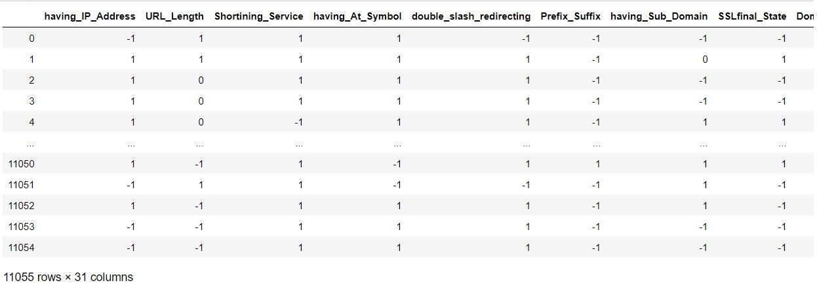

Slide 6
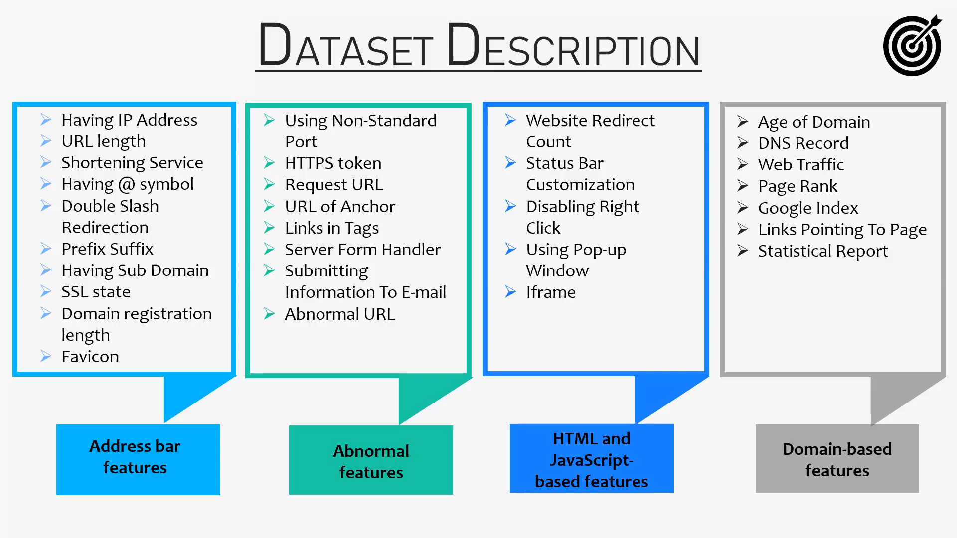

Slide 7

1. Using the IP Address :
If an IP address is used as an alternative of the domain name in the URL, such as “http://125.98.3.123/fake.html”, users can be sure that someone is trying to steal their personal information. Sometimes, the IP address is even transformed into hexadecimal code as shown in the following link “http://0x58.0xCC.0xCA.0x62/2/paypal.ca/index.html”.
Rule: IF$\left\{\begin{aligned}If The Domain Part has an IP Address → Phishing \\ Otherwise→ Legitimate\end{aligned}\right.$
2. Long URL to Hide the Suspicious Part :
Phishers can use long URL to hide the doubtful part in the address bar. For example:
http://federmacedoadv.com.br/3f/aze/ab51e2e319e51502f416dbe46b773a5e/?cmd=_home&amp;dispatch=11004d58f5b74f8dc1e7c2e8dd4105e811004d58f5b74f8dc1e7c2e8dd4105e8@phishing.website.html
To ensure accuracy of our study, we calculated the length of URLs in the dataset and produced an average URL length. The results showed that if the length of the URL is greater than or equal 54 characters then the URL classified as phishing. By reviewing our dataset we were able to find 1220 URLs lengths equals to 54 or more which constitute 48.8% of the total dataset size.
Rule: IF$\left\{\begin{aligned}URL length<54 → feature=Legitimate \\ else if URL length≥54 and ≤75 → feature=Suspicious \\ otherwise→ feature=Phishing\end{aligned}\right.$

Slide 8

3. URL’s having “@” Symbol :
Using “@” symbol in the URL leads the browser to ignore everything preceding the “@” symbol and the real address often follows the “@” symbol.
Rule: IF $\left\{\begin{aligned}Url Having @ Symbol→ Phishing \\ Otherwise→ Legitimate\end{aligned}\right.$
4. Age of Domain :
This feature can be extracted from WHOIS database (Whois 2005). Most phishing websites live for a short period of time. By reviewing our dataset, we find that the minimum age of the legitimate domain is 6 months.
Rule: IF $\left\{\begin{aligned}Age Of Domain≥6 months → Legitimate \\ Otherwise → Phishing\end{aligned}\right.$

Slide 9
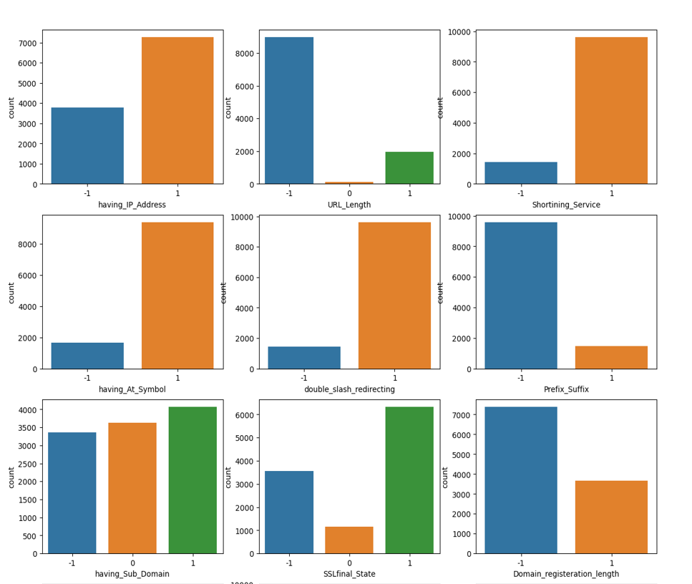
CountPlot of Input Column

Slide 10
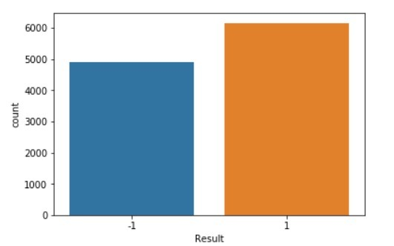
CountPlot of Output Column

Slide 11
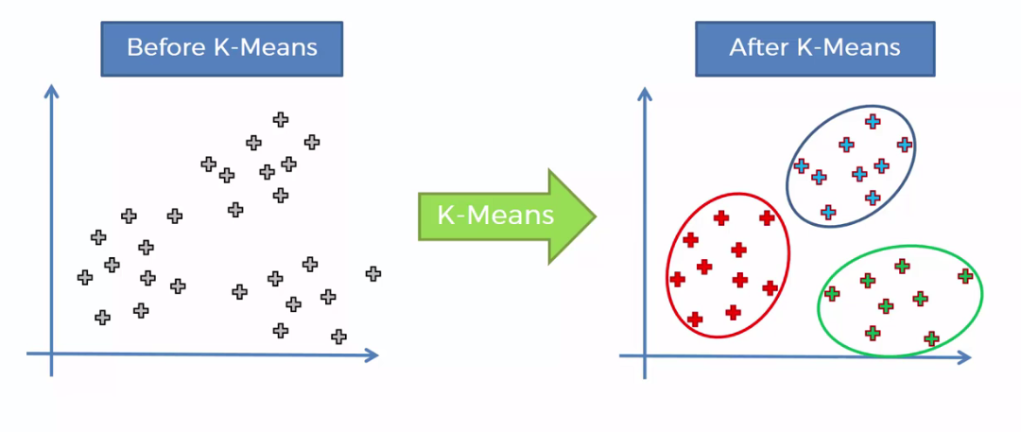
K-means Clustering
What is K means algorithm?
K means algorithm that try to partition the dataset into K predefined distinct non overlapping subgroups(clusters) where each data point belongs to only one group.
The K-means algorithm is used to find groups which have not been explicitly levelled in the data. This can be used to confirm assumption about what data types of group exist or to identify unknown groups in complex data sets.

Slide 12
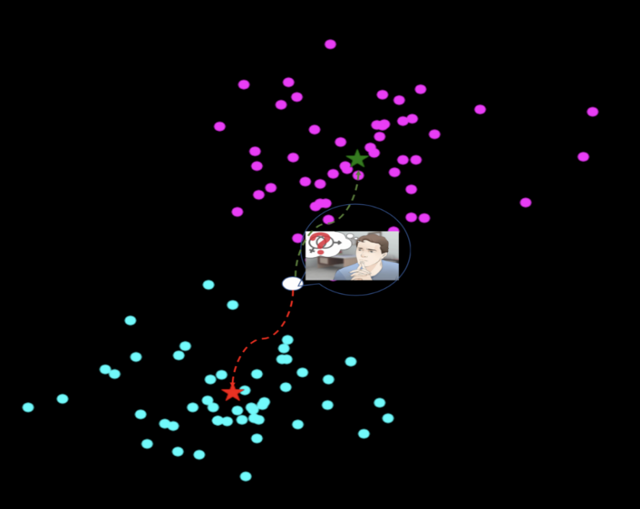
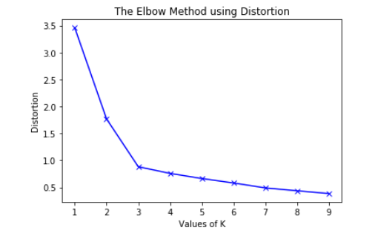
Steps of K-means Clustering :
Step 1: decide the number of cluster using Elbow method(WCSS).
Step 2: Initialize centroids.
Step 3: calculate distance from each data point to centroids.
What type of distance should we use?
Squared Euclidean distance
Step 4: Assign each object to the closest cluster
Step 5: Compute the new centroid for each cluster
Step 6: Iterate:
Calculate distance from objects to cluster centroids.
Assign objects to closest cluster
Recalculate new centroids
Step 7: Stop based on convergence criteria
No change in clusters
Max iterations

Slide 13
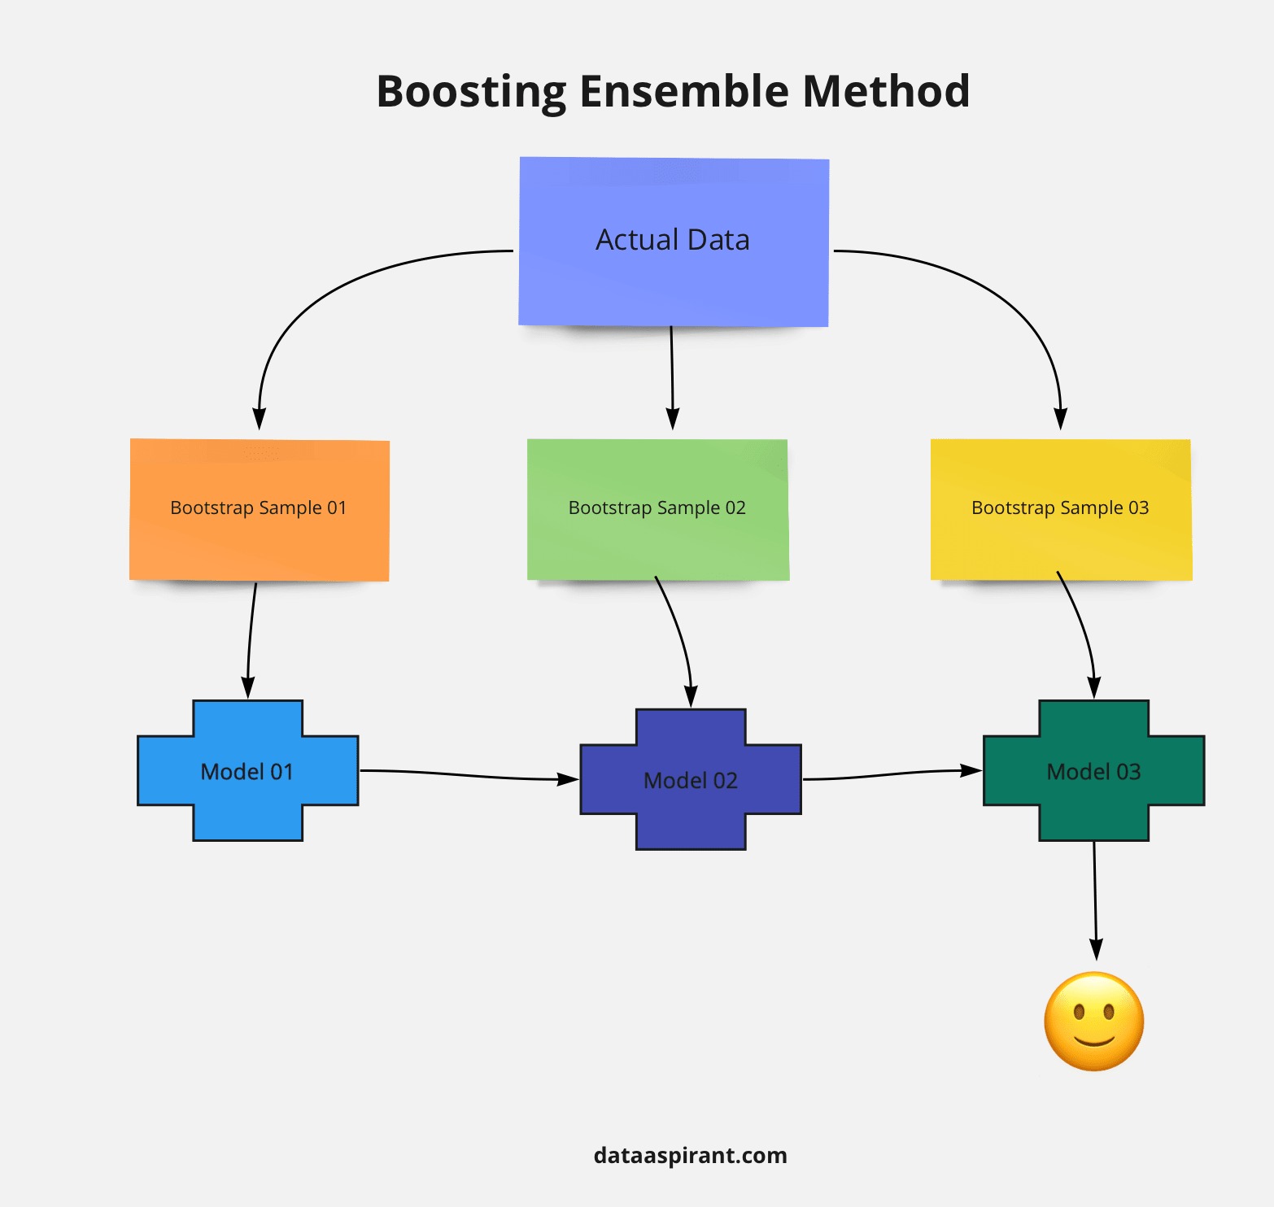
What is Boosting?
Boosting is an ensemble learning method that combines a set of weak learners into a strong learner to minimize training errors. In boosting, a random sample of data is selected, fitted with a model and then trained sequentially—that is, each model tries to compensate for the weaknesses of its predecessor. With each iteration, the weak rules from each individual classifier are combined to form one, strong prediction rule.

Slide 14
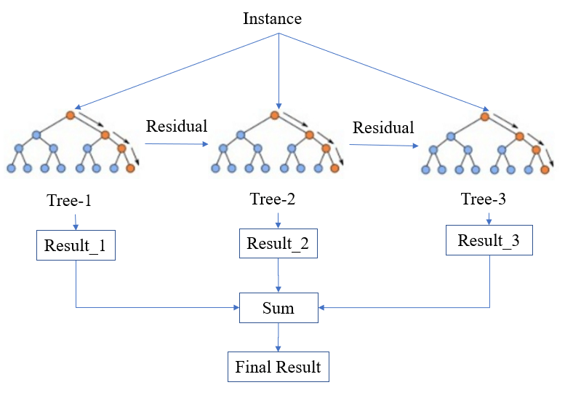
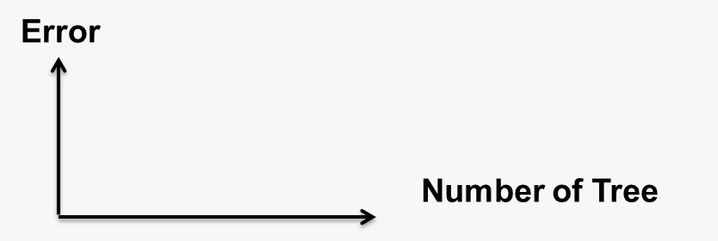

XGBoost
XGBoost stands for extreme gradient boosting it became popular in the recent days and is dominating applied machine learning and kaggle competition for structured data.
XGBoost is an extension to gradient boosted decision trees and specially designed to improve speed and performance. So our problem is based on classification so we have used XGBoost classifier.

Slide 15
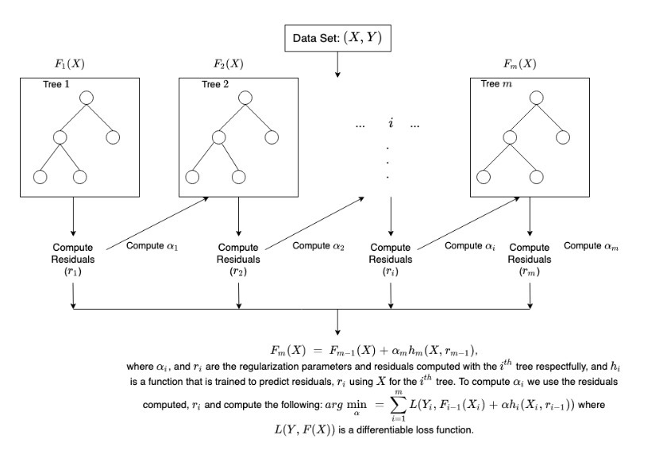
How does XGBoost work?

Slide 16
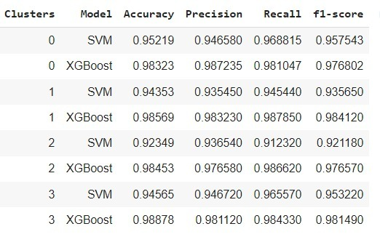
RESULTS

Slide 17
CONCLUSION & FUTURE WORK
As mentioned, at first we have divided the training data into 4 clusters using K-means algorithm.
After that for every cluster we have perfomed SVM and XGBoost algorithm. On the basis of the performance matrices we have noticed that XGBoost perfoms well for all clusters.
So we have selected XGBoost algorithm for phishing website classifier.
Our future plan for this project is to make an application which can automatically perform the validation and the transformation of a website and extract all the features to perform the chosen Machine Learning model to rectify whether a website is phishing or not.

Slide 18
REFERENCES
https://archive.ics.uci.edu/ml/machine-learning-databases/00327/
[1] Abdelhamid N, Thabtah F, Abdel-Jaber H Phishing detection : a recent intelligent machine learning comparison based on models content and features. In Beijing, China: IEEE, 2017.
[2] Harikrishnan NB, Vinayakumar and Soman KP on “A machine learning approach towards Phishing email detection; 2018.
[3] V. B.et al, “Study on Phishing attacks,” International Journal of Computer Applications, 2018.
[4] S. Mishra and D. Soni, “ Smishing detector: A security model to detect smishing through SMS content analysis and URL behaviour analysis,” (in English), future generation computer systems-the International Journal of Escience, Article vol. 108, pp. 803-815, Jul 2020.
[5] Ollmann, Gunter. "The Phishing Guide: Understanding and Preventing Phishing Attacks". Technical Info. Archived from the original on 2011-01-31. Retrieved 2006-07-10.
[6] "Spear phishing". Windows IT Pro Center. Retrieved March 4, 2019.
[7] O'Leary, Daniel E. (2019). "What Phishing E-mails Reveal: An Exploratory Analysis of Phishing Attempts Using Text Analyzes". SSRN Electronic Journal.
[8] R. Kohavi and F. Provost, "Glossary of terms," Machine Learning, vol. 30, no. 2–3, pp. 271–274, 1998
[9] Chen, Tianqi; Guestrin, Carlos (2016). "XGBoost: A Scalable Tree Boosting System". In Krishnapuram, Balaji; Shah, Mohak; Smola, Alexander J.; Aggarwal, Charu C.; Shen, Dou; Rastogi, Rajeev (eds.). Proceedings of the 22nd ACM SIGKDD International Conference on Knowledge Discovery and Data Mining, San Francisco, CA, USA, August 13-17, 2016. ACM. pp. 785–794.
[10] Gandhi, Rohith (2019-05-24). "Gradient Boosting and XGBoost". Medium. Retrieved 2020-01-04.

Slide 19
THANK YOU

