Slide 1


SOUMI MANDAL School of Physical Sciences School of Earth and Planetary Sciences
Modelling Clouds in Exo- Planetary Atmospheres
Supervisor – Dr. Jayesh M. Goyal
Co- Supervisor – Dr. Luke Chamandy
Physics Dissertation Project- II (P599) - Spring, 2026
29th April 2026

Slide 2
Overview
Motivation – the big picture
Recap of equation
Code Workflow
Improvement over previous work – NH₃ clouds in Jupiter
WASP – 17b – work with SiO₂ and Al₂O₃ molecules
Summary
Scope of Future work
Notes:
Mention you are varying f_sed in Jupiter and metallicity, kzz in wasp17b for testing

Slide 3
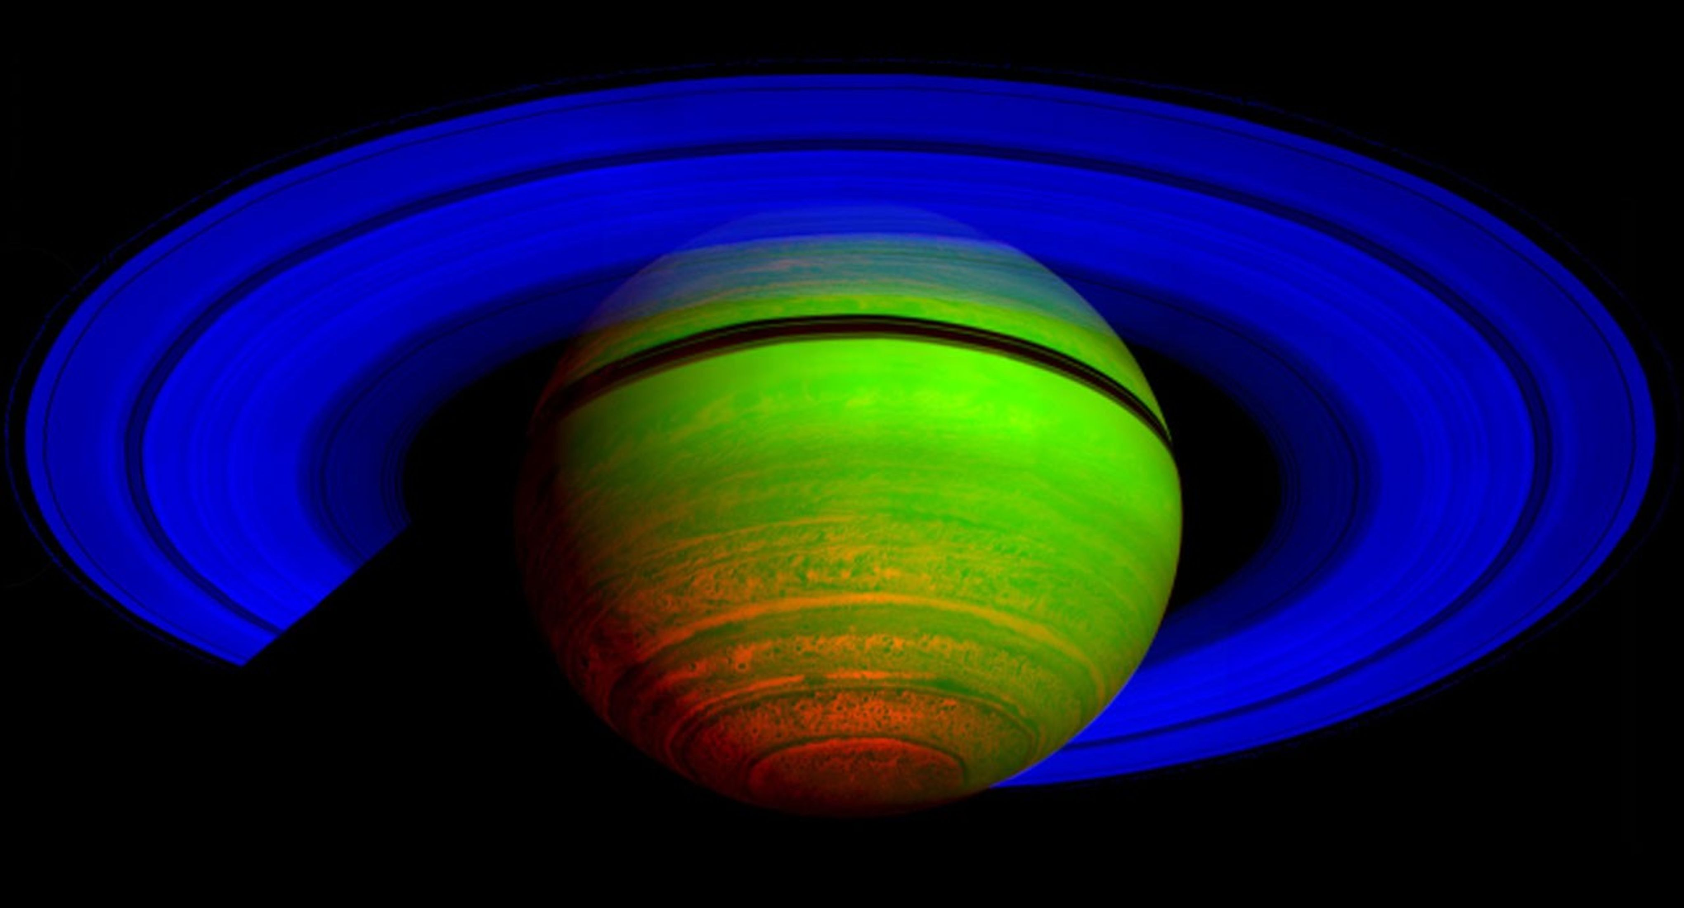
Why are clouds important for study?
Albedo
Spectra
Climate
Habitability
Saturn in Infrared from Cassini’s Visual in 2008 | NASA/JPL/ASI/University of Arizona
Notes:
Clouds are among the most significant sources of uncertainty in the characterization of planetary atmospheres. Their vertical structure, particle size distribution, and condensate abundance directly shape the observed spectra of both Solar System planets and exoplanets, making accurate cloud modeling an essential component of any self-consistent atmospheric retrieval or forward modeling framework.
In this image constructed from data collected in the near-infrared wavelengths of light, scientists designated blue to indicate sunlight reflected at a wavelength of 2 microns, green to indicate sunlight reflected at 3 microns and red to indicate thermal emission at 5 microns. Saturn's rings reflect sunlight at 2 microns, but not at 3 and 5 microns, so they appear deep blue. Saturn's high altitude haze reflects sunlight at both 2 and 3 microns, but not at 5 microns, and so it appears green to blue-green. The heat emission from the interior of Saturn is only seen at 5 microns wavelength in the spectrometer data, and thus appears red. The dark spots and banded features in the image are clouds and small storms that outline the deeper weather systems and circulation patterns of the planet. They are illuminated from underneath by Saturn's thermal emission, and thus appear in silhouette.
Transmission spectrum is the spectrum of a planet’s atmosphere measured during transit, when the planet passes in front of its star and some starlight filters through the planet’s atmospheric limb.
Albedo is the fraction of incoming stellar light that a planet (or any surface/atmosphere) reflects back into space.
Opacity is a measure of how strongly a material (gas, cloud, or atmosphere) absorbs or scatters radiation, i.e. how difficult it is for light to pass through it.
higher opacity = less light transmitted lower opacity = more light transmitted

Slide 4
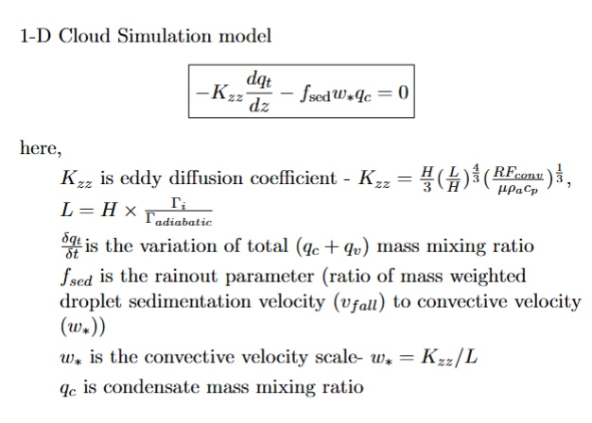
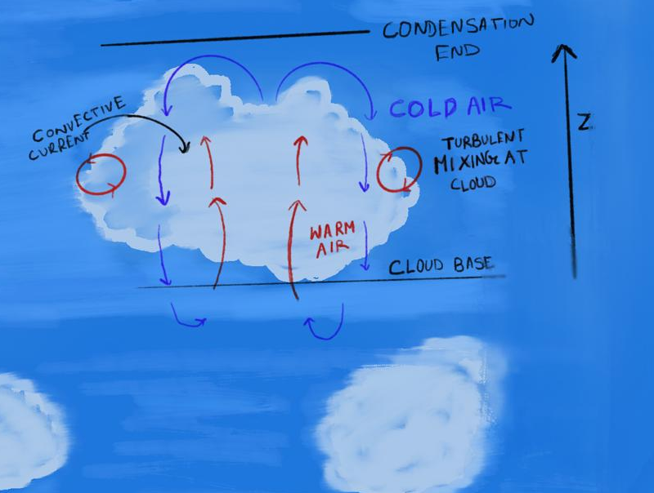
Ackerman and Marley Cloud model
Notes:
If the surface temperature is greater than the atmospheric temperature aloft, convection begins.
A parcel of air rises, and as it rises it expands and cools.
When the air parcel cools to the dew point temperature, saturation occurs.
Dew point temperature is the temperature at which air must be cooled (at constant pressure and moisture content) for saturation to occur.
Condensation begins (usually around condensation nuclei), and the cloud base forms.
Condensation releases latent heat, so the lapse rate changes and differs from the dry adiabatic lapse rate.
Inside the cloud, the air is typically saturated ($RH=100\%$).
A cloud remains active only if air continues to move upward through it, i.e. the convection cycle continues.
If the parcel rises further and the temperature drops more, then:
$$q_{v}>q_{s}$$
This means the atmosphere contains more vapor than can be supported in equilibrium.
The excess vapor condenses into cloud particles.
Cloud formation stops when temp of atmosphere becomes greater than the cloud’s inside temperature.
Lapse rate rate of change of T wrt Z, adiab lapse rate = g/cp, mixing length theory is first order closure of turbulence closure problem

Slide 5
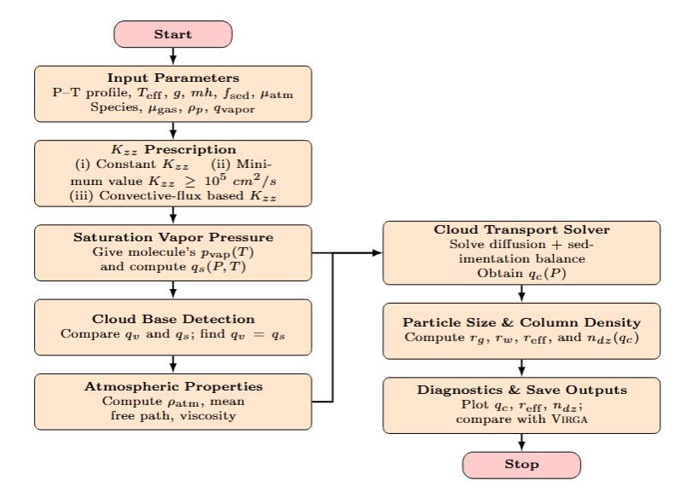
CODE WORKFLOW
Notes:
The code that I made/ wrote. Virga is a published model in AM frame

Slide 6


Improvements over previous modelling formulation – (main points)
Old Model
New Model
Manual layer by layer root propagation
Used find_root (bracketed secant method) algorithm for finding fall radius
No clearly separated free molecular regime branch
Old Cunningham slip correction factor
Directly solving ODE using RK23 method
Using brentq method to find fall radius
Clearly separated to free molecular regime and continuum regime
Updated Cunningham Slip correction factor
Notes:
It is called RK23 because:
it computes:
a 3rd-order solution
and an embedded 2nd-order solution
the difference between them is used to estimate the error
that error is then used to adapt the step size automatically
Brentq method uses bisection, secant method and inverse quadratic interpolation, guaranteed convergence (for continuous bracketed roots) good speed high robustness
To use brentq, you need:
$$f\left(a\right) f\left(b\right)<0$$
This means:
one endpoint is positive
the other is negative
So the root is guaranteed inside the interval.
The free molecular regime is the gas-flow regime where the mean free path of gas molecules is much larger than the particle size, so the particle experiences drag from individual molecule–particle collisions rather than from a continuous fluid.
The free molecular regime is common when:
pressure is low
gas density is low
the mean free path is large
particles are small
The continuum regime is the gas-flow regime where the mean free path of gas molecules is much smaller than the particle size, so the gas behaves like a continuous fluid around the particle. In the continuum regime:
gas molecules collide with each other many times near the particle
the gas acts like a smooth continuous medium
the particle feels fluid drag
classical viscous drag laws (like Stokes drag) can be used

Slide 7
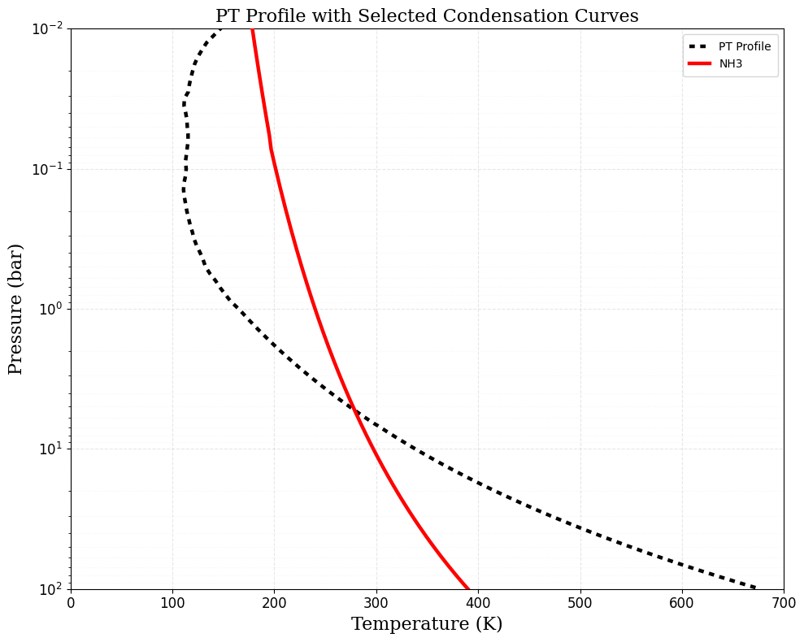
Why NH3 is found in Jupiter ?
Ammonia’s spectral lines were observed by NASA’s Galileo Probe in 1989 detecting clouds of ammonia ice on Jupiter.
Earlier data constrained from the transmission spectra of the planet obtained from Voyager spacecraft showed that the Ammonia gas absorbed certain wavelengths of light.
Notes:
Data constrained from transmission spectra of the planet
At the intersection:
the atmosphere reaches the temperature–pressure conditions where NH${}_{3}$ becomes saturated
i.e.
$$q_{v}=q_{s}$$
So this is the level where:
NH${}_{3}$ vapor can no longer remain fully in gas form
condensation begins
Where condensation is thermodynamically possible.
Kzz​ $f_{sed}$available condensable abundance vertical mixing sedimentation depletion of $q_{t}$

Slide 8
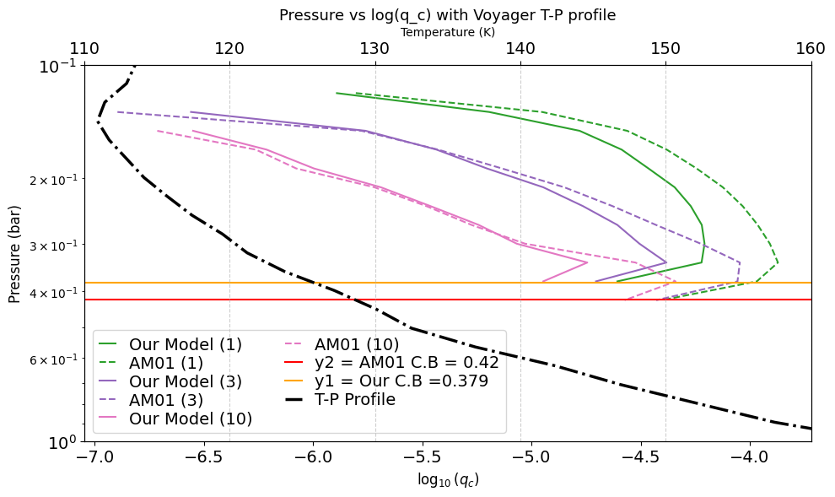

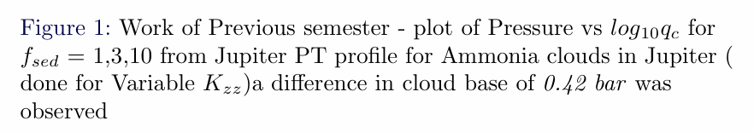
Recap of previous semester main result
PT profile is taken from Ackerman and Marley (2001)
Notes:
Cloud base mismatch overall trend even though same above cloud base we can see for lower f_sed value the agreement is very bad. I was comparing my model to the old model of ackerman and marley which used old methods to compute.

Slide 9
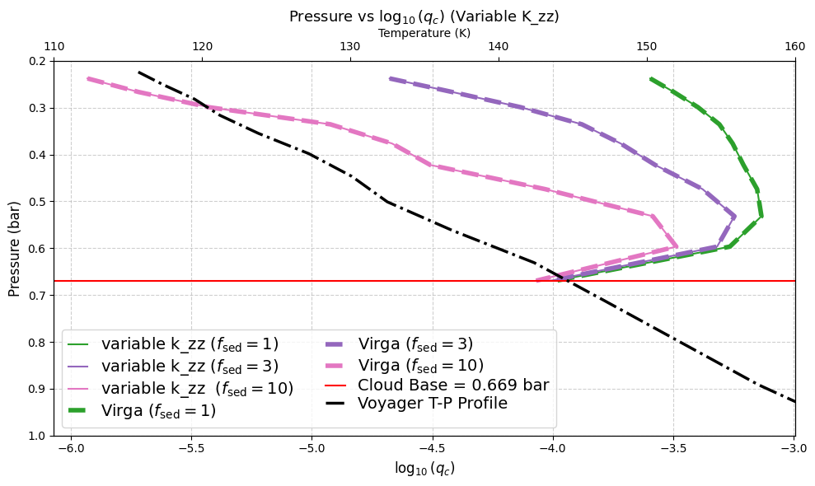
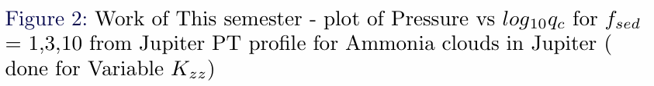
Improvement of this semester’s result
The work is compared with Virga cloud model, (Batalha et al., open-source code)
https://github.com/natashabatalha/virga
Notes:
Our work exactly matches with the latest cloud formation model – virga. Lower f_sed forms cloud at hotter temperatures, it forms clouds at lower pressure levels. Lower f_sed gives more clouds than higher f_sed, f_sed more means sedimentation force is dominating the turbulent force, condensate particles settle downward the total condensable reservoir gets depleted vertical mixing may no longer fully replenish the cloud $q_{t}$starts to drop significantly and then:
$$q_{c}=q_{t}−q_{s}$$
starts to decrease.
Thus the curve turns back left.

Slide 10
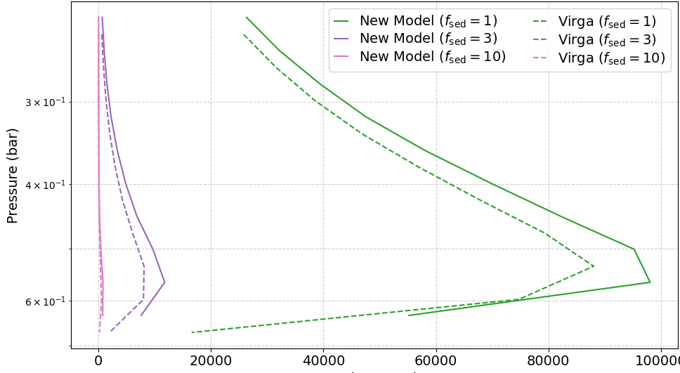
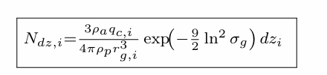
Plot of Pressure vs Column Density
Plot of Pressure vs Column Density
Column Density (cm⁻²)
Notes:
Column density is the total amount of material integrated along a vertical column (or line of sight) through the atmosphere. N depends inverse of r_g, which depends on r_w, rho_a – atmo density, rho_p density of molecule
Reff – area weighted particle radius
Rg – geometric mean radius of logarithm size distribution, rg is center of particle size distribution in log space

Slide 11
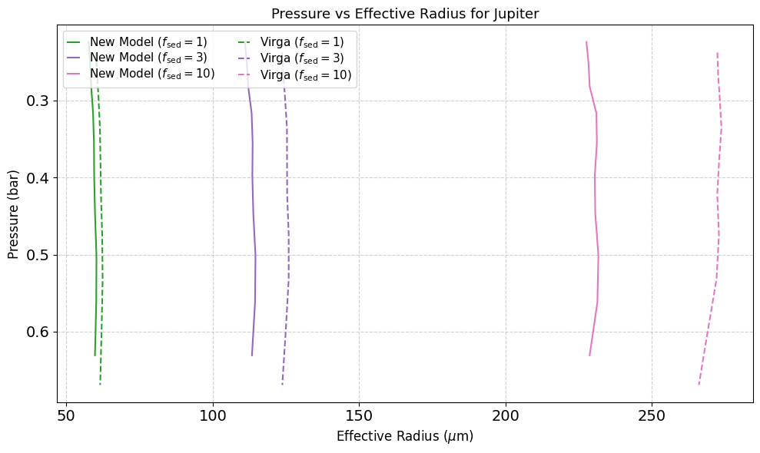



Plot of Pressure vs Effective Droplet Radius
Plot for Pressure vs Effective Droplet radius (microns) for different values of sedimentation efficiency.
Notes:
R_g depends on rw, reff depends linearly on rg, sigma is geometric standard deviation of cloud particle size distribution, alpha is power law approximation

Slide 12
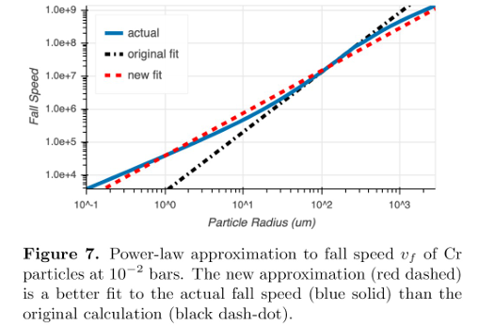


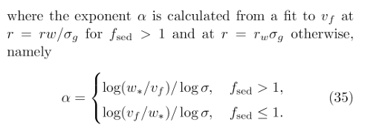

Why the different at higher sedimentation efficiency values :
Currently we use the algorithm of Power law approximation fit as :
Virga obtains a better fit for calculating α using SciPy.optimize function called curve_fit
Figure taken from Batalha.et.al- 2025
Notes:
Higher fall speed gives higher rw, higher fsed, rw influences ndz and reff, Beta is cunningham slip correction factor, eta is atmospheric viscosity

Slide 13

Key findings by varying Sedimentation Efficiency Parameter
Higher sedimentation efficiency values results in lower condensate mass mixing ratio values, they also tend to form clouds in colder temperatures
Higher sedimentation efficiency value results in lower column density.
Higher sedimentation efficiency value results in bigger effective droplet radius.

Slide 14
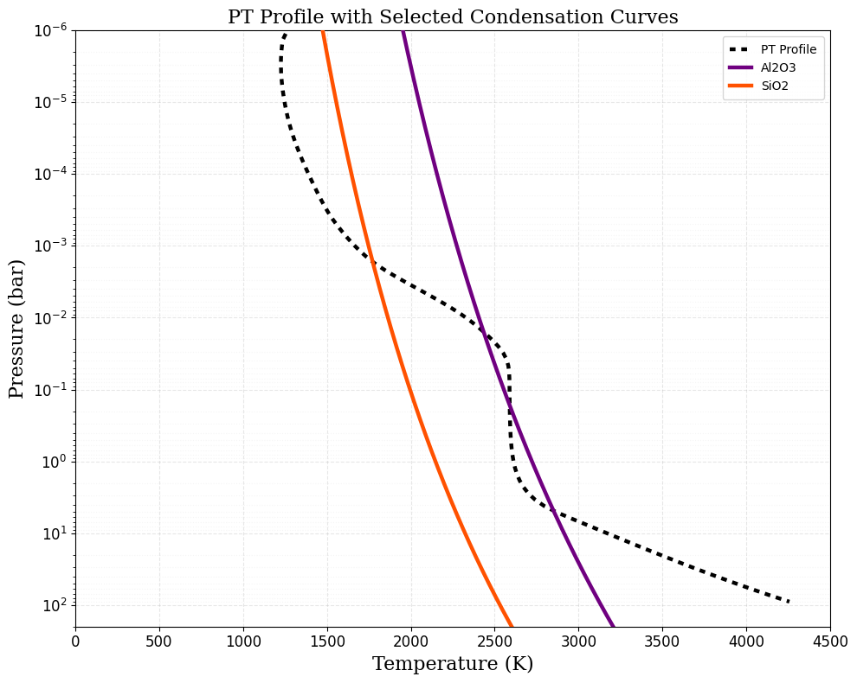
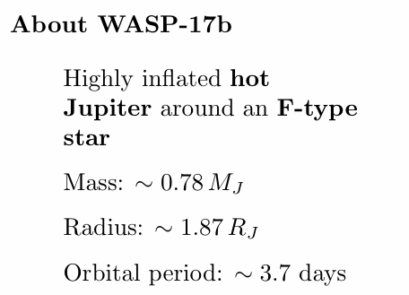
WASP -17b (A hot Jupiter case study)
The Grant.et. Al. 2023 discusses about the detection of SiO₂ and Al₂O₃ species, given the range of temperature expected in WASP -17b’s atmosphere and presence of a clear 8.6 micro meter spectroscopic feature – crucial for detection of SiO₂ and Al₂O₃
PT profile taken from Grant et. al. 2023
Notes:
F type star is white yellow main sequence star, hotter (6000 – 7.4k) and more massive than sun (1.1 -1.6) solar masses he 8.6-micrometer (
m) spectroscopic feature for Aluminum Oxide (
) is significant because it provides a unique, non-destructive signature to identify and distinguish crystalline phase alumina feature arises from vibrational mode in Al-O bond. 8.6 um is key identifier of amorphos silica

Slide 15

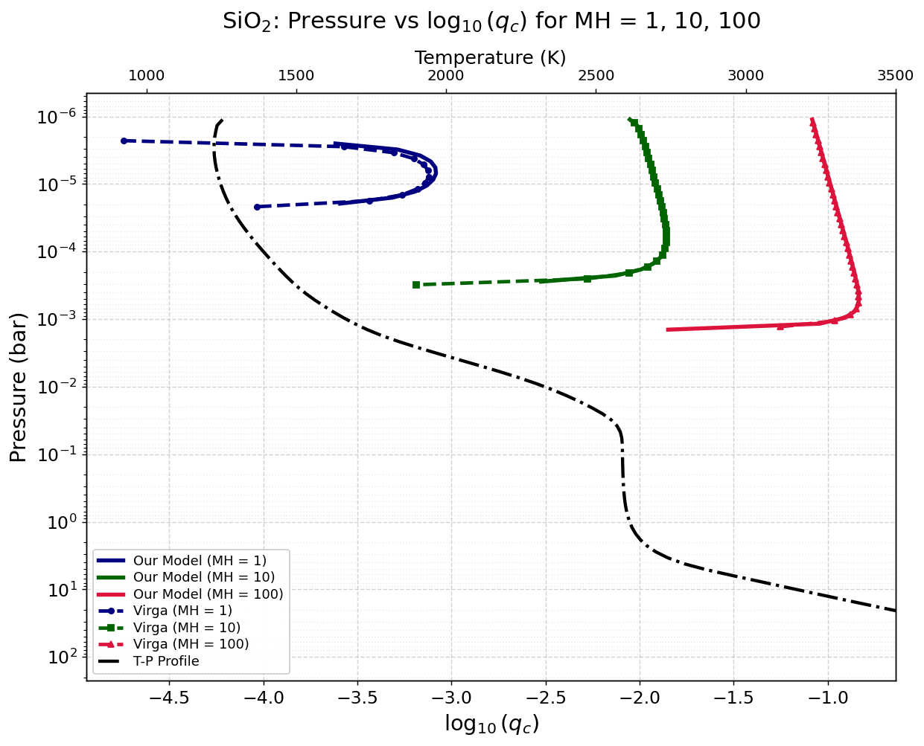
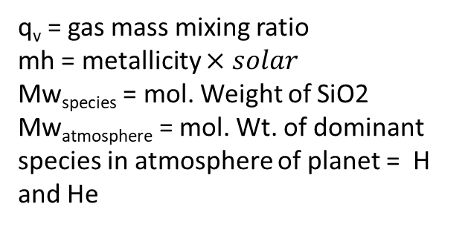
A study of condensate mass mixing ratio across various metallicities
q_{v} = gas mass mixing ratio
mh = metallicity $×solar$
Mw_{species} = mol. Weight of SiO2
Mw_{atmosphere} = mol. Wt. of dominant species in atmosphere of planet = H and He
The higher the metallicity, the more is the cloud formation.
Higher metallicity leads to the shift to the cloud base at a higher pressure
Clouds are formed at high temperature for higher metallicity
Notes:
Q_below is q_t in the immediately preceeding layer towards higher pressure., metallicity also influences q_v – mh is abundance of elements heavier than H and He, high qv, high qc, more element present in the atmosphere it becomes readily condensable at higher temp and pressure. 100 mh = 100 times elemental abundance in sun

Slide 16
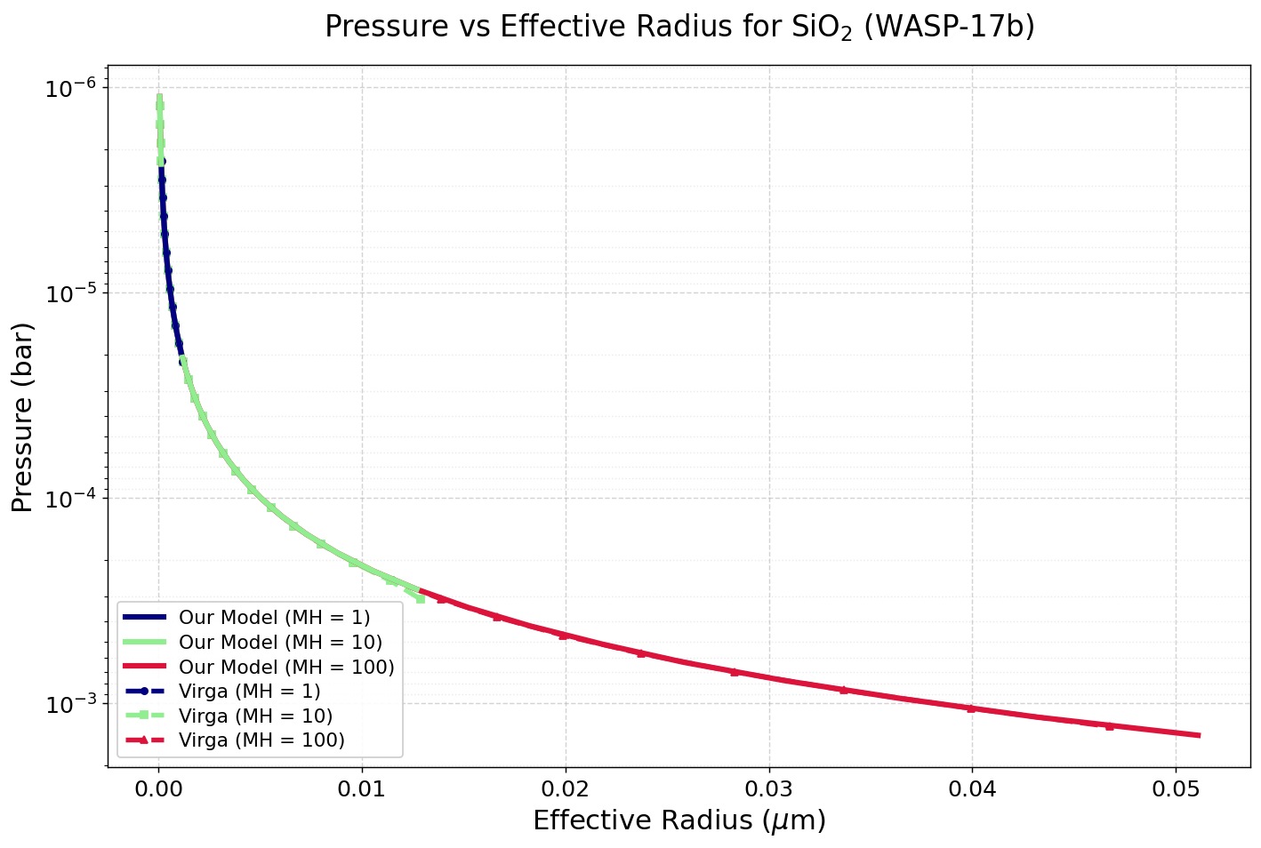
Variation of droplet radius across various metallicities
Higher the metallicity higher is the effective droplet radius.
F_{sed} = 0.1 , K_{zz} = 10⁹ ⁽parameter taken from Grant et.al. 2023
Notes:
Mh =1 , 0.005 microns, mh = 10 goes up until 0.015 microns and mh = 100 goes up to 0.05 microns, more metallicity means more qc which means more condensable material. But in sedimenting cloud models, larger $q_{c}$with finite settling often tends to favor larger characteristic particle radii because:
larger particles carry more mass efficiently

Slide 17
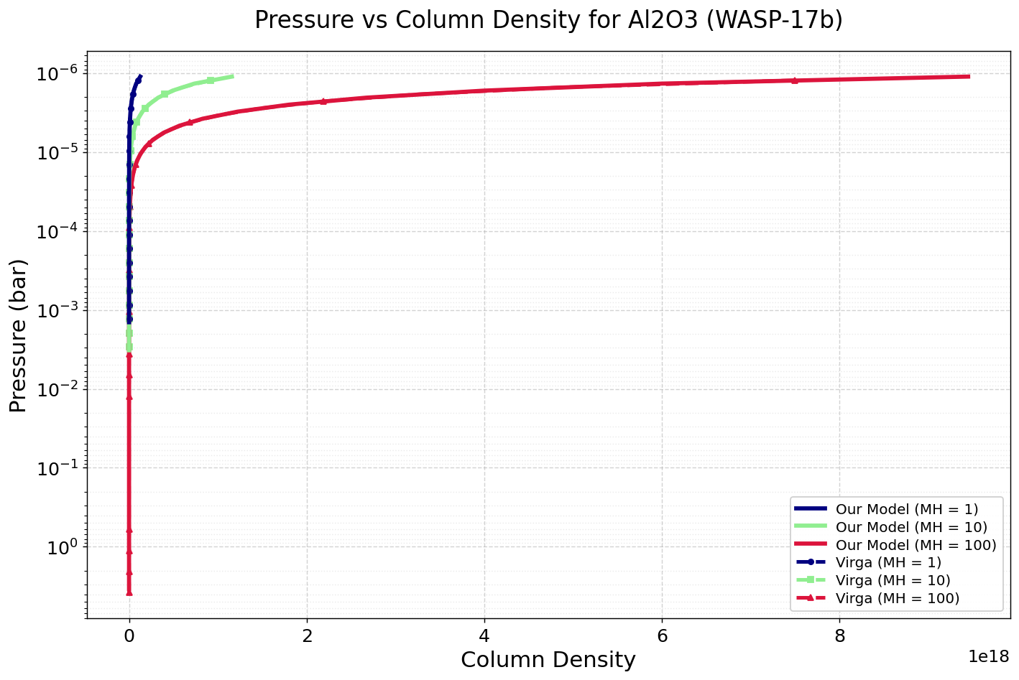
Variation of Column Density across various metallicities
Higher the metallicity, higher is the Column density.
Notes:
metallicity adds so much more condensable material that even though particles become larger, the total integrated particle column still increases larger condensate loading more cloud mass larger integrated particle abundance

Slide 18
Key findings by varying Metallicity
Higher metallicity values results in shift in cloud base to higher pressure values , making the clouds heavy and form more than that of lower metallicity values
Higher metallicity have higher effective droplet radius
Higher metallicity also have higher column density
Metallicity is the abundance of elements heavier than hydrogen and helium present in an astronomical object (stars and planets)

Slide 19
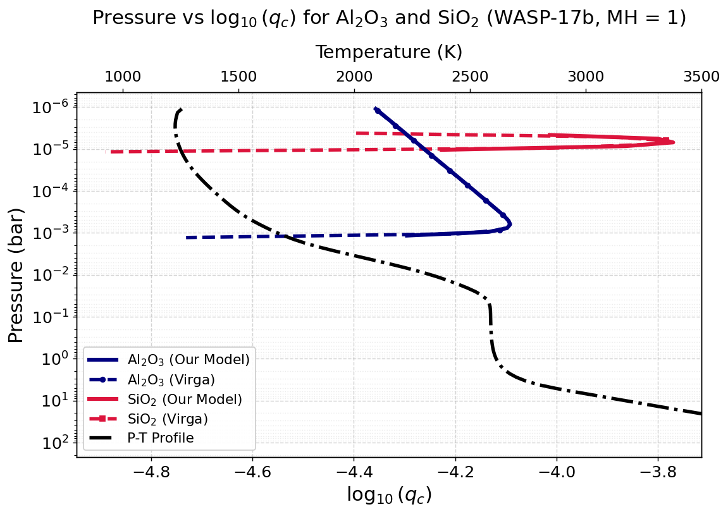
Molecular weight and formation of clouds
The molecular weight of Al₂O₃ = 101.96 g/mol and that of SiO₂ = 60.08 g/mol
The heavier the species, lower is the cloud base (closer to the surface)
The clouds for the heavier species condenses and forms at higher pressure.
Notes:
Material heavy sedimentation term dominates

Slide 20


Variation of Eddy Diffusion Parameter and its role in cloud formation
This is a parameter which increases the intensity of turbulence in the vertical mixing, it controls the convective velocity w* which in turn controls the fall radius.
Thus, making fall radius highly dependent on eddy diffusion parameter – which then goes on to control droplet radius and number density
Values of K_{zz} used are = 10⁸,10⁹,10¹⁰,10¹¹,10¹²
The change of constant eddy diffusion parameter does not cause a change in the condensate mass mixing ratio or formation of clouds, for a fixed metallicity and sedimentation efficiency
Notes:
Eddies bring different seizes of droplets into contact which leads to collision leading larger particles (many particles sticking together) that eventually settle downward due to sedimentation.

Slide 21
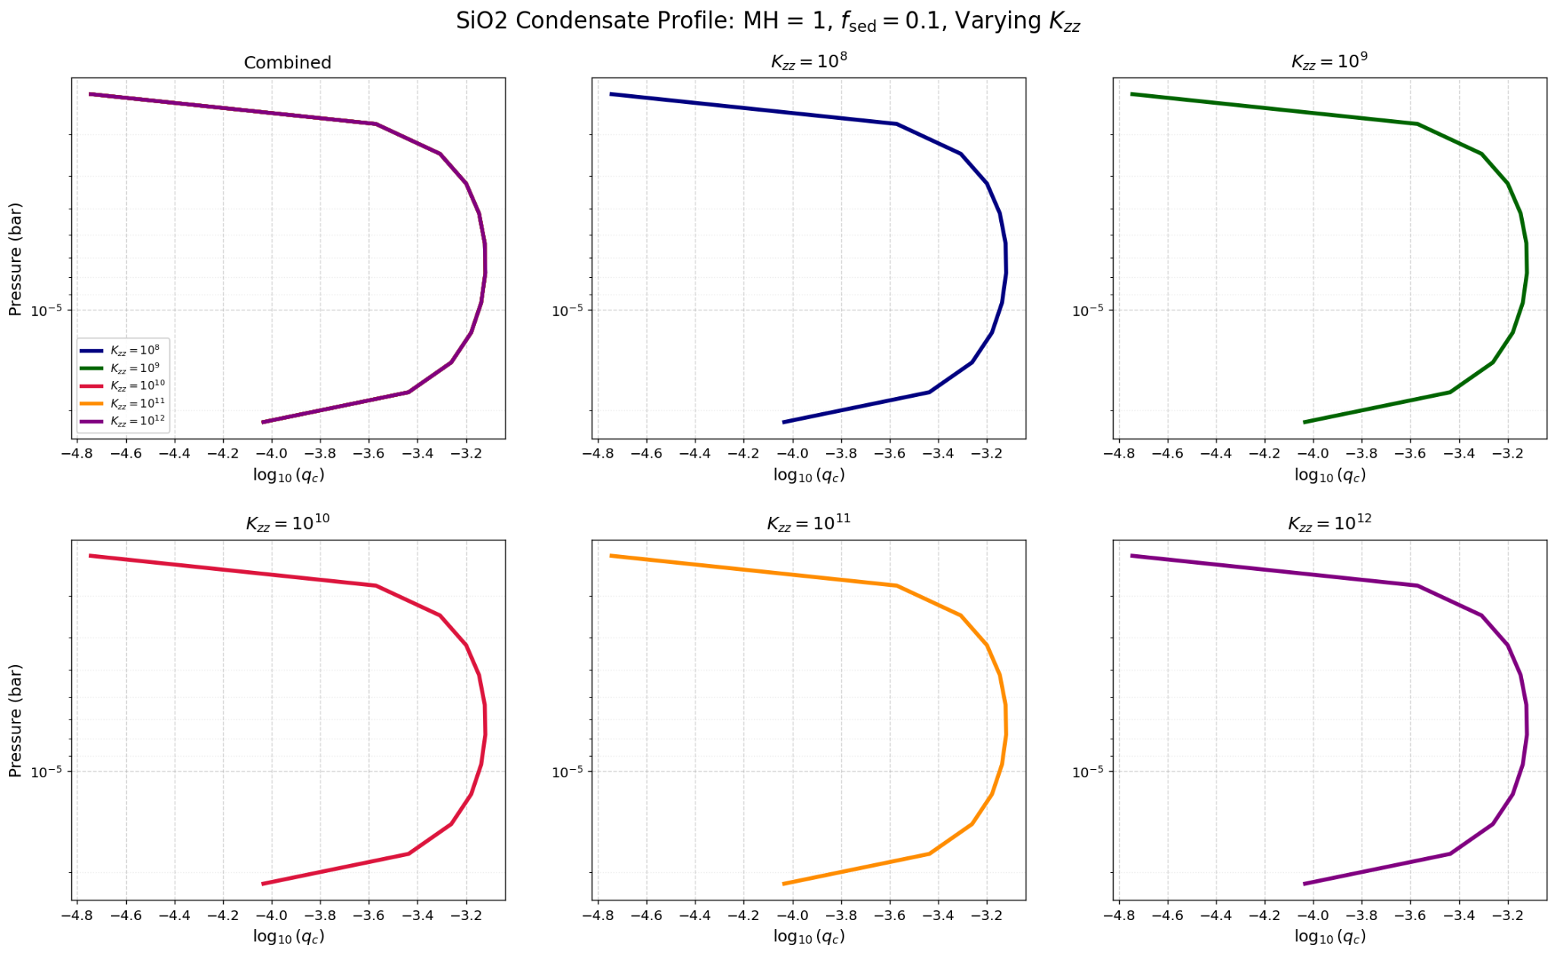
Eddy Diffusion parameter and condensate mass mixing ratio
F_{sed} = 0.1 , MH = 1, Varying K_{zz}
Notes:
Refer to analytical solution of the equation for a possible explaination.

Slide 22
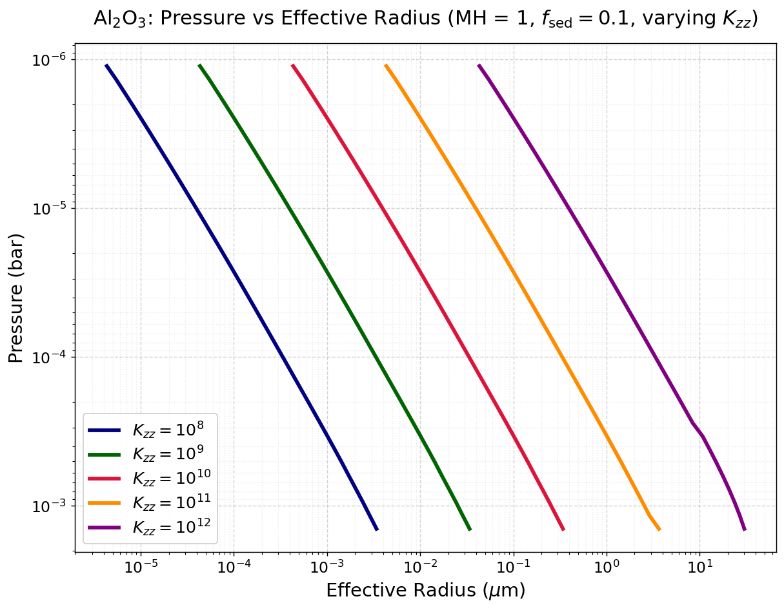
Eddy Diffusion parameter and droplet radius
Higher the value of eddy diffusion parameter, higher is the droplet radius.
Notes:
Kzz controls w* which controls the balance equation of vall and w*, so if L is fixed for atmosphere increasing kzz means increasing vfall which is increased through increase in rw

Slide 23
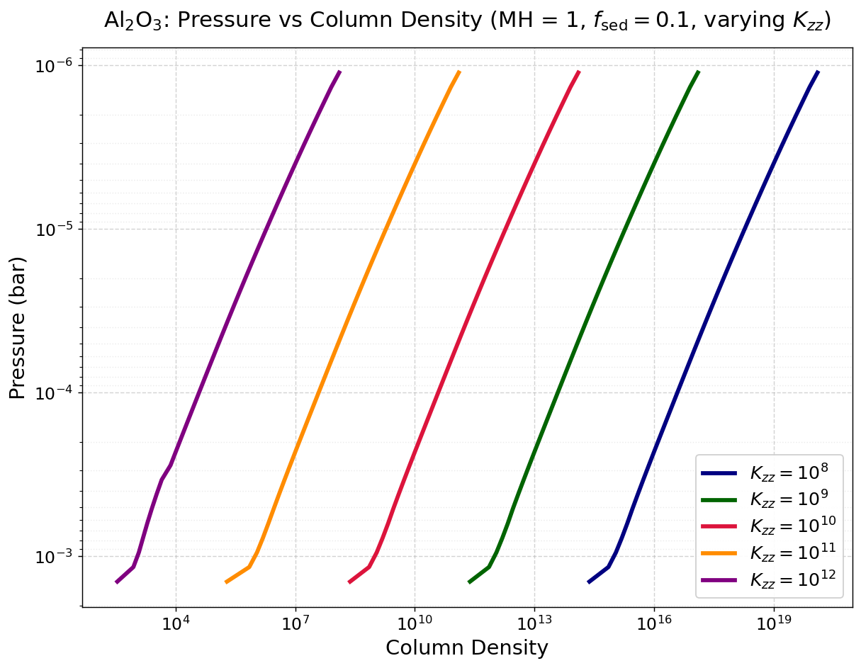
Eddy Diffusion parameter and Column Density
Higher the value of eddy diffusion parameter, lower is the column density.
Notes:
Rw influences rg, ndz is 1/ rg cube

Slide 24
Key findings by varying eddy diffusion parameter
The change in the value of eddy diffusion parameter is not playing a significant role in changing the formation of clouds, it leaves the condensate mass mixing ratio the same.
Eddy diffusion parameter mainly controls the fall radius of the particle
Higher values of eddy diffusion parameter results in higher values of droplet radius
Higher values of eddy diffusion parameter results in lower values of column density – telling us that higher the eddy diffusion parameter lesser is the concentration of particles per layer in the atmosphere indicating that the turbulent mixing is happening well.

Slide 25
Summary of results :
The interplay of eddy diffusion parameter, sedimentation parameter and metallicity cause significant change in structure and formation of clouds
The whole 1D model is based on the upward turbulent force and the downward motion of the particles due to sedimentation force
While plots of pressure versus condensation mass mixing ratio give the location and extend of the cloud formation, the details of cloud structure and gradient mostly comes from analysing its column density and effective droplet radius.

Slide 26
Scope of future work
I plan on integrating the consideration of treating the particles as aggregates and not just sphere – currently all fall radius calculations are assumed that the particles are spherical in shape.
Since my model only calculates the structural and formation of clouds, it will later be used to club into our group’s model – SANSAR so that it can be used in the retrieval models
Notes:
Forward model: predicts the spectrum from a given set of atmospheric parameters. Retrieval model: infers the atmospheric parameters by fitting a model spectrum to the observed spectrum.

Slide 27
Thank You

Slide 28
Questions?

Slide 29
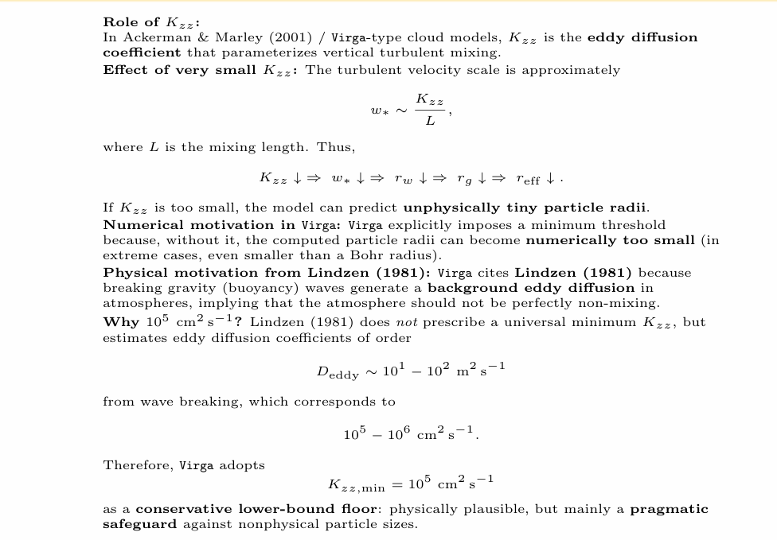
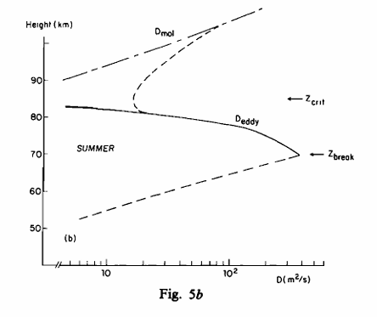
Appendix

Slide 30




Slide 31
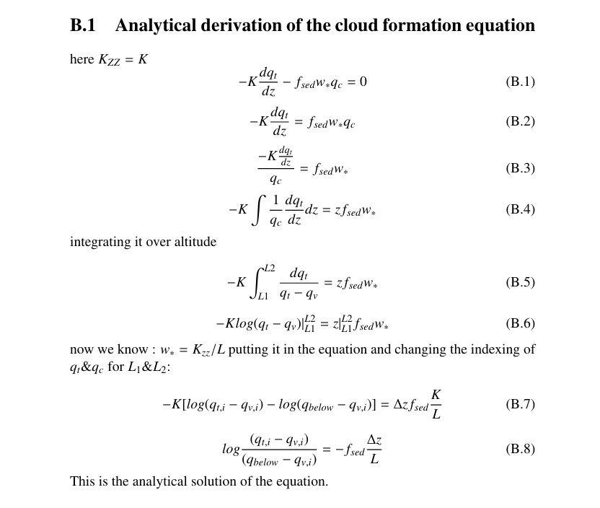
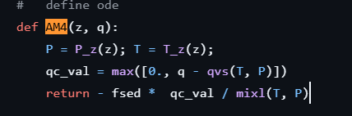
How the differential equation is solved in Virga and my work

Slide 32
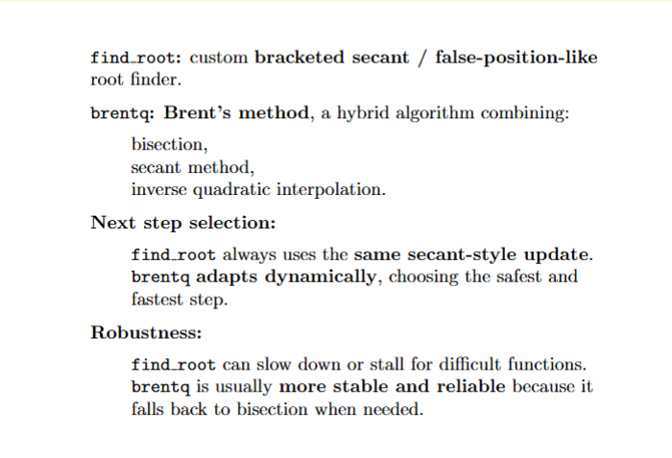
RK23 is an adaptive explicit Runge–Kutta 2(3) method (Bogacki–Shampine) used to solve non-stiff ordinary differential equations with embedded error control.
The RK23 method, often implemented as the Bogacki-Shampine method, is an explicit Runge-Kutta pair of order 3(2) used to solve ordinary differential equations (ODEs). It uses a 3rd-order formula to take steps while utilizing a 2nd-order formula for error estimation, making it ideal for adaptive step-size control.

Slide 33
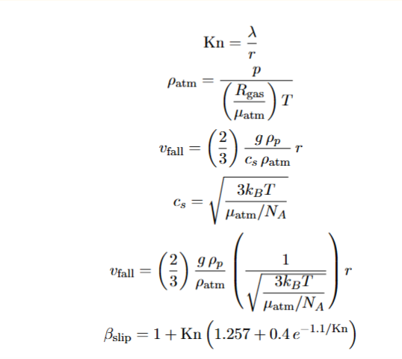
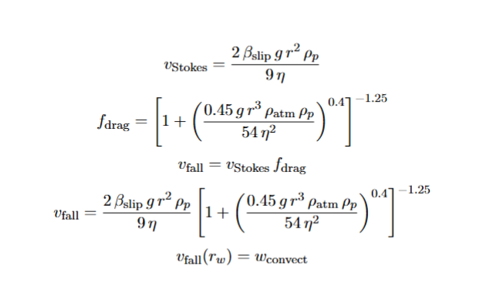
New Method of v_{fall} calculation
K_{n} >10
K_{n} <₌ 10
Here we use find root algorithm

Slide 34
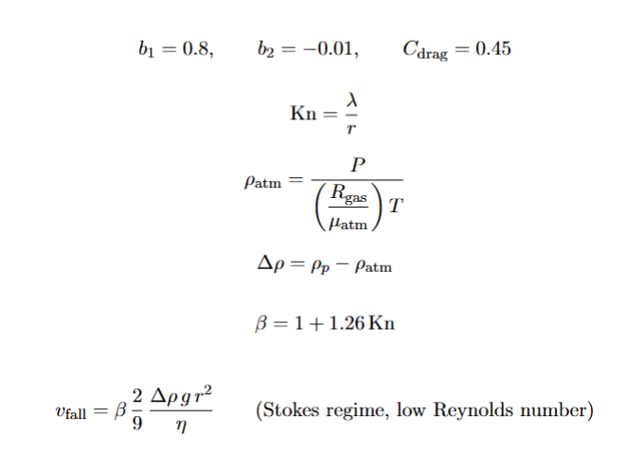
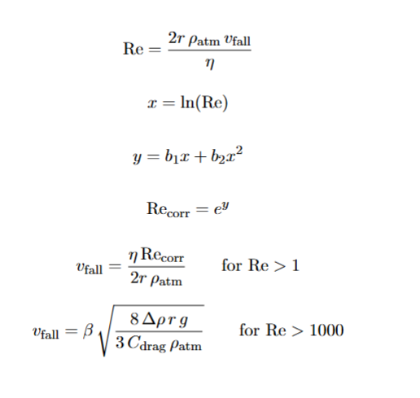
Old Calculations for v_{fall}

Slide 35
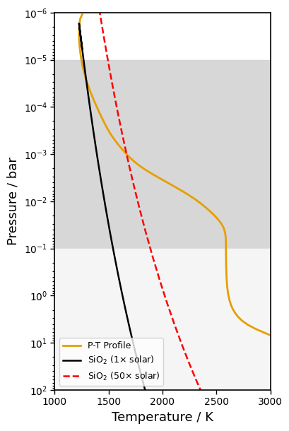
Grant. Et. Al - 2023

Slide 36
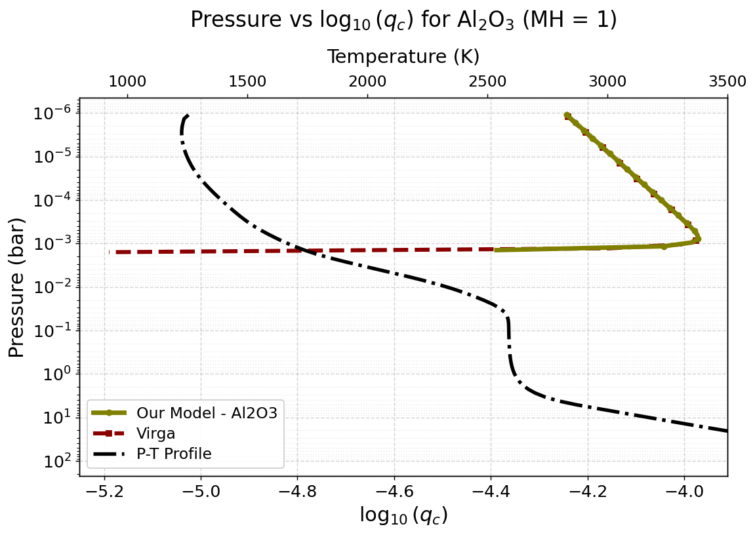
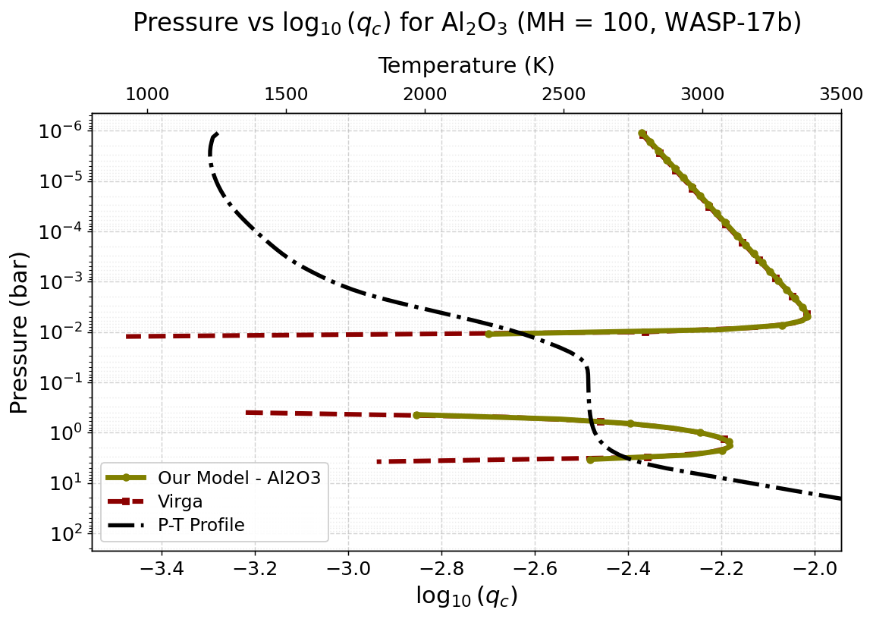

Slide 37
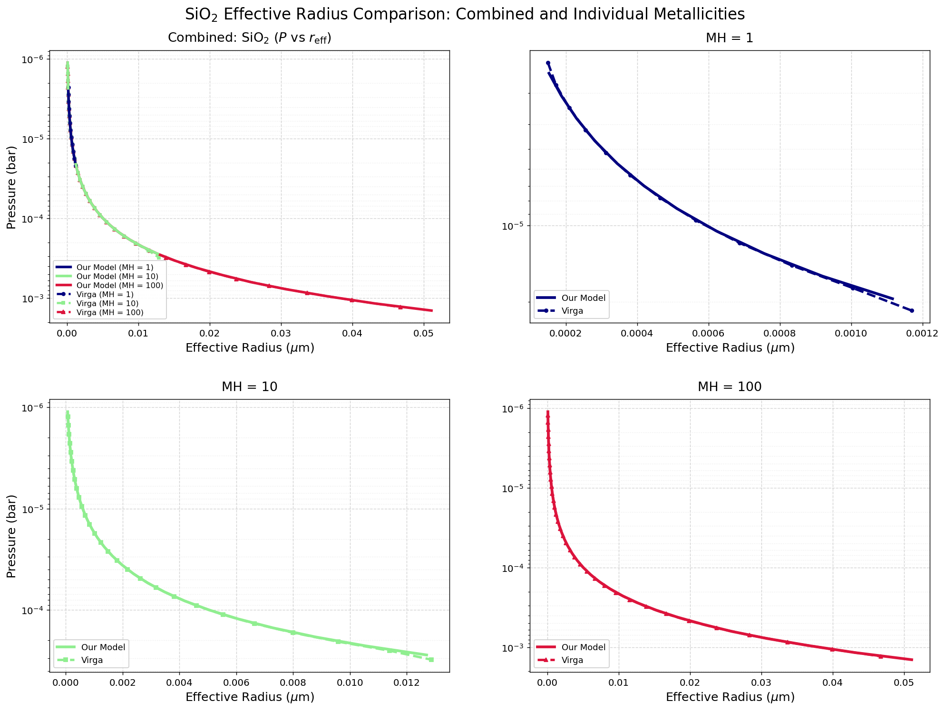

Slide 38
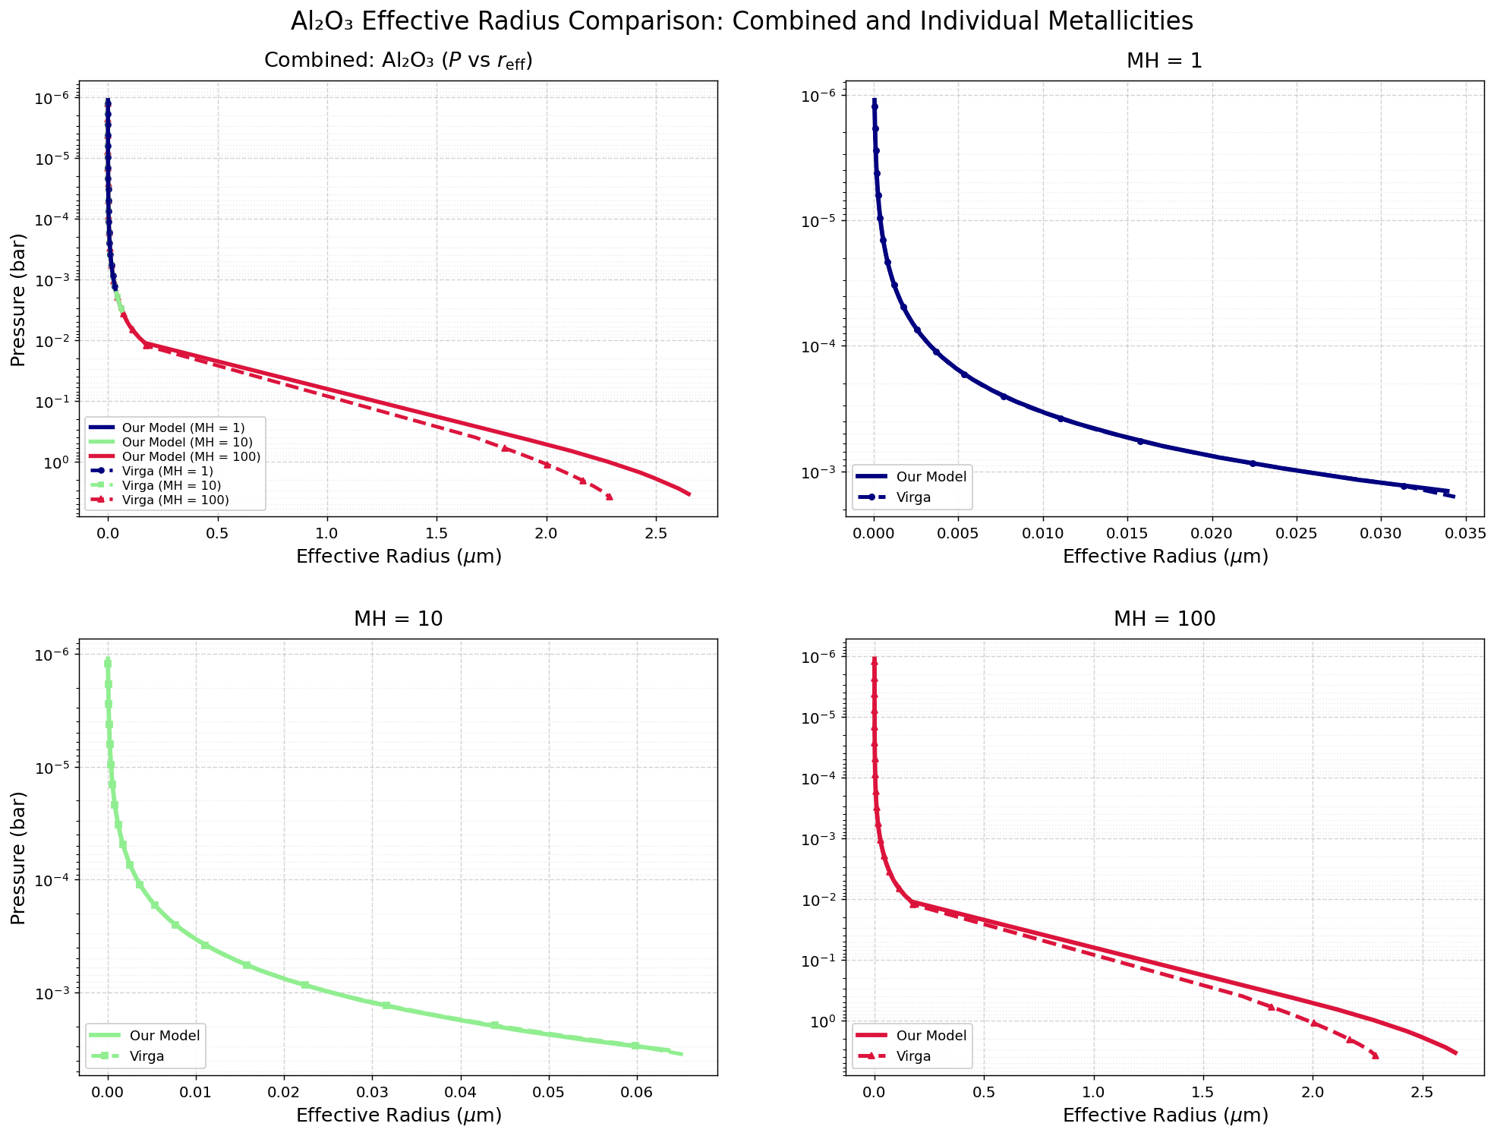

Slide 39
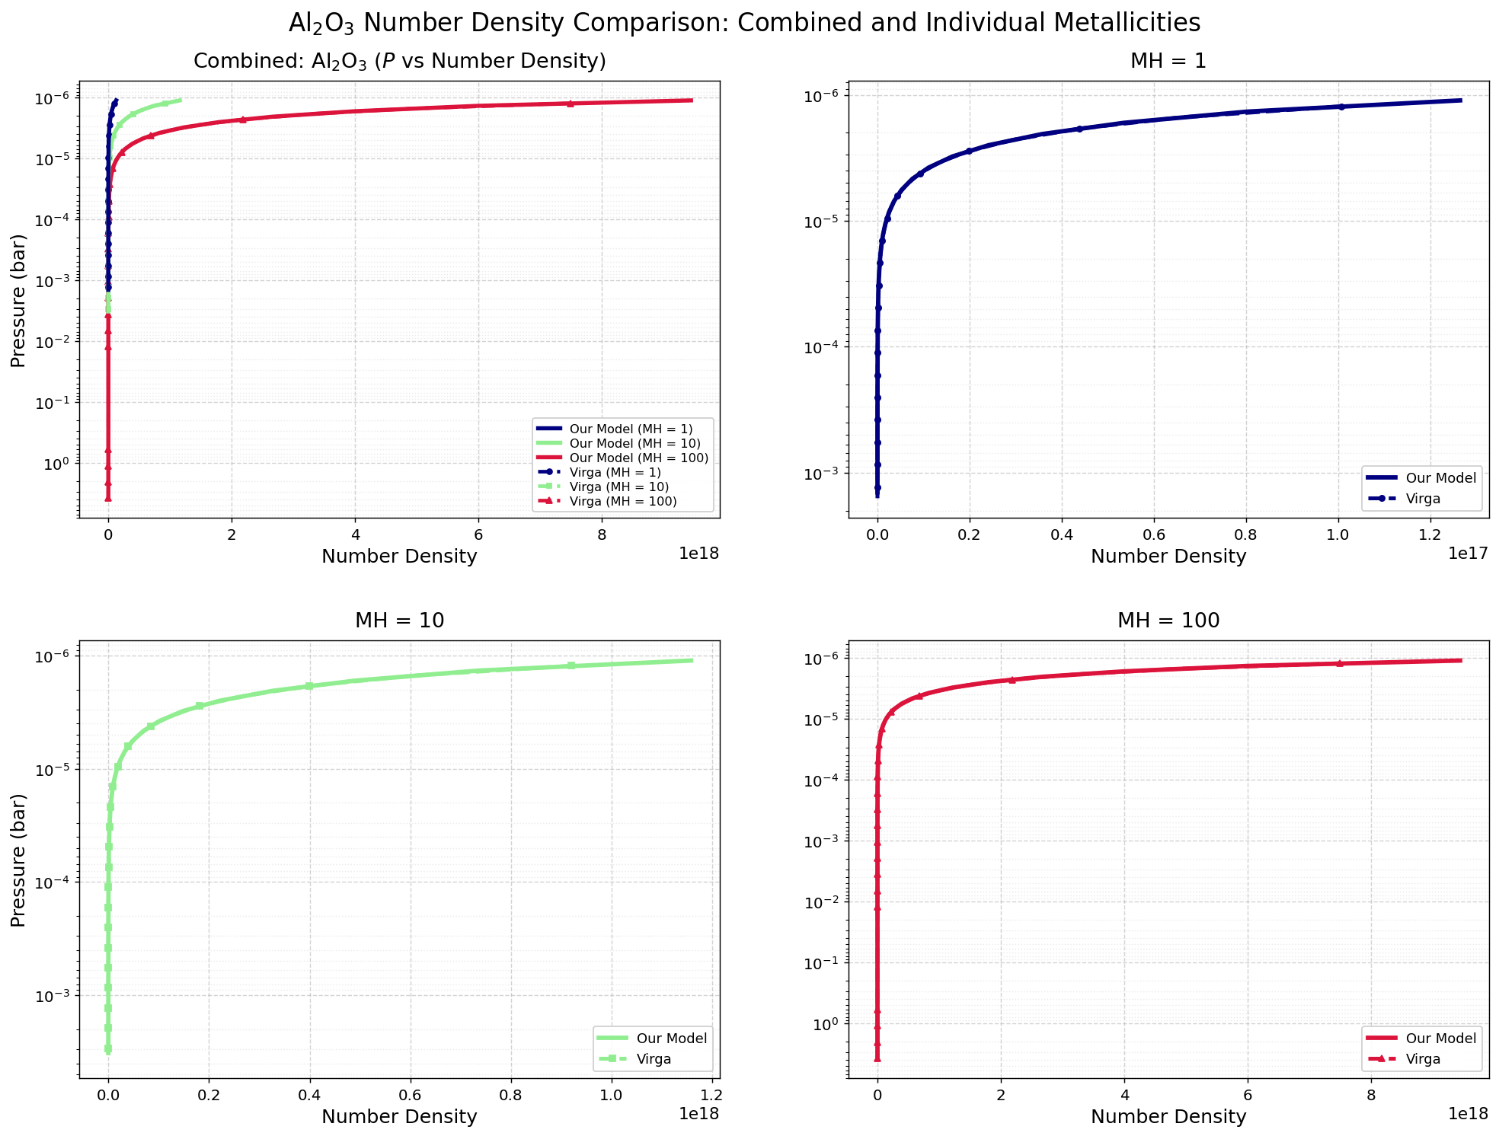

Slide 40
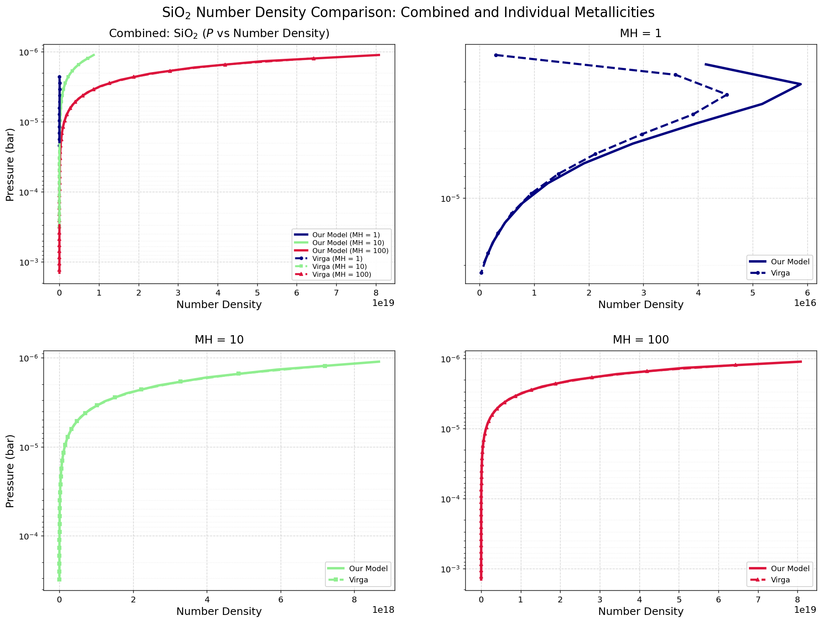

Slide 41
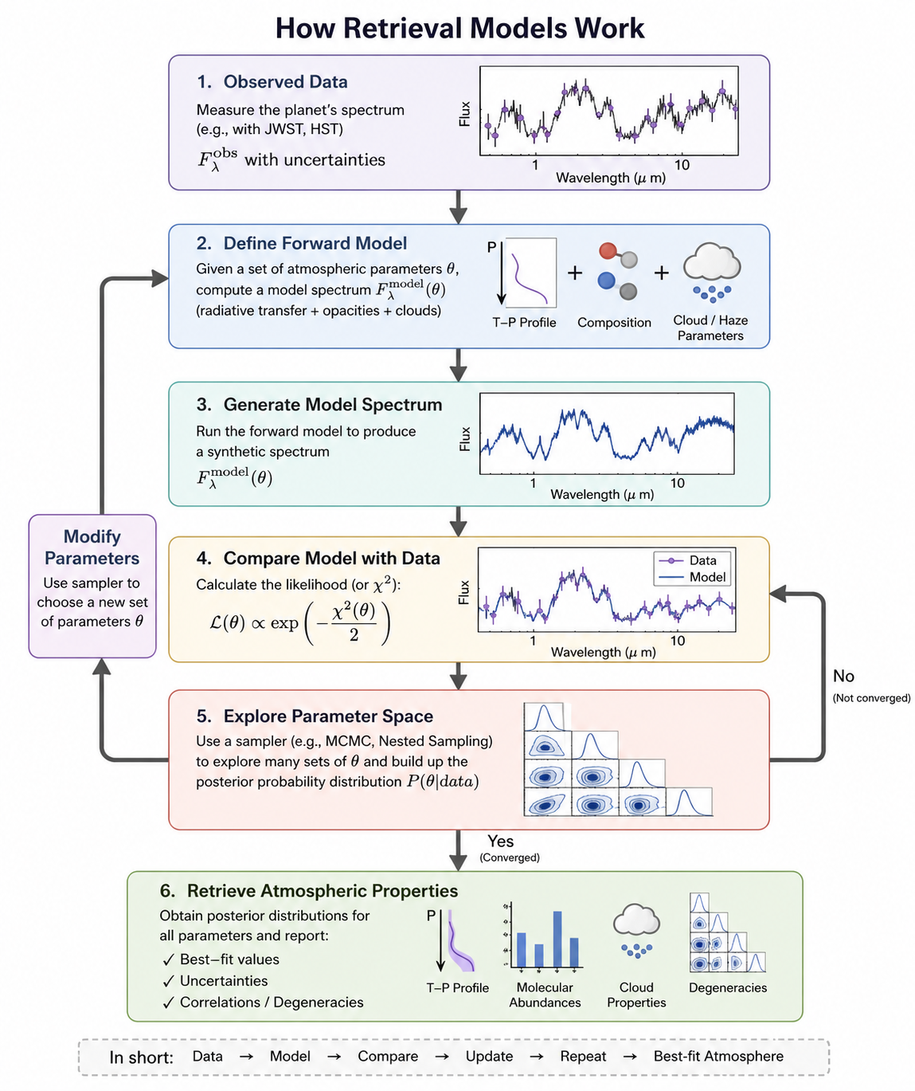
Image source - ChatGPT

Slide 42
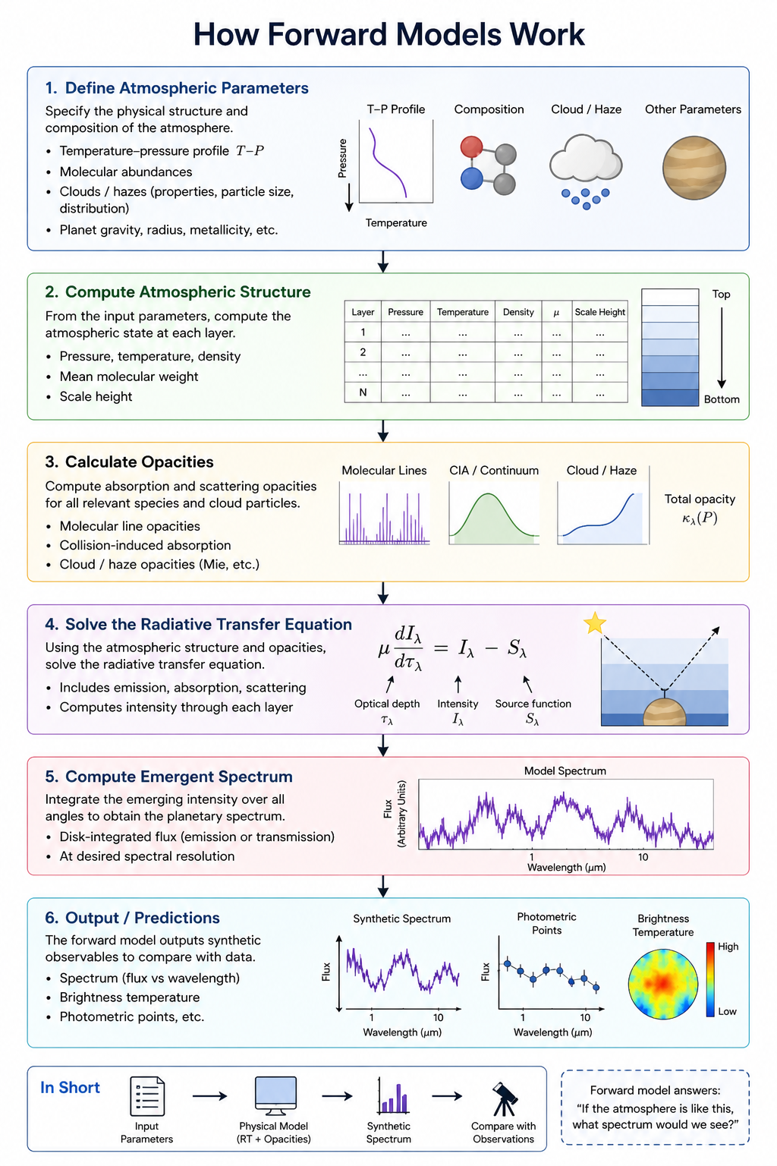
Image source - ChatGPT

Slide 43
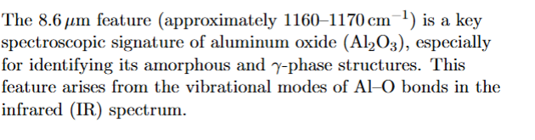
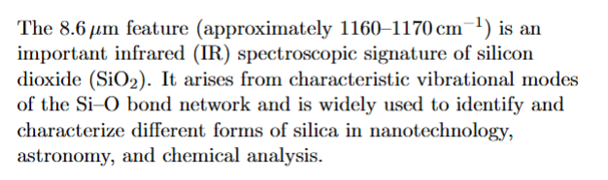
F type stars are yellow-white main-sequence stars, hotter and more massive than our Sun, with surface temperatures ranging from 6,000 to 7,400 K.
Retrieval models are inverse atmospheric models that fit observed spectra with synthetic spectra in order to infer atmospheric properties such as temperature structure, chemical abundances, and cloud parameters.

Slide 45
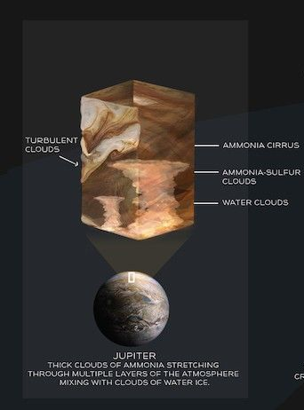
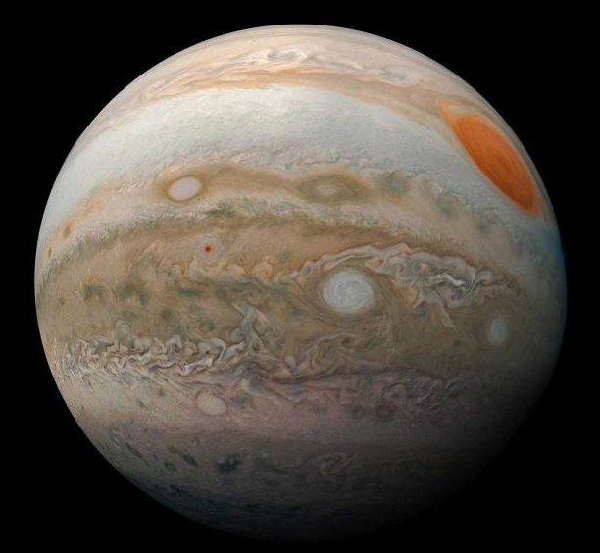
Clouds shape atmosphere of the planet
images provided courtesy of NASA/JPL-Caltech/SwRI/MSSS
Infographic: NASA/JPL-Caltech/Lizbeth B. De La Torre

Slide 46
