Slide 1


Fin-ExBERT
User Intent-Based Text Extraction in Financial Contexts Using Graph-Augmented BERT and Trainable Plugin
Soumick sarker
Abhijit kumar rai

Slide 2



Objectives of Intent based text Extraction Tasks in Financial context
Implicit meaning: Dubious meanings or margin calls in text
Latency challenges: Large text corpus may lead to a larger processing time
Domain specific terminology: 401k, 529 etc.
Hardware issues: Specific task model. No need an LLM for this
Accuracy concerns: Precision is the most important metric
Customizable learning: Either use a unsupervised or few shot approach for generalization

Slide 3

Gaps in Modern Techniques
LLMs are heavy and they will give you more than what you asked for. They are suited for QA tasks but text span extraction is a different ball game.
The whole point is to avoid LLMs so that’s what we will do
Most methods go with pattern matching rather than actual context reasoning
Multi-turn dialogues in texts often cause a mode collapse while training modern models.
Models like FinGPT and FinBERT are mostly sentiment analysis models and are unable to capture contexts based on intent.

Slide 4
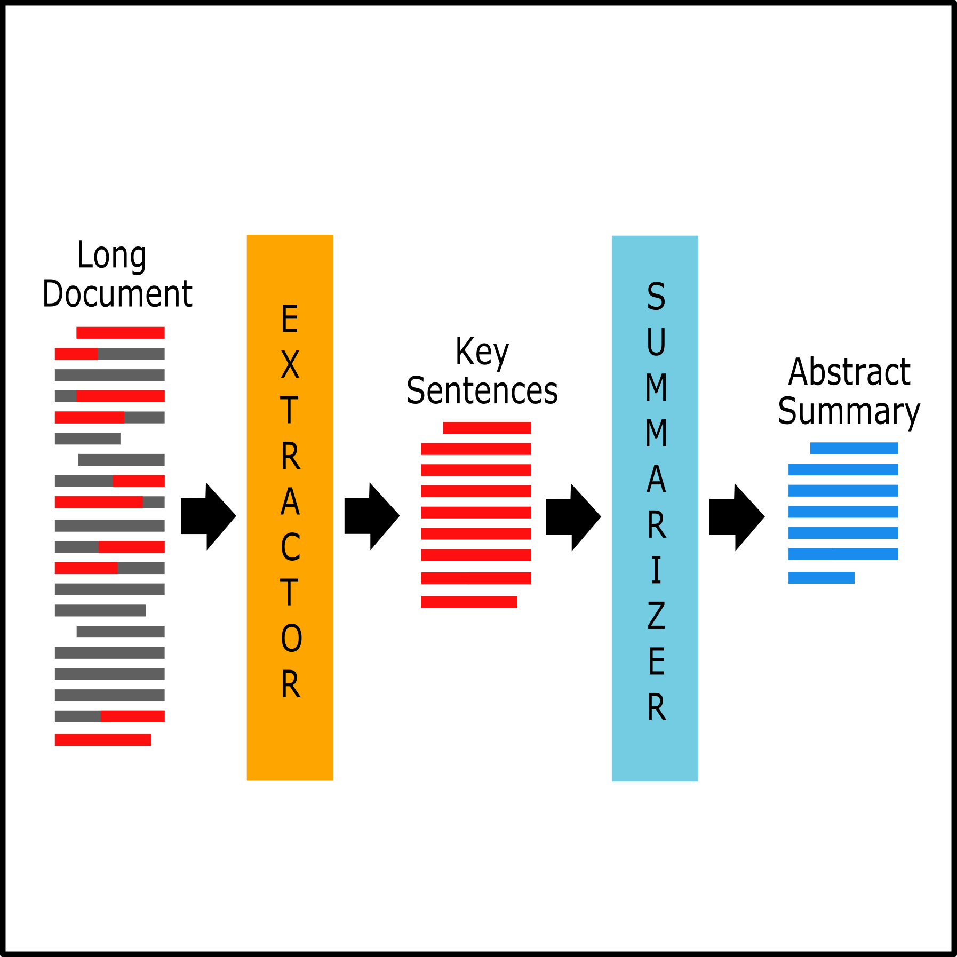
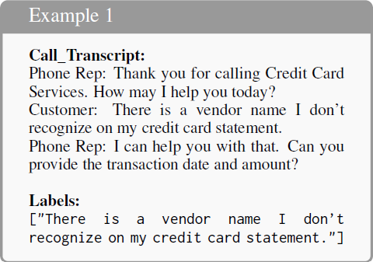
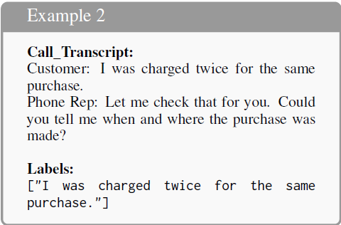
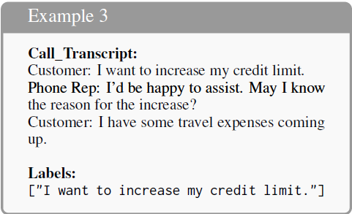
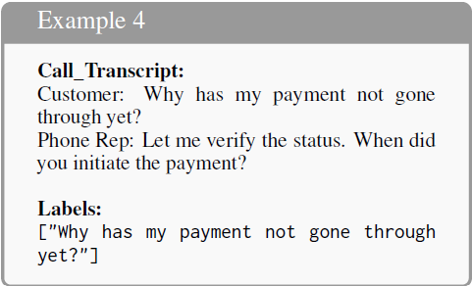
Inference Examples: How the model extracts target spans

Slide 5
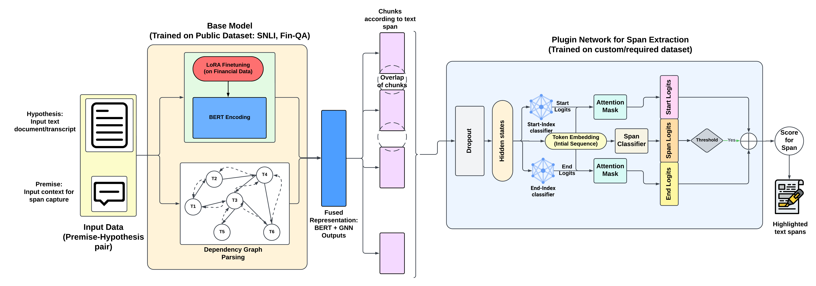
Methodology: Overall Architecture

Slide 6

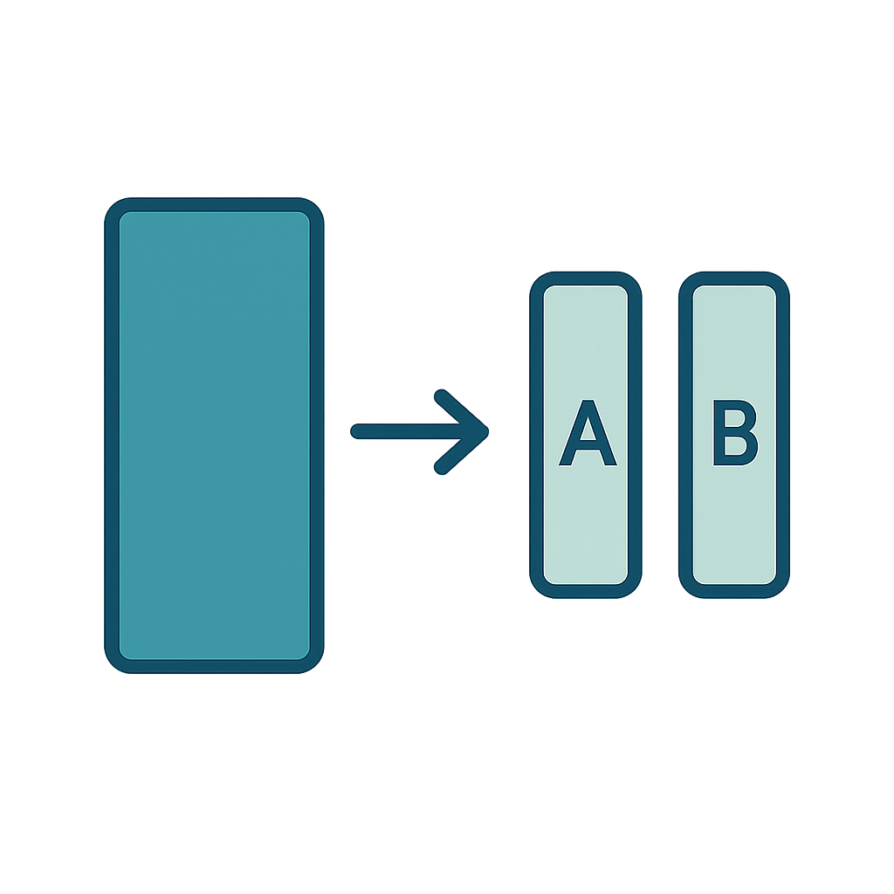
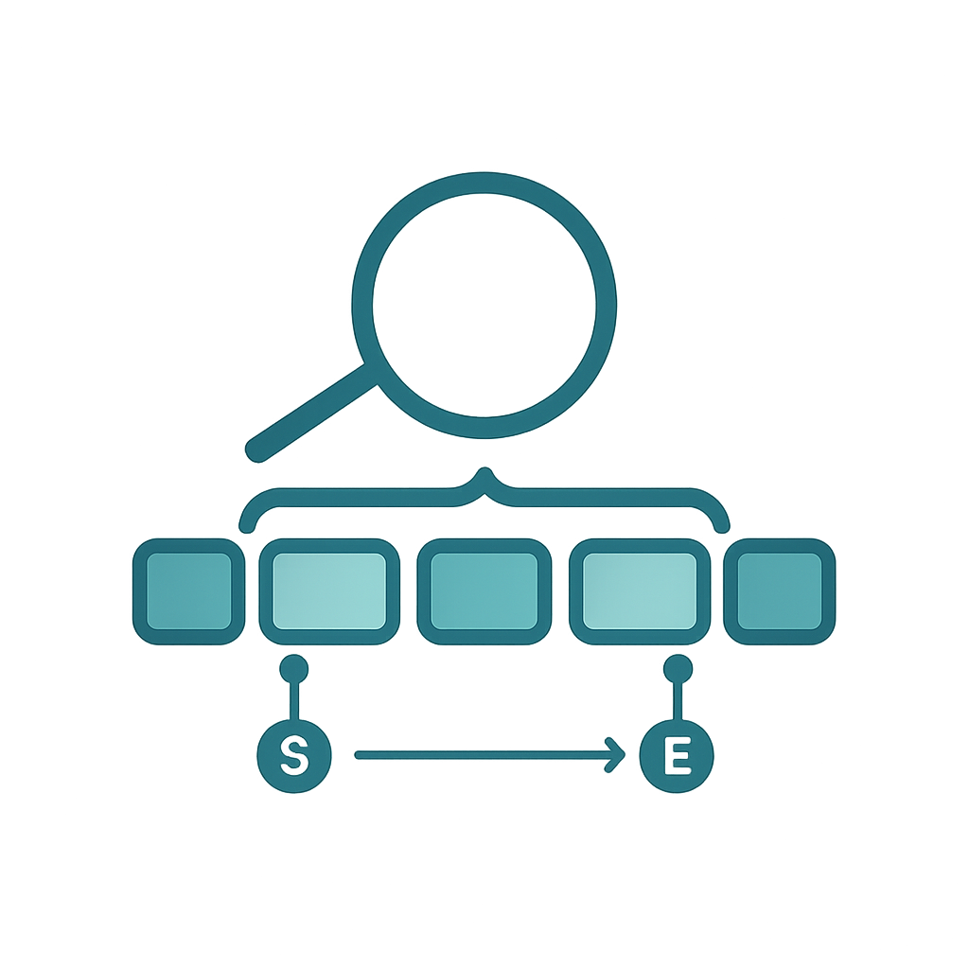
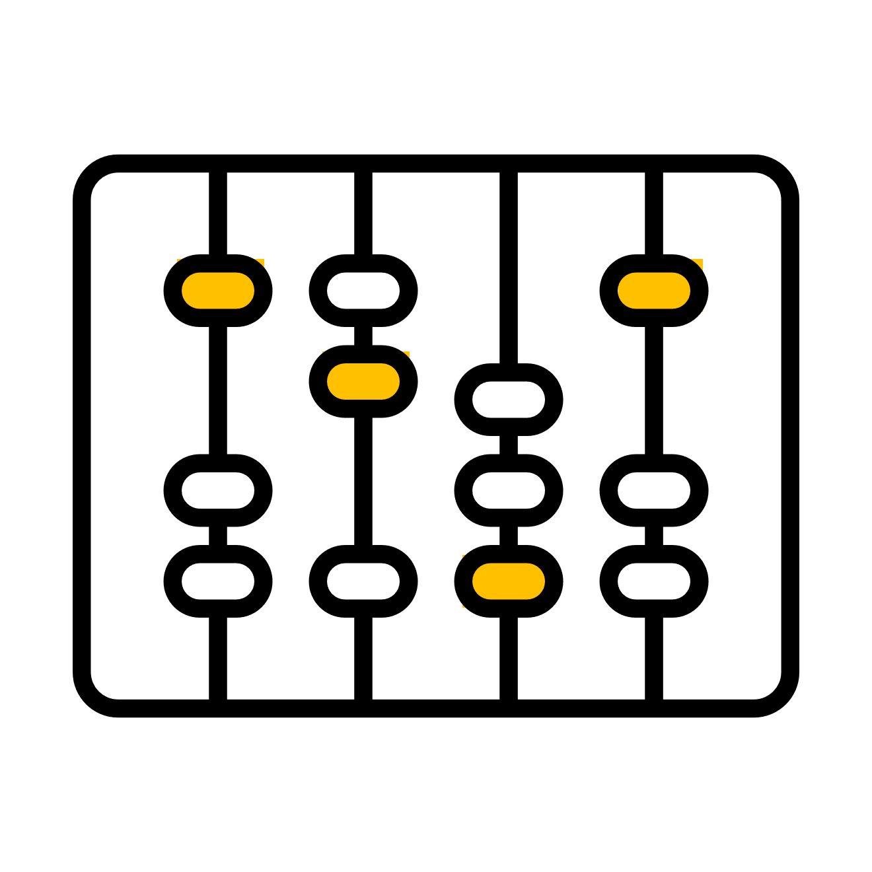


Distinct Segments of The Methodology
Base Model (general context understanding)
Financial Domain Adaptation
Span Extraction Head (Plugin)
A base model for contextual understanding
To catch financial nuances and terminology
A tunable plugin for extraction of target text span

Slide 7
Segment 1: The Base Model
Some Keypoints:
Utilization of BERT for contextual embeddings The BERT encoder provides context-aware embeddings for understanding complex text
Incorporation of a GNN component The GNN component allows for better data insights and interpretation.
Training of the Base Model The Base model was trained on the Stanford Natural Language Inference Dataset (SNLI). It has a premise-hypothesis structure giving us a gateway to the intent-text corpus pairing task.

Slide 8

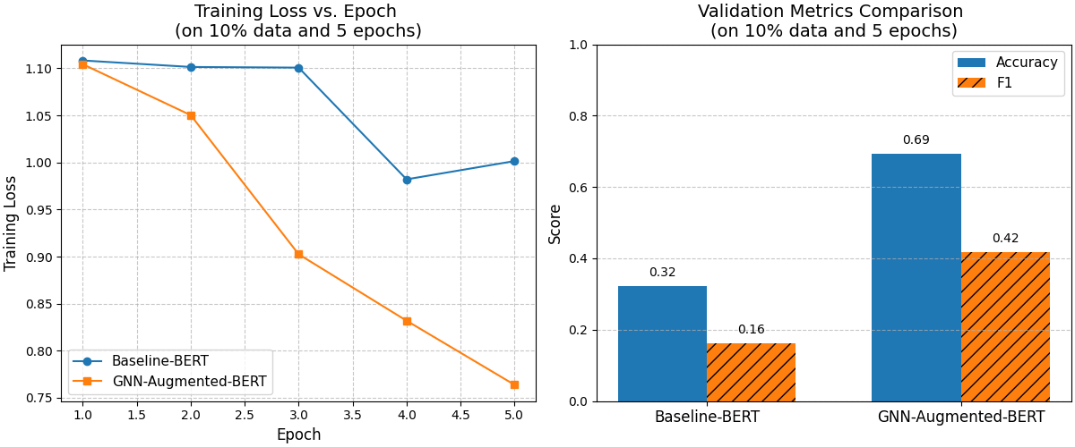
Why Use GNN at all?
What does it do?
The syntactic graph created by the GNN is integrated using two rounds of message passing between and fused with the BERT encodings
Fused Representation

Slide 9
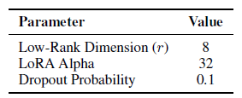
Segment 2: Financial Domain Adaption using LoRA
Some Keypoints:
Specific finance terminology like ‘401k’ or ‘529’ or ‘403b’ were perceived as just numbers in most cases without domain adaptation.
The domain adaptation training was done using the FinQA dataset which is a financial question answering dataset whose structure we modified to serve our use case.
The LoRA configuration is as follows:

Slide 10
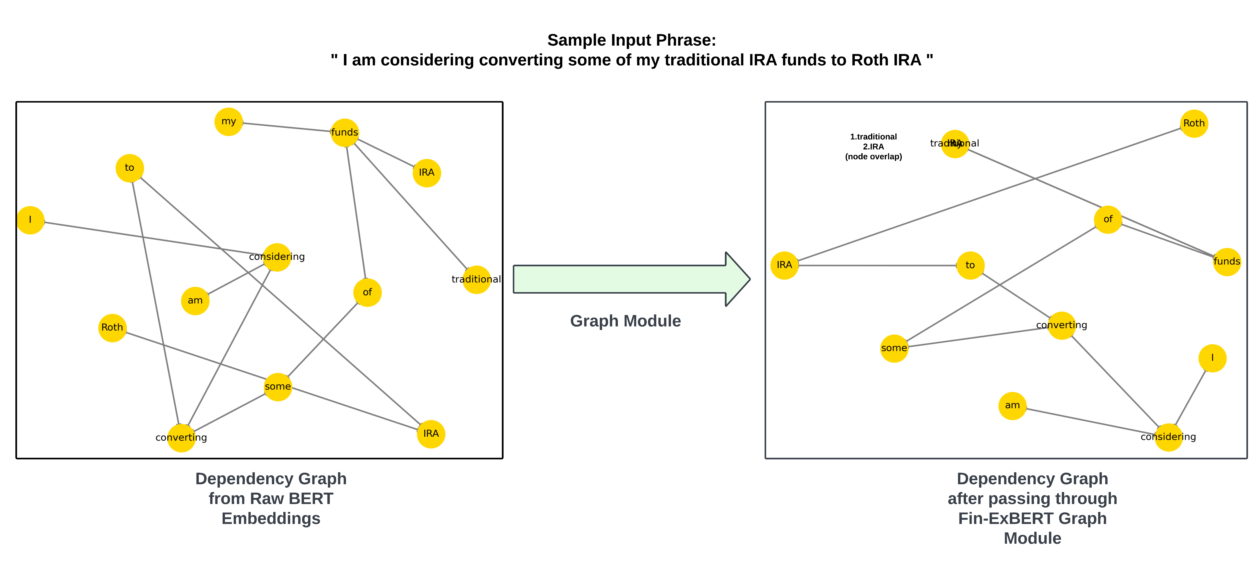
Visual Map Evidence of The Domain Adaptation

Slide 11
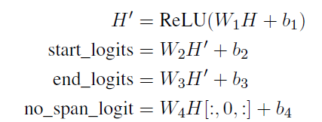
Segment 3: Span Extraction Head
To support fine-grained span-level predictions in call transcripts, we introduce a tunable plugin network atop the Base Model:
Nuanced queries, such as identifying whether an agent expressed appreciation require precise span localization.
Our plugin head addresses this by predicting start and end indices of relevant text spans using a multi-layer perceptron (MLP) with ReLU activations and dropout.
It receives the hidden states H ∈ R^{B×L×D} from the BaseModel and applies token-level classifiers:

Slide 12

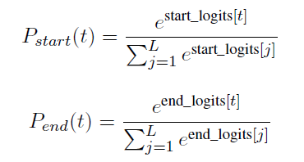
How are the spans decided?
During inference, the span extraction head predicts start and end indices for possible spans. To ensure robustness, token-level logits are converted into probability distributions using the softmax function shown by these two equations:
The final span is determined by selecting the token pair (i, j) that maximizes the joint probability P_{start}(i) . P_{end}(j), subject to the constraint i ≤ j. If the ‘no span’ probability P_{no_span} = σ(no_span_logit) exceeds a predefined threshold, the model abstains from span extraction.

Slide 13
CreditCall12H: Annotated Financial Conversations
Volume and context
Dataset generation
Metrics of Evaluation
These annotations were generated using a two-stage LLM-assisted labeling strategy. high-confidence extraction candidates were generated using ChatGPT4o. This allowed us to simulate noisy but realistic QA-style extraction in multi-turn dialogues, thereby creating a benchmark tailored to sentence-level relevance and call quality analysis
Accuracy, Precision, and F1-Score were chosen as the core metrics, given the many-to-many nature of valid sentence selection within each transcript.
1,200 anonymized long-form customer service transcripts. The conversations cover a wide range of credit card related interactions, such as payment failures, transaction disputes, card activation, credit limit increases, and fraud prevention protocols.

Slide 14
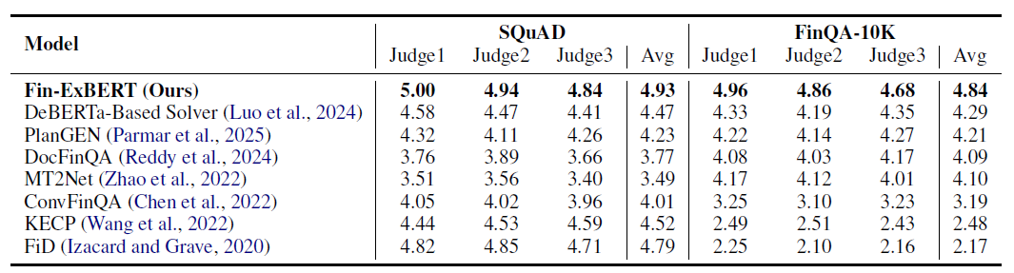
Evaluation I: Public Datasets with short corpus and generic text (LLM Judge)
Judge 1: facebook/bart-large-mnli Judge 2: roberta-large-mnli Judge 3: microsoft/deberta-large-mnli

Slide 15
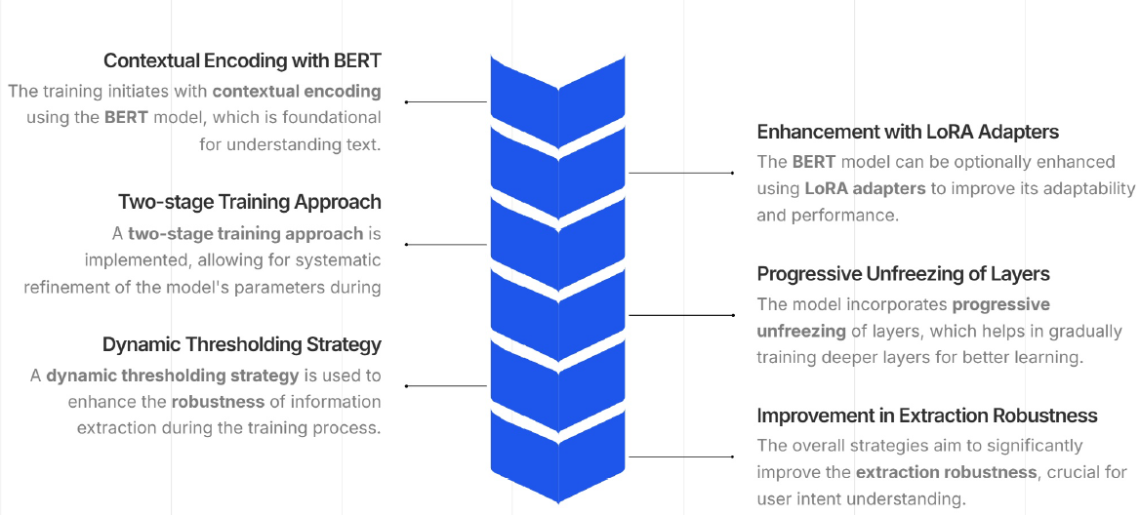
Model Training Workflow (on CreditCall12H Dataset)

Slide 16
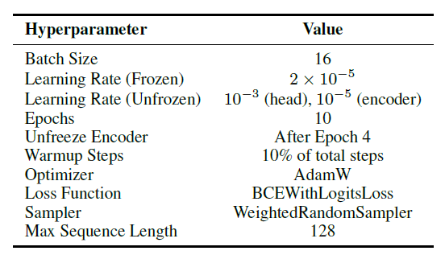
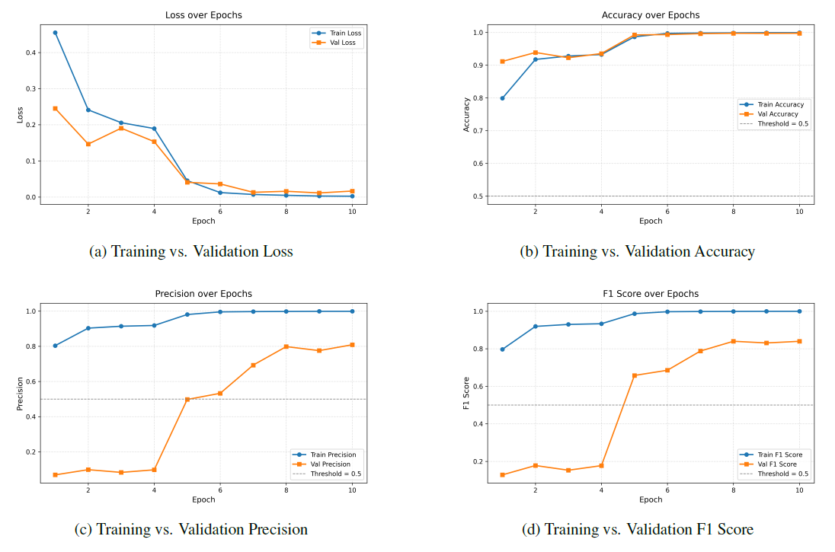
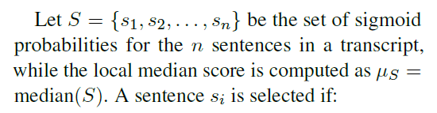

Evaluation II: CreditCall12H Dataset (Standard Metrics)
Dynamic Thresholding

Slide 17
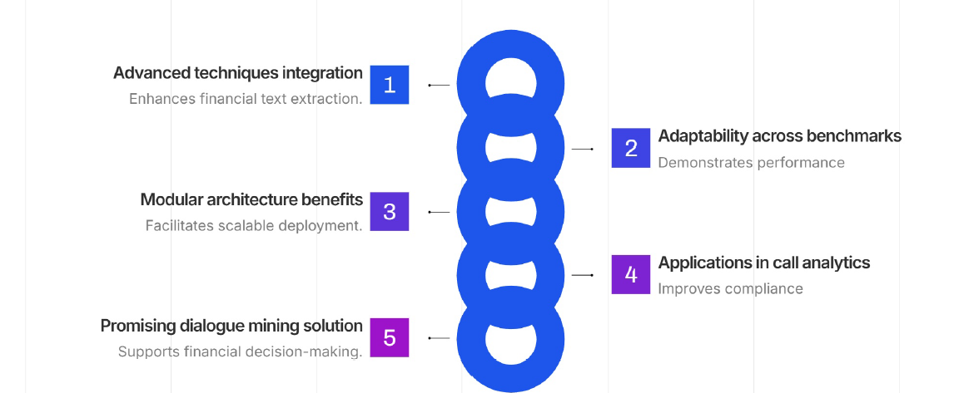
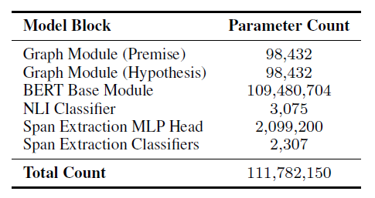
Fin-ExBERT: Key Highlights
*Fin-ExBERT can infer 500 transcripts in 12 seconds

Slide 18

Thank you

