Slide 1
ASE PROJECT

Slide 2
IIITS CART ONLINE MARKETING SYSTEM

Slide 3
FEATURES
Users can sell ,buy and rent
Can upload pictures of the items
Can chat with each other
Review on seller
Search for items
Categorize the items
Mail and Notification System
Android App

Slide 4
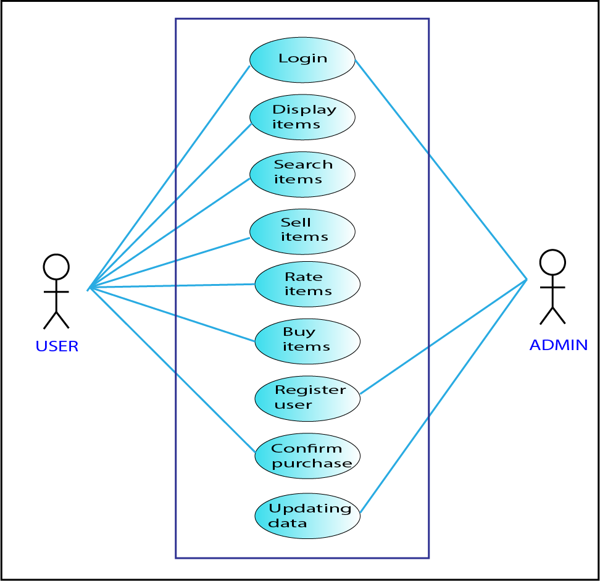
Usecase

Slide 5
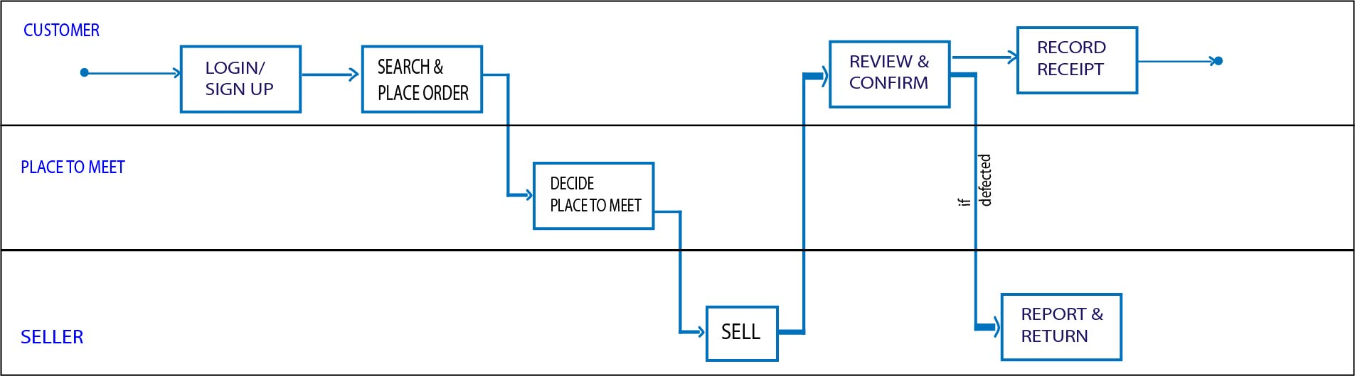
Buisness Usecase

Slide 6
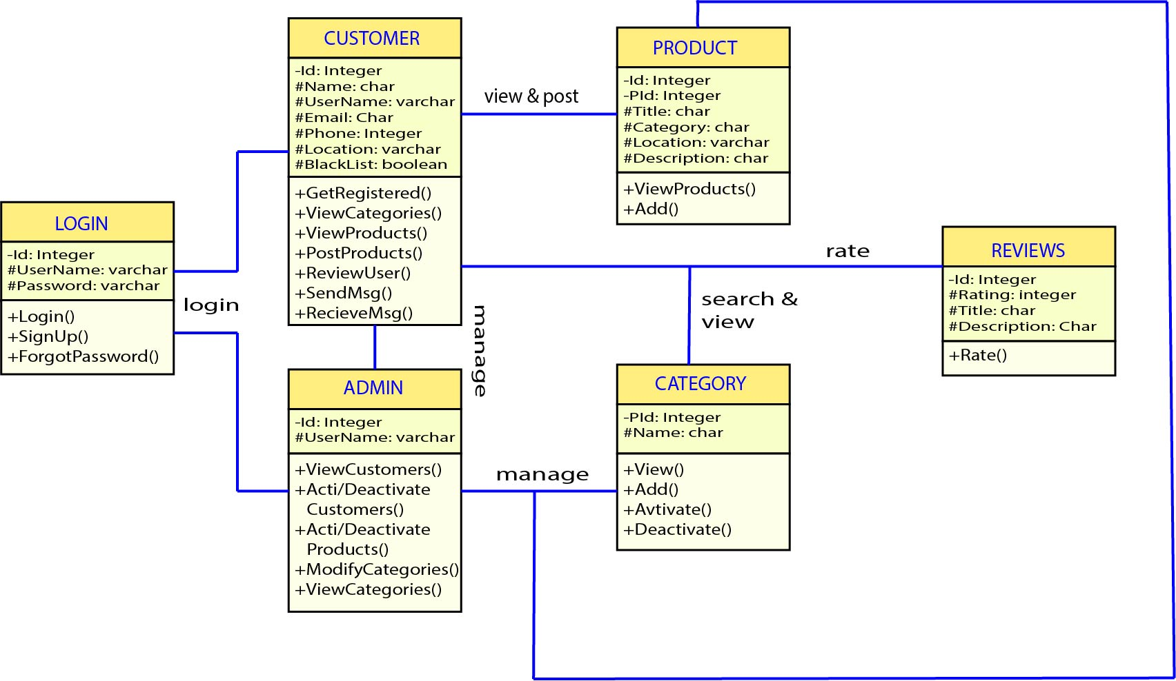
Class Diagram

Slide 7
Tables, Menus and Sub-menus
Customer Credentials
Order Details
Blacklist
Receipt Details
Review
History
Categories-
Books
Projects
Tech
Utilities
Miscellaneous

