Slide 1
Multimodal AI Framework For Image Captioning, Story Generation, and Natural Speech Narration

Slide 2
Contents
Problem Statement
Existing System
Proposed Problem
Software Requirements
Hardware Requirements
Functional and Non-Functional requirements
System Analysis
System Design
Conclusion

Slide 3
Problem Statement:
Traditional image captioning systems generate only short factual descriptions, without capturing deeper context, emotion, or imagination. They also lack storytelling and voice interaction, making them less engaging, especially for kids or visually impaired users. There is a growing need for an intelligent system that can not only describe an image but also narrate an imaginative story and speak it aloud in a human-like voice.

Slide 4
Existing Systems:
While existing systems independently generate image captions or convert text to speech, they are limited in functionality. Captioning models focus on object-level description, GPT-based systems generate stories from prompts, and TTS tools speak text. However, these are disconnected, and there’s no integrated system that turns an image into a full narrative experience with voice output.

Slide 5
Proposed Solution:
The proposed system is a multi-stage AI storytelling pipeline composed of four key modules:
1. Image Feature Extractor
2. Caption Generator
Uses InceptionV3 to extract visual features from the input image.
Uses an LSTM model trained on caption datasets to generate meaningful sentences.
3. Story Generator
4. Voice Synthesizer
GPT-2 expands the caption into a rich, creative story.
gTTS (Google Text-to-Speech) converts the story into spoken audio.

Slide 6
System Requirements:
Python 3.x
Libraries
TensorFlow/ PyTorch
Hugging Face Transformers
gTTS
OpenCV/Pillow
NumPy,
Streamlit

Slide 7
Hardware Requirements:
Processor: Intel Core i5 (Intel Core i7 recommended)
RAM: 8 GB (16 GB recommended)
GPU: NVIDIA GTX 1060 or higher (RTX series recommended)
Storage: 512 GB SSD (1 TB HDD optional)
Display: 15-inch LED monitor

Slide 8
Functional Non-Functional
Caption Generation
Story Generation
Story-to-Speech Generation
User Interface / Output Display
Usability
Performance
Reliability
Scalability
Portability
Maintainability
Accessibility
Audio Quality

Slide 9
System Analysis:
Problem Definition
Requirements
Embedding
Generation (InceptionV3 CNN)
Caption Generation (LSTM)
Story Generation (GPT-2)
Speech Generation (gTTS)
Output Display

Slide 10
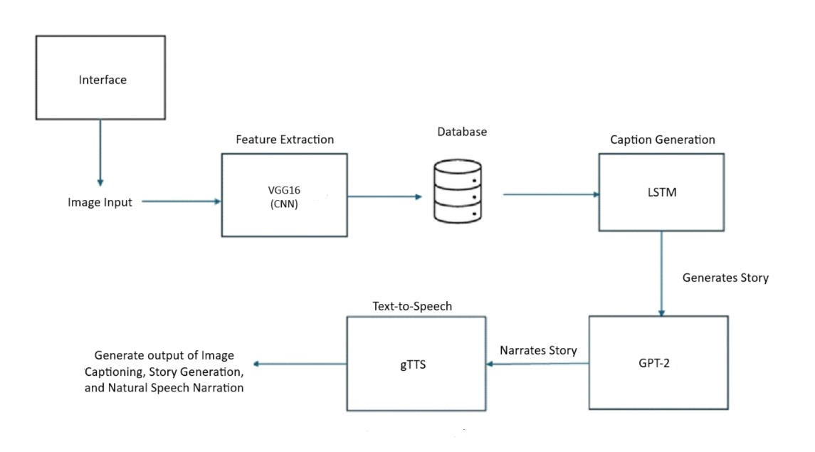
System Design

Slide 11
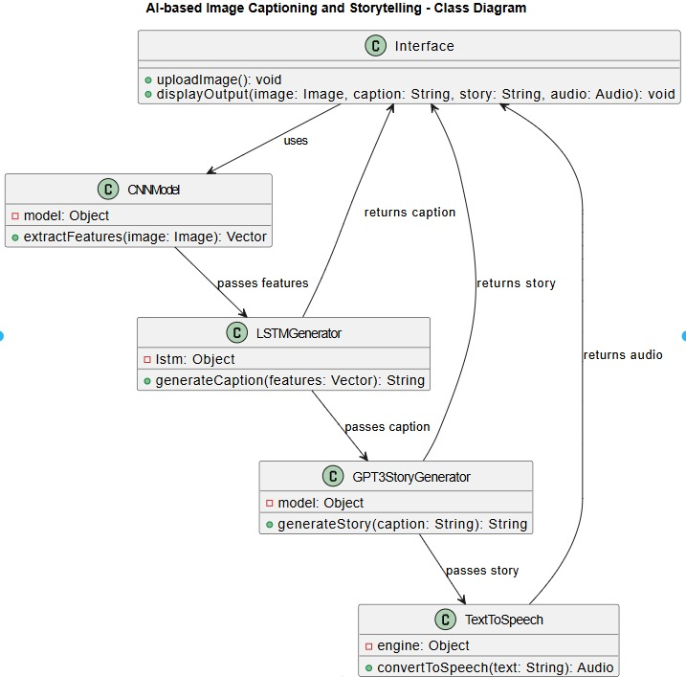
Class Diagram

Slide 12
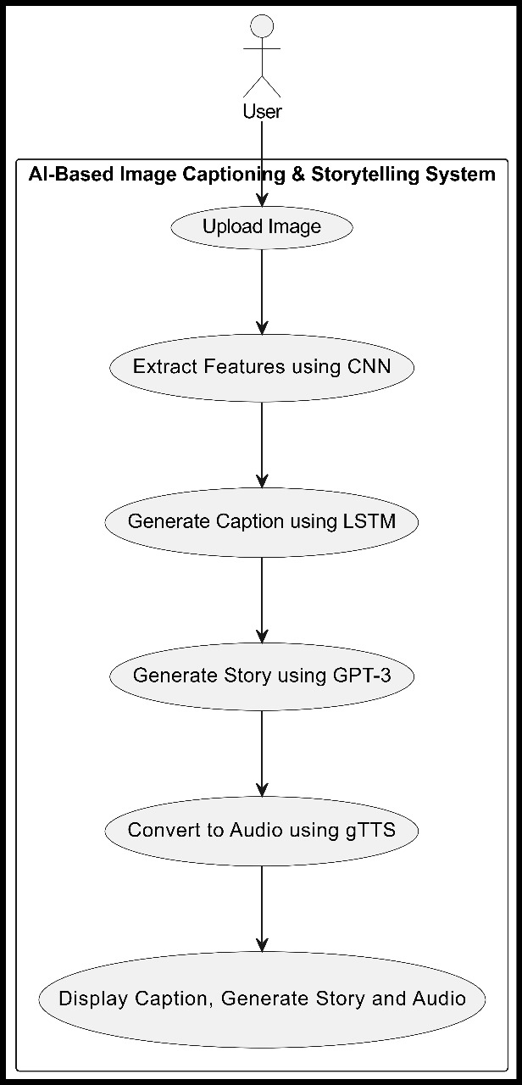
Use Case Diagram

Slide 13
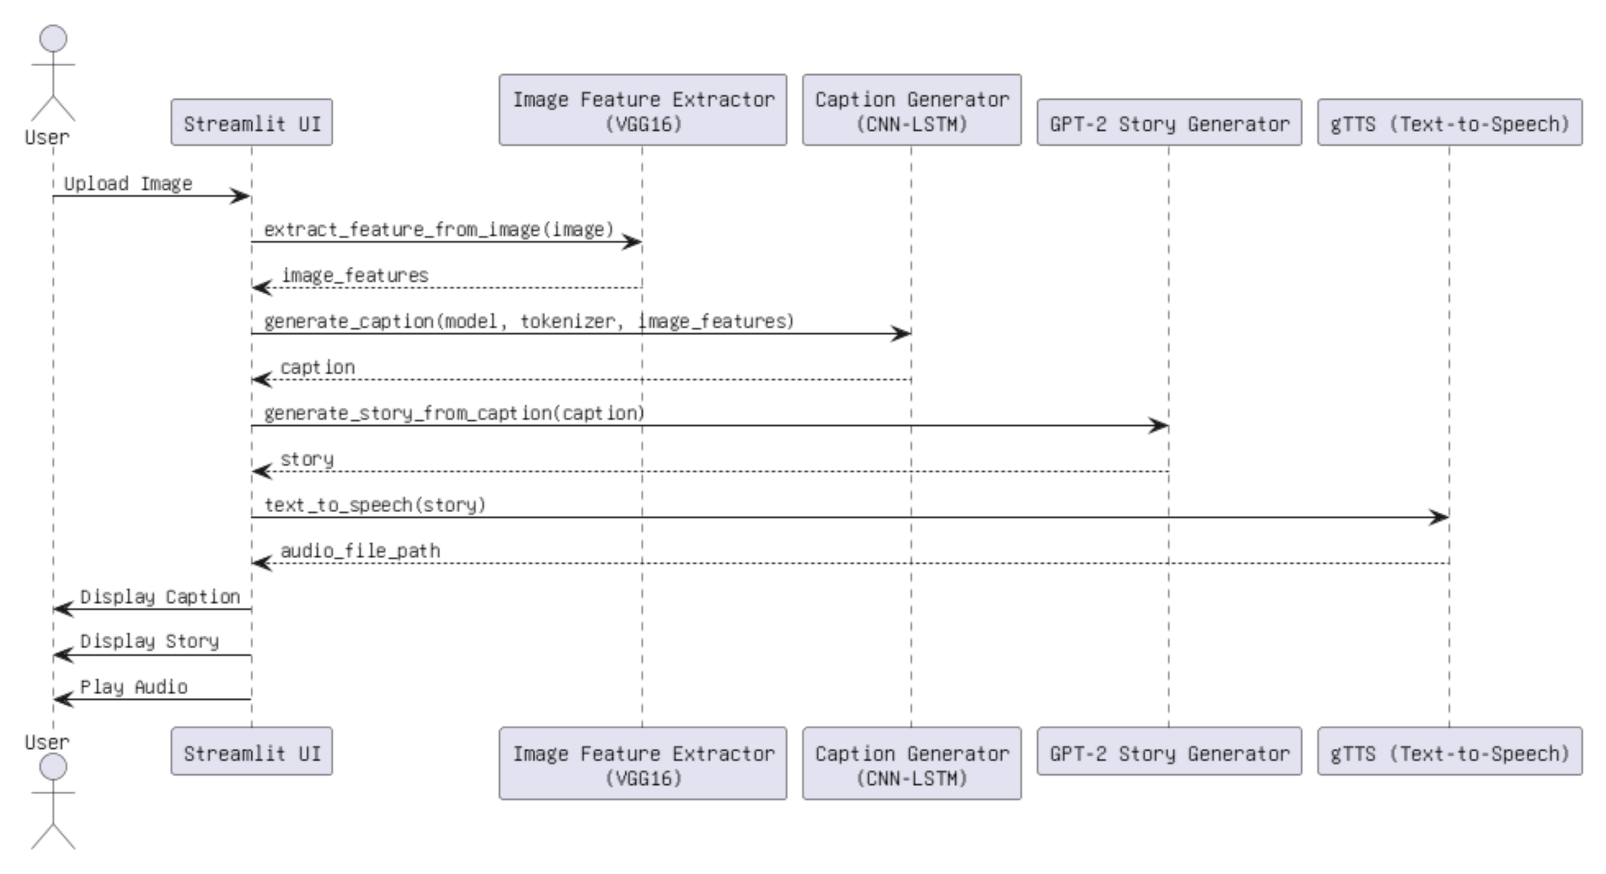
Sequence Diagram

Slide 14
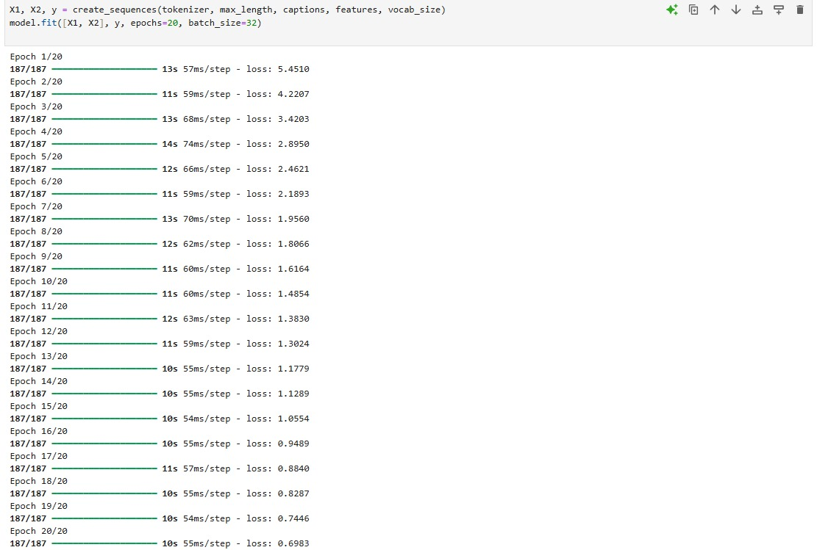
Sample Code

Slide 15
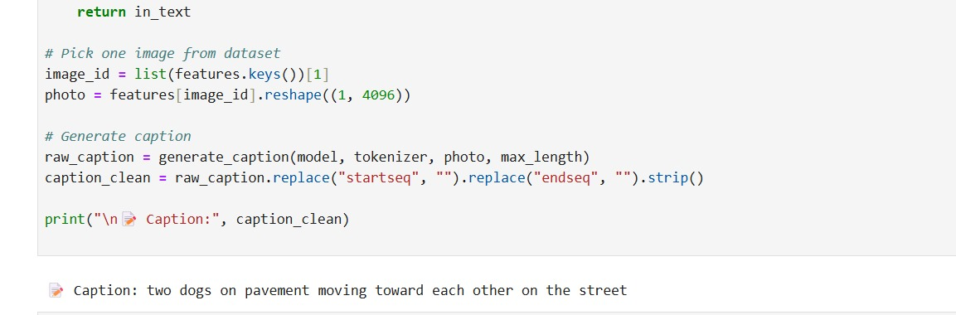
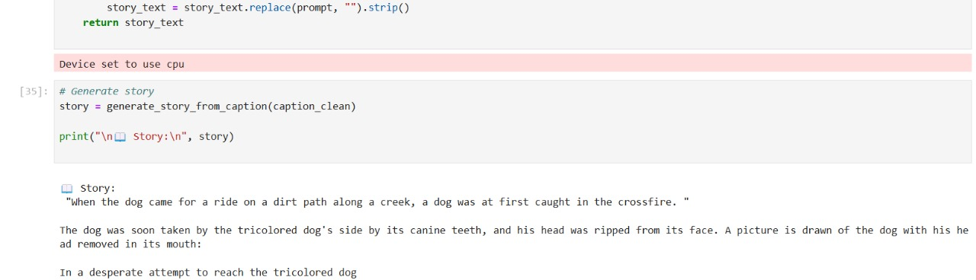

Slide 16
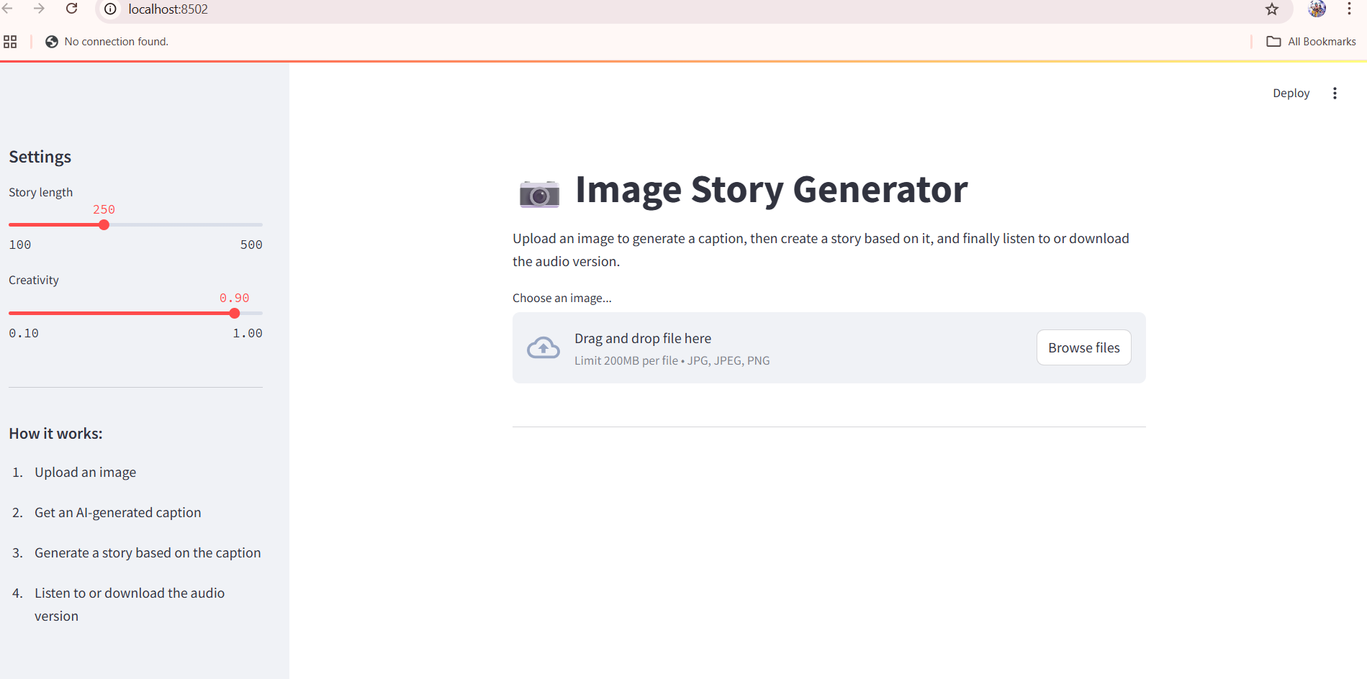
Output

Slide 17
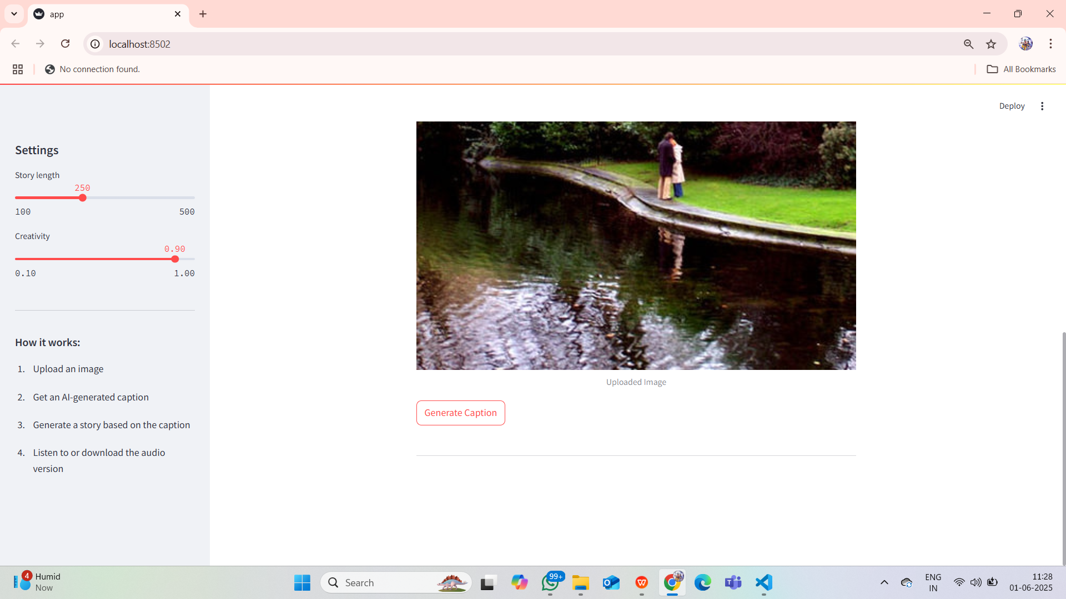

Slide 18
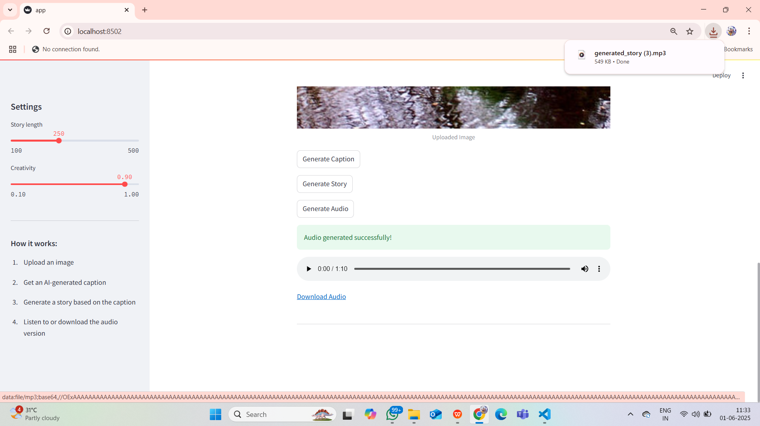

Slide 19
Conclusion
This project successfully integrates CNNs for image feature extraction, LSTM for caption generation, GPT-2 for story creation, and gTTS for voice narration. The result is an AI system that can understand an image, describe it in natural language, generate a creative story, and narrate it aloud. It showcases the potential of combining vision, language, and speech models to create interactive and intelligent applications.

