Slide 1
Intrusion Detection System Using Hybrid Detection Approaches
Combining Signature-Based and Anomaly-Based Techniques

Slide 2
Mini Project Final Presentation
Presented by
Roll Number | Name of the Student
21AG1A6725 | G. PRIYANKA
21AG1A6716 | CH. VAISHNAVI
21AG1A6747 | M. SOUMIKA
22AG5A6701 | K. NITHIN
Under the supervision of
Mr. Ashwani Attri (Assistant professor)
Department of computer science and engineering (Data Science)
ACE ENGINEERING COLLEGE

Slide 3
Content :
1. Introduction
2. Types of NIDS
3. Existing Systems
4. Proposed System
5. Software Requirements and Hardware Requirements
6. Functional and Non-Functional Requirements
7. System Analysis
8. System Architecture
9. UML Diagrams
10.Implementation
11. References

Slide 4
Introduction
What is Intrusion Detection?
A process of identifying unauthorized access or abnormal behavior in a network.
Two main techniques: Signature-based and Anomaly-based detection.

Slide 5
Existing System
Signature-Based Detection
Anomaly-Based Detection
Challenges
Detects threats based on predefined patterns.
Identifies deviations from normal behavior.
Lack of integration between these approaches.
Limitations: Cannot detect new or unknown attacks.
Limitations: High false positive rate.
Difficulty in handling complex threats.

Slide 6
Proposed Model
1
Hybrid Approach
2
Key Features
Combine signature-based and anomaly-based detection.
Enhanced accuracy in detecting intrusions.
Real-time alerts using a graphical interface (Tkinter).
Use machine learning (Isolation Forest) for anomaly detection.
Persistent storage for anomaly tracking.
Detect known attacks using predefined patterns (regex signatures).

Slide 7
System Requirements
Software Requirements (SRS)
Hardware Requirements (HRS)
Python 3.8+
Processor: Dual-core 2 GHz or higher
Libraries: Pandas, NumPy, Scikit-learn, Tkinter
RAM: 4 GB minimum
Operating System: Windows
Storage: 1 GB for application and dataset
Dataset: KDD CUP 1999

Slide 8




Functional Requirements
Detect known attacks using signature patterns.
Identify anomalous behavior using Isolation Forest.
Display alerts for detected threats in real-time.
Persist detected anomalies for future analysis.

Slide 9




Non-Functional Requirements
Performance
1
Process dataset efficiently for real-time alerts.
Scalability
2
Handle large datasets with minimal delay.
Usability
3
Provide user-friendly alerts via a GUI.
Reliability
4
Maintain accurate detection with low false positives.

Slide 10
System Analysis
1
Inputs: Network traffic data from the KDD CUP 1999 dataset.
2
Processing:
Signature-based detection using regex patterns.
Anomaly-based detection using Isolation Forest.
3
Outputs: Real-time alerts for detected intrusions.
4
Benefits:
Early detection of threats.
Persistent storage of anomalies for future reference.

Slide 11


System Design
Architecture:
Workflow:
Data Preprocessing
1. Load dataset.
Signature Detection Module
2. Detect threats using both techniques.
Anomaly Detection Module
3. Display and store results.
Alert System (Tkinter-based GUI)

Slide 12
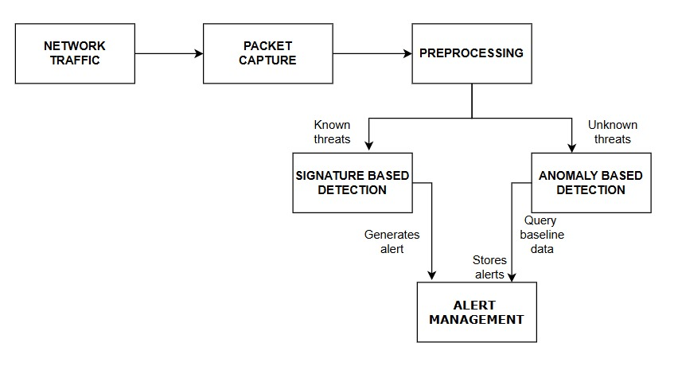
System Architecture

Slide 13
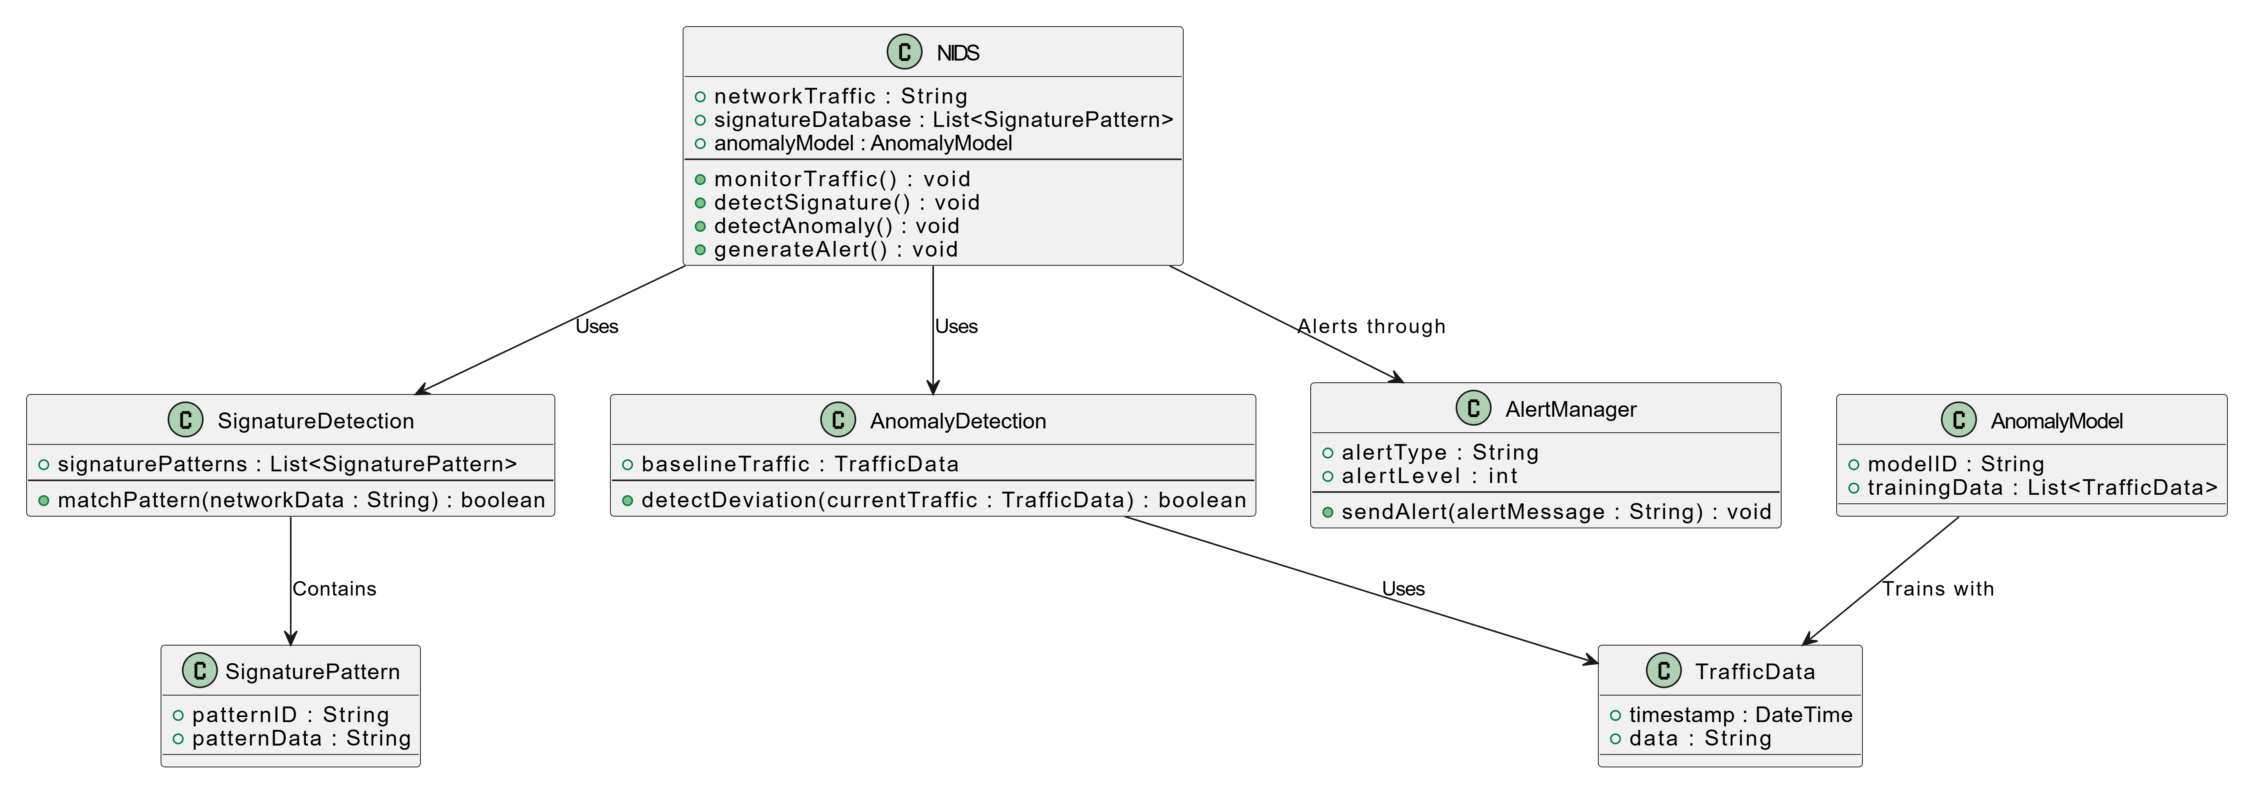
Class Diagram

Slide 14
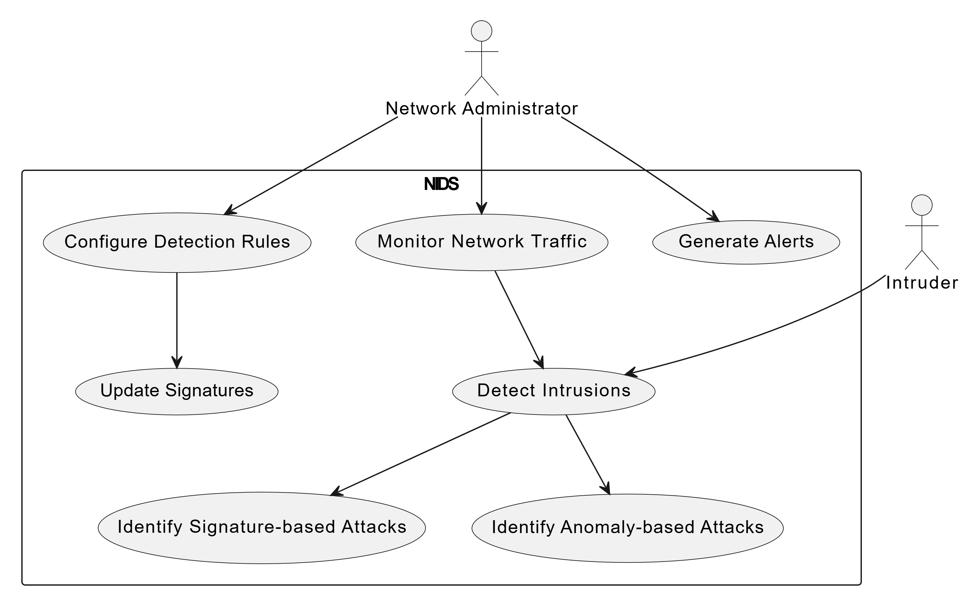
Use Case Diagram

Slide 15
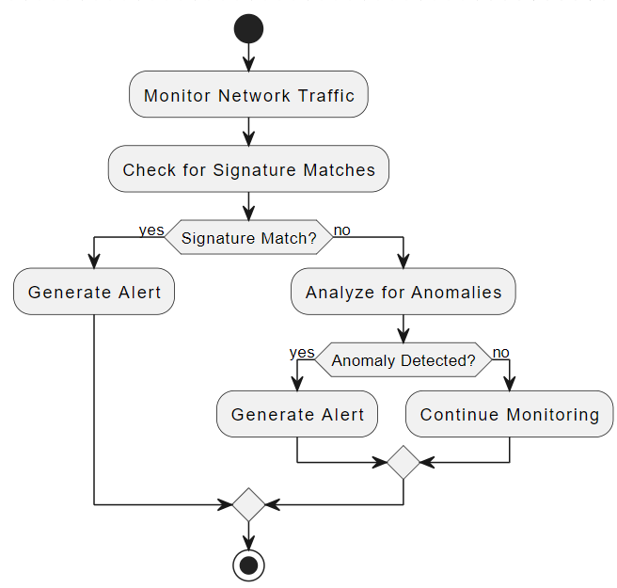
Activity Diagram

Slide 16
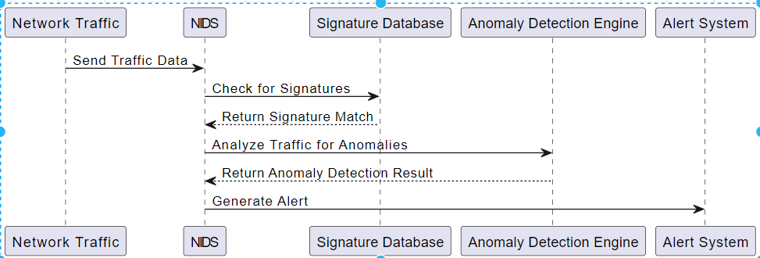
Sequence Diagram

Slide 17
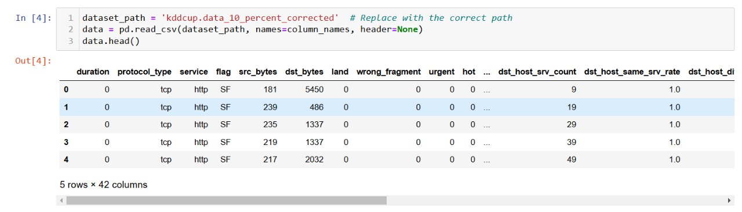
Loading the Data File

Slide 18
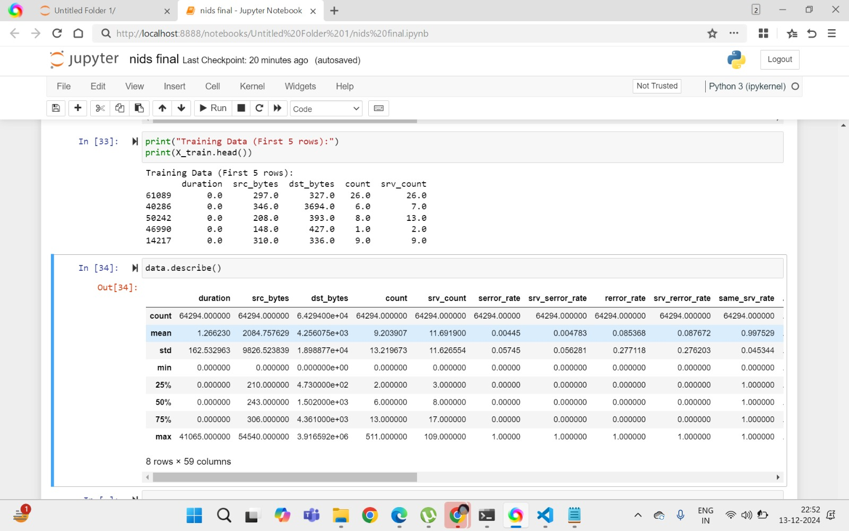
Data Description

Slide 19
Training Data

Slide 20
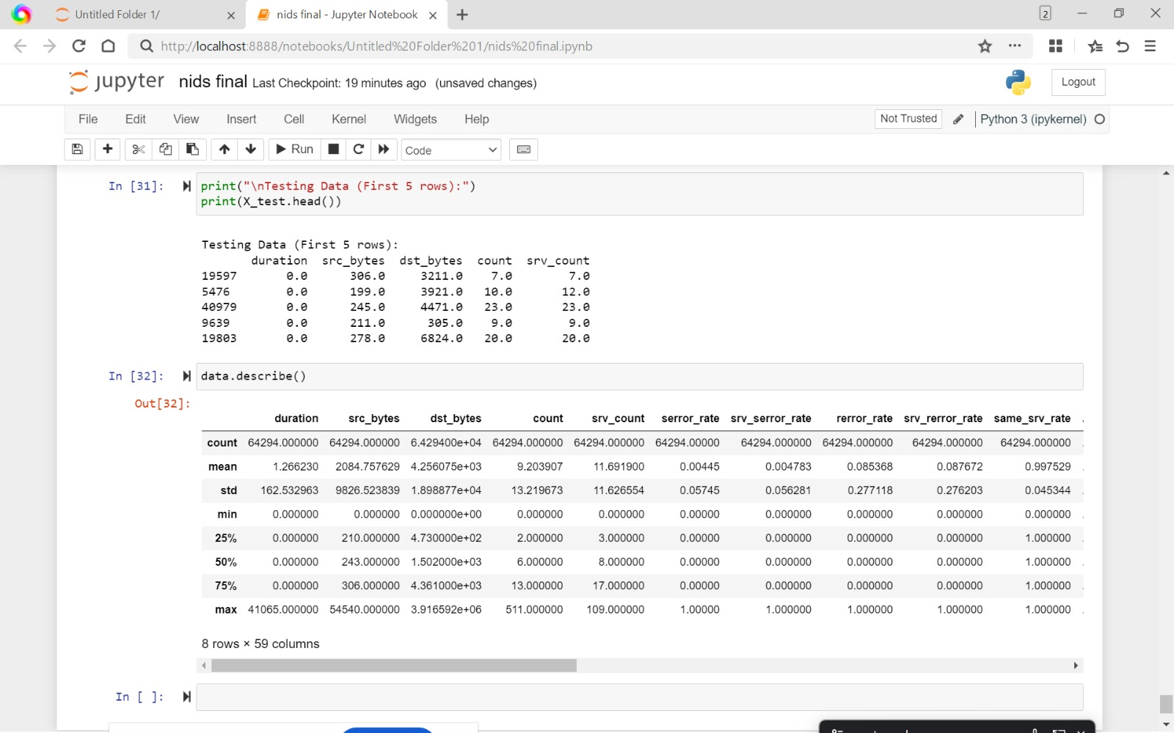
Testing Data

Slide 21
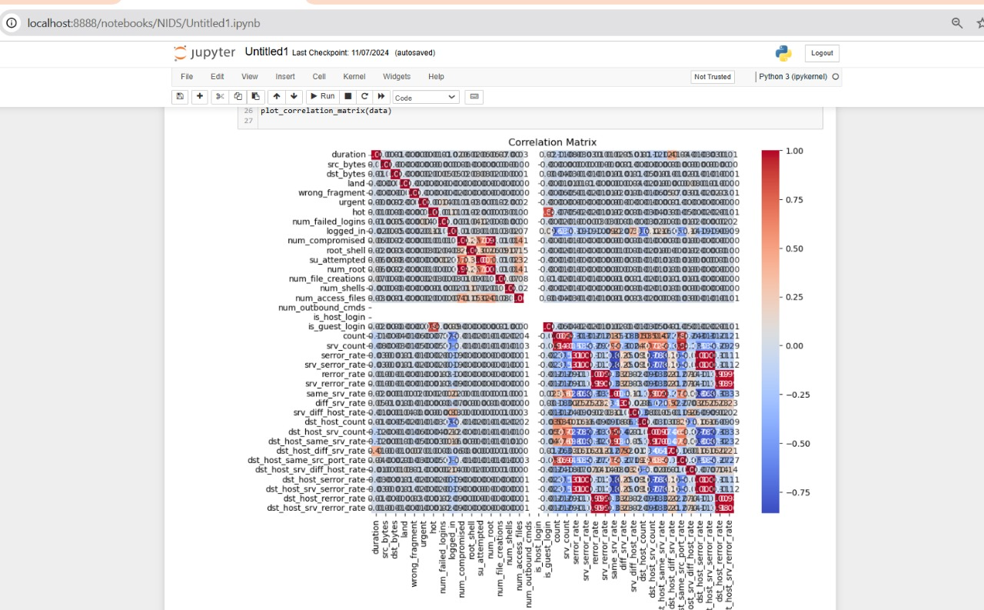
Co-relation Matrix

Slide 22
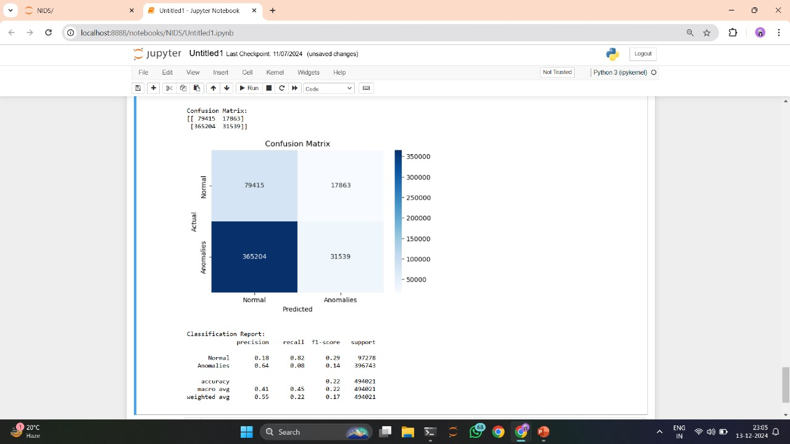
Evaluation of the Model

Slide 23
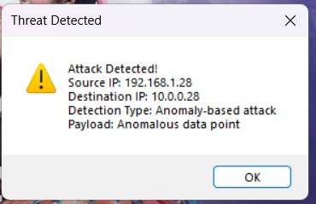
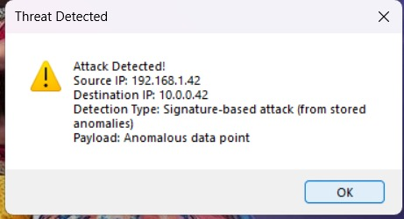
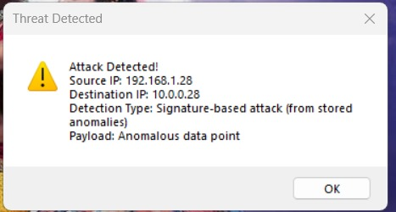
Final Report

Slide 24
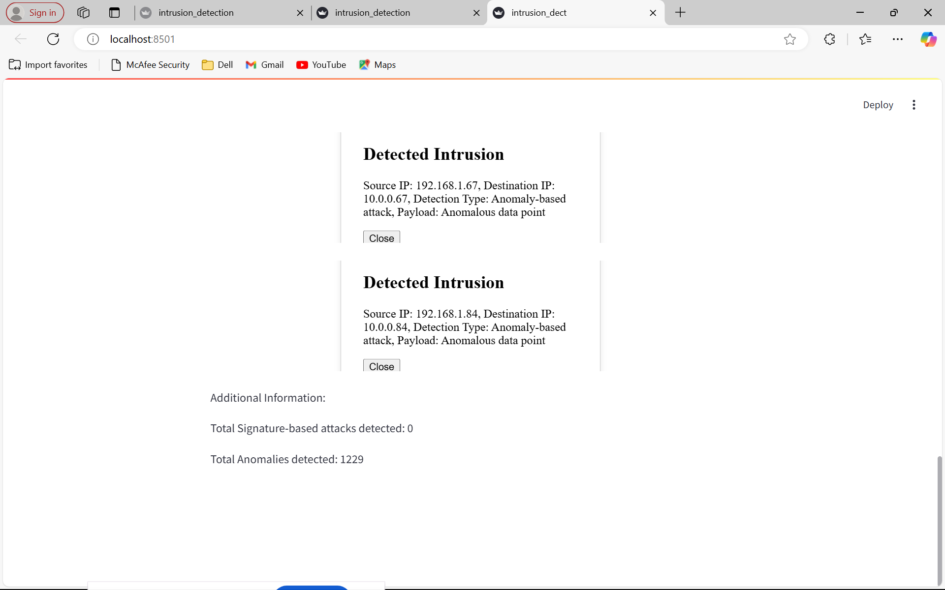
Output

Slide 25
Conclusion
Summary:
Future Scope:
A hybrid IDS combining signature-based and anomaly-based approaches enhances detection capabilities.
Integrate with real-time network traffic.
Enhance detection using deep learning models.
Real-time alerts and persistent storage make the system reliable and user-friendly.

Slide 26

References
https://m4d.iti.gr/wp-content/uploads/2022/12/Host-based-intrusion-detection-
using-signature-based-and-AI-driven-anomaly-detection-methods_final.pdf
https://onlinelibrary.wiley.com/doi/full/10.1155/2021/6639714
3 Sommer, Robin, and Vern Paxson. 2010. "Outside the closed world: On using machine learning
for network intrusiondetection." 2010 IEEE symposium on security and privacy.
https://doi.org/10.1109/sp.2010.25.
6Wang, Xingyou, Weijie Jiang, and Zhiyong Luo. "Combination of convolutional
and recurrent neural network for sentiment analysis of short texts." In Proceedings
of COLING 2016, the 26th internationalconference on computational linguistics:
Technical papers, pp. 2428-2437. 2016.
Paxson, Vern. 1999. "Bro: A system for detecting network intruders in real-time." Computer networks
31 (23-24): 2435-2463.

Slide 27
Thank You

