Slide 1




G. NARAYANAMMA INSTITUTE OF TECHNOLOGY & SCIENCE
AUTONOMOUS (For Women)
Shaikpet, Hyderabad ,Telangana
DEPARTMENT OF COMPUTER SCIENCE AND ENGINEERING
Smart Document Processing System
Batch No. - D7
Guide:
Mrs. S. Sandhya
Assistant Professor, CSE Department.
Presented By:Team Members:
1.Soumika-24251A05L1
2.S.Pavani-24251A05N8
3.Shaik Roshan-24251A05N7

Slide 2



TABLE OF CONTENTS:
Introduction
Literature Survey
Existing system
Problem Statement
Proposed system
Objectives
Methodology
Technologies
Results

Slide 3
INTRODUCTION
Large volumes of institutional documents are generated daily.
Documents are often stored in unstructured formats.
Manual formatting is time-consuming and error-prone.
Maintaining consistency across documents is difficult.
Automated document processing improves efficiency and accuracy

Slide 4
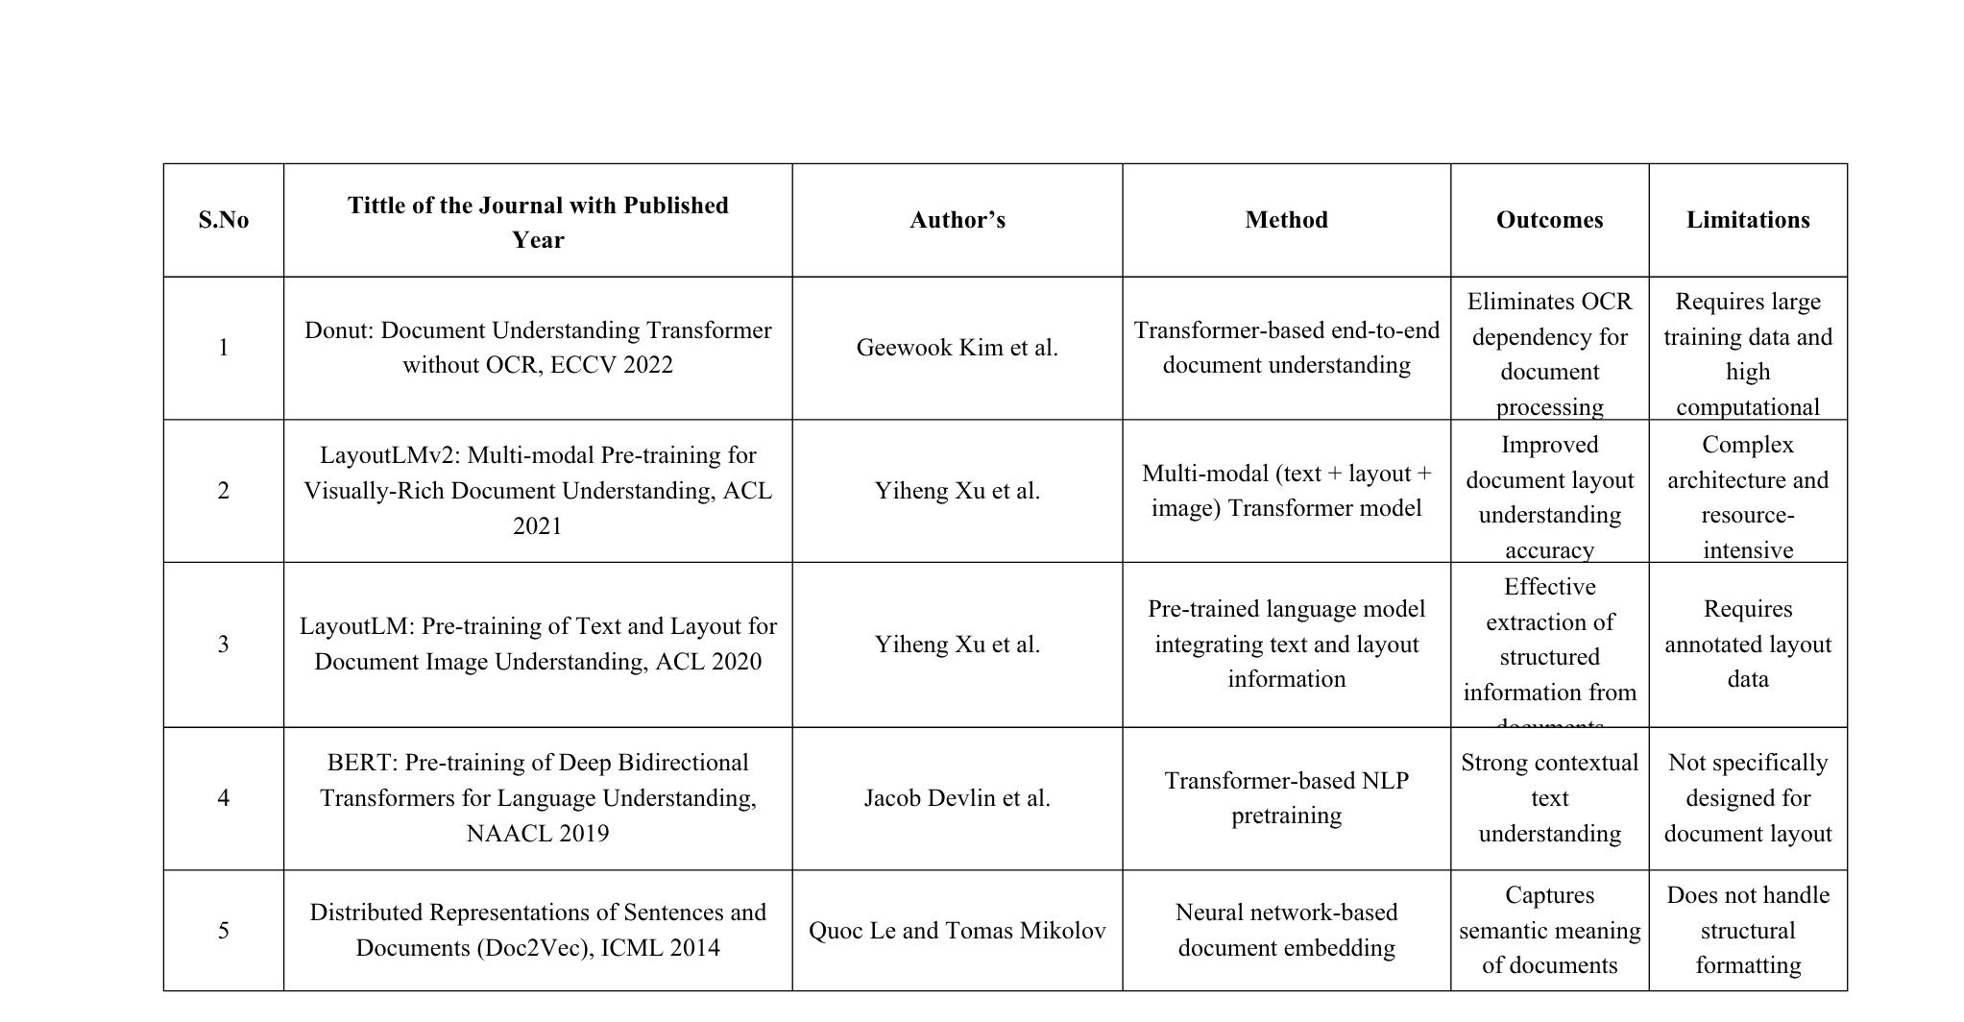
LITERATURE SURVEY

Slide 5

EXISTING SYSTEM
Documents are maintained in formats such as Word and PDF files.
Document formatting and structuring are performed manually using editing tools and templates.
Users manually apply headings, numbering, alignment, and formatting styles.
Repeated modifications are often required to maintain consistency across documents.
Existing tools support basic formatting but provide limited automation.

Slide 6
PROBLEM STATEMENT
Institutional documents exist in multiple formats such as Word,
Excel, and PDF.
Manual formatting and conversion are time-consuming and error-prone.
Maintaining consistency across documents is difficult.
Automated document processing is required to generate standardized outputs efficiently.

Slide 7
PROPOSED SYSTEM
Provides an automated solution for processing and structuring institutional documents.
Accepts documents in formats such as PDF, Word, and Excel.
Extracts and organizes information using predefined processing rules.
Converts documents into standardized formats based on the selected module.
Generates structured outputs and stores processed data in a database.
Reduces manual effort, improves consistency, and minimizes errors

Slide 8
OBJECTIVES
To develop a Smart Document Processing System for institutional documents.
To extract and store relevant document data in a database.
To organize extracted information into a structured format.
To automate the conversion of documents into predefined output formats.
To reduce manual effort and improve processing accuracy.

Slide 9
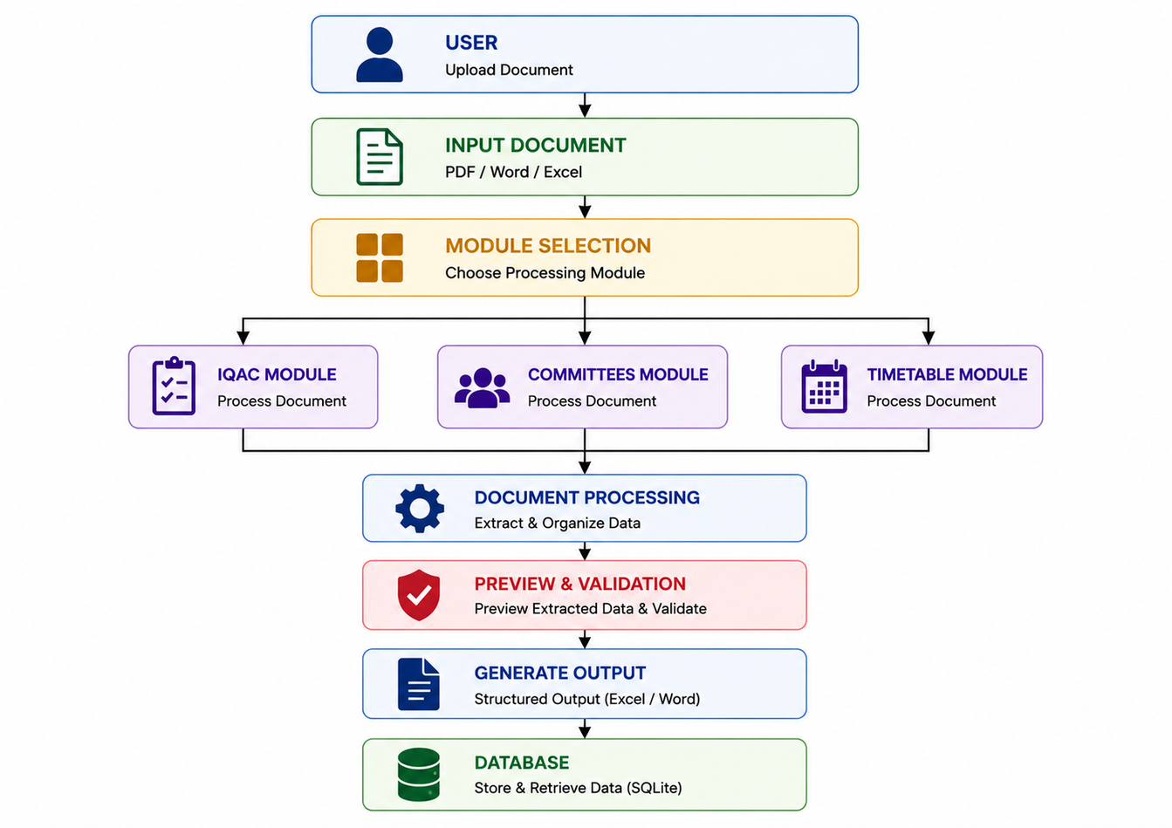
METHODOLOGY:
System Layers:
1.Input Layer
2.Module Selection Layer
3.Processing Layer
4.Document Processing Layer
5.Preview & Validation Layer
6.Output Layer
7.Database Layer

Slide 10
TECHNOLOGIES
Languages | Python, HTML, CSS
Framework | Flask
Database | SQLite
Libraries | Pandas, OpenPyXL, python-docx

Slide 11
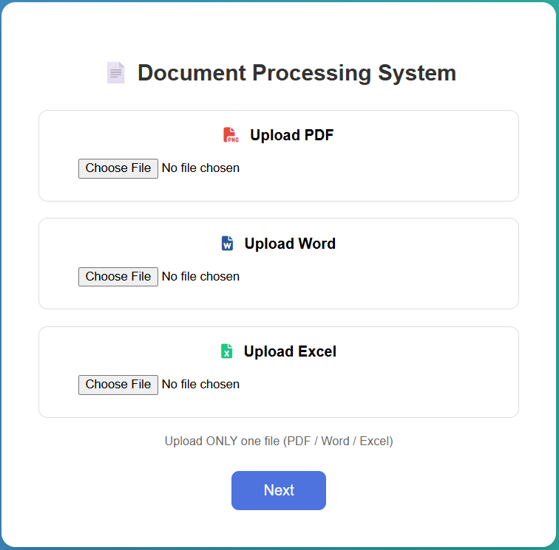
RESULTS
Successfully uploaded and processed Excel input files
Converted input documents into a structured Bridge Template
Generated IQAC formatted Excel output automatically
Ensured accurate CO & Bloom’s Level mapping

Slide 12
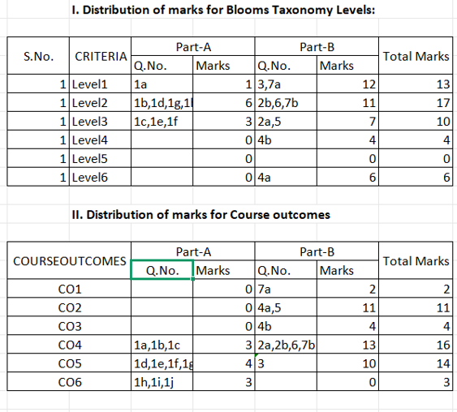
RESULTS:
Performance
Reduced manual effort involved in document formatting
and organization.
Improved consistency and uniformity in document structure.
Minimized human errors during data extraction and
processing.
Observations
The system successfully processed documents using
predefined templates and rules.
Structured outputs were generated accurately from
the input documents.
Processed data was stored in the database for future retrieval and
management.

Slide 13
REFERENCES
Katti H., Arun P., Automated Document Processing Using Machine Learning Techniques, 2018.
Smith J., Data Extraction from Semi-Structured Documents Using Pattern Matching, 2019.
Python Software Foundation, Python Documentation.
Flask Documentation, Flask Web Framework.
Pandas Documentation, Data Analysis Library for Python.
OpenPyXL Documentation, Excel Processing Library for Python.

Slide 14
Thank You

