Slide 1
Hand gestures for emergency situations: A video dataset based on words from Indian sign language
Name: Soumik Roy ID: 20101573 Section: 01

Slide 2
Abstract
The videos of eight ISL words have been collected from 26 individuals (including 12 males and 14 females) in the age group of 22 to 26 years with two samples from each individual in an indoor environment with normal lighting conditions. The dataset is useful for the researchers working on vision based sign language recognition (SLR) as well as hand gesture recognition (HGR). Moreover, support vector machine based classification and deep learning based classification of the emergency gestures has been carried out and the base classification performance shows that the database can be used as a benchmarking dataset for developing novel and improved techniques for recognizing the hand gestures of emergency words in Indian sign language.

Slide 3
Value of the Data
The dataset proposed in this article is the first publicly available dataset of the hand gestures of the emergency ISL words. This dataset can act as a basic benchmarking database of a set of hand gestures of emergency ISL words. It can be referred for further expanding the dataset by replicating the samples, or adding new samples of the gestures in different views and background conditions to further develop and improve the SLR and HGR techniques.

Slide 4
Data Description
The dataset contains the RGB videos of hand gestures of eight ISL words, namely, ‘accident’, ‘call’, ‘doctor’, ‘help’, ‘hot’, ‘lose’, ‘pain’ and ‘thief’ which are commonly used to convey messages or seek support during emergency situations.
The dataset is included in two folders namely ‘Raw_Data’ and ‘Cropped_Data’. The folder ‘Raw_Data’ contains the original ISL videos of size 1280x720 pixels. The folder ‘Cropped_Data’ contains the video sequences obtained after cropping out the excessive backgrounds and rescaling the frames to a uniform size of 500x600 pixels.

Slide 5
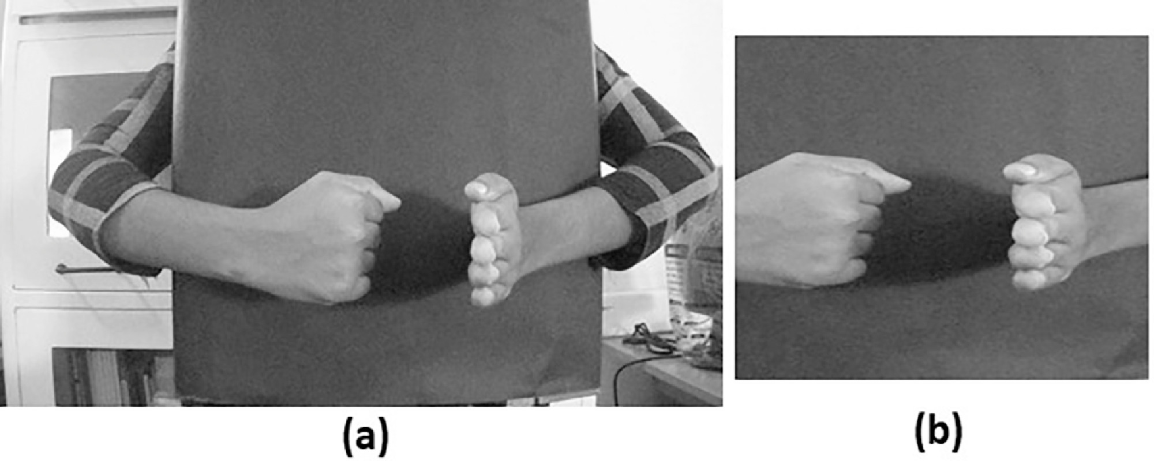
Experimental design
A Sony cyber shot DSC-W810 digital camera with 1280x720 pixels frame size is used for the data collection.
Fig. (a) A single frame of the video for the hand gesture of the word ‘accident’ in original form (b) the corresponding frame obtained after cropping and downsampling.

Slide 6
Data analysis
The ISL gestures in the cropped dataset have been analysed by classifying them with the conventional feature driven approach using multiclass support vector machine (SVM) as well as the recently evolved data driven approach using deep learning model. In both cases, 50% of the dataset is used for training and the remaining 50% is used for testing.
SVM is a supervised machine learning approach used for binary and multiclass pattern recognition.
Multiclass SVM is utilized in this work and obtained an average classification accuracy of 90%.

Slide 7
Declaration of Competing Interest
The authors declare that they have no known competing financial interests or personal relationships which have, or could be perceived to have, influenced the work reported in this article.

