Slide 1

Bangla Sign Language (BdSL-D1500) Numerals Classification using
CNN based Transfer Learning Models
01
Submitted by:
Mohammad Aman Ullah Khan; ID: 19301139.
Nirjhar Gope; ID: 19301140.
Soumik Roy; ID: 20101573.
Rifha Hossain Munaja; ID: 20301466.
Submitted to:
Mr. Annajiat Alim Rasel Sir

Slide 2
02
Abstract
Research Focus:
Utilizing Convolutional Neural Networks (CNN) and Deep Learning to analyze Bengali sign languages.
Identifying unique hand gestures for letters and numerals.
Challenges:
Bengali sign language images pose challenges due to variations in hand color and lighting conditions, causing misinterpretation of numerical digits.
Dataset:
Training dataset: 13,990 images across 10 different classes.
Test dataset: 1,010 images across 10 classes.
Results:
CNN achieved a remarkable test accuracy of 0.99 in DenseNet-121 and VGG16 on the Bengali sign language numeral test dataset.

Slide 3
03
VGG16
Developed by Visual Graphics Group from Oxford (VGG).
A breakthrough in deep convolutional neural networks (CNNs) for image recognition tasks.
VGG16 (Visual Geometry Group 16) is a deep convolutional neural network architecture.
Widely used in image processing, feature extraction, and as a pre-trained model for transfer learning.
Excellent in object detection and classification tasks.

Slide 4
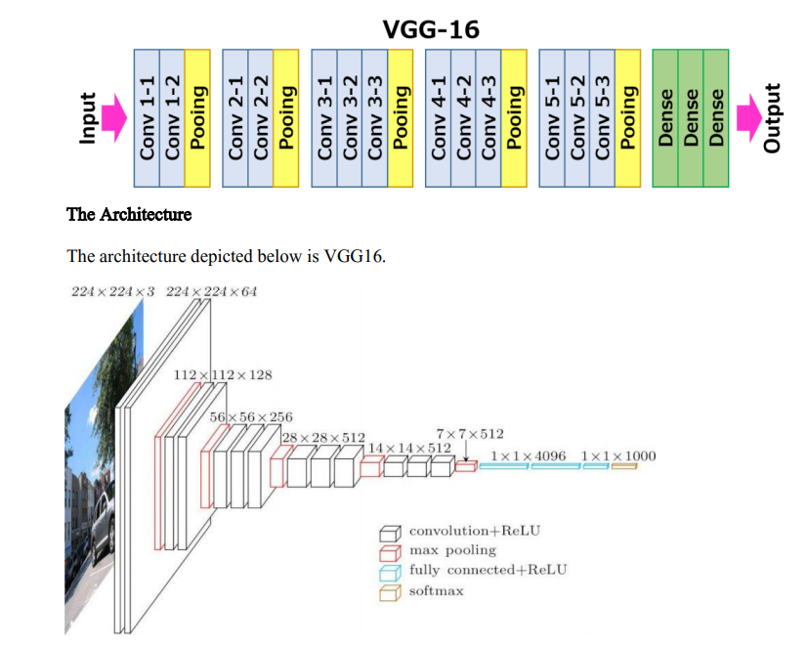
04
5 Max pooling layers following some of the Conv layers, reducing the spatial dimensions by half (e.g., 224x224 to 112x112).
These layers reduce the number of parameters and computation in the network, helping to prevent overfitting.
Accepts an image of size 224x224 pixels with 3 color channels (RGB).
13 Conv layers using 3x3 filters, which capture patterns and features from the input image.
Sequentially numbered from Conv1_1 to Conv5_3, indicating the order
& the layer block they belong to.
Each Conv layer is followed by a ReLU (Rectified Linear Unit) activation function to introduce non-linearity.

Slide 5
05
DENSENET-121
DenseNet-121 is a convolutional neural network (CNN) architecture designed for image classification and feature extraction.
Strong feature reuse and gradient flow.
Requires fewer parameters compared to traditional architectures.
DenseNet-121 is a powerful model for image classification and feature extraction.
Its unique architecture leads to better feature reuse and efficiency.
Image classification.
Feature extraction.
Transfer learning for various computer vision tasks.

Slide 6
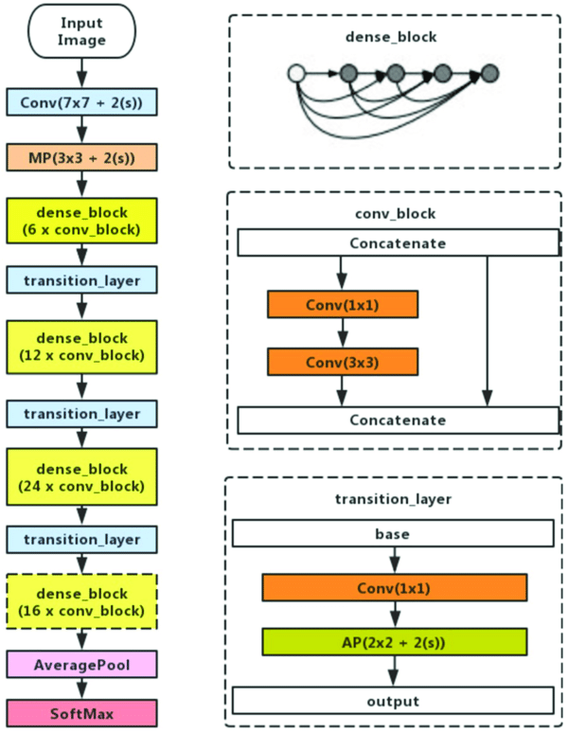
06
Input and Initial Convolution:
Input Image: The network accepts an input image for processing.
Initial Convolution: Begins with a convolutional layer with a 7x7 kernel and a stride of 2 (notation: Conv(7x7 + 2(s))) followed by a max pooling layer with a 3x3 kernel and a stride of 2 (notation: MP(3x3 + 2(s))).
Dense Blocks and Transition Layers:
Dense Blocks: Composed of multiple "conv_block" units. Each "conv_block" includes a 1x1 convolution (for feature reduction) followed by a 3x3 convolution (for feature extraction), with the outputs of each block being concatenated to the inputs of the subsequent blocks.
The dense blocks have varying numbers of layers: 6, 12, 24, and 16, as shown in the image.
Transition Layers: These layers are between dense blocks and are used to reduce the dimensionality of the feature maps. Typically includes a 1x1 convolution followed by 2x2 average pooling (notation: AP(2x2 + 2(s))).
Average Pooling and Softmax Output:
After the last dense block, the network uses an average pooling layer to reduce the spatial dimensions of the feature maps.
A softmax activation function is applied in the output layer, which provides the probabilities for the different classes that the network can predict.

Slide 7
07
DENSENET-201
DenseNet-201 is an evolution of the DenseNet architecture which consists of 201 layers. It is known for its densely connected layers, where each layer receives inputs from all preceding layers and passes its own feature-maps to all subsequent layers.
DenseNet-201 is commonly utilized for complex image processing tasks like image classification, segmentation, and object recognition where large datasets and deep feature hierarchies are present.
Advantages of DenseNet-201:
Feature Propagation: Improved flow of information and gradients throughout the network, which makes it easier to train.
Parameter Efficiency: Requires fewer parameters than traditional deep networks due to feature reuse, which makes it computationally efficient.
Feature Reuse: Increases variation in the input of subsequent layers and improves efficiency by reusing features.

Slide 8
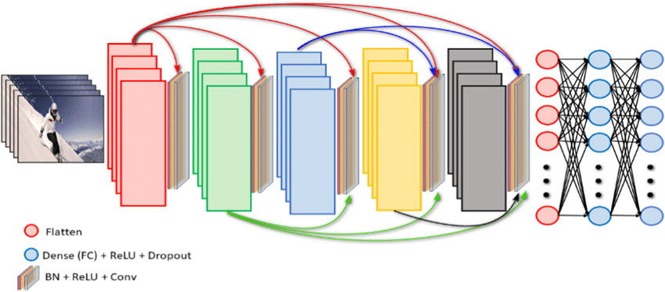
08
Input Image: The network accepts an input image, which
undergoes initial preprocessing.
Dense Blocks and Transition Layers (Colored Blocks): The architecture consists of several dense blocks (depicted in different colors). Each block contains layers that are densely connected.
Between the dense blocks are transition layers that help in reducing the dimensions of the feature maps and to compress the model.
Batch Normalization + ReLU + Convolution (BN + ReLU + Conv):
Within each dense block, the layers include batch normalization (BN), followed by a Rectified Linear Unit (ReLU) activation, and then a convolutional operation (Conv). This sequence ensures normalization and non-linear transformation of the inputs before applying the learned filters.
Skip Connections (Colored Arrows): The architecture uses skip connections (shown as colored arrows) to carry forward features from earlier layers directly to subsequent layers, enabling feature reuse and reducing the vanishing gradient problem.
Classification Layers:
Flattening (Red Circle):
The feature maps from the final dense block are flattened to form a single long vector, which is necessary before passing them to the fully connected layers.
Dense (Fully Connected) + ReLU + Dropout (Dense (FC) + ReLU + Dropout):
After flattening, one or more dense (fully connected) layers apply a non-linear transformation (ReLU) and use dropout for regularization to prevent overfitting.
Output Layer: The final layer is a fully connected layer that uses the softmax activation function to output a probability distribution over the predicted classes.

Slide 9
09
MOBILENET
MobileNet is a lightweight convolutional neural network (CNN) architecture designed for mobile and embedded devices. It uses depth wise separable convolutions to reduce the number of parameters and computations required, without sacrificing too much accuracy.
MobileNet applications:
Image classification
Object detection
Semantic segmentation
Image retrieval
Video classification

Slide 10
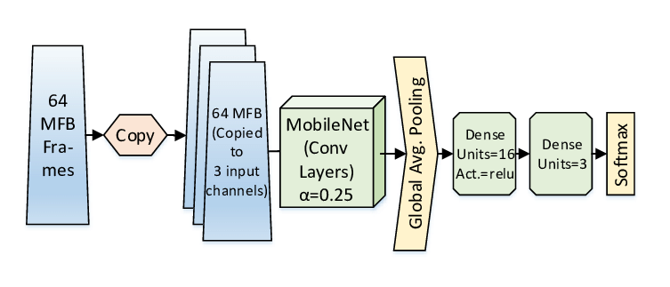
10
Architecture Overview
Create a simple diagram or illustration of the MobileNet architecture.
Highlight key components:
Input layer (e.g., image)
Convolutional layers
Depthwise separable convolutions
Pointwise convolutions
Down-sampling (e.g., pooling)
Fully connected layers (if applicable)
Output layer (e.g., classification or regression)
Depthwise Separable Convolutions
Explain that MobileNet utilizes depth wise separable convolutions
Depthwise convolution: Applies a separate convolution to each input channel.
Pointwise convolution: Combines the output of depthwise convolution using 1x1 convolutions.
Efficiency
Emphasize the efficiency of MobileNet
Low computational cost due to reduced parameters.
Suitable for real-time applications on resource-constrained devices.

Slide 11
11
Research Methodology (1)
DenseNet201:
Research Objective: To leverage DenseNet201 for image classification.
Batch Size: 32
Target Size: (150, 150)
Epochs: 50
Methodological Approach:
Utilizing transfer learning, fine-tuning a pre-trained DenseNet201 model.
Pre-trained on the ImageNet dataset.
Employing data augmentation techniques.
Training for 50 epochs to achieve convergence.
DenseNet121:
Research Objective: To investigate the capabilities of DenseNet121 for image analysis.
Image Size: 224
Batch Size: 16
Epochs: 100
Methodological Approach:
Employing transfer learning by fine-tuning a pre-trained DenseNet121 model.
Utilizing the pre-trained weights from the ImageNet dataset.
Extending training for 100 epochs to capture complex image patterns.

Slide 12
12
Research Methodology (2)
MobileNet:
Research Objective: To assess MobileNet's performance in resource-constrained environments.
Image Size: 64
Batch Size: 32
Epochs: 30
Methodological Approach:
Utilizing transfer learning, fine-tuning MobileNet pre-trained on ImageNet.
Employing a reduced image size (64x64) to conserve computational resources.
Training for 30 epochs to balance performance and resource efficiency.
VGG16:
Research Objective: To explore the capabilities of VGG16 in deep image classification.
Image Size: 224
Batch Size: 16
Epochs: 75
Methodological Approach:
Leveraging transfer learning by fine-tuning a pre-trained VGG16 model on ImageNet.
Extensive training for 75 epochs to capture fine-grained image features.
Using high-resolution images (224x224) to preserve image details.

Slide 13
13
Thanks!
Do you have any questions?

