Slide 1
Helping Hearing-Impaired in Emergency Situations: A Deep Learning-Based Approach
Name: Soumik Roy ID: 20101573 Section: 01

Slide 2
Introduction
Implementation of state-of-the-art classification and object detection methods that can be used when hearing-impaired people are in desperate situations and want to convey their thoughts to other people at the earliest.
A thorough literature review of related studies.
Based on the first publicly available dataset of the hand gestures of the emergency ISL words.
Analysis of videos of eight emergency signs.
Comparison of the performance of proposed methods with each other on various metrics and with the previous studies.
Establishing the superiority of the VGG + LSTM model over other classification models.
To unveil an impressive performance of the object-detection model to identify dynamic gestures.

Slide 3
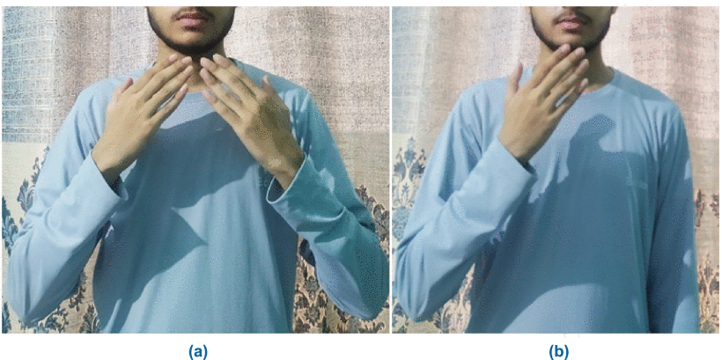
Expressing ‘Thank you’ in a) Indian, and b) American sign languages.

Slide 4
Related Works
Static and dynamic gestures.
Long short-time memory (LSTM)
YOLO (You Only Look Once)
Sexual assault alert system

Slide 5
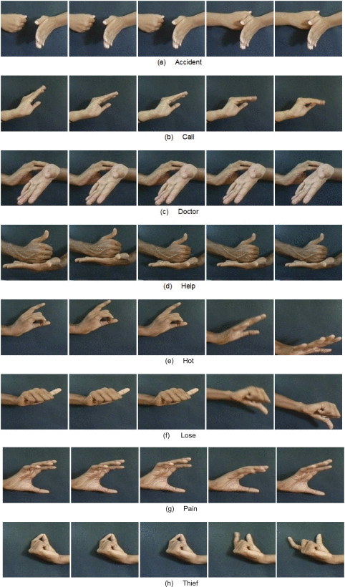
Set of frames for different emergency signs of the video dataset.

Slide 6
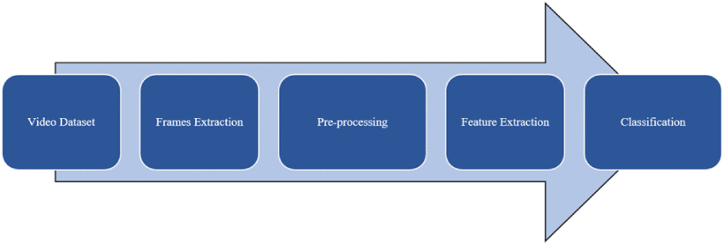
Methodology
General process of sign language recognition system.

Slide 7
A. Dataset
In this study, a video-based ISL dataset is used that contains 412 videos. The dataset included eight hand gestures representing ISL words such as ‘accident,’ ‘call,’ ‘doctor,’ ‘help,’ ‘hot,’ ‘lose,’ ‘pain,’ and ‘thief’. Out of a total of 412 videos, each sign is represented in 50 different videos on average. The video was shot on 26 adult individuals, 12 males and 14 females aged 22 and 26 years.

Slide 8
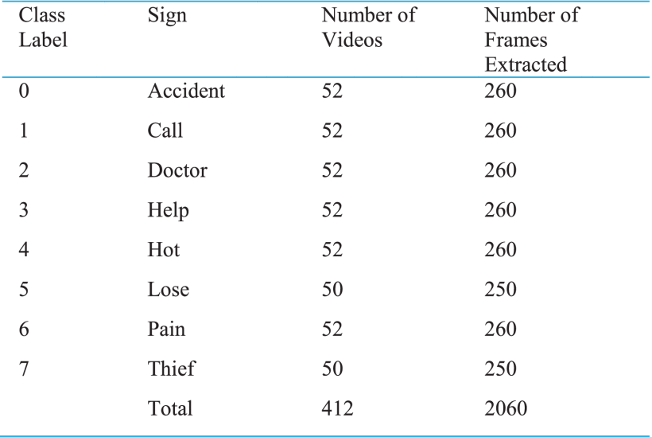

Slide 9
B. Pre-Processing
Extracting 20 frames from each video.
Images were graded from 0 to 7 to represent eight different classes.
The YOLO format was used to label data in a text file format and store information such as class ID and the class to which it belongs.
The extracted frames have been resized from (500 by 600) to (150 by 150) pixels.
The overall dataset (100%) is divided into three subsets: training (60%), validation (20%), and testing (20%).

Slide 10
C. Proposed Methods
We utilized two models for the classification task, Model I and Model II. Model I consist of 3D CNN, while Model II uses a combination of pre-trained CNN and LSTM. Model III, an object detection model, is based on the YOLO (You Only Look Once) v5 algorithm for detecting hand gestures.

Slide 11
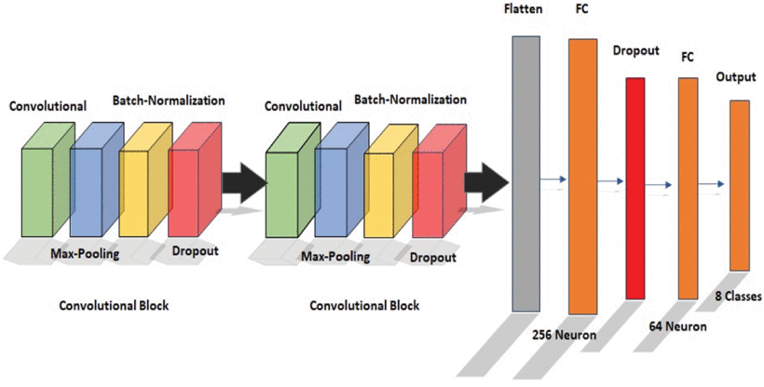
1) Classification
The detailed overall architecture of Model I.

Slide 12
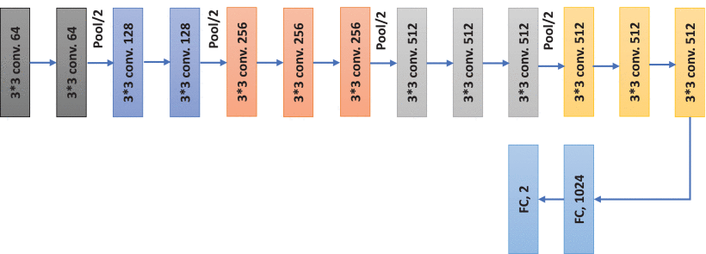
Model II is based on LSTM on top of a pre-trained CNN (VGG-16) to classify the video sequence. It uses transfer learning and LSTM for learning spatial and temporal features respectively. Each frame is passed onto the CNN (VGG-16) to extract spatial features. The outputs are then sent into a LSTM to find temporal characteristics in the image stream. Finally, the extracted features are sent to a fully connected layer that predicts the classification for the whole input sequence.
Layer-wise architecture of VGG-16 model.

Slide 13
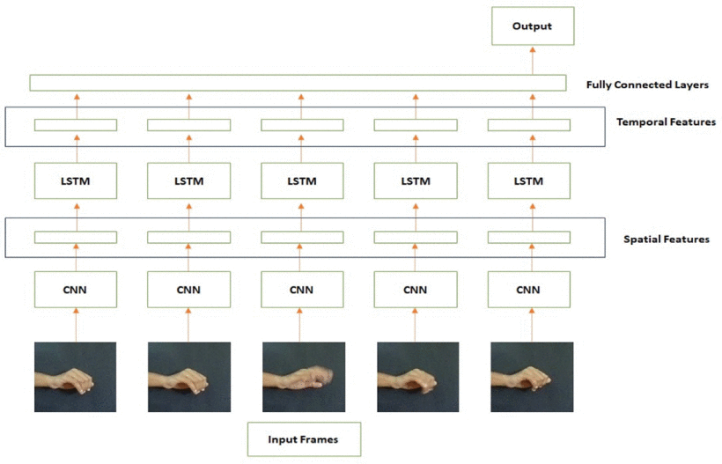
Combining VGG-16 and LSTM networks to design the framework of Model II.

Slide 14
2) Detection
YOLO v5 is an advanced real-time object detection algorithm with top performances on two official object detection datasets: Pascal VOC and Microsoft COCO. YOLO v5 comprises of three segments; CSPDarknet network, PANet network, and YOLO Layer, often referred to as backbone, neck, and head of the architecture, respectively.

Slide 15
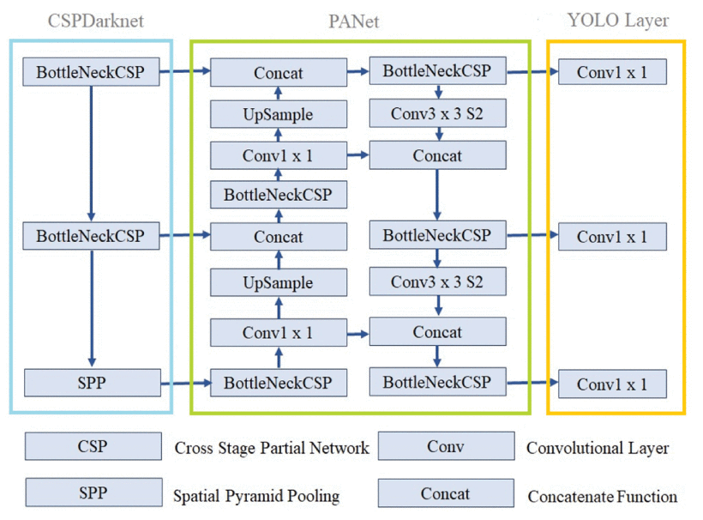
Detailed architecture of YOLO v5 algorithm.

Slide 16
Results and Discussions
A. Evaluation Metrics
Two medium accuracy ranges, map@0.5 and map@0.5:0.95, are used. The mAP@0.5 shows the average confidence level accuracy of 50%. The mean value of average precision in the range of 50% to 95% is the mAP@0.5:0.95.

Slide 17
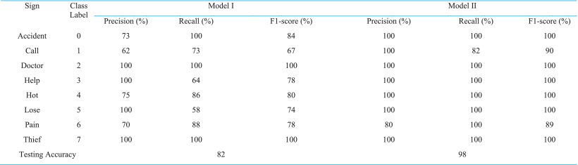
B. Performance of Classification Models
The classification models were trained and tested on 2060 frames from 412 videos.
Performance Comparison of Classification Models I and II

Slide 18
3D CNN-based model was able to achieve a maximum of 82% accuracy on the test set.
Since the signs ‘Doctor’ and ‘Thief’ had the least movement among all, the model achieved relatively better results on them while the other signs such as ‘Help,’ ‘Lose’ and ‘Call’ weren’t classified with accuracy.
It was observed that double-handed signs were classified more accurately than single-handed ones.
VGG-16, combined with LSTM achieved an accuracy of 98%.
Due to the similarity of movement of the hands, Model II showed some error in differentiating the signs ‘Pain’ and ‘Call’.

Slide 19
C. Performance of Detection Models
Model III is trained on 500 epochs with a batch size of 16. The learning rate is 0.01, and the decay is 0.0005. It took around 4 hours to train the model.
D. Performance Comparison and Discussion
YOLO v5 was used as the detection model.
‘Call,’ and ‘Pain’ were the most difficult signs to be categorized accurately by any model. Both signs have dynamic gestures, and at a point in their movement, they seem to have a common hand position, which might have been challenging for models to differentiate.
The model I could not yield satisfactory results in identifying dynamic signs such as Accident, Call, Hot, and Pain, implying that 3D CNN did not correctly learn all of the temporal characteristics.

Slide 20
In contrast, Model II was able to learn both the spatial and temporal features more comfortably because of the presence of a pre-trained VGG16 feature extractor. Compared to the 3D-CNN network, the combination of a VGG16 network with an LSTM architecture achieved considerably greater precision and recall rates. On the other hand, YOLO v5 successfully detected each sign in the dataset with an overall precision and recall of 99.5%. YOLO offers several benefits over other techniques, making it an advanced detector. YOLO uses a single CNN for both classification and localization instead of utilizing a two-step approach for object classification and localization. Second, YOLO is fast and processes images at around 40–90 frames per second. It implies that streaming video can be handled in real-time, with only a few milliseconds of delay. It suggests that Model III may be used to recognize emergency gestures in real-time.

Slide 21
Conclusion
The present work proposes classification and detection models on an emergency ISL dataset. The best classification model uses a combination of pre-trained VGG-16 and LSTM, while the detection model is based on the YOLO v5. The classification model achieved 98% accuracy, and the detection model achieved 99.6% mean average precision. The developed hand gesture recognition system classifies and detects both static as well as dynamic hand gestures from video frames. Furthermore, we found that even a smaller set of images are enough to recognize the dynamic gesture. For deaf people, sign language provides a means of emergency communication that helps them deal with difficult times. Situations like feeling pain, calling for help, or a doctor may arise anytime and anywhere. The present study opened the door to develop applications based on proposed methods that can be used when hearing-impaired people are in desperate situations and want to convey their thoughts to other people at the earliest.

