Slide 1
Bangla Sign Language (BdSL-D1500) Numerals Classification using
CNN based Transfer Learning Models
Submitted by:
Mohammad Aman Ullah Khan; ID: 19301139.
Nirjhar Gope; ID: 19301140.
Soumik Roy; ID: 20101573.
Rifha Hossain Munaja; ID: 20301466.
Submitted to:
Mr. Annajiat Alim Rasel Sir

Slide 2
Abstract
Putting up a plan to use CNN-based Transfer Learning Models for the classification of Bangla Sign Language Numerals.
Addressing particular difficulties with Bangla sign language graphics, such as hand colour changes and problems with exposure to light.
Overcoming communication barriers in today's fast-paced environment.
Information: "Trained on a dataset of 13,990 images across 10 classes."
Evaluation: "Evaluated using a test dataset of 1,010 images in 10 classes."
Obtained a test accuracy of 0.99 for the VGG16 and DenseNet121 models.

Slide 3
Introduction
one of the languages spoken the most commonly in the globe (7th in the world, 5th in Asia).
Of Bangladesh's population, 13.7 million people, or 9.6%, have hearing impairments.
Use of the VGG16, MobileNet, DenseNet 201, and DenseNet 121 models.
Pay attention to categorising Bengali sign language.
Transfer Learning Models to recognise Bangla sign language are a unique contribution.
making use of an extensive practice dataset.
utilising cutting-edge AI technology to provide effective communication solutions for those with speech and hearing impairments.

Slide 4
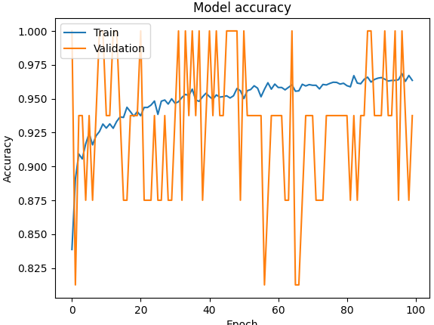
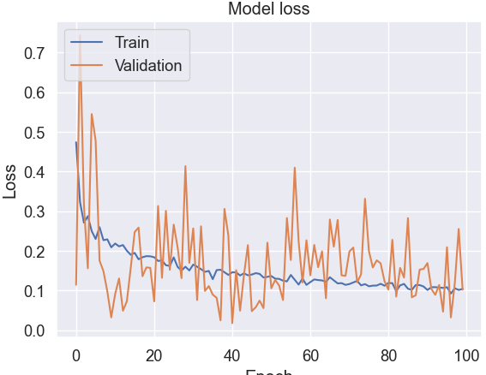
DenseNet121
Test Accuracy: 0.99

Slide 5
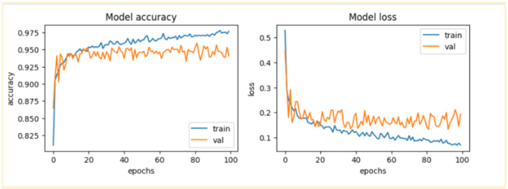
DenseNet 201
Test Accuracy: 0.942

Slide 6
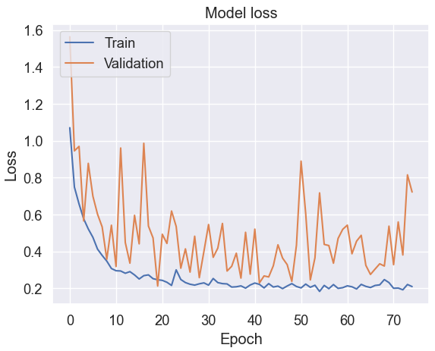
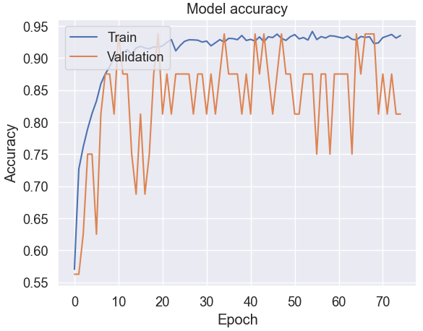
VGG16
Test Accuracy: 0.99

Slide 7
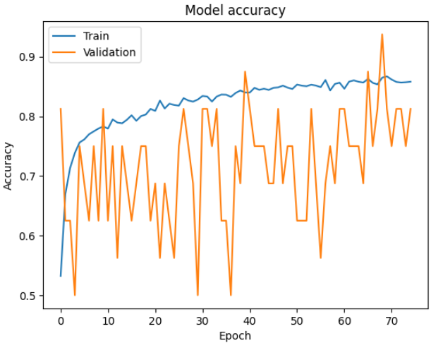
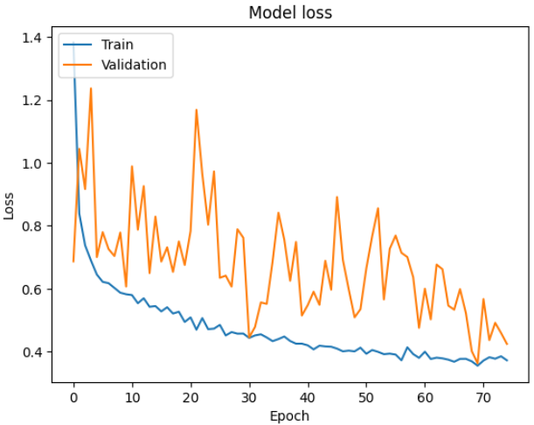
MobileNet
Test Accuracy: 0.966

Slide 8
Conclusion
An overview of the importance of technology for Bangladeshi people who are hard of hearing or speaking.
There were four models employed for transfer learning: DenseNet 121, VGG16, DenseNet 201, and VGG19.
DenseNet121 and VGG16 are the best-performing models with test accuracy of 0.99.
Restrictions: inability to discern differences in skin tones, light exposures, etc.
Performance uncertainty in several scenarios including hand gestures.
Public access to research papers and datasets.
contribution to the future development of models with higher efficiency.

