Slide 1
Notes:
We began our analysis in November by mapping the survey data using polychoric correlations, which successfully identified key clusters of risks but relied on undirected associations

Slide 2
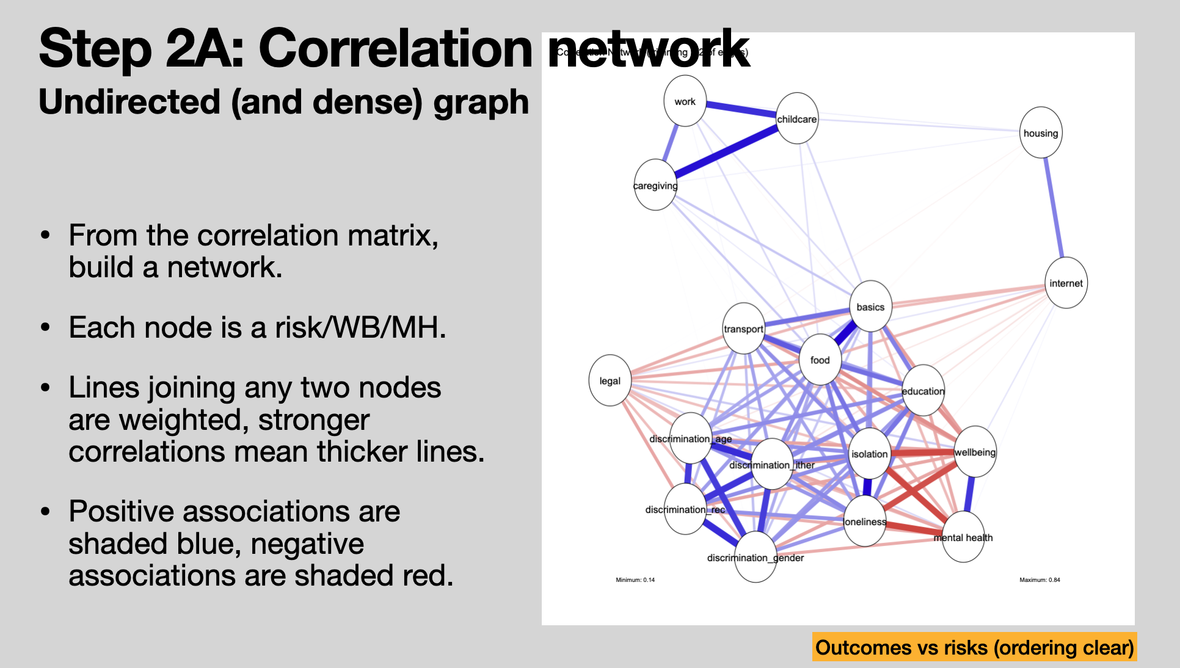
Notes:
This approach resulted in dense, ambiguous networks that could not tell us whether health outcomes were driving social risks or vice versa

Slide 3
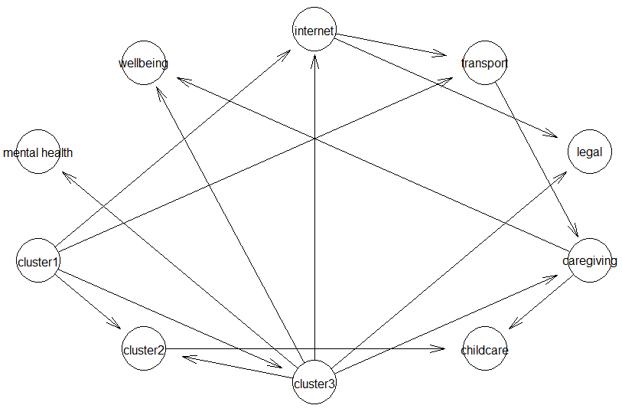
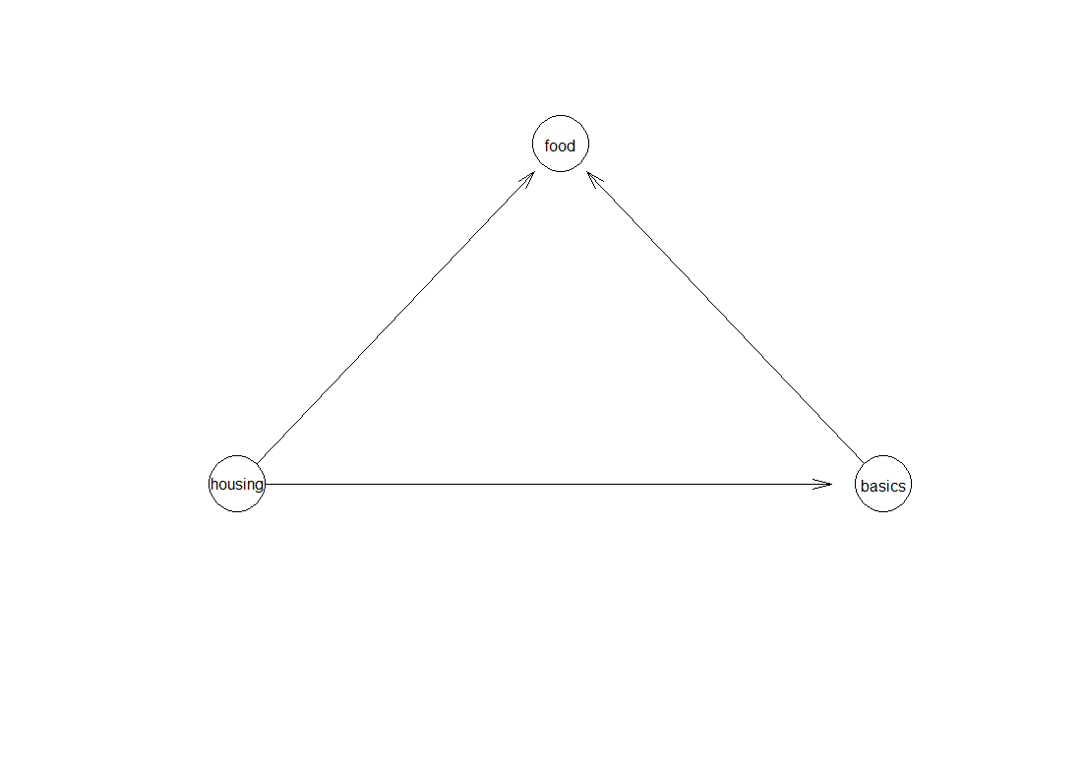
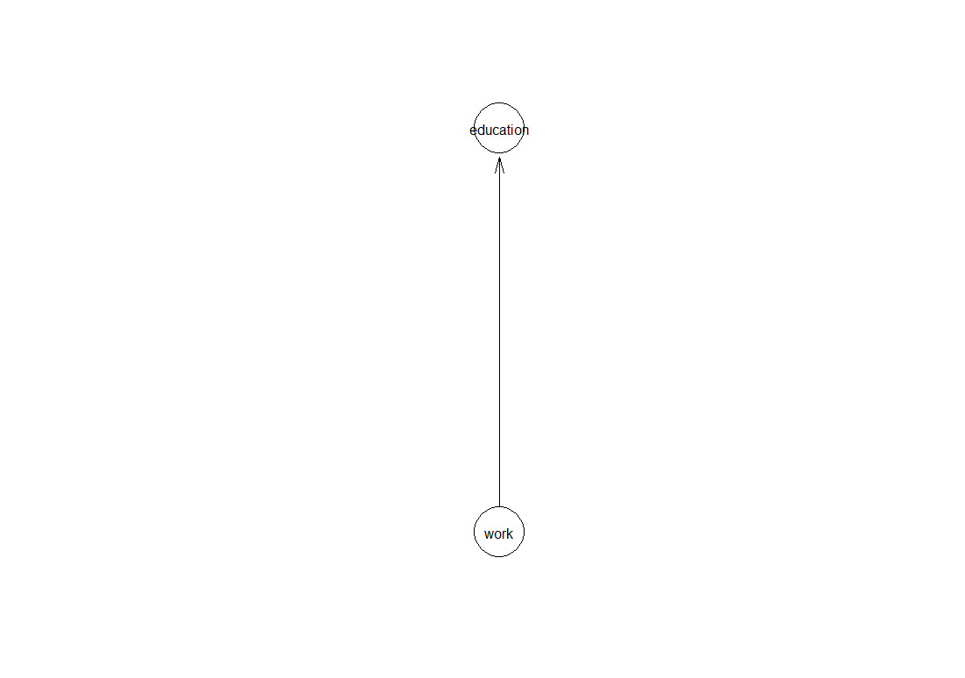
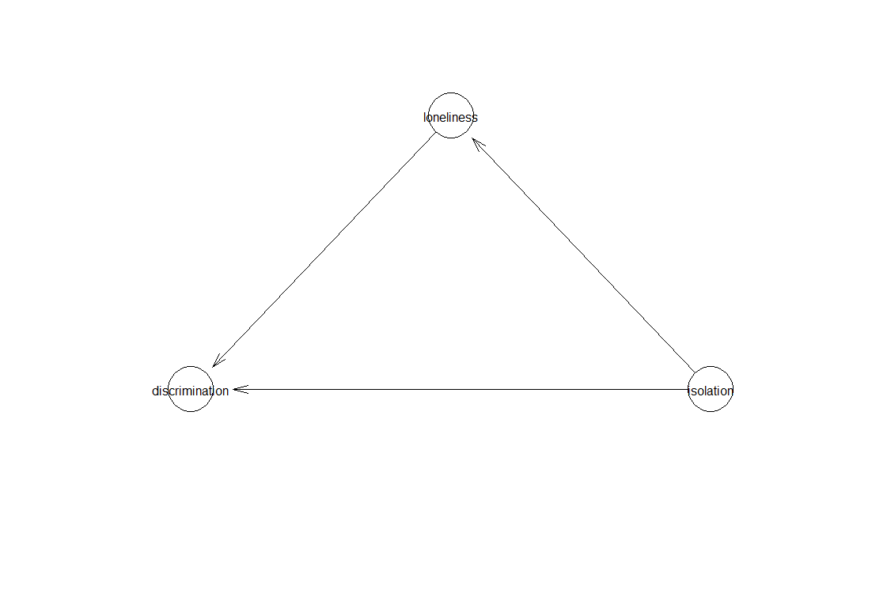
Supervised cluster + causal discovery:
Manually aggregated survey items into distinct theoretical domains (3 clusters) and learnt topological relationships,
Enforcing constraints to prevent reverse arrows from health outcomes.
The learned structure revealed parallel, independent pathways where both cluster 2 and cluster 3 directly degrade Mental Health and Wellbeing through separate pathways.
Notes:
To solve this, we moved from simple correlation maps to causal structural learning, implementing a Hill Climbing algorithm to mathematically determine the direction of these relationships.
Slide 4: Supervised Model Results: By enforcing logical constraints on manually aggregated domains, the algorithm revealed that distinct social risk clusters degrade mental health through independent, parallel pathways

Slide 4
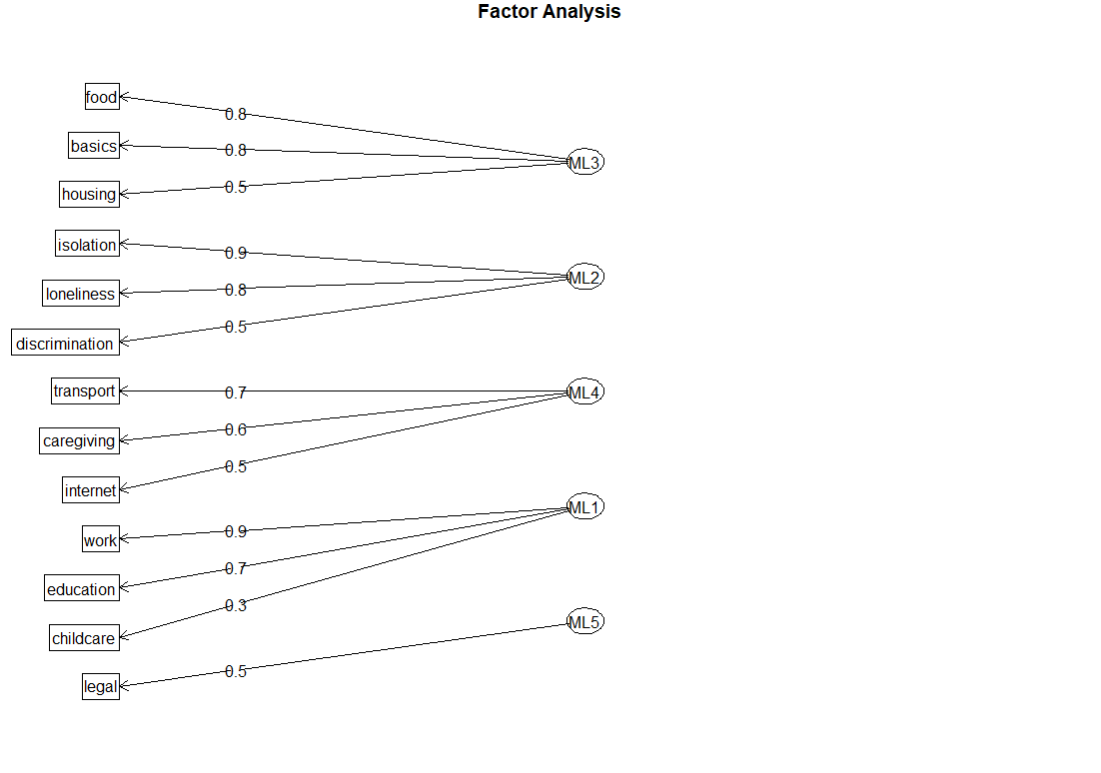
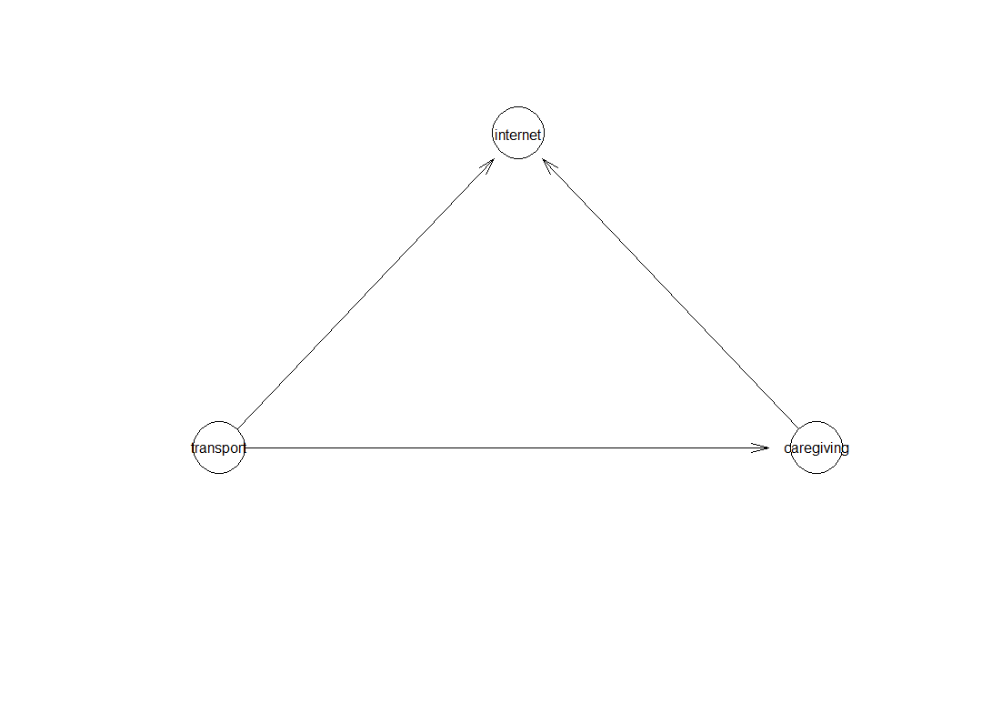
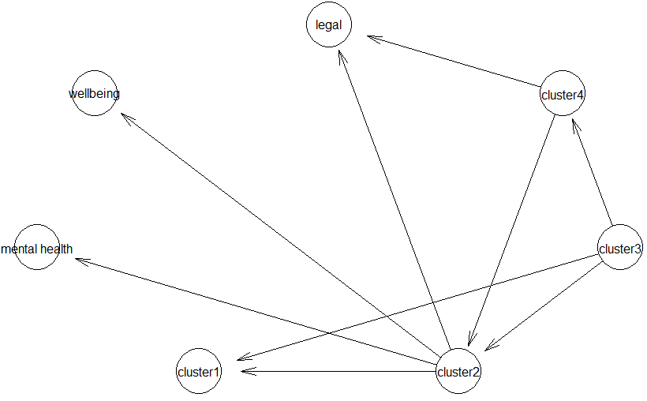
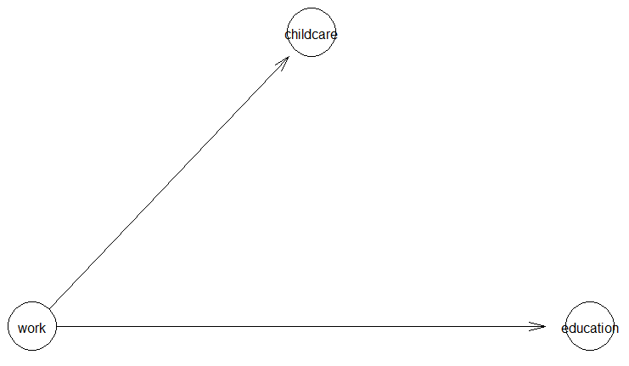
Unsupervised cluster + causal discovery:
Factor analysis based aggregation into distinct theoretical domains (5 clusters) and learnt topological relationships,
Enforcing constraints to prevent reverse arrows from health outcomes.
Notes:
Finally, our unsupervised model uncovered a clear hierarchy of material needs, identifying specific causal chains such as housing instability directly precipitating food insecurity

