Slide 1
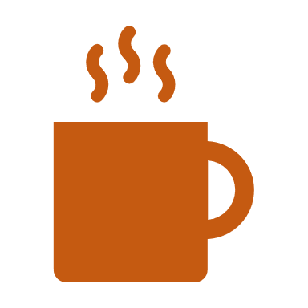
COFFEE BRAND REVIEW ANALYSIS
Top Ranked Data Science & Analytics Education Provider since 2007

Slide 2
Introduction
Table of Contents
Project Overview
Objective
Questions to Explore
Insights
Top Ranked Data Science & Analytics Education Provider since 2007

Slide 3
INTRODUCTION
In today's global coffee market, understanding how roasters operate is crucial for coffee lovers, analysts, and businesses alike. The World Roaster Review dataset provides a wealth of information on different aspects of roasters, such as brands, types of roasts, prices, consumer reviews, Production & Selling location and market trends. It's a valuable resource for uncovering insights that can guide strategic decisions and innovations in the industry.
Top Ranked Data Science & Analytics Education Provider since 2007

Slide 4
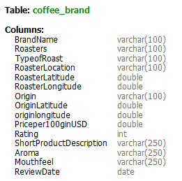
CONTENTS OF THE TABLE
Top Ranked Data Science & Analytics Education Provider since 2007

Slide 5
OBJECTIVE
Our goal is to analyze the World Roaster Review dataset through detailed exploration and advanced analytics, to answer important questions about the coffee market. We'll focus on understanding trends in roaster popularity, consumer preferences for roast types, evaluating roaster performance based on customer feedback and pricing, and predicting future market trends. By using this data effectively, we aim to provide actionable insights that can help stakeholders make informed decisions and improve their strategies.
Top Ranked Data Science & Analytics Education Provider since 2007

Slide 6
Questions to Explore
What is the most expensive coffee per 100g, and what features distinguish it?
What are the top 10 highest-rated coffee brands?
Which roaster has received the best reviews in terms of average rating?
Which country of origin has the highest average rating for coffee?
Which coffee brand has the best/worst average rating every year?
How many coffees have a rating above 90?
Which locations have the highest and lowest average prices per 100g, and what are these prices?
Find the average rating for coffee in each selling location.
Top 5 high average rating coffee brands in Asia, do they have a common Mouthfeel?
Which country contributes the most to the dataset in terms of coffee production?
Top Ranked Data Science & Analytics Education Provider since 2007

Slide 7
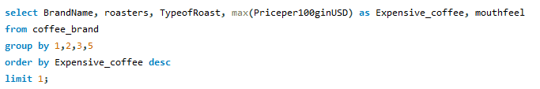
What is the most expensive coffee per 100g, and what features distinguish it?
Top Ranked Data Science & Analytics Education Provider since 2007

Slide 8

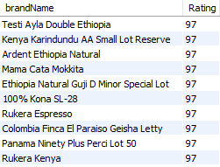
What are the top 10 highest-rated coffee brands?
Top Ranked Data Science & Analytics Education Provider since 2007

Slide 9
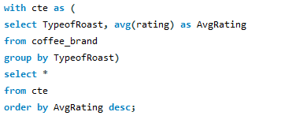
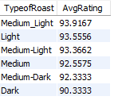
Which roaster has received the best reviews in terms of average rating?
Top Ranked Data Science & Analytics Education Provider since 2007

Slide 10
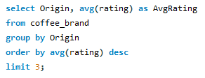

Which country of origin has the highest average rating for coffee?
Top Ranked Data Science & Analytics Education Provider since 2007

Slide 11
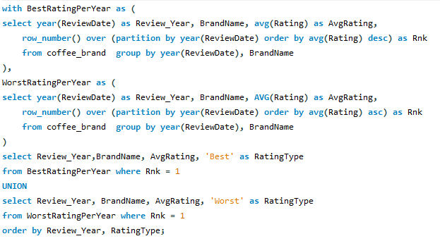
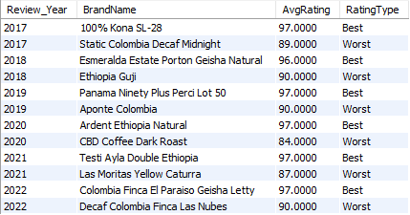
Which coffee brand has the best/worst average rating every year?
Top Ranked Data Science & Analytics Education Provider since 2007

Slide 12


How many coffees have a rating above 90?
Top Ranked Data Science & Analytics Education Provider since 2007

Slide 13
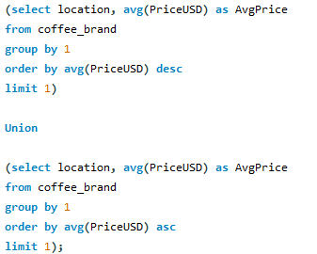

Which locations have the highest and lowest average prices per 100g, and what are these prices?
Top Ranked Data Science & Analytics Education Provider since 2007

Slide 14
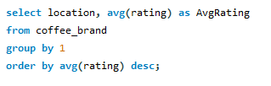
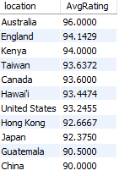
Find the average rating for coffee in each selling location
Top Ranked Data Science & Analytics Education Provider since 2007

Slide 15
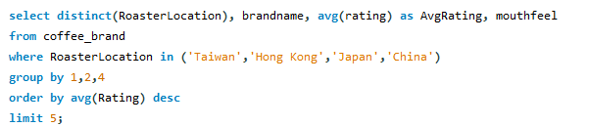
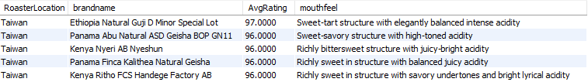
Top 5 high average rating coffee brands in Asia, do they have a common Mouthfeel?
Top Ranked Data Science & Analytics Education Provider since 2007

Slide 16


Which country contributes the most to the dataset in terms of coffee production?
Top Ranked Data Science & Analytics Education Provider since 2007

Slide 17
INSIGHTS
Costly Coffee: The brand “mama cata mokkita” stands out as the most expensive coffee, has a unique combination of medium light roast and a rich mouthfeel, making it highly sought after despite its high price.
Roast Quality Matters: Coffee with a “Medium Light” roast received better ratings.
Tanzania’s Quality Advantage: Tanzania, as a coffee-producing country, achieved the highest average rating.
High-Quality Coffee Abounds: An impressive 96% of the analyzed coffees received ratings above 90.
Price Variation by Country: England had the highest average coffee price, while Guatemala had the lowest.
Roaster Location Impact: England, as a roaster location, had the best average rating for coffee.
Ethiopia’s Production Dominance: Ethiopia emerged as the top coffee producer.
Top Ranked Data Science & Analytics Education Provider since 2007

Slide 18
RECOMMENDATION
Expand Medium Light Roast Offerings: Introduce more medium light roast products to enhance customer satisfaction and loyalty.
Market Unique High-End Coffees: Emphasize unique features such as rich mouthfeel in marketing campaigns to attract premium customers.
Leverage High-Quality Regions: Highlight regions like Tanzania in marketing materials to appeal to quality-conscious consumers.
Optimize Pricing Strategies: Adjust pricing slightly upwards in regions like Guatemala to better align with market averages while maintaining value perception.
Promote High-Rated Products: Expand the product line with high-rated options (scoring above 90) to attract discerning customers.
Educational Campaigns on Regional Qualities: Launch campaigns to inform consumers about the unique aspects of high-quality coffees from various regions, enhancing their appreciation and demand.
Top Ranked Data Science & Analytics Education Provider since 2007

Slide 19

Thank You !
Top Ranked Data Science & Analytics Education Provider since 2007

