Slide 1
Category review: Chips
August 2024
Retail Analytics
Brand note: If client logo is not required, use alternate title page layout right click slide thumbnail > Layout > Title

Slide 2
Notes:
To view Privacy video explaining how important data privacy is to Quantium, please click here: https://www.youtube.com/watch?v=Zq1QDAkoRzU
or here Q:\Company Reference\Brand & Design\Brand videos\Q Privacy.mp4
At Quantium, we believe that data is the behavioural footprint of humanity and that it has to be treated with the utmost care and responsibility.
Histories, attitudes, indeed lives are stored within it in ways that aren’t always apparent – and that’s what makes its potential so powerful.
To work with it responsibly, sensitively, we set ourselves the highest data privacy protection and governance standards.
We have spent 17 years perfecting privacy-by-design and secure-by-design principles. Central to this is not holding any personally identifiable information about people –
we neither receive it, and put the necessary protections in place to be unable to decipher it.
Every aspect of handling data is safeguarded: from its de-identification, to its encryption – data security is paramount and of the highest grade.
We pride ourselves on gaining the trust of iconic organisations around the world through years of securely working with their data,
and in turn the trust that builds with their stakeholders.

Slide 3
Executive summary
01
Task 1
Here you will include your high-level findings and any key callouts for task 1
02
Task 2
Here you will include your high-level findings and any key callouts for task 2

Slide 4
01
Customer Segmentation and Sales Analysis

Slide 5
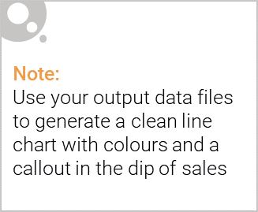
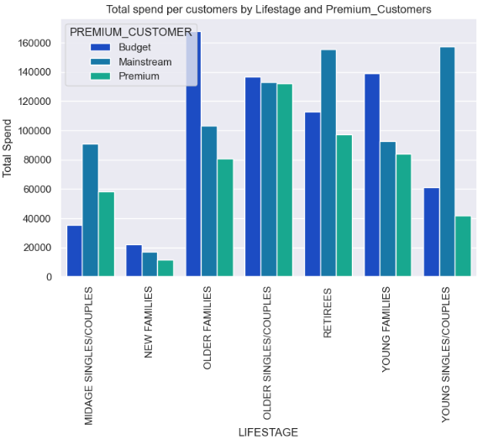
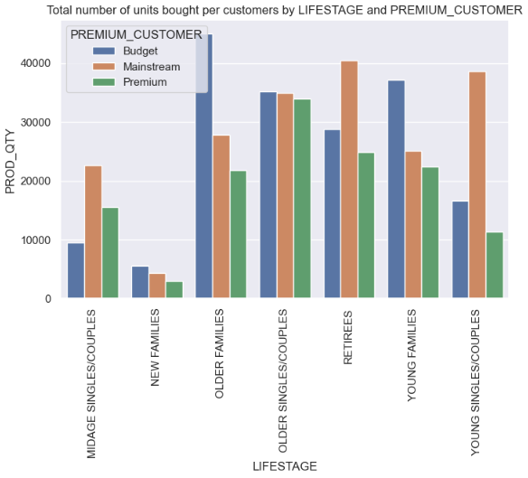
Customer Purchase Pattern

Slide 6

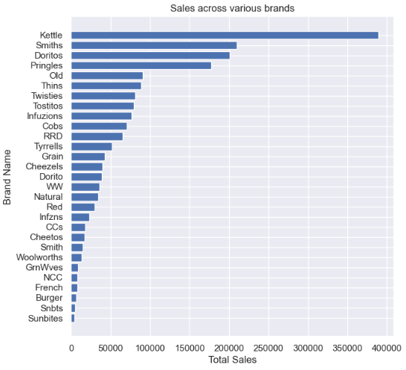
This slide will be commentary on affluence and its effect on consumer buying for the category of chips

Slide 7
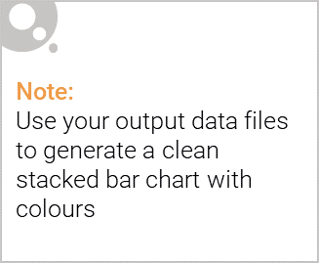
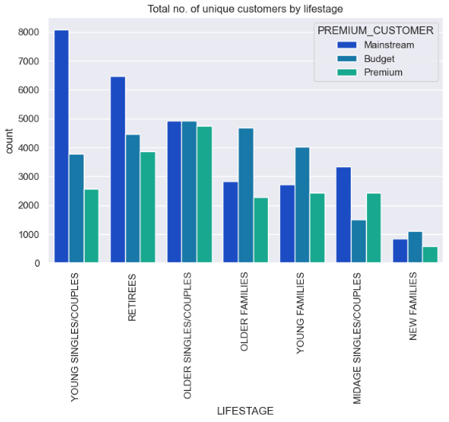
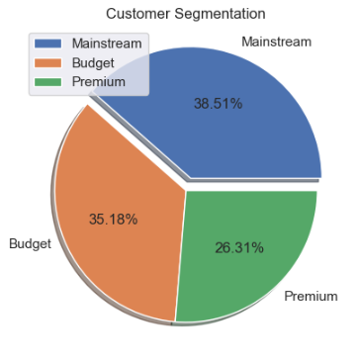
Editable (delete this)
Stretch: Try visualising the proportion of customers by affluence and life stage on this slide

Slide 8
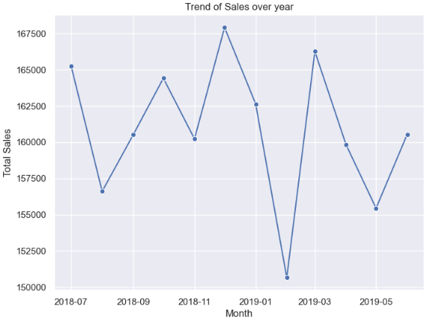
Editable (delete this)
Stretch: How sales differ across years

Slide 9
Editable (delete this)
Affluence and its effect on consumer buying for the category of chips
Kettle is the most popular brand followed by Smiths, Doritos and Pringles.
Mainstream young singles/couples, retirees are the most common customers and also account for a great share of chips sale.
Budget older families have the maximum contribution to sales.
Mainstream young singles/couples and mid-age single/couples pay more per packet than any other group.
The plot shows significant fluctuations in total sales over the year, with peaks around January 2019 and November 2018, and a notable drop in February 2019. These variations suggest possible seasonal trends or market anomalies that may warrant further investigation and strategic adjustments during low periods.

Slide 10
02
Trial store performance

Slide 11
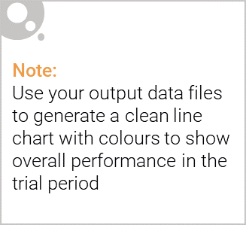
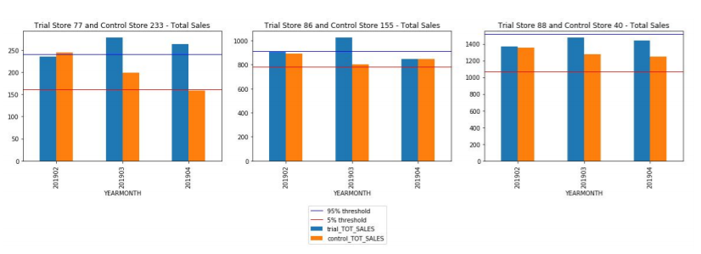
Explanation of the control store vs other stores

Slide 12



The control store is constructed to reflect performance of the trial store rather than the average of other stores
$700
$600
$500
Sales
$400
$300
$200
$100
$0
JUL
AUG
SEP
OC T
NOV
DEC
JAN
FEB
Control Store
Trial Store
Other Stores

Slide 13
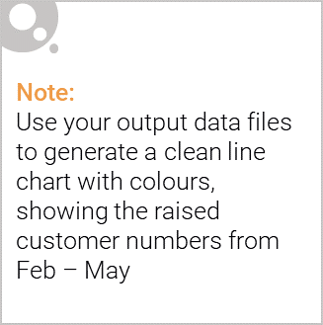



From Feb to May the trial store outperformed the control store highlighting the success of the new store layout
Snack Food – Chips – Number of customers over time
70
60
50
Number of Customers
40
30
20
10
0
JUL
AUG
SEP
OC T
NOV
DEC
JAN
FEB
MAR
APR
MAY
JUN
Control Store
Control Store
5% Confidence Interval
Control Store
95% Confidence Interval
Trial l Store

Slide 14
Call out of the performance in the trial store, determining if it was successful
Conclusion
We've found control stores 233, 155, 237 for trial stores 77, 86 and 88 respectively.
The results for trial stores 77 and 88 during the trial period show a significant difference in at least two of the three trial months but this is not the case for trial store 86.
We can check with the client if the implementation of the trial was different in trial store 86 but overall, the trial shows a significant increase in sales.
Recommendations
Stocks should be high in December before the Christmas
Kettle, Smiths, Doritos and Pringles should be kept in stocks as they are the most sold
Mainstream young singles/couples, retirees are the account for a great share of chips sale so they need much attention.
Budget older families have the maximum contribution to sales.
Control stores 233, 155, 237 for trial stores 77, 86 and 88 respectively would be a good choice

