Slide 1
ReviewLens
LLM-Powered Customer Review Analyzer
Soumil Ahuja | 23FE10CDS00529 | Data Science | Section G
github.com/soumilahuja/MUJ-DS-23FE10CDS00529

Slide 2
Reviews are valuable, but nobody can read thousands of them
The problem
The solution
The output
Businesses collect hundreds of customer reviews. Reading them by hand is slow, inconsistent, and urgent complaints get buried.
ReviewLens sends each review to an LLM through an API and gets back structured, machine-readable analysis in seconds.
Sentiment, rating, emotion, aspects, key issue, urgency, a suggested reply, plus an executive summary for a manager.

Slide 3
How the LLM is used
1
2
3
4
Analyze
Validate
Aggregate
Summarize
Each review goes to Gemini with a few-shot prompt that demands a strict JSON schema.
Output is parsed and checked. If the JSON is broken, the LLM is re-asked with a repair prompt.
Counts, average rating, top negative aspects and high-urgency reviews are computed.
The stats go back to the LLM, with its own prompt, to write a manager-ready summary.
CSV → Prompt file → Gemini API → Validate → Report (JSON, CSV, Markdown)

Slide 4
Prompt design and reliability
Prompt file (prompts.yaml)
Engineering for reliability
Expert-analyst system prompt with strict rules
Exact JSON schema in the instructions
Two worked examples (few-shot)
Separate repair and summary prompts
Validation of every field before use
Retries with exponential backoff
Rate limiting for the free API tier
One failed review never crashes a batch

Slide 5
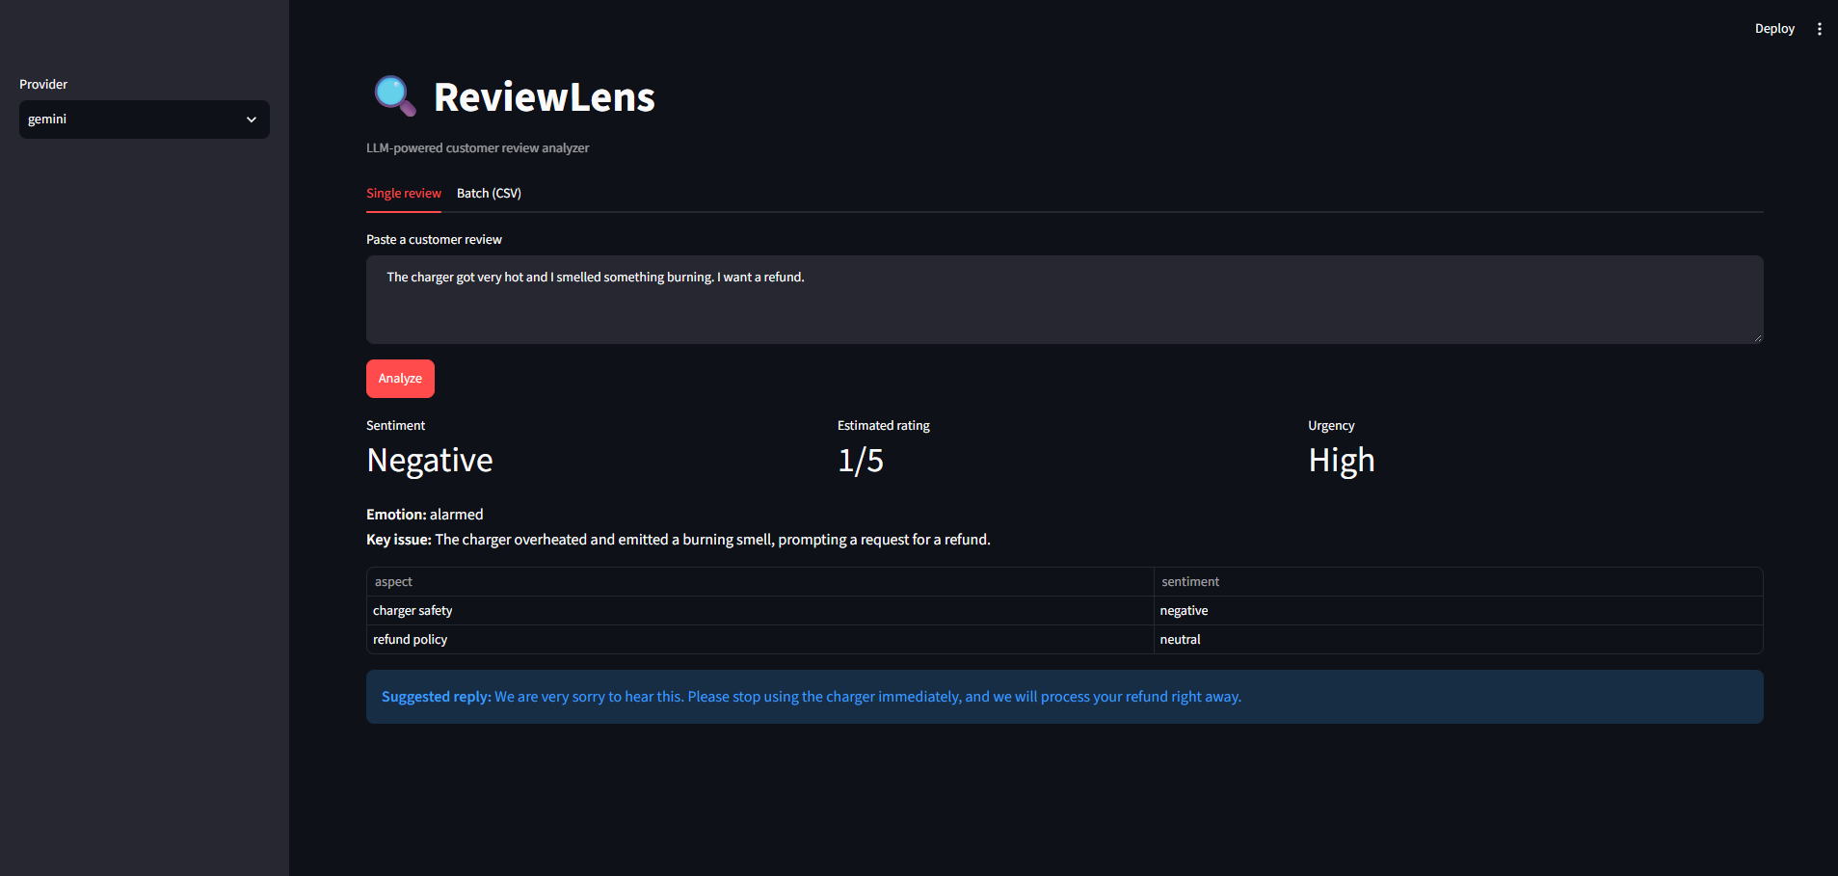
Live demo: Streamlit web app
A charger complaint is classified Negative, rated 1/5, and flagged High urgency, with a suggested reply.

Slide 6
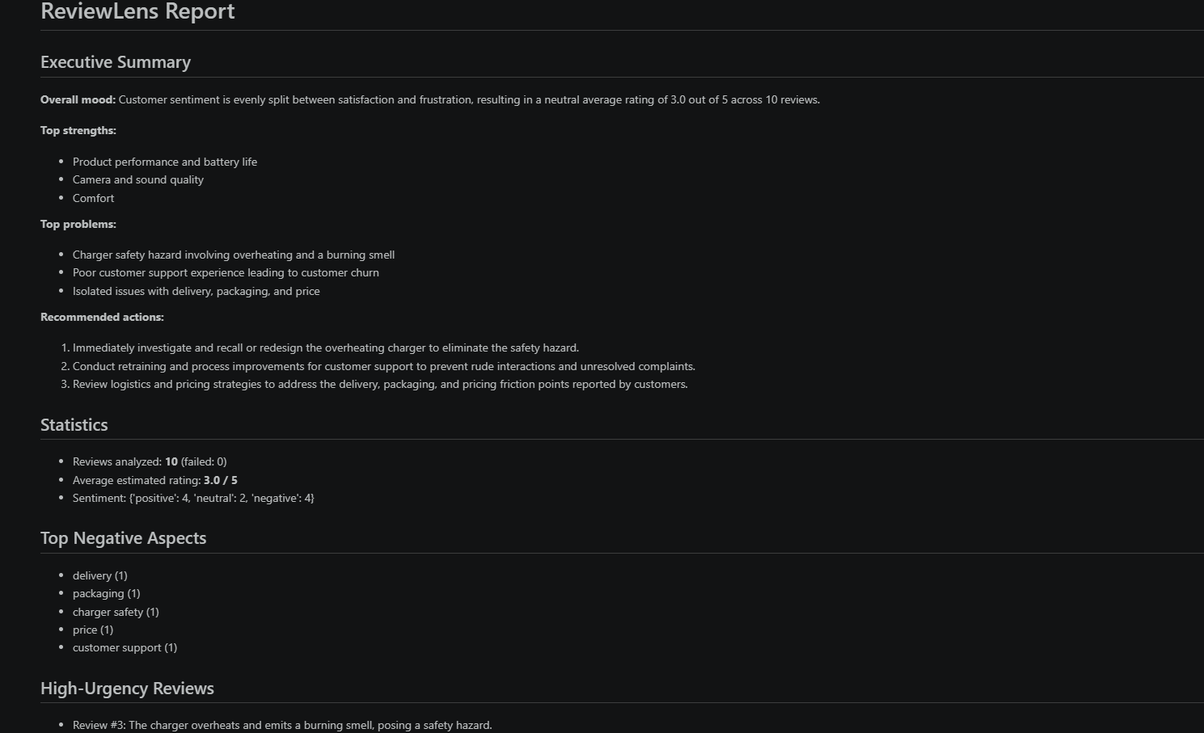
Results on 10 sample reviews
10 / 10
reviews analyzed, 0 failed
High urgency
overheating charger caught as #1 problem
4 · 2 · 4
positive, neutral, negative

Slide 7
Challenges and what I learned
Rate limits
Conflicting prompts
Secret safety
Problem: Free tier allows 5 calls per minute.
Problem: A JSON-only system prompt broke the text summary.
Problem: API keys must never reach a public repo.
Fix: Built client-side throttling and disabled hidden SDK retries.
Fix: Gave the summary its own system prompt.
Fix: Key lives in .env, which is gitignored.
Next: multi-language reviews, sentiment trends over time, deployment.

