Slide 1
ZELDA
Presented By :
1. Rahul Chakraborty 34801220035
2. Sayani Mukherjee 34801220039
3. Kunal Mondal 34801220018
4. Soumili Chatterjee 34801220026

Slide 2
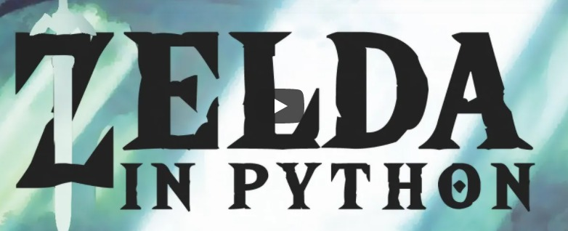
ZELDA GAME DEVELOPING IN PYTHON
The basic mechanics of a ZELDA game like a player camera , depth and collisions .
The ZELDA games feature action, adventure/battle game play and exploration.

Slide 3
Project Objectives
In ZELDA, First you will need to install the python packages containing all the scritps.
Here the player must avoide enimies while proceeding through a level. Although in the game can be beaten with a minimal amount of exploration and side quest.
Some items are consistent and appear many times throughout the game (such as bomb and bomb flowers, which can be used both as weapons and to open blocked, magic swords, shields and bows and arrows), which are unique in this single game.

Slide 4
TOOLS & TECHNOLOGIES:
i. Game Engine : Pygame 2.3.0
ii .Operating Systems : windows 10, 64bit
iii. Hardware : 8gb, RAM
iv. Language : Python 3.9.8

Slide 5
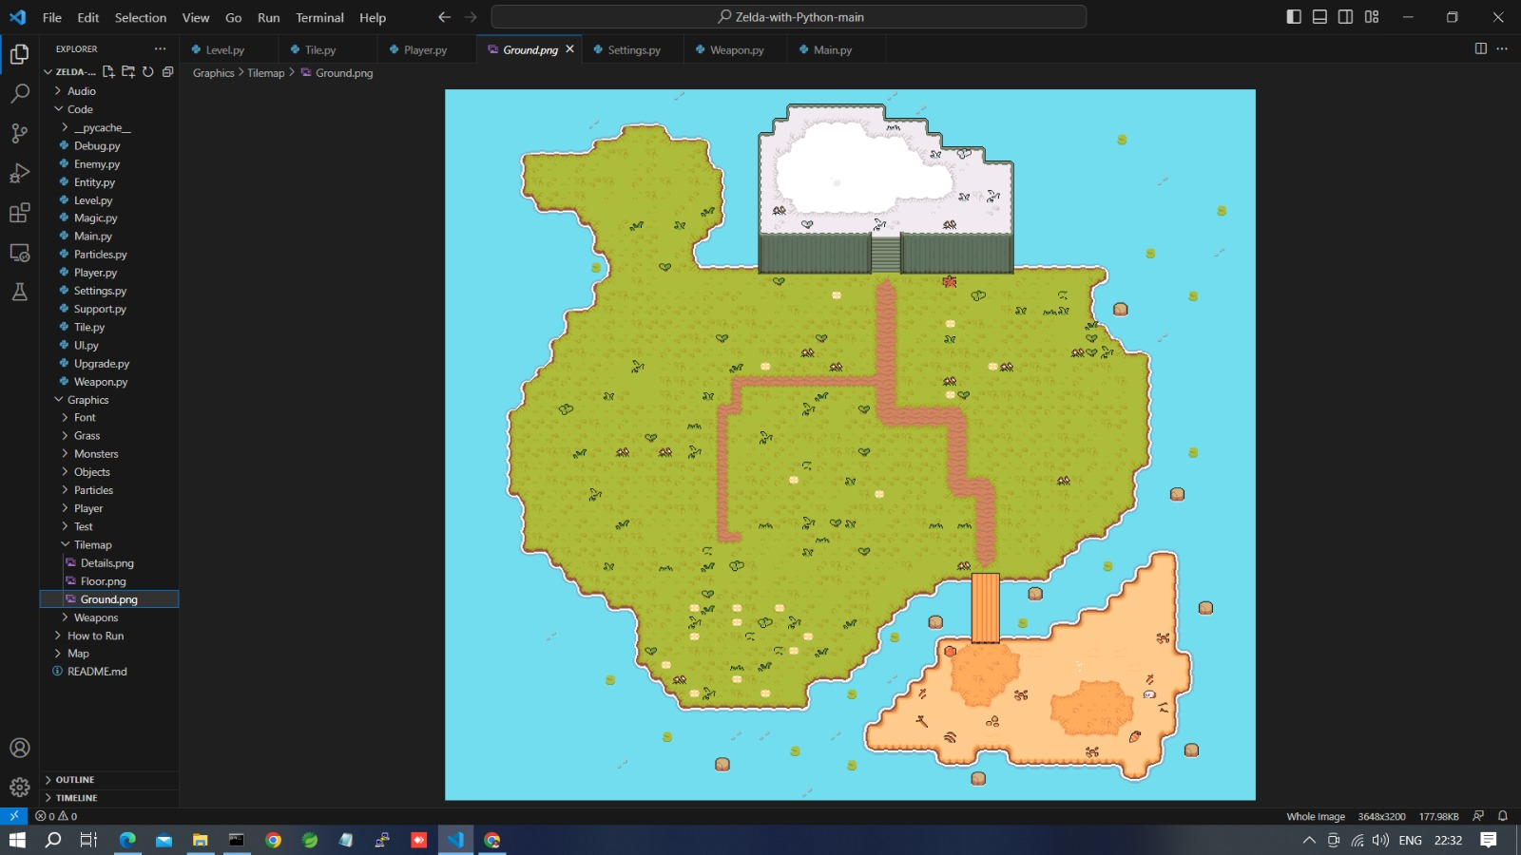
Development Stages
The map which we use :

Slide 6
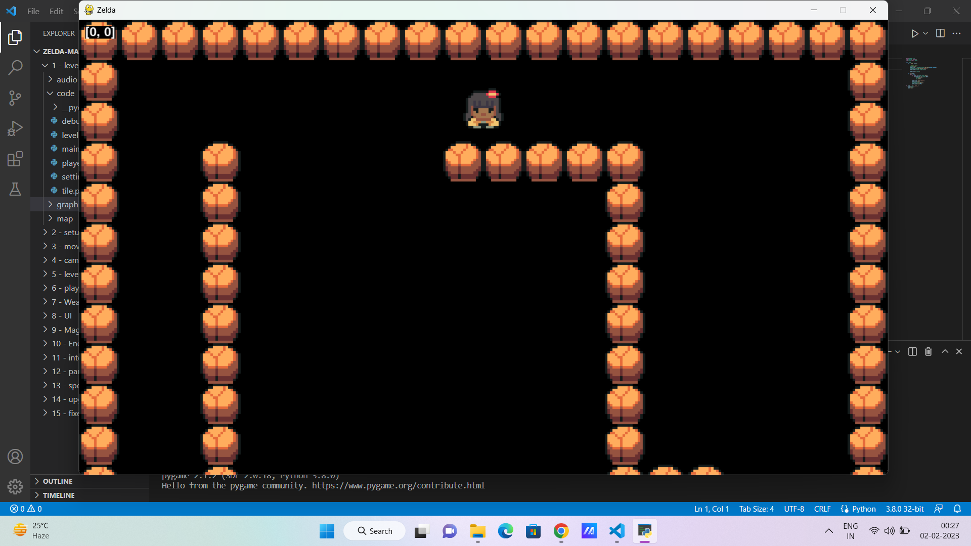
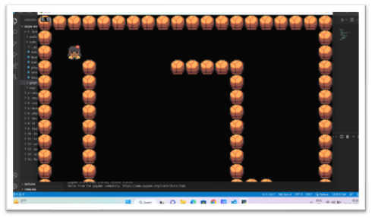
First Step of Development :

Slide 7
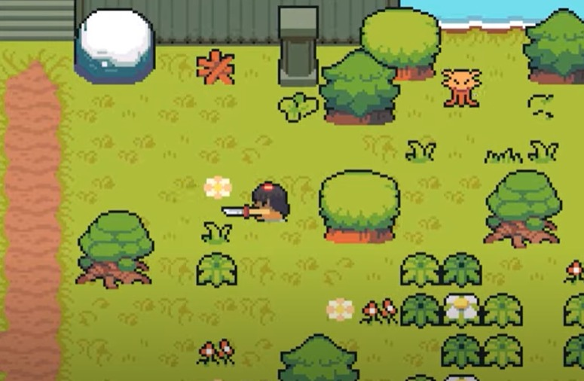
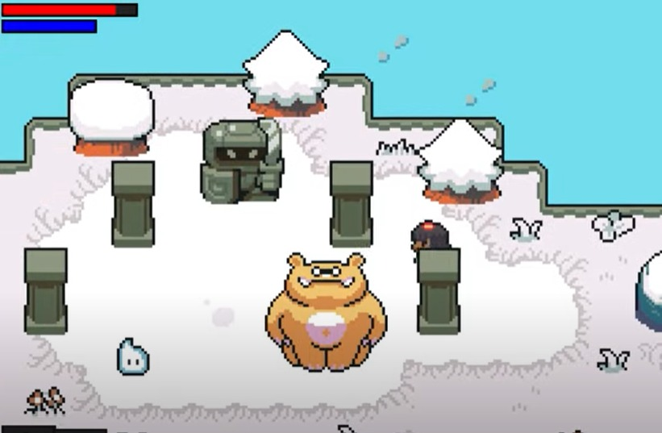
Final Step of Development :

Slide 8
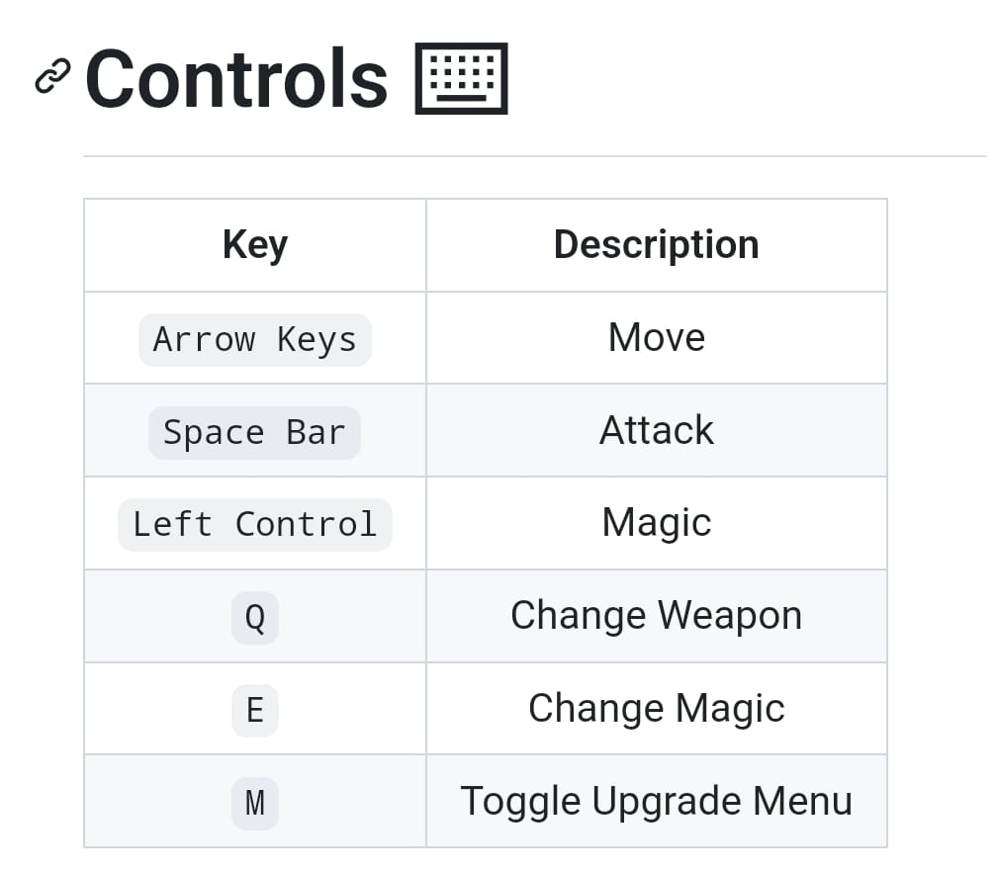
Controls we use :

Slide 9
Conclusion :
Here we all have a good understanding of the Python language as well as the PyGame library.
In this game we’ve covered player input, displaying graphics, playing sounds, and moving characters about the screen as well as alternative forms of input and output in the form of reading and writing to the GPIO pins.

Slide 10
THANK YOU

