Slide 1














Audio Classification
Supervisor: Dr. Anshul Verma
Organisation: Banaras Hindu University, Varanasi
Start Date: 30th January 2024
End Date: 30th June 2024

Slide 2
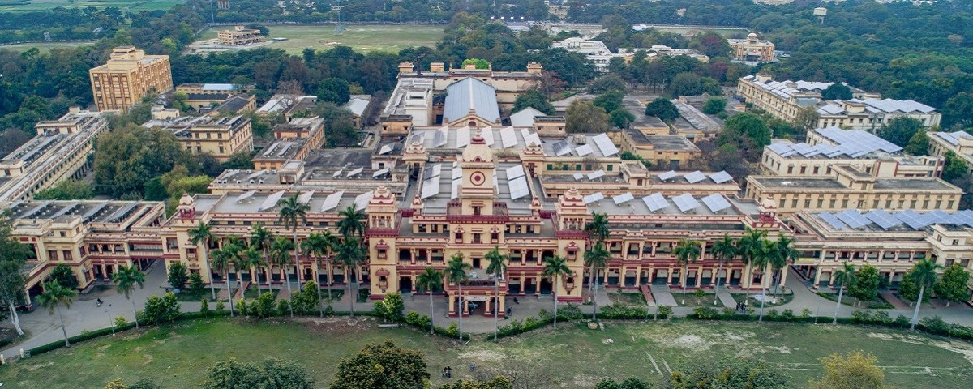
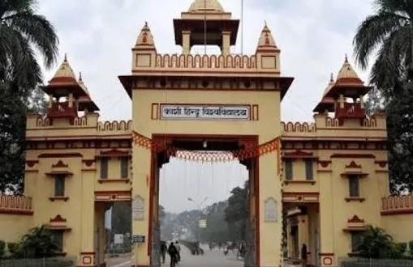
About BHU
Banaras Hindu University is an internationally reputed temple of learning, situated in the holy city of Varanasi. This creative and innovative university was founded by the great nationalist leader, Pandit Madan Mohan Malaviya, in 1916, through close cooperation with great personalities like Dr Annie Besant, who viewed it as the University of India. Banaras Hindu University was established by the Parliamentary legislation-B.H.U. Act 1915. It is a collegiate, central, and research university located in Varanasi, Uttar Pradesh, India.

Slide 3
01.
In the digital age, music classification and recommendation systems have become pivotal in enhancing user experience across various platforms. The objective of this research is to classify audio files into different genres and develop a recommendation system based on audio similarity. Utilizing the GTZAN dataset, which comprises 1000 audio files categorized into 10 distinct genres, this project leverages advanced machine learning and deep learning techniques to achieve high accuracy in genre classification and to recommend similar songs to users.
Project Background
Music genre classification, a vital component of Music Information Retrieval (MIR), continues to captivate researchers due to its relevance in content-based searching and recommendation systems. In this research, I introduced a comprehensive methodology for classifying music into distinct genres. Leveraging features extracted from audio files and employing various machine learning models, including Naive Bayes, Stochastic Gradient Descent, KNN, Decision Tree, Random Forest, Support Vector Machine, Logistic Regression, Neural Networks, and XGBoost, an ensemble model is proposed to enhance classification accuracy
02.
The research encompasses several key stages: data preprocessing, feature extraction, exploratory data analysis (EDA), dimensionality reduction, model training and evaluation, and the development of a recommendation system. Various machine learning algorithms, including Naive Bayes, Logistic Regression, K-Nearest Neighbors, Decision Trees, Random Forest, Support Vector Machine, and deep learning models, have been employed and compared to achieve the best performance. Ensemble techniques like Voting and Stacking classifiers are also explored to enhance accuracy.
03.
Furthermore, the research delves into deep learning models, implementing several neural network architectures to push the boundaries of classification accuracy. A recommendation system based on cosine similarity has been integrated, offering users recommendations based on audio features.

Slide 4
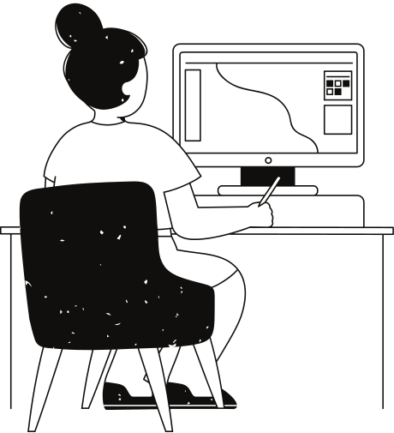
Scope And Utility
Music Genre Classification: Music streaming services can improve content organization and personalized recommendations.
Audio Retrieval and Recommendation Systems: The cosine similarity method, implemented for nearest neighbor search, allows the retrieval of audio samples most similar to a provided query. This functionality can be used to build music recommendation systems suggesting similar music based on user preferences.
Benchmarking for Future Research: This project establishes a baseline performance for audio classification on the GTZAN dataset. Future research can leverage these results as a reference point for exploring new techniques and algorithms.
Potential Applications: The project's findings have broader implications beyond music. The approach can be adapted for audio fingerprinting in copyright protection, environmental sound classification (e.g., identifying bird calls), or anomaly detection in audio streams.

Slide 5
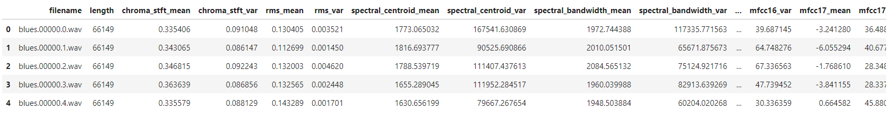
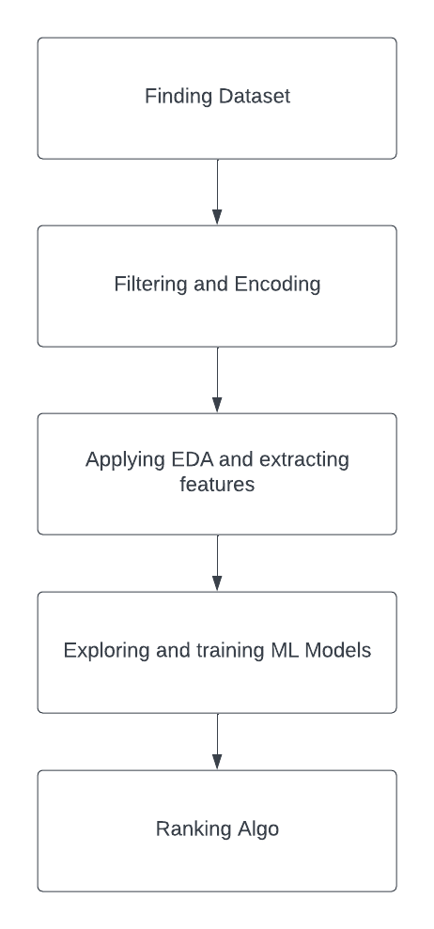
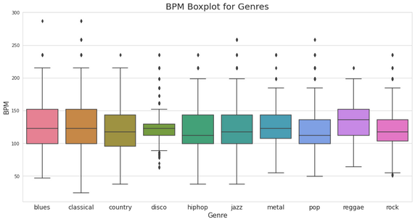
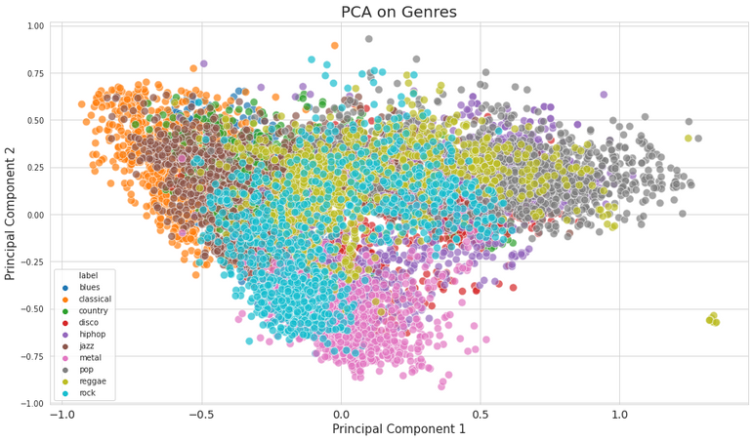
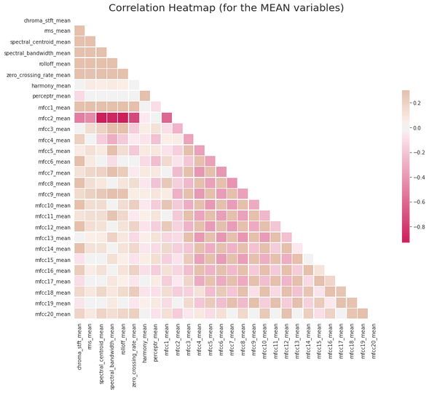
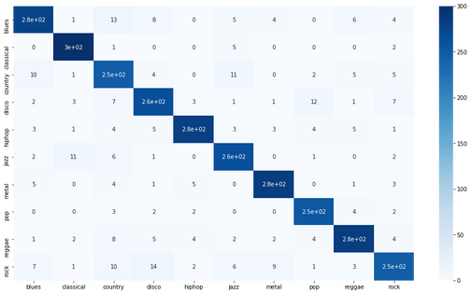
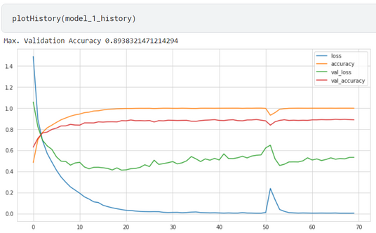
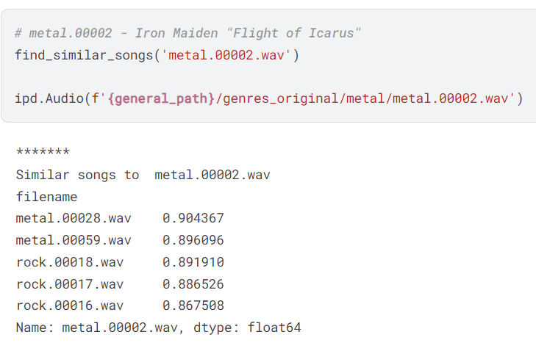
Architecture of the Project

Slide 6

Techniques And Tools Used
Data Acquisition and pre-processing
Google Colab and Kaggle
GTZAN dataset was used for training the MLmodels and for making the ranking algo, after performing all the necessary pre-processing steps like scaling, encoding etc.
I used Google Colab for the Python coding part for Machine Learning. Along with it, most of the coding was done on Kaggle due to easy availability of the GTZAN Dataset.
Machine Learning and Deep Learning
OverLeaf
Concepts of machine Learning and Deep learning like overfitting, knn, hyperparameter tuning for the training of the ML and Deep learning models
I used OverLeaf for writing the Research paper that I want to submit in one of the upcoming conferences.

Slide 7
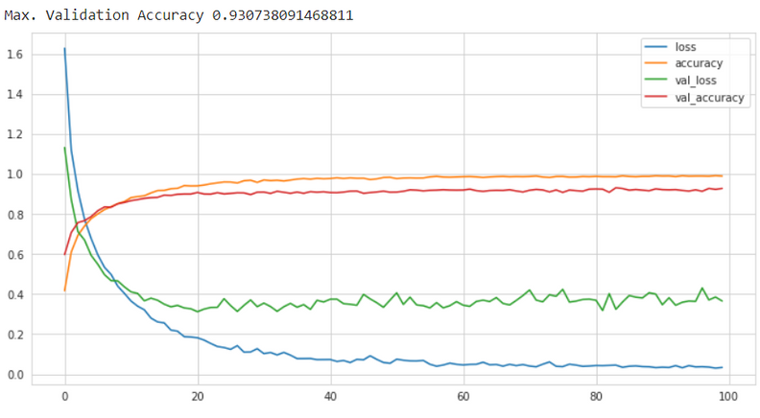

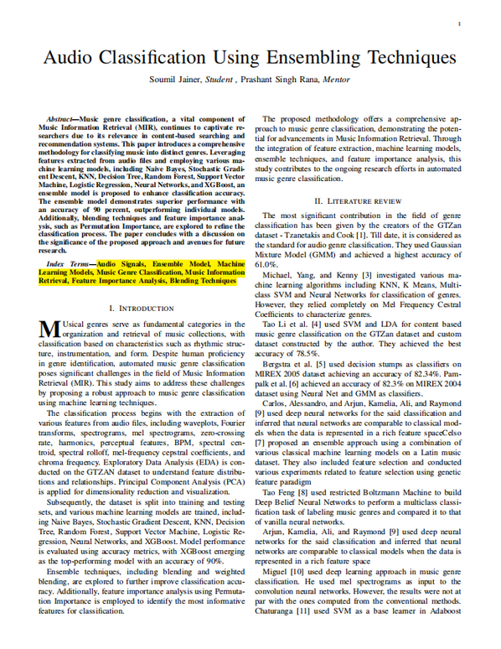
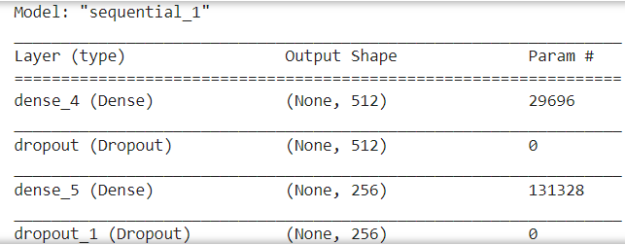
Snapshots
Of
The
Project
And
Research
Paper

Slide 8

Professional And Technical Learning
Developed proficiency in Machine learning and Data Analytics.
Developed Effective communication and collaboration skills through continuous interaction with mentor and other students doing internship there.
Cultivated problem solving ability and adaptability by addressing challenges and incorporating feedback from industry and faculty mentors.
Learnt to write a research paper under the guidance of Faculty mentor, Dr, Prashant Singh Rana and Industry Mentor, Dr, Anshul Verma.

Slide 9
Key Highlights
01
02
03
04
Machine Learning Achievements:
Achieved high accuracy in music genre classification using deep learning models (mention the specific accuracy achieved).
Explored various traditional machine learning models like KNN, Random Forest, XGBoost (Highest accuracy of 90% ).
Implemented hyperparameter tuning to optimize the performance of machine learning models.
Deep Learning Exploration:
Utilized Keras to build and train deep learning models for music genre classification.
Developed a custom callback function for early stopping during deep learning training, improving efficiency.
Audio Retrieval and Recommendation Potential:
Implemented cosine similarity for efficient retrieval of audio samples similar to a provided query.
This functionality lays the groundwork for building music recommendation systems based on user preferences.
Project Significance:
Established a baseline performance for audio classification on the GTZAN dataset, valuable for future research.
Demonstrated the potential of machine learning and deep learning for various audio classification tasks.
Highlighted the utility of cosine similarity for audio retrieval applications.

Slide 10
Video Link
link

Slide 11
Feedback
The internship/project semester provided by the college has been incredibly valuable, offering hands-on-experience and practical knowledge that bridges the gap between academic learning and industry requirements. The support and guidance from faculty and industry mentors were instrumental in helping me navigate challenges and achieve my project goals.
Overall, it has been an enriching experience that has prepared me well for my future careers.

Slide 12
Thank you very much!

