Slide 1


Develop an innovative approach to extend the lifecycle of consumer electronic devices
Machine .inc
A new way to work with electronics

Slide 2

About Us
HardwareHub an new and efficient way to protect yourself and your devices
We work to make sure your devices last and stay relevant.

Slide 3



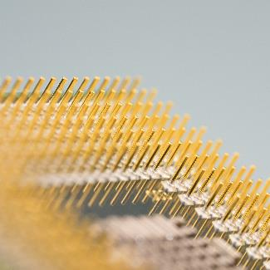
The Problem
Productivity
User Frustration
Clutter
Chip Pricing
The decline in productivity caused by unexpected system failures.
Improper device configuration often leads to significant operational challenges.
Avoid allowing application clutter to disrupt your daily activities.
The current chip pricing structure is unsustainable and poses significant challenges.

Slide 4



The new and improved management system
Prioritize
Cost saving
When you are with us you are our priority
Our preventive maintenance ensures that no device is left unused or goes to waste.
The new S.M.A.R.T based system makes sure all your data stays safe .

Slide 5





HardwareHub
Unique
Open source
The all-inclusive system ensures that you are relieved of any additional workload.
We have made it open source to ensure the identification and resolution of bugs and errors.
Tested
Authentic
HardwareHub helps predict when something will fail and help protect you and your data
Our software goes thorough extensive testing
We mad this from ground up for this application

Slide 6

Product
Ties up with local repair shops for quick and easy repairs
Other benefits include
Notification system
Email system for remote management

Slide 7

Intelligence monitoring system
A new way to engage with your computer from across the globe.

Slide 8

Summary
HardwareHub presents an innovative approach to extending the lifecycle of consumer electronic devices, addressing key challenges like productivity loss from system failures, user frustration from misconfigured devices, and unsustainable chip pricing. The preventive maintenance, and failure prediction, minimizing waste and maximizing device utility. By offering open-source software that undergoes extensive testing, HardwareHub provides a reliable, cost-effective, and user-friendly solution..
The new way of electronics

Slide 9




Thank You
Machine .inc
The das corporation
+91 891 824 8750
pd3366990@gmail.com

