Slide 1
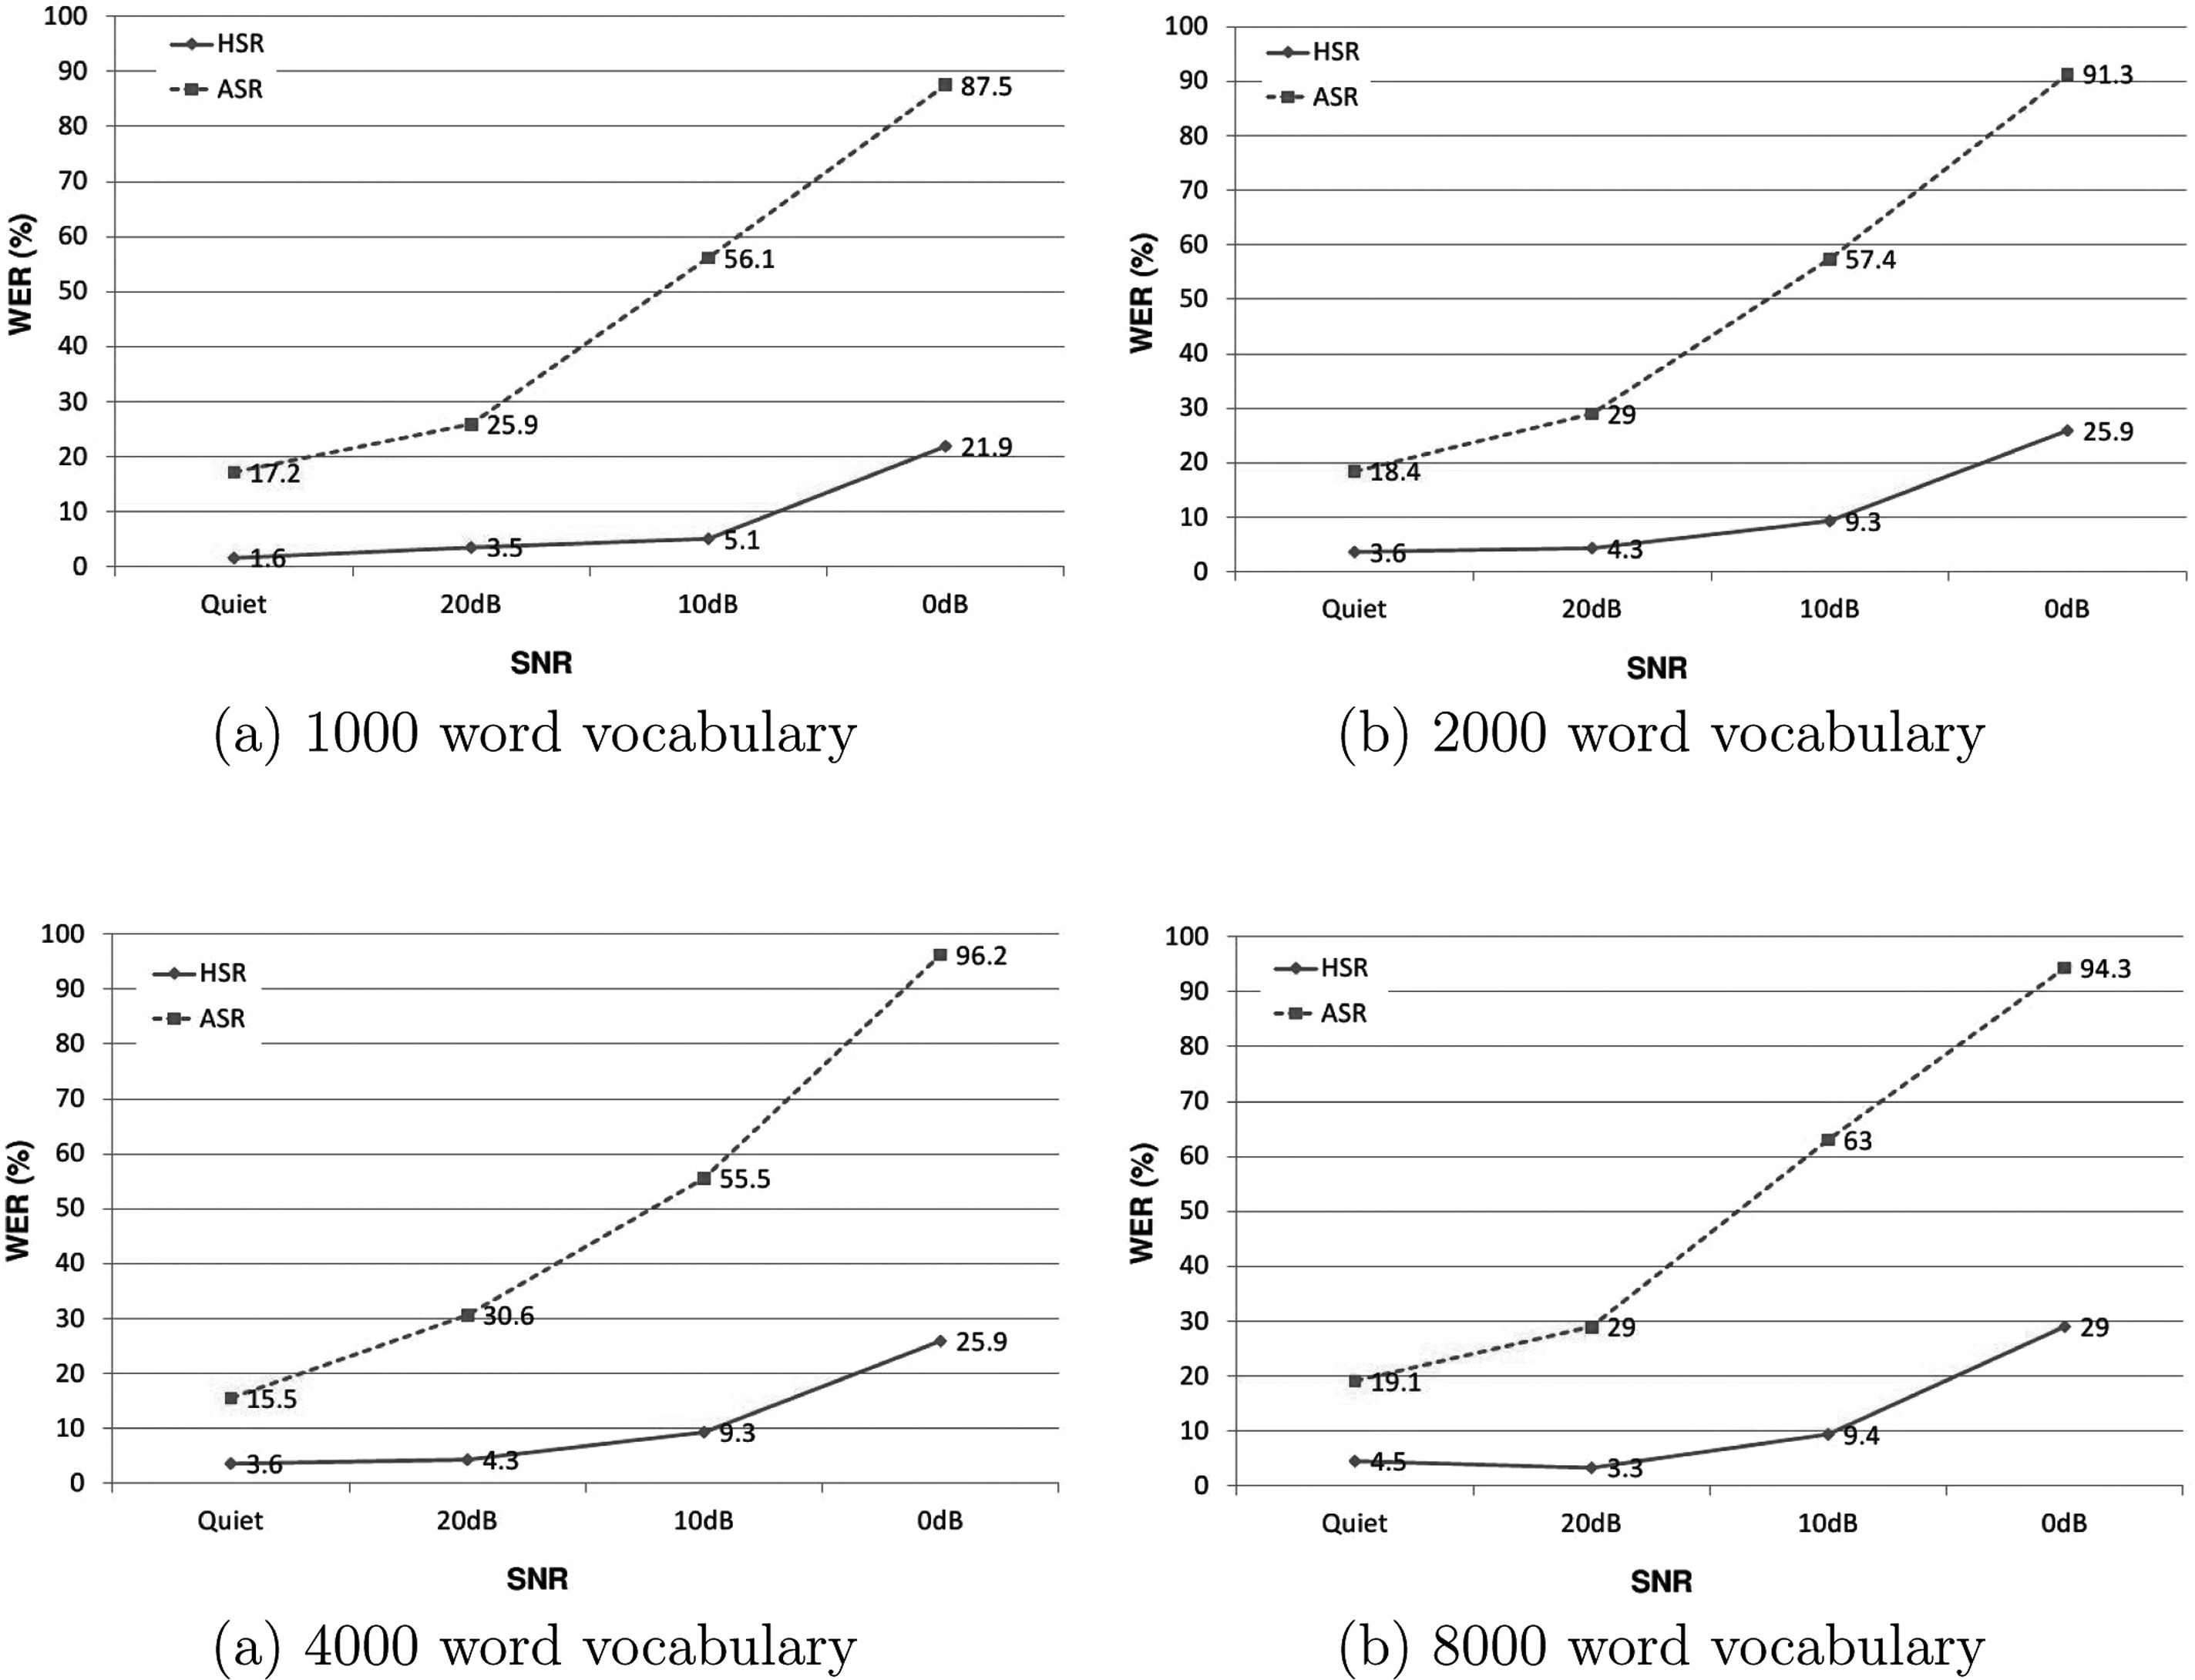
FIG. 2. (Color online) Variation of WER for ASR and HSR with SNR at different vocabulary sizes or perplexities.
Published in: Amit Juneja; ; The Journal of the Acoustical Society of America 2012, 131, EL256-EL261.
DOI: 10.1121/1.3684744
Copyright © 2012 Acoustical Society of America

